Slide 2
Which do you like better?
A
B

Slide 3
Which do you like better?
A
B

Slide 4
Which do you like better?
A
B

Slide 5
Which do you like better?
A
B

Slide 6
What do you think biodiversity means?

Slide 7
Biodiversity
What does “Bio” mean?
Life
Bio =

Slide 8
Biodiversity
What does “Diversity” mean?
Diversity = Variety

Slide 9
Biodiversity is the variety of life on Earth and the essential interdependence of all living things
Scientists have identified more than 1.4 million species. Tens of millions -- remain unknown (www.thecatalogueoflife.org)
The tremendous variety of life on Earth is made possible by complex interactions among all living things including micro-oganisms.

Slide 10
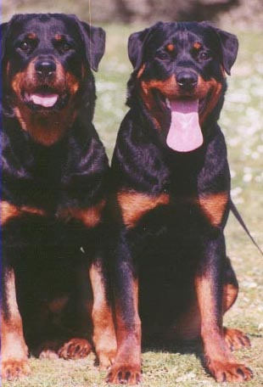
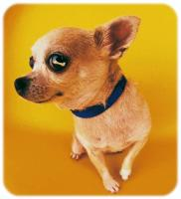
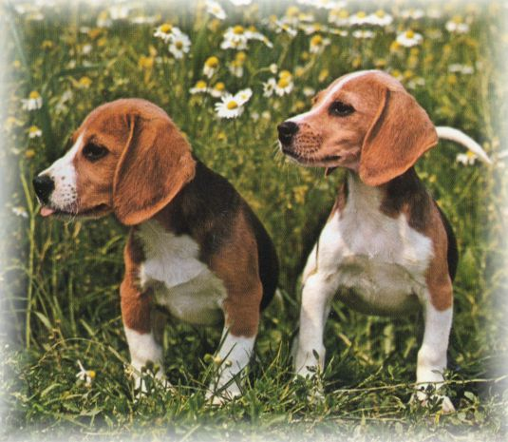
There are 3 components of biodiversity
Diversity of genes Chihuahuas, beagles, and rottweilers are all the same species —but they're not the same because there is variety in their genes.
Chihuahua
Beagle
Rottweilers

Slide 11
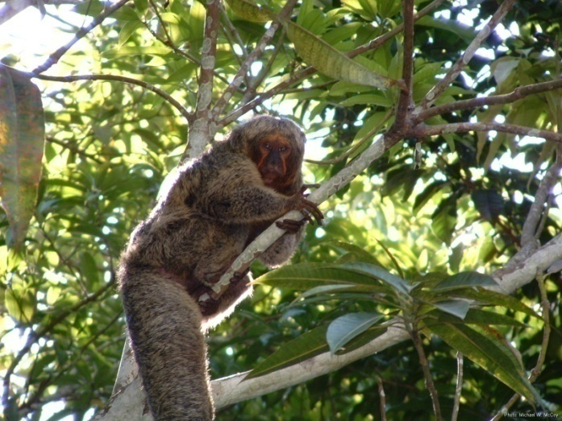
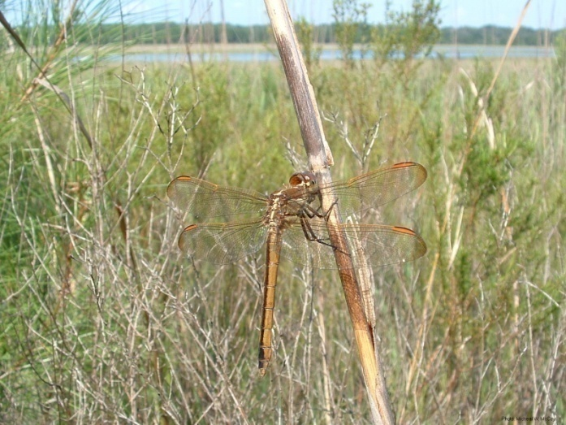
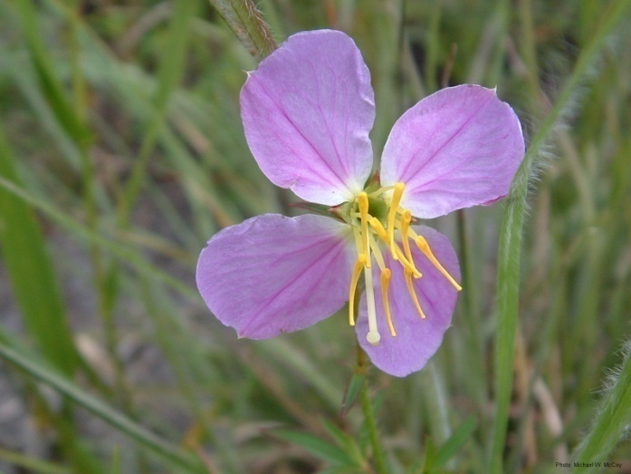
There are 3 components of biodiversity
2. Diversity of number of species For example, monkeys, dragonflies, and meadow beauties are all different species.
Saki Monkey
Golden Skimmer
Meadow Beauty

Slide 12
There are 3 components of biodiversity
3. Variety of ecosystems
Lakes, Ponds, and Rivers are all Freshwater Ecosystems.
Rocky coast, Sand Dune, Estuary, Salt Marsh , Coral Reef are all Marine Ecosystems.
So what’s an ECOSYSTEM???

Slide 13
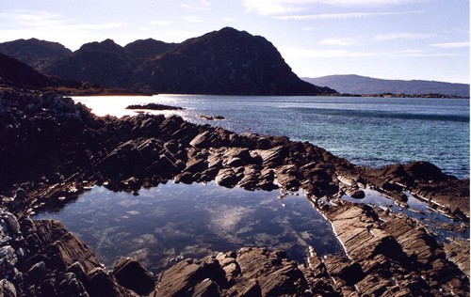
ECOSYSTEM DEFINITION
“ A self-contained community of microorganisms, animals and plants, that interact with each other and with their physical environment.”
eg a rock pool

Slide 14
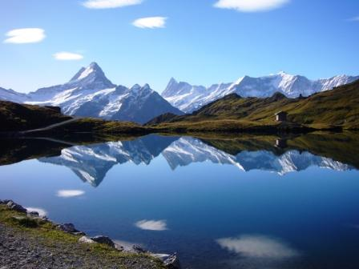

Slide 15
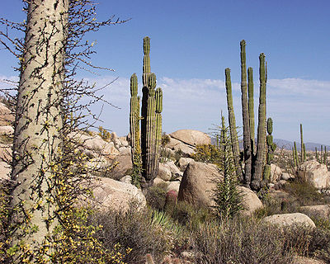
Within an ecosystem there can be many HABITATS
This is the physical and chemical description of where a creature lives...

Slide 16
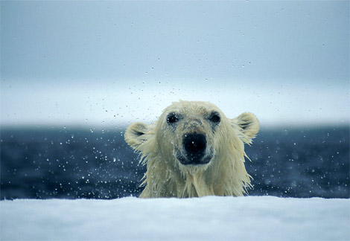
HABITATS might describe:
The NAME of the place where the creature lives.
eg Arctic Canada is the habitat of the polar bear Ursa maritima.

Slide 17
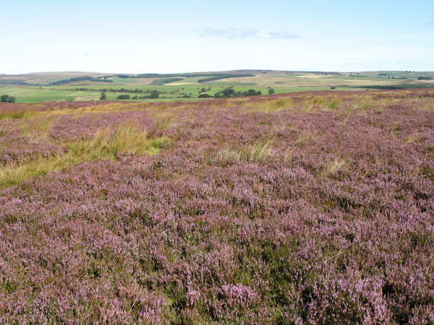
HABITATS might describe:
The DOMINANT VEGETATION of the place where the creature lives.
eg Heather moorland is the habitat of the grouse.

Slide 18
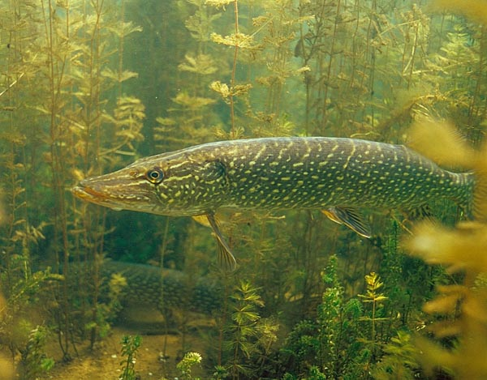
HABITATS might describe:
The TYPE of place where the creature lives.
eg species of fish like Pike (Esox lucius) are found in freshwater lakes and ponds.
So what’s a SPECIES??

Slide 19
1. A group of morphologically similar creatures which can:
Interbreed to produce fertile offspring
Are ‘reproductively isolated’.
Problems with this definition include…

Slide 20
2. Creatures who are related through PHYLOGENY
Similar DNA
Similar proteins eg in blood
Similar biochemistry
Similar embryology

Slide 21
DNA profiles of Primates
Gibbon Orang Utan Gorilla Chimp Man
% DNA similar
100
99
98
97
96
95
94
93
Humans share 98-99% of their DNA with Chimps. They are our closest living relatives.

Slide 23
Biodiversity has Intrinsic Value
Intrinsic Value = Something that has value
in and of itself

Slide 24
Biodiversity also has Utilitarian Value
Utilitarian Value = the value something has as a means to another’s end.
Utilitarian values include:
Goods eg sustainable timber
Services eg eco-tourism
Information eg National Park Wardens

Slide 25
What do we get from biodiversity?
Oxygen
Food
Clean Water
Medicine
Aesthetics
Ideas

Slide 26
Should we be concerned about biodiversity?
What we know: The Earth is losing species at an alarming rate
Some scientists estimate that as many as 3 species per hour are going extinct and 20,000 extinctions occur each year.
when species of plants and animals go extinct, many other species are affected.

Slide 27
Threats to biodiversity
Habitat destruction
Pollution
Species Introductions
Global Climate Change
Exploitation

Slide 28
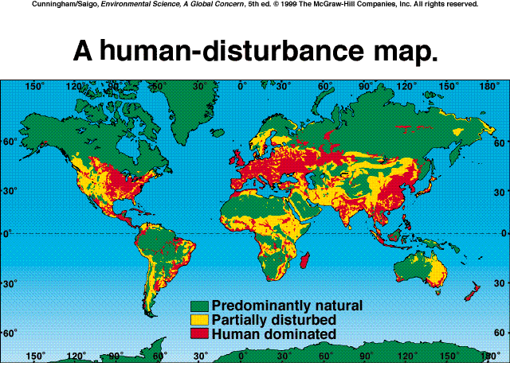

Slide 29
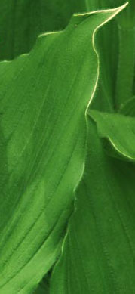
GOALS OF CONVENTION
ON BIODIVERSITY
“The conservation of biological diversity, the sustainable
use of its components and the fair and equitable sharing
of the benefits arising out of the utilization of genetic
resources”
“Biodiversity is a common concern of humankind and
an integral part of the development process”
> 100,000 plant/animal species lost in last 5 years
Habitat loss is biggest current threat to biodiversity
Deforestation and forest degradation has increased
since the Rio Earth Summit

Slide 30
BIODIVERSITY
How many species are there?
-- 1.4 million named species (70% of which are invertebrates)
-- estimated 3 to 50 million species alive!

Slide 31
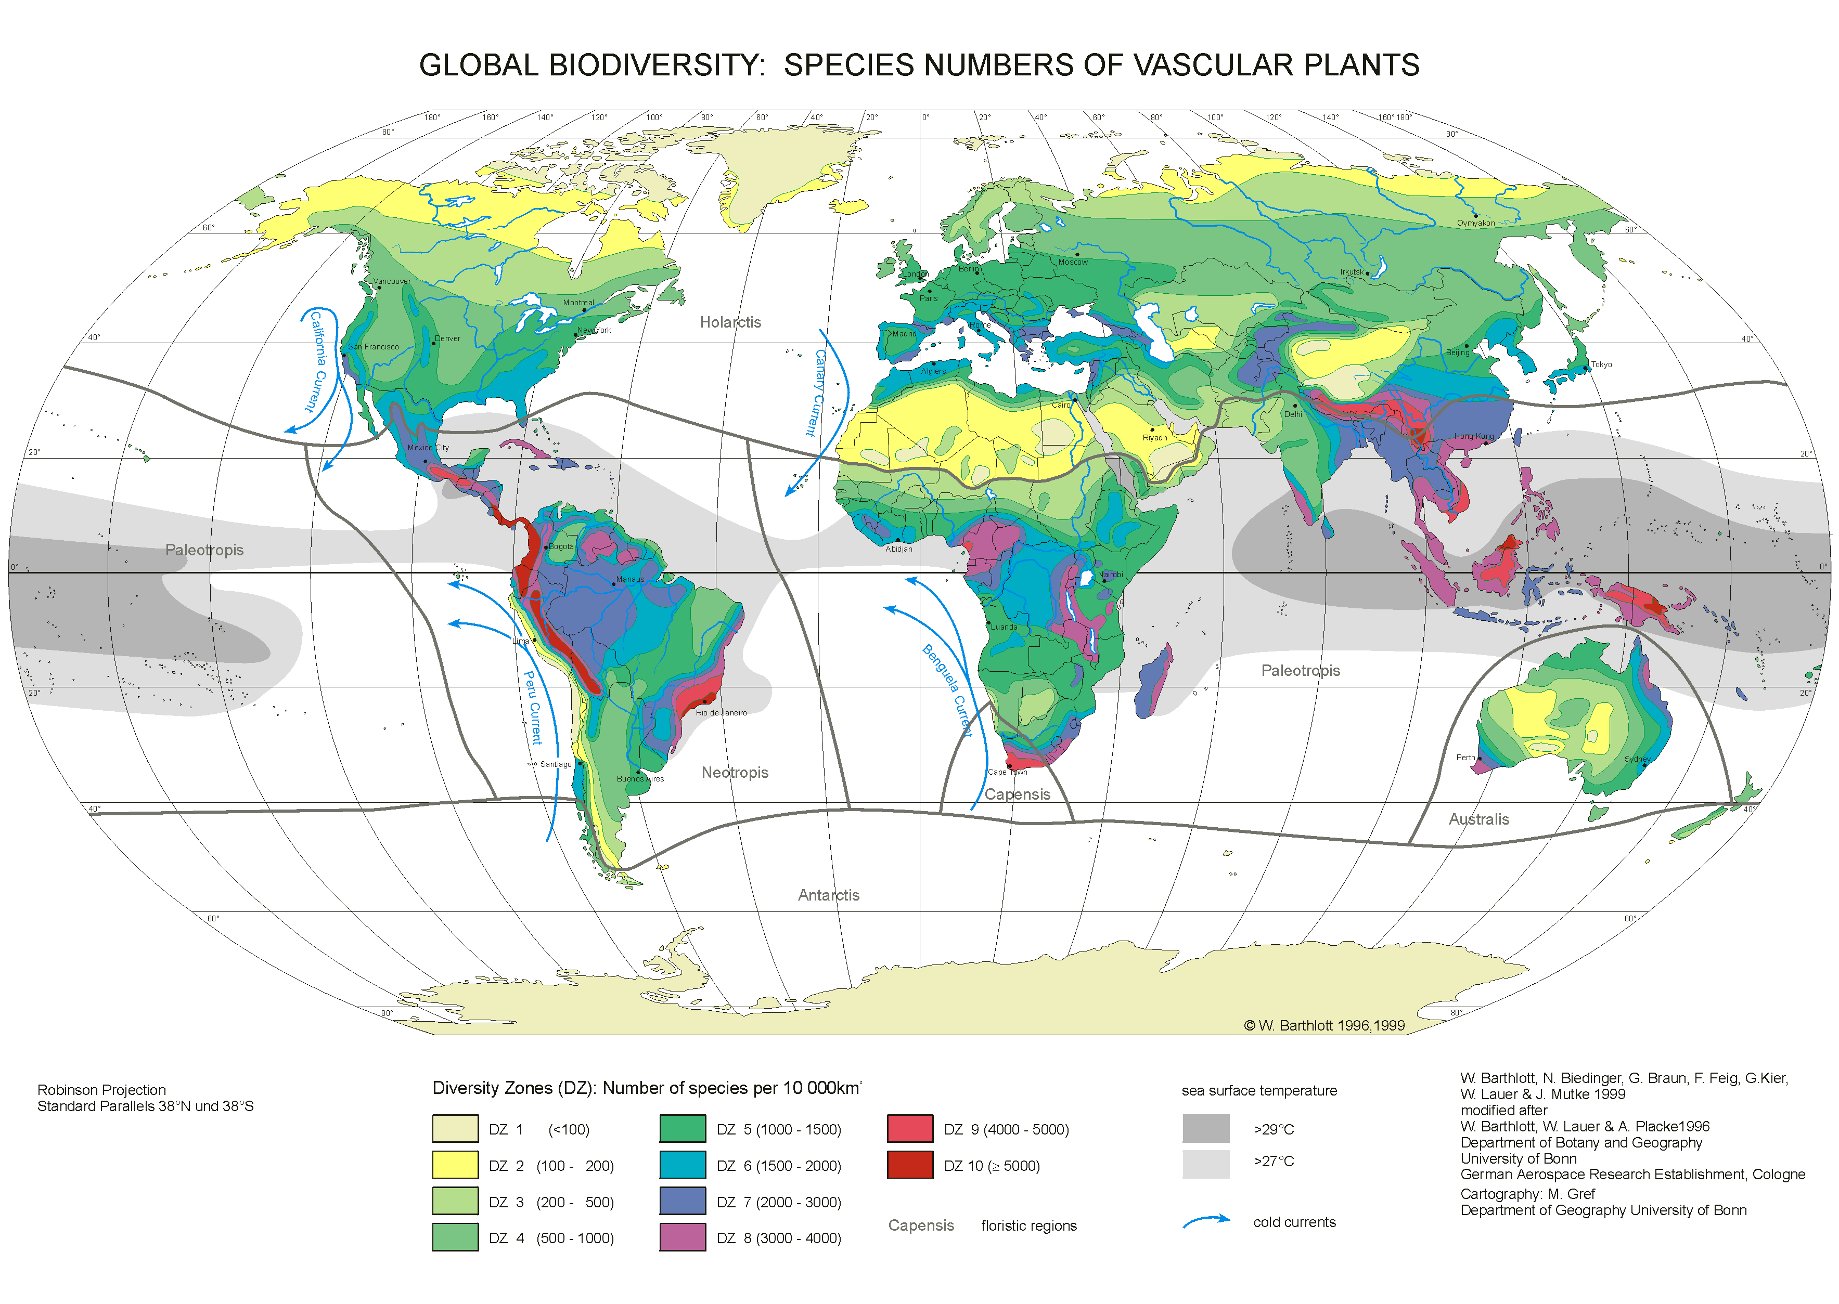

Slide 32
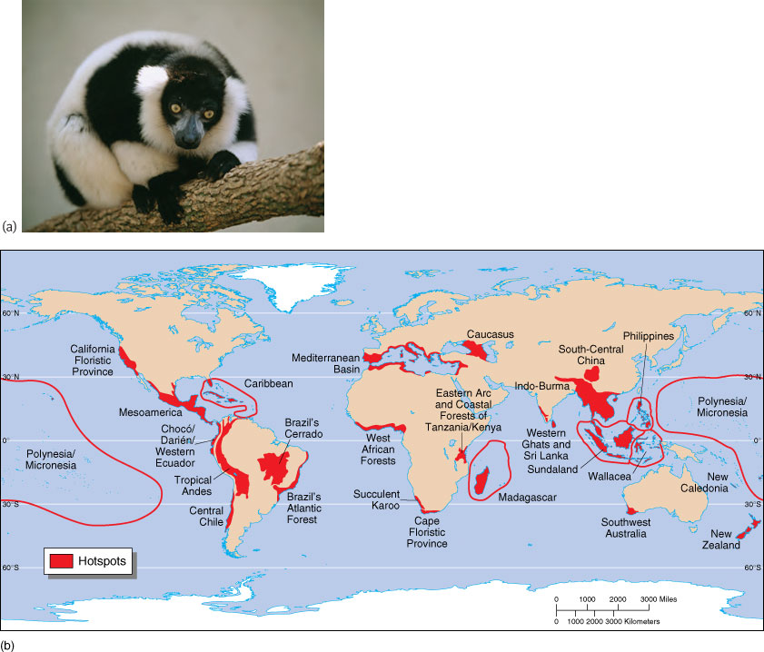

Slide 33
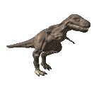
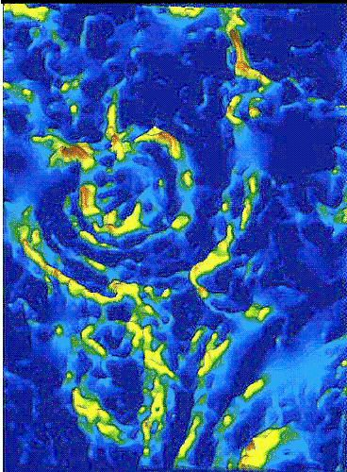
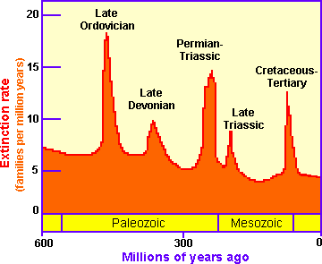
WHAT THREATENS
BIODIVERSITY?
Background extinction (95% of all extinctions)
Mass extinction

Slide 34
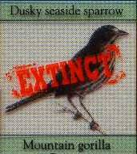
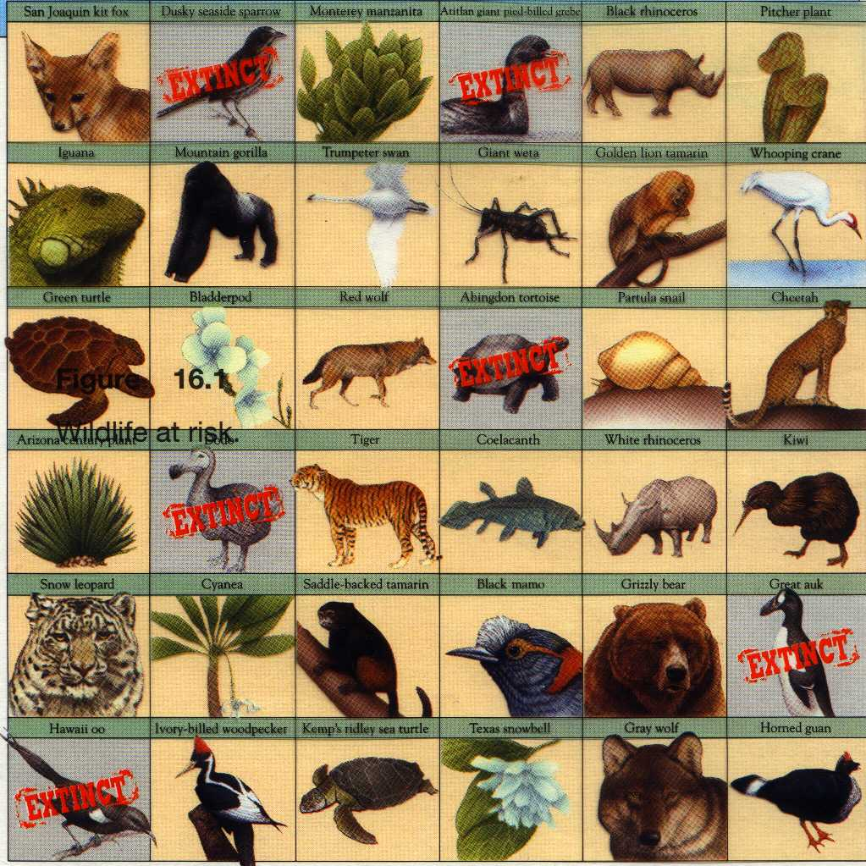
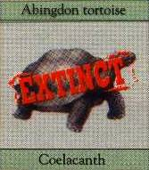
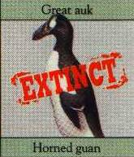
BIODIVERSITY
Background rates
1 mammal species
every 400 years
1 bird species/200 yrs
Now…………...
10,000 times the
background rate!
20-75 plant/animal
species each day?

Slide 35
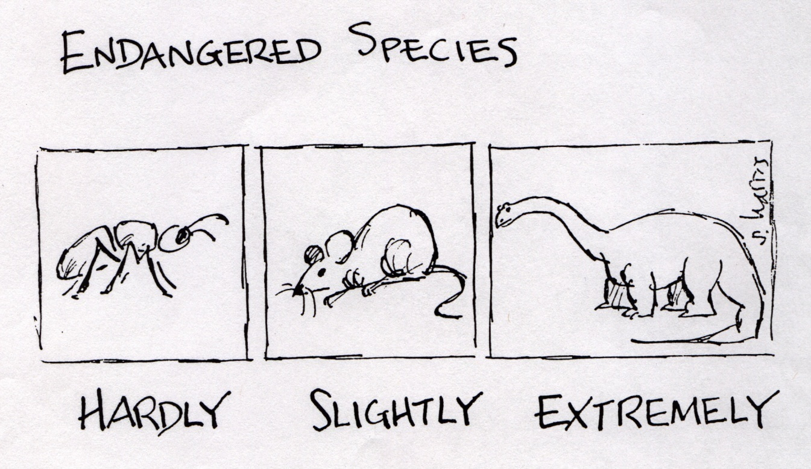
ENDANGERED VS
THREATENED
Threatened: population low but extinction less imminent
Endangered: nos so low that extinction imminent

Slide 36
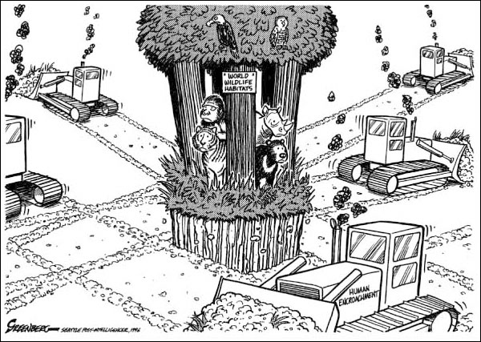
THE GREATEST THREAT

Slide 37
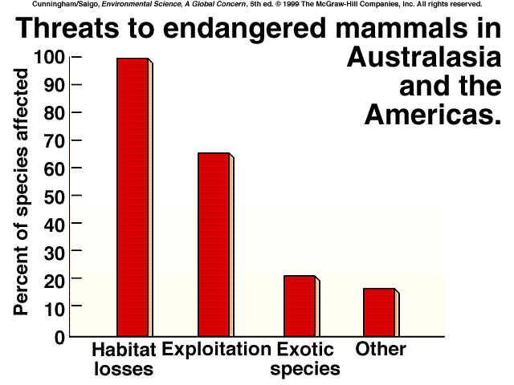

Slide 38
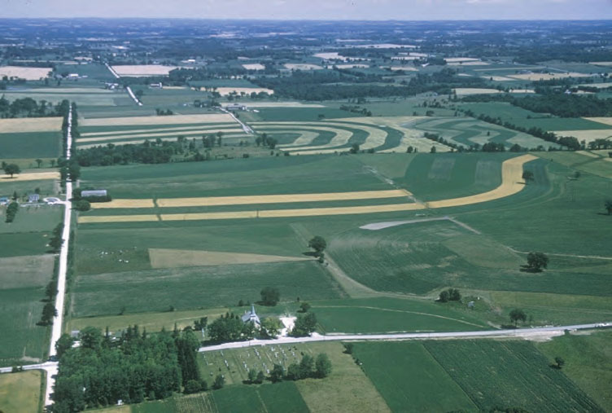
HABITAT FRAGMENTATION

Slide 39
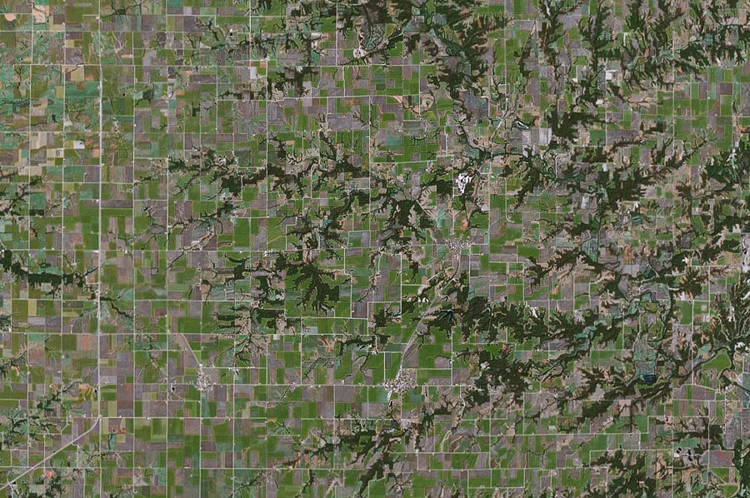

Slide 40
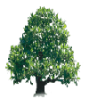
SYSTEM REGULATORS
75% water
recycled by
ET
1000
Effective runoff (mm)
0 100
Ground cover removal (%)
25% water
lost in runoff

Slide 41
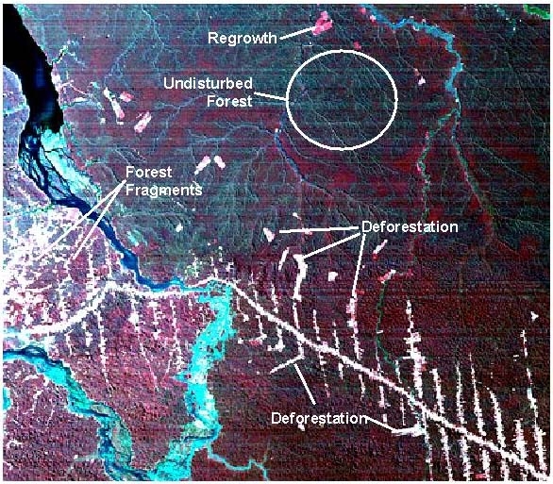
RATES OF DEFORESTATION
1981-1990:
0.9%/year
53,000 sq. mi./year
21,000 sq. mi. in
South America (Amz)
= area of NC
By 1988, +/- 10% of
the Amazon had been
cut down
Due to isolation of
fragments and in
forest/clearing
boundaries = 16%
affected by deforestation

Slide 42
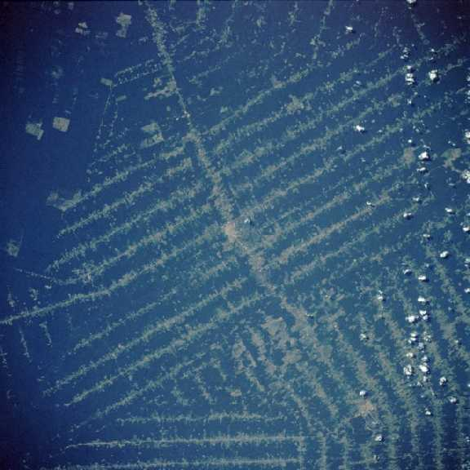

Slide 43
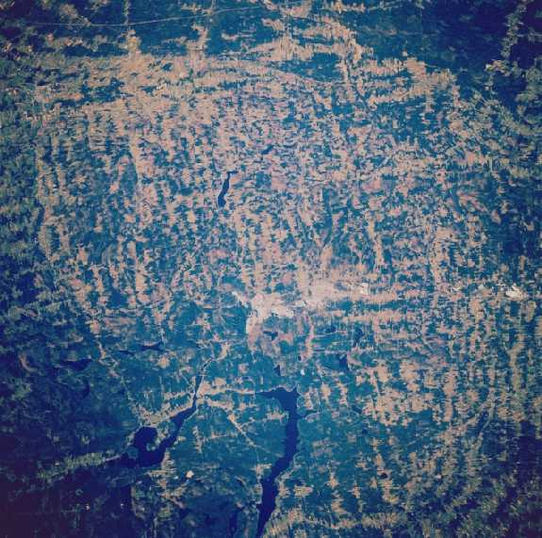

Slide 44
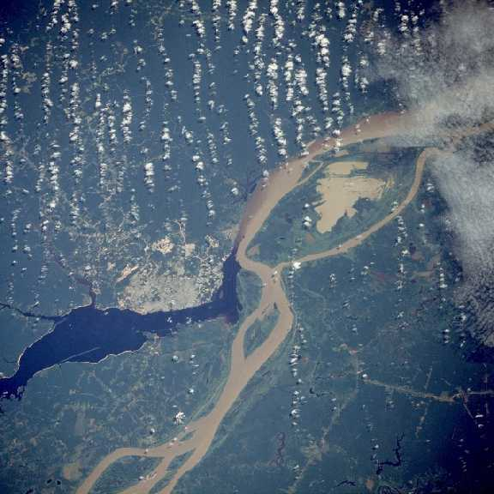

Slide 45
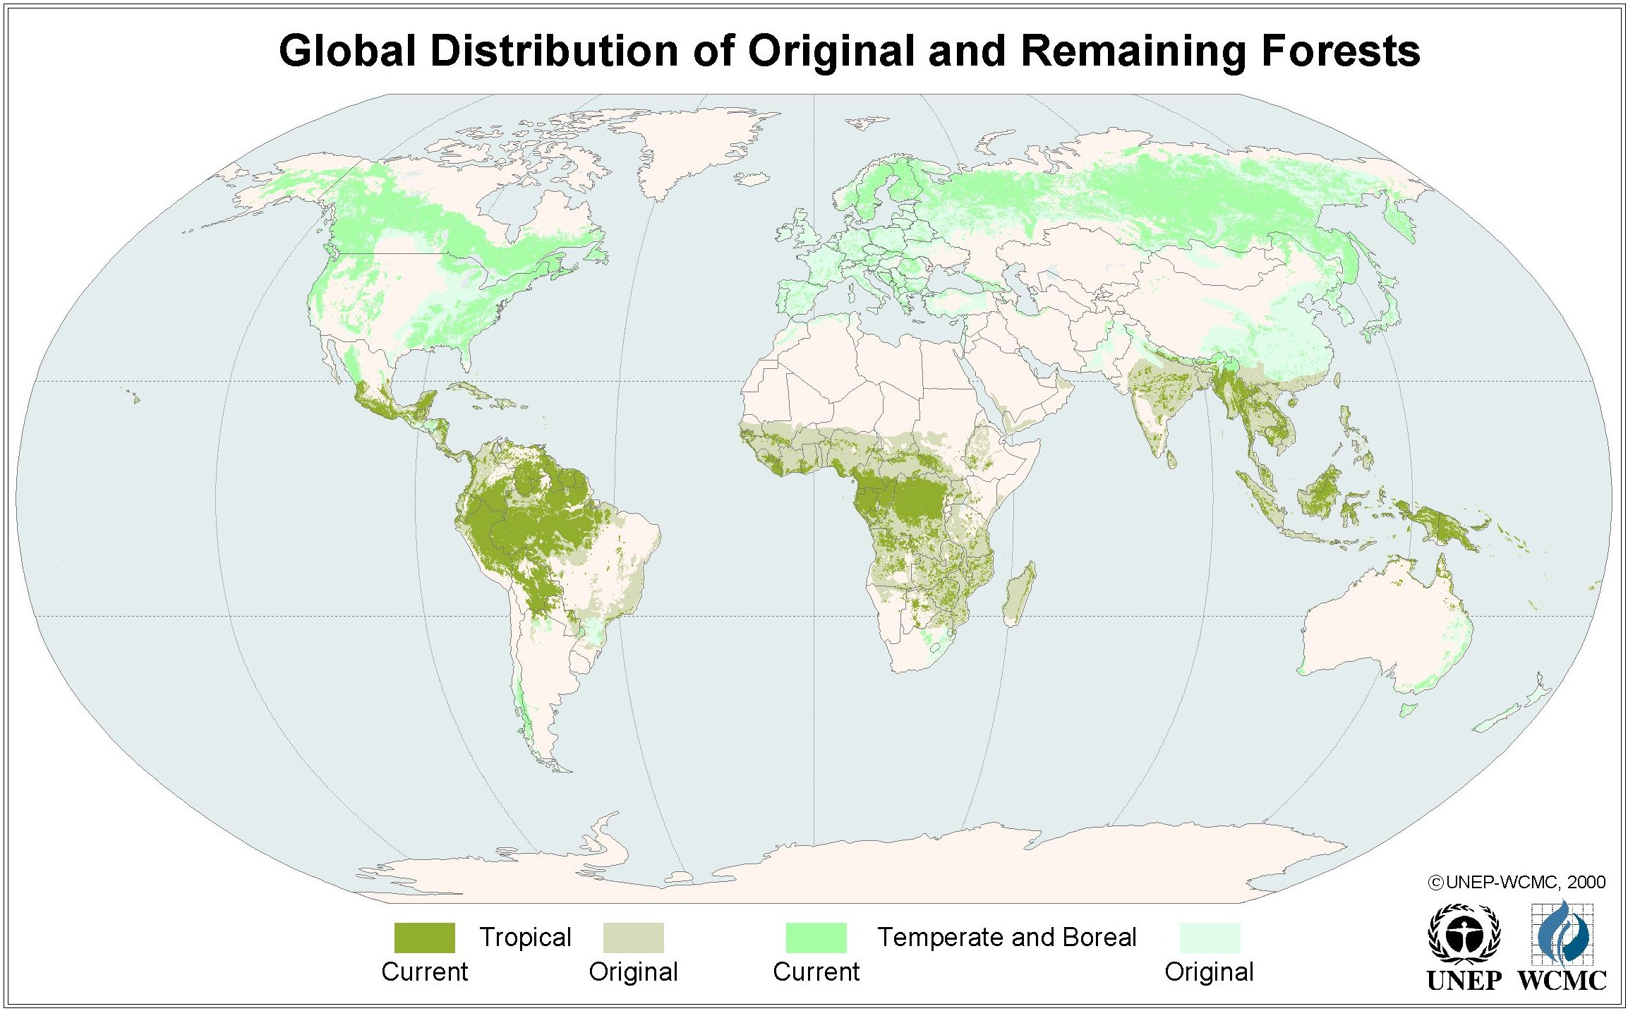

Slide 46
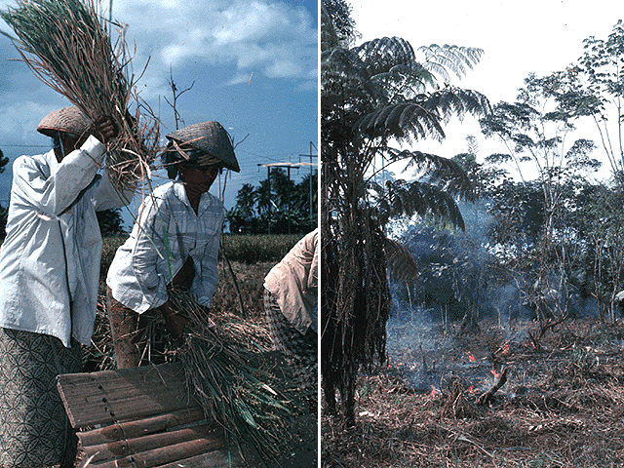
CAUSES
Swidden agriculture (slash-and-burn)
> 60% of deforestation
> Rapid decline in soil productivity (nutrient storage?)
> Can be sustainable
-- (15 - 20 year rotation)
> Inequitable land ownership (e.g., Brazil where only 5% of
farmers own land)

Slide 47
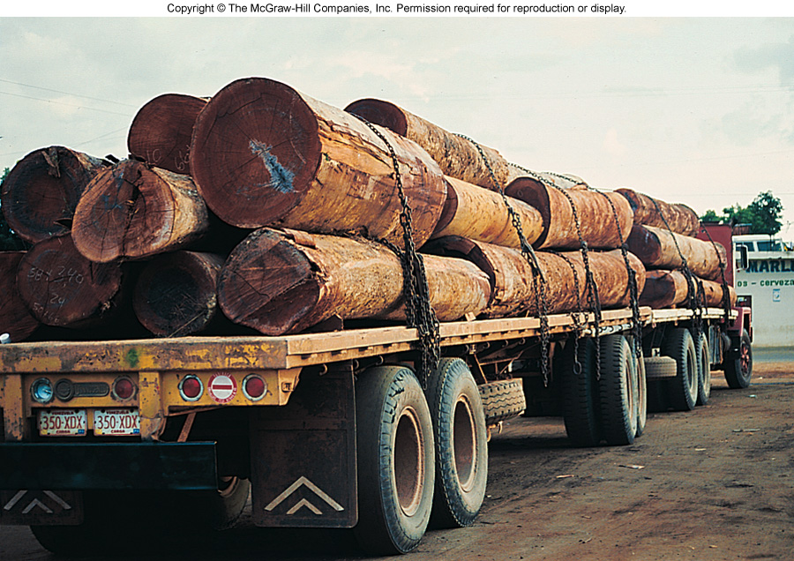
CAUSES
Commercial logging
21% of deforestation
creaming of the most valuable hardwoods
1-2 trees per hectare taken (widespread damage)
clearcut versus selective

Slide 48
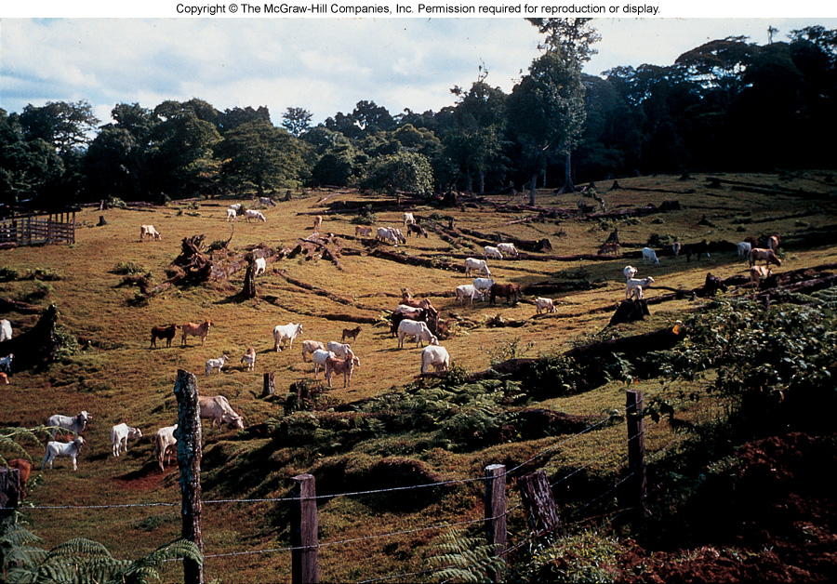
CAUSES
Cattle ranching
12% of deforestation
frequently aided by government subsidies
2 trees destroyed for each hamburger made from
“tropical forest beef”

Slide 49
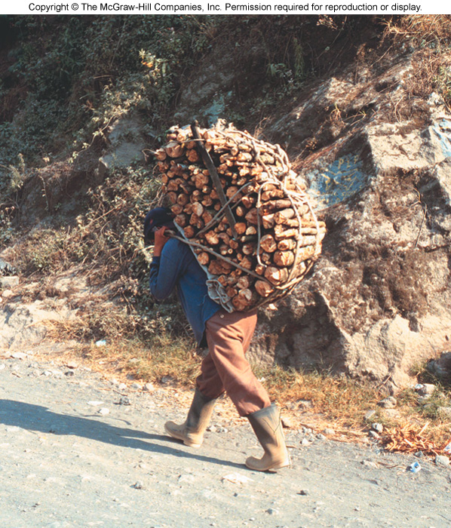
WHY DEFORESTATION?

Slide 50
WHY DEFORESTATION?
Complex
Many underlying social problems giving impetus to deforestation:
> over-consumption in industrialized countries
> foreign debt
> poverty
> unequal ownership of land
> overpopulation
Deforestation

Slide 51
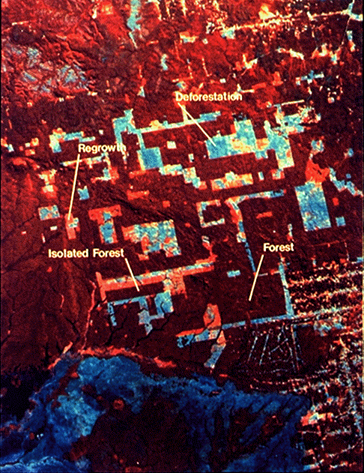
WHAT CAN BE DONE?
1. The need to preserve intact sections of tropical forest
> The question of “edge communities”

Slide 52
WHAT CAN BE DONE?
2. The need to address the economic needs of the lesser
developed nations in which all of the tropical
forests reside
> Are the ideas of commercial development and maintaining
the health of the environment mutually exclusive?

Slide 53
WHAT CAN BE DONE?
Broad-scale commercial and conservation strategies need to be
developed but these must take into account the economic and
environmental constraints of the particular country (i.e., detailed
local knowledge!)
There must be designated core and buffer conservation zones
centered around areas of particular endemism (other areas can
be designated for limited sustainable commercial activities
(polycyclic logging, selective extraction of forest products etc.)

Slide 54
Total area: 39 ha; core: 2 Total area: 42 ha; core: 25
Research and training
Tourist facility
Human settlement
Multiple-use
Buffer
Core

Slide 55
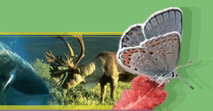
BIODIVERSITY
http://endangered.fws.gov
http://www.nesarc.org
http://www.stopextinction.org
http://www.audubon.org/campaign/esa/esa.html

Slide 95
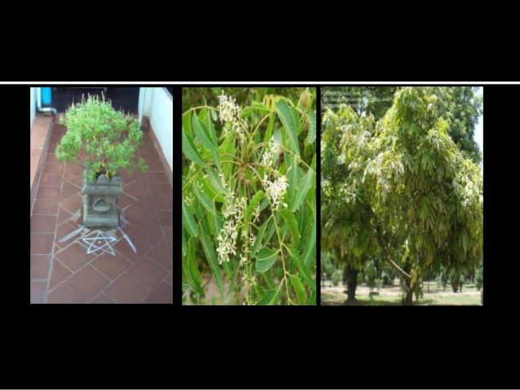

Slide 98
