Slide 1
ADDRESSING MODES OF 8086
By:
Ms. ZEENATH
Asst.Prof
Dept. Of ECE

Slide 2
Addressing modes for program memory
Intra segment direct(relative)mode: same segment ex: JMP NEXT
Intra segment indirect mode: ex: JMP CX
Inter segment direct mode : other segment
Ex: JMP CONTINUE;
4. Inter segment indirect mode : IP is replaced with a pointed by SI .
CS is replaced with a word pointer by SI+2
JMP DWORD PTR[SI]

Slide 3
Addressing modes for I/O ports
Fixed port/direct port address
Variable port /indirect port address

Slide 4
Classification of Instructions
Data transfer
Arithmetic transfer
Bit manipulation transfer
String transfer
Program execution transfer
Process control instruction

Slide 5
Data transfer
General purpose byte/word transfer :
Syntax: MOV Dest,s
I/o port transfer: IN,OUT
Flag transfer: LAHF(load lower byte of flag to AH)
SAHF(store ),PUSHF,POPF
Special address: LEA(load effective address),LDS(load data segment)

Slide 6
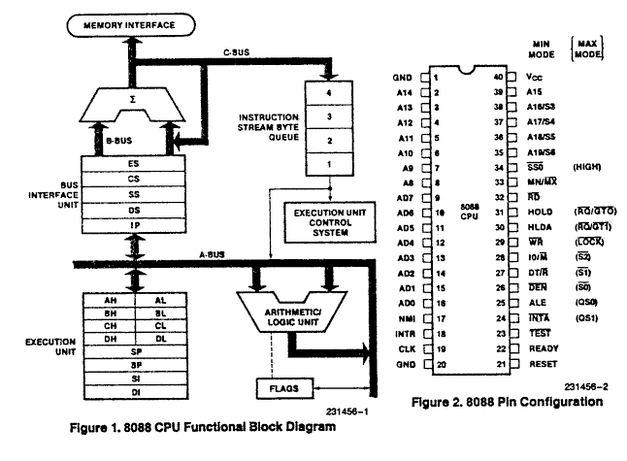
8088 MP

Slide 7
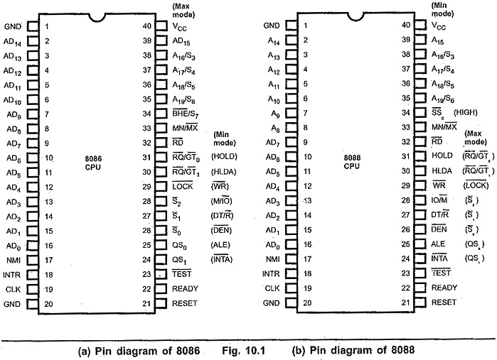

Slide 8
The architecture of 8088 is same as 8086 except for two changes
(a)8088 has 4-byte instruction queue
(b)8088 has 8-bit data bus

Slide 9
8086 | 8088
The instruction Queue is 6 byte long. | The instruction Queue is 4 byte long.
In 8086, memory divides into two banks -even or lower bank -odd or higher bank | The memory in 8088 does not divide into two banks.
The data bus of 8086 is 16-bit wide | The data bus of 8088 is 8-bit wide.
It has BHE (bar) signal on pin no. 34 & there is no SSO (bar) signal. | It does not have BHE (bar) signal on pin no. 34 & has only SSO (bar) signal. It has no S7 pin.
Control pin in 8086 is M/IO (bar).
Control pin in 8088 is IO/M (bar).
It needs one machine cycle to R/W signal if it is at even location otherwise it needs two. | It needs one machine cycle to R/W signal if it is at even location otherwise it needs two.
In 8086, all address & data Buses are multiplexed. | In 8088, address bus; AD₇- AD₀ buses are multiplexed.
It needs two IC 74343 for de-multiplexing AD₀-AD₁₉. | It needs one IC 74343 for de-multiplexing AD₀-AD₇.
Maximum supply current 360mA. | Maximum supply current 340mA.
Three clock speed: 5, 8, 10 MHz | Two clock speed: 5, 8 MHz

