Slide 1
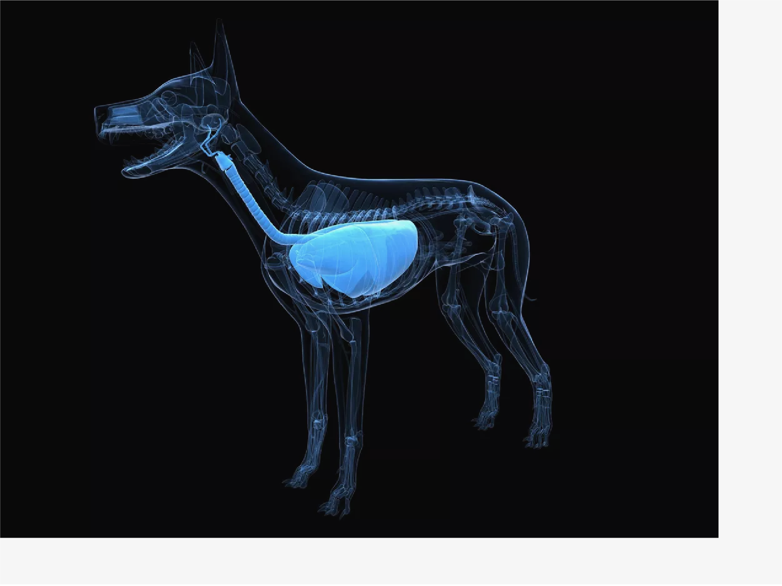
9/3/2019
https://www.thoughtco.com/animal-organ-systems-4101795?print
Home
The 12 Animal Organ Systems
by Bob Strauss
Updated January 06, 2019
Even the simplest animals on earth are exceedingly complicated—and advanced vertebrates like birds and mammals are composed of so many deeply intermeshed, mutually dependent moving parts that it can be hard for a non-biologist amateur to keep track of them. Below are the 12 organ systems shared by most higher animals, including the respiratory system and the integumentary system.
01
of 12
The Respiratory System
https://www.thoughtco.com/animal-organ-systems-4101795?print

Slide 2
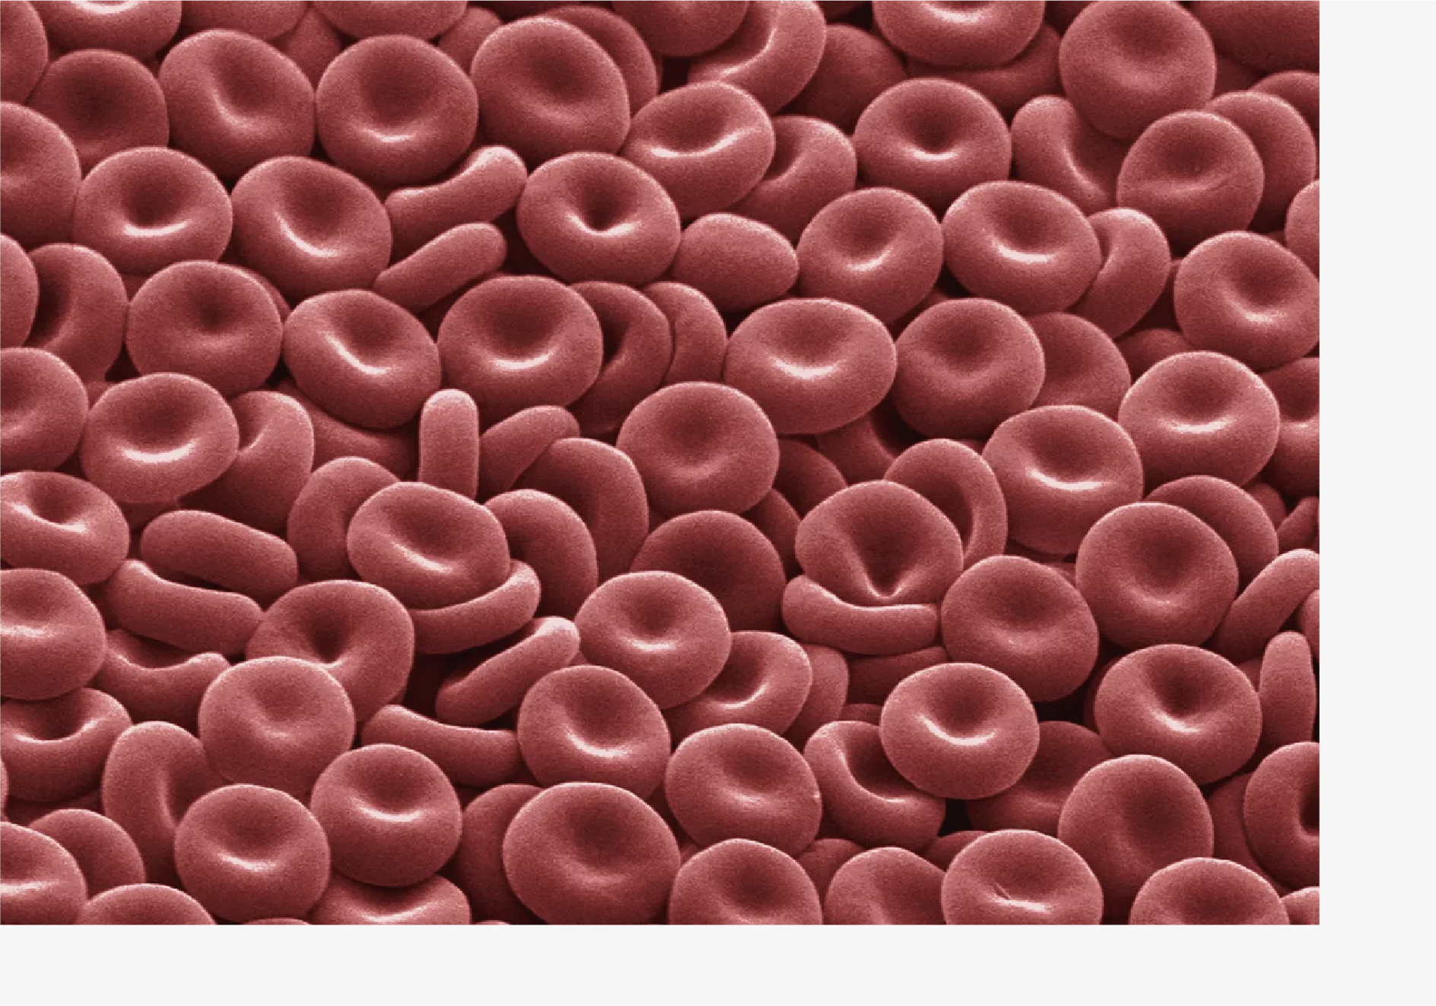
9/3/2019
https://www.thoughtco.com/animal-organ-systems-4101795?print
SCIEPRO/Getty Images
All cells need oxygen, the crucial ingredient for extracting energy from organic compounds. Animals obtain oxygen from their environment with their respiratory systems: the lungs of land-dwelling vertebrates gather oxygen from the air, the gills of ocean-dwelling vertebrates filter oxygen from the water, and the exoskeletons of invertebrates facilitate the free diffusion of oxygen (from the water or the air) into their bodies. The respiratory systems of animals also excrete carbon dioxide, a waste product of metabolic processes that would be fatal if left to accumulate in the body.
02
of 12
The Circulatory System
DAVID MCCARTHY/Getty Images
Vertebrate animals supply oxygen to their cells via their circulatory systems, which are networks of arteries, veins, and capillaries that carry oxygen-containing blood cells to every cell in their bodies. (The circulatory systems of invertebrate animals are much more primitive; essentially, their blood diffuses freely throughout their much smaller body
https://www.thoughtco.com/animal-organ-systems-4101795?print

Slide 3
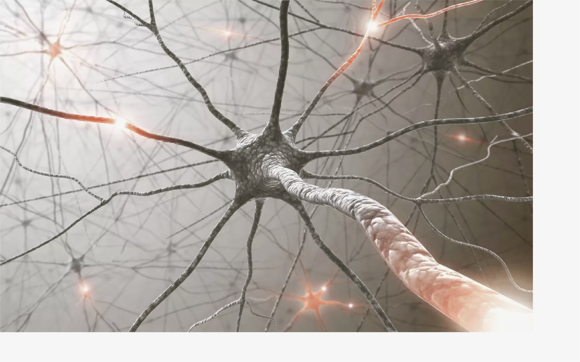
9/3/2019 https://www.thoughtco.com/animal-organ-systems-4101795?print
cavities.) The circulatory system in higher animals is powered by the heart, a dense mass of muscle that beats millions of times throughout a creature's lifetime.
03
of 12
The Nervous System
Science Photo Library - KTSDESIGN/Getty Images
The nervous system is what enables animals to send, receive, and process nerve and sensory impulses, as well as to move their muscles. In vertebrate animals, this system can be divided into three main components: the central nervous system (which includes the brain and spinal cord), the peripheral nervous system (the smaller nerves that branch off from the spinal cord and carry nerve signals to distant muscles and glands), and the autonomic nervous system (which controls involuntary activity such as the heartbeat and digestion). Mammals possess the most advanced nervous systems, while invertebrates have nervous systems that are much more rudimentary.
04
of 12
The Digestive System
https://www.thoughtco.com/animal-organ-systems-4101795?print

Slide 4
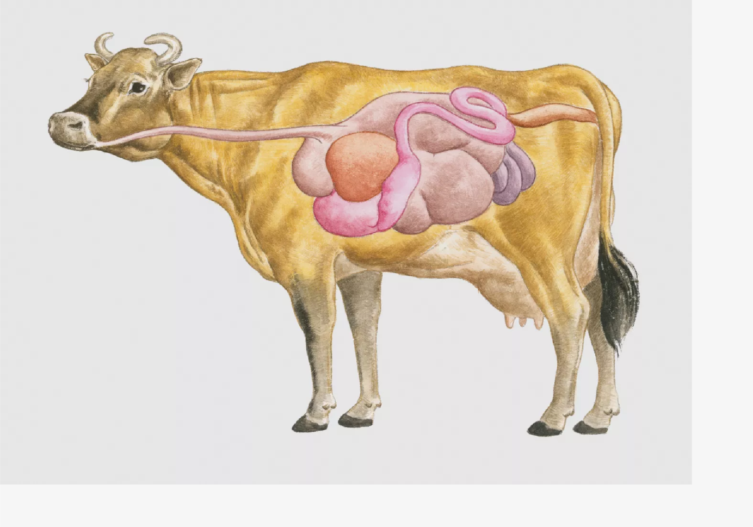
9/3/2019
https://www.thoughtco.com/animal-organ-systems-4101795?print
Dorling Kindersley/Getty Images
Animals need to break down the food they eat into its essential components in order to fuel their metabolism. Invertebrate animals have simple digestive systems—in one end, out the other (as in the case of worms or insects)—but all vertebrate animals are equipped with some combination of mouths, throats, stomachs, intestines, and anuses or cloacas, as well as organs (such as the liver and pancreas) that secrete digestive enzymes. Ruminant mammals such as cows have four stomachs in order to efficiently digest fibrous plants.
05
of 12
The Endocrine System
https://www.thoughtco.com/animal-organ-systems-4101795?print

Slide 5
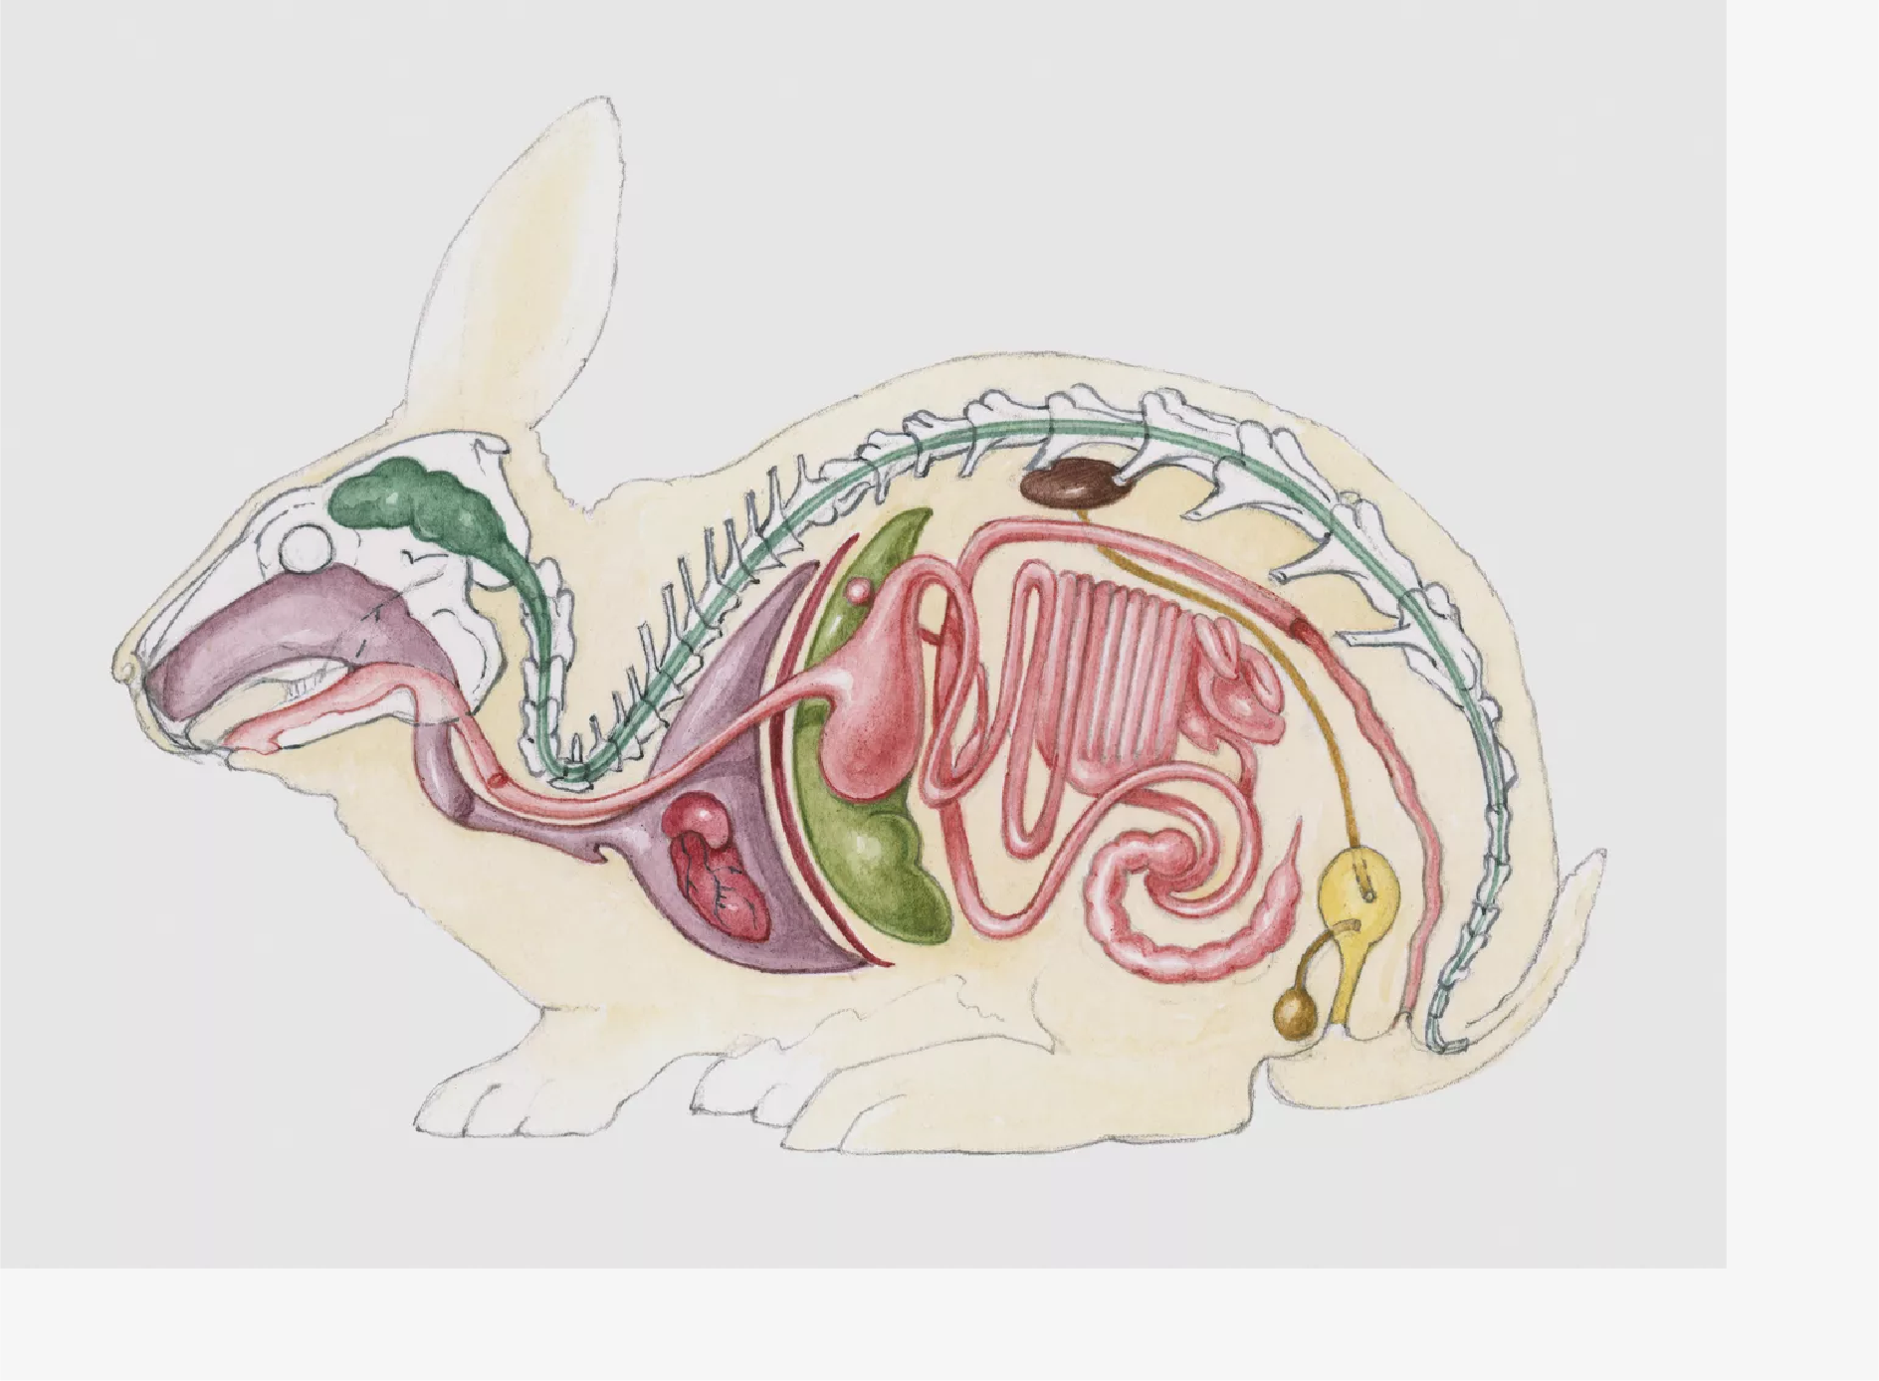
9/3/2019
https://www.thoughtco.com/animal-organ-systems-4101795?print
Angelika Elsebach/Getty Images
In higher animals, the endocrine system is made up of glands (such as the thyroid and the thymus) and the hormones these glands secrete, which influence or control various body functions (including metabolism, growth, and reproduction). It can be difficult to fully tease out the endocrine system from the other organ systems of vertebrate animals: for example, testes and ovaries (which are intimately involved in the reproductive system) are technically glands, as is the pancreas, which is an essential component of the digestive system.
06
of 12
The Reproductive System
https://www.thoughtco.com/animal-organ-systems-4101795?print

Slide 6
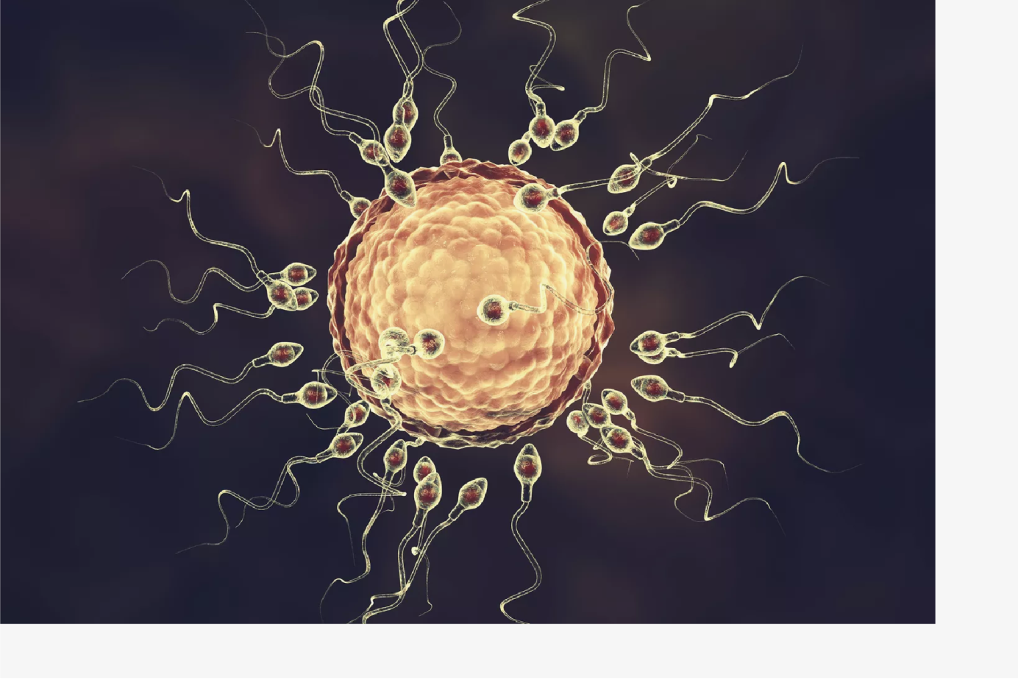
9/3/2019
https://www.thoughtco.com/animal-organ-systems-4101795?print
KATERYNA KON/SCIENCE PHOTO LIBRARY/Getty Images
Arguably the most important organ system from the perspective of evolution, the reproductive system enables animals to create offspring. Invertebrate animals exhibit a wide range of reproductive behavior, but the bottom line is that (at some point during the process) females create eggs and males fertilize the eggs, either internally or externally. All vertebrate animals—from fish to reptiles to human beings—possess gonads, paired organs that create sperm (in males) and eggs (in females). The males of most higher vertebrates are equipped with penises, and the females with vaginas, milk-secreting nipples, and wombs in which fetuses gestate.
07
of 12
The Lymphatic System
https://www.thoughtco.com/animal-organ-systems-4101795?print

Slide 7
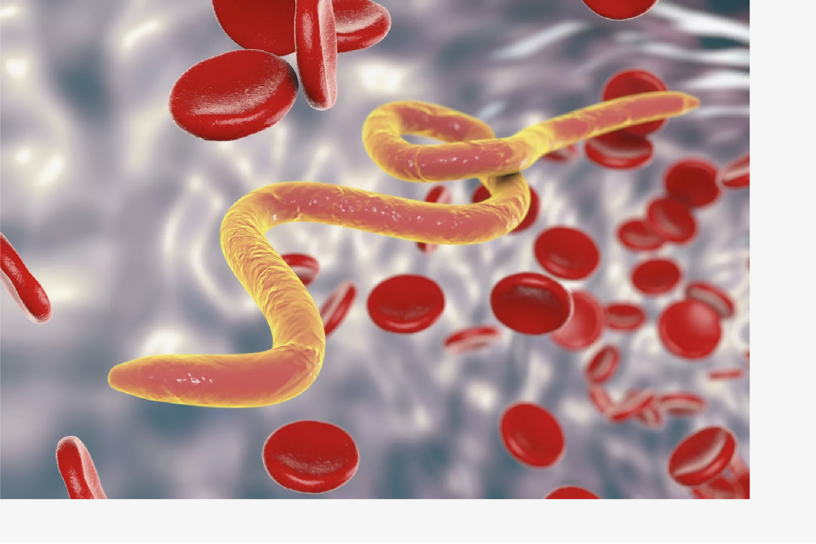
9/3/2019
https://www.thoughtco.com/animal-organ-systems-4101795?print
KATERYNA KON/SCIENCE PHOTO LIBRARY/Getty Images
Closely associated with the circulatory system, the lymphatic system consists of a body- wide network of lymph nodes, which secrete and circulate a clear fluid called lymph (which is virtually identical to blood, except that it lacks red blood cells and contains a slight excess of white blood cells). The lymphatic system is only found in higher vertebrates, and it has two main functions: to keep the circulatory system supplied with the plasma component of blood and to maintain the immune system. (In lower vertebrates and invertebrates, blood and lymph are usually combined, and not handled by two separate systems.)
08
of 12
The Muscular System
https://www.thoughtco.com/animal-organ-systems-4101795?print

Slide 8
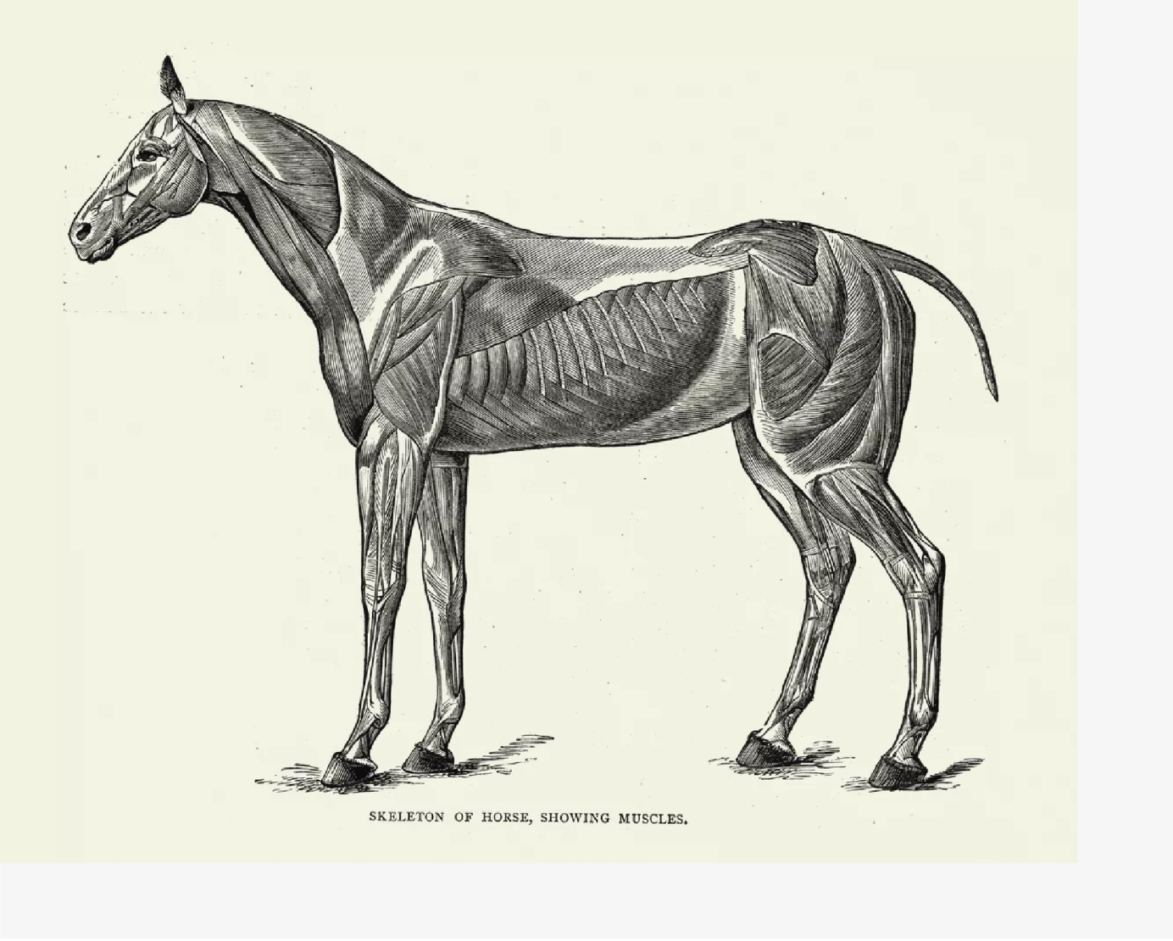
9/3/2019
https://www.thoughtco.com/animal-organ-systems-4101795?print
duncan1890/Getty Images
Muscles are the tissues that allow animals both to move and to control their movements. There are three main components of the muscular system: skeletal muscles (which enable higher vertebrates to walk, run, swim, and grasp objects with their hands or claws), smooth muscles (which are involved in breathing and digestion, and are not under conscious control); and cardiac or heart muscles, which power the circulatory system. (Some invertebrate animals, like sponges, completely lack muscular tissues, but can still move thanks to the contraction of epithelial cells).
09
of 12
The Immune System
https://www.thoughtco.com/animal-organ-systems-4101795?print

Slide 9
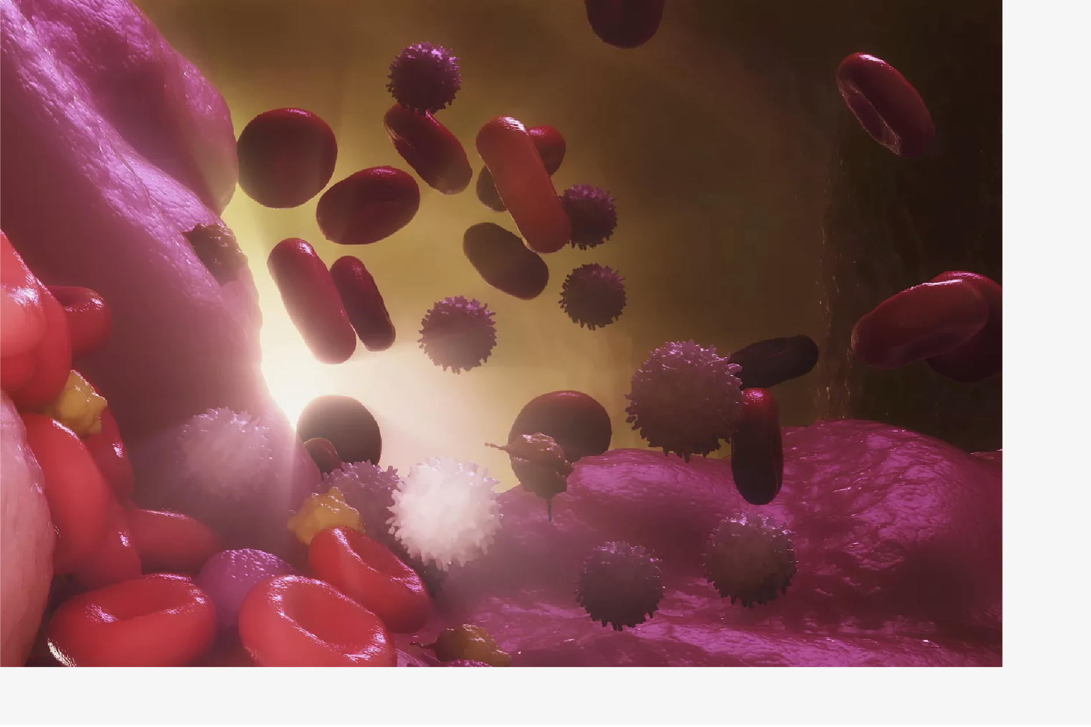
9/3/2019
https://www.thoughtco.com/animal-organ-systems-4101795?print
Science Picture Co/Getty Images
Probably the most complicated and technically advanced of all the systems listed here, the immune system is responsible for distinguishing an animal's native tissues from foreign bodies and pathogens like viruses, bacteria, and parasites, and for mobilizing immune responses, whereby various cells, proteins, and enzymes are manufactured by the body to destroy the invaders. The main carrier of the immune system is the lymphatic system; both of these systems only exist, to a greater or lesser extent, in vertebrate animals, and are most advanced in mammals.
10
of 12
The Skeletal (Support) System
https://www.thoughtco.com/animal-organ-systems-4101795?print

Slide 10
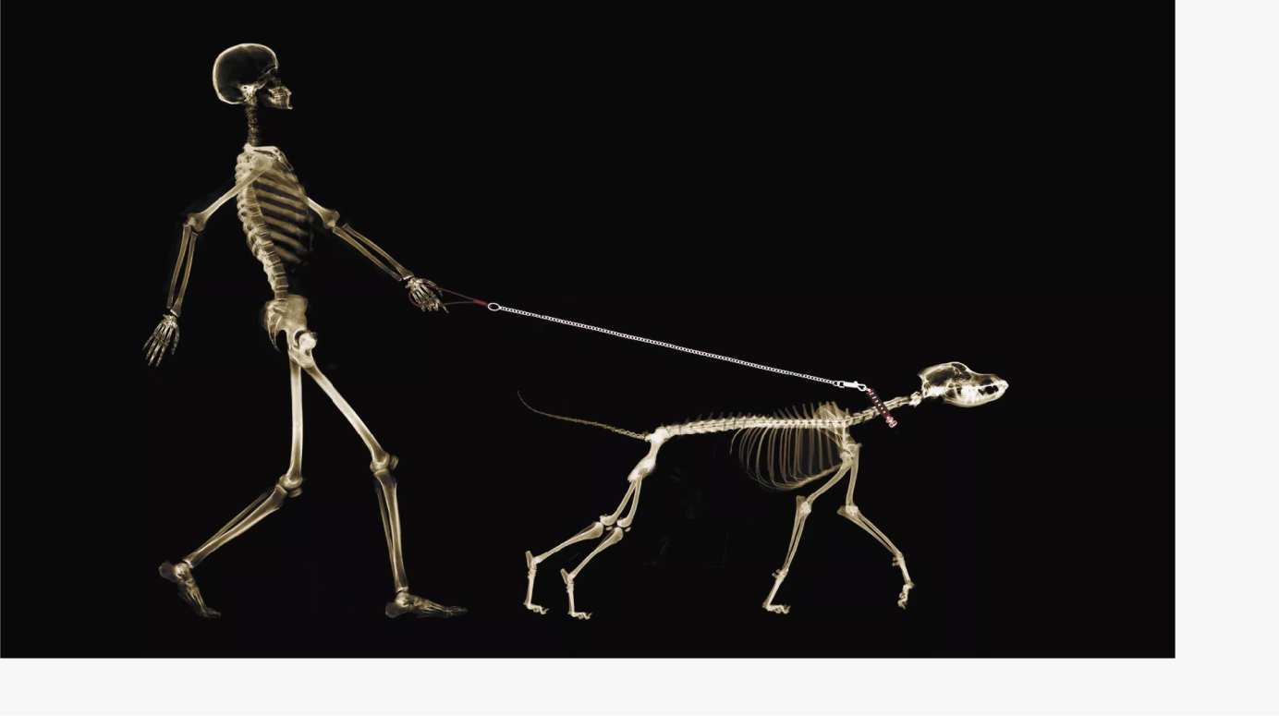
9/3/2019
https://www.thoughtco.com/animal-organ-systems-4101795?print
Digital Vision/Getty Images
Higher animals are composed of trillions of differentiated cells, and thus need some way to maintain their structural integrity. Many invertebrate animals (such as insects and crustaceans) have external body coverings, also known as exoskeletons, composed of chitin and other tough proteins; sharks and rays are held together by cartilage; and vertebrate animals are supported by internal skeletons, also known as endoskeletons, assembled from calcium and various organic tissues. Many invertebrate animals completely lack any kind of endoskeleton or exoskeleton; witness soft-bodied jellyfish, sponges, and worms.
11
of 12
The Urinary System
https://www.thoughtco.com/animal-organ-systems-4101795?print

Slide 11
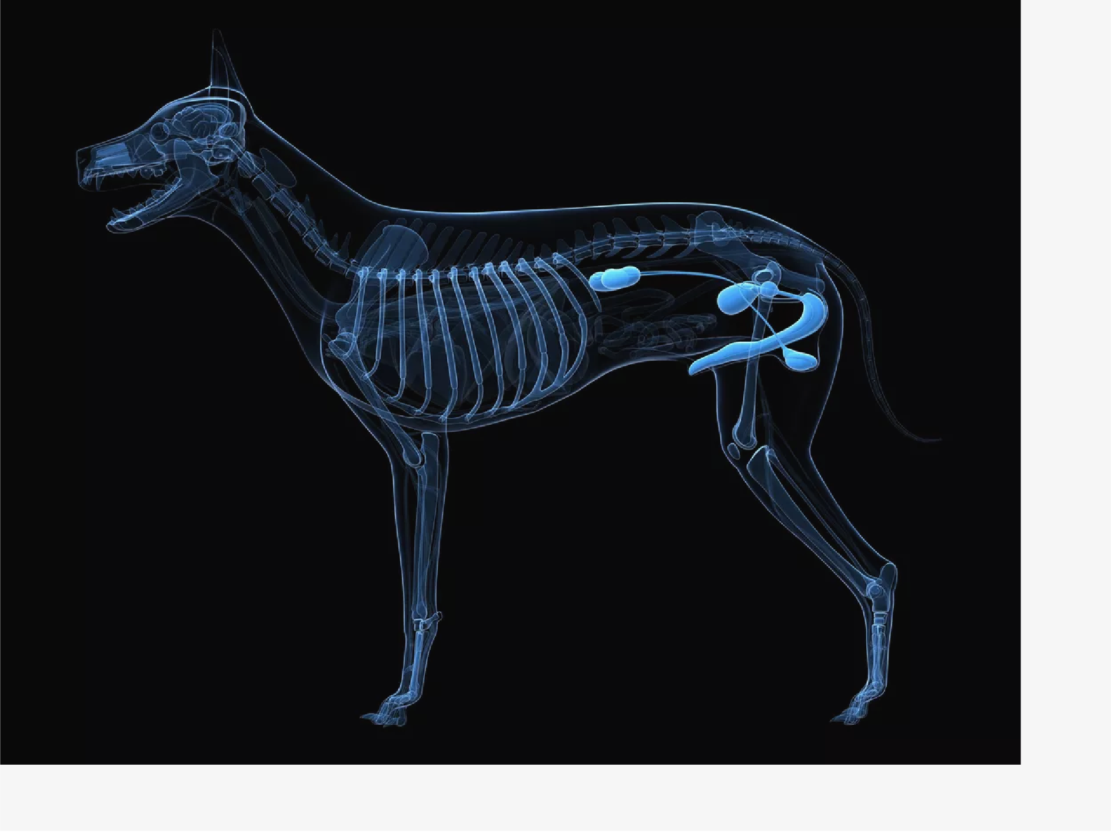
9/3/2019
https://www.thoughtco.com/animal-organ-systems-4101795?print
SCIEPRO/Getty Images
All land-dwelling vertebrates produce ammonia, a by-product of the digestion process. In mammals and amphibians, this ammonia is turned into urea, processed by the kidneys, mixed with water, and excreted as urine. Interestingly, birds and reptiles secrete urea in solid form along with their other wastes—these animals technically have urinary systems, but don't produce liquid urine—while fish expel ammonia directly from their bodies without first turning it into urea.
12
of 12
The Integumentary System
https://www.thoughtco.com/animal-organ-systems-4101795?print

Slide 12
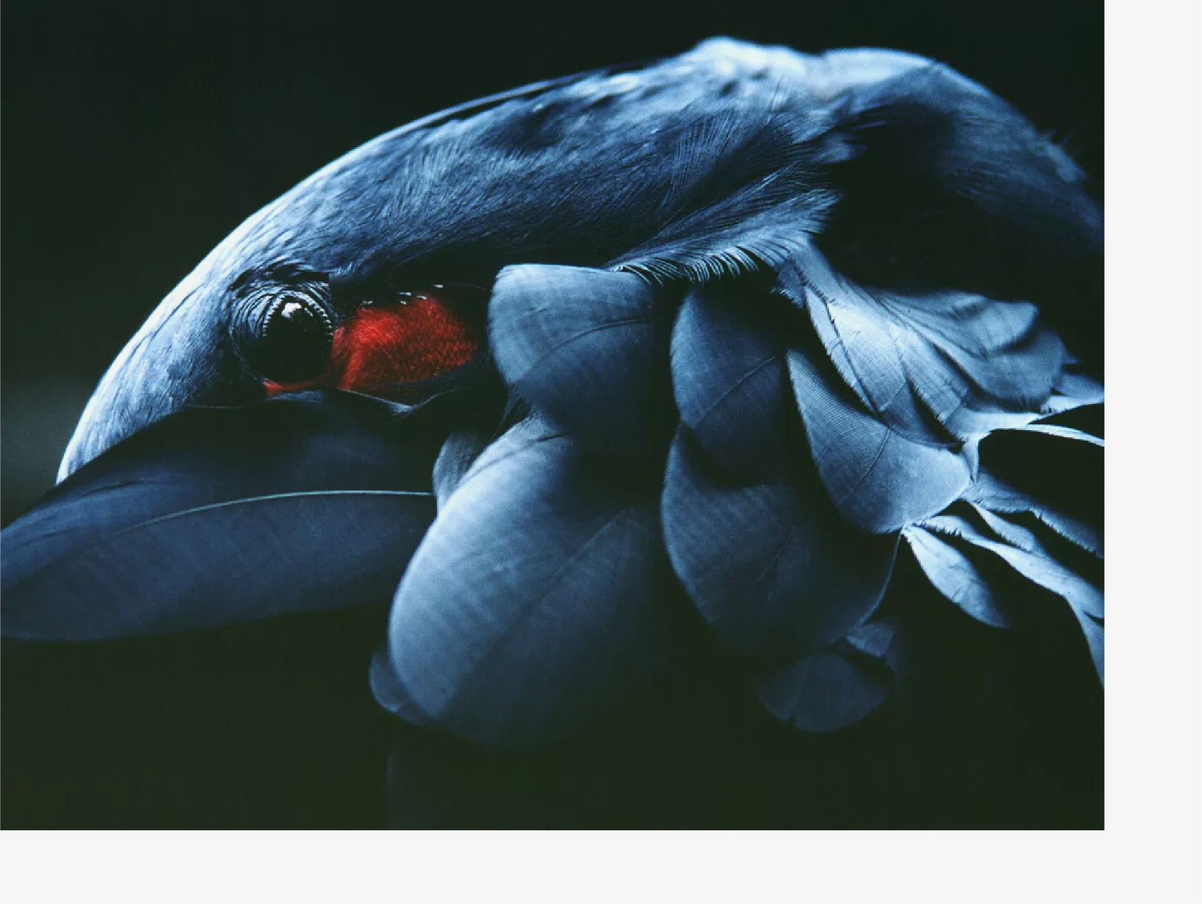
9/3/2019
https://www.thoughtco.com/animal-organ-systems-4101795?print
Carl Shaneff/Getty Images
The integumentary system consists of the skin and the structures or growths that cover it (the feathers of birds, the scales of fish, the hair of mammals, etc.), as well as claws, nails, hooves, and the like. The most obvious function of the integumentary system is to protect animals from the hazards of their environment, but it's also indispensable for temperature regulation (a coating of hair or feathers helps to preserve internal body heat), protection from predators (the thick shell of a turtle makes it a tough snack for crocodiles), sensing pain and pressure, and, in humans, even producing important biochemicals like Vitamin D.
https://www.thoughtco.com/animal-organ-systems-4101795?print

Slide 13
9/3/2019
https://www.thoughtco.com/animal-organ-systems-4101795?print
https://www.thoughtco.com/animal-organ-systems-4101795?print

