Slide 1
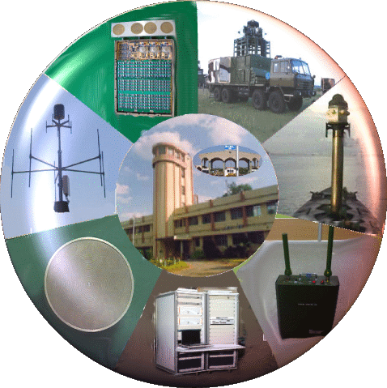
Broadband Antenna Design
&
Recent Advances in Antenna Technology
By
M. Balachary, (Retd.) Sc H
Outstanding Scientist & Associate Director, DLRL

Slide 2
FOCUS / OUTLINE OF TALK
Electromagnetic spectrum
Antenna Radiation Mechanism and Antenna Parameters
Antenna Classification and Antenna configurations
Application of Antennas
Antenna Simulation Softwares & simulation case Studies
Electronic Warfare and Broadband Antennas for EW
Broadband Radomes
Phased Array Antennas
Requirements & Trends in Antenna design
High Performance Computing in antenna Design
Recent Development in Antennas & Application
Antenna 3D manufacturing Methods
Antenna Testing & Measurement Techniques
Conclusion

Slide 3
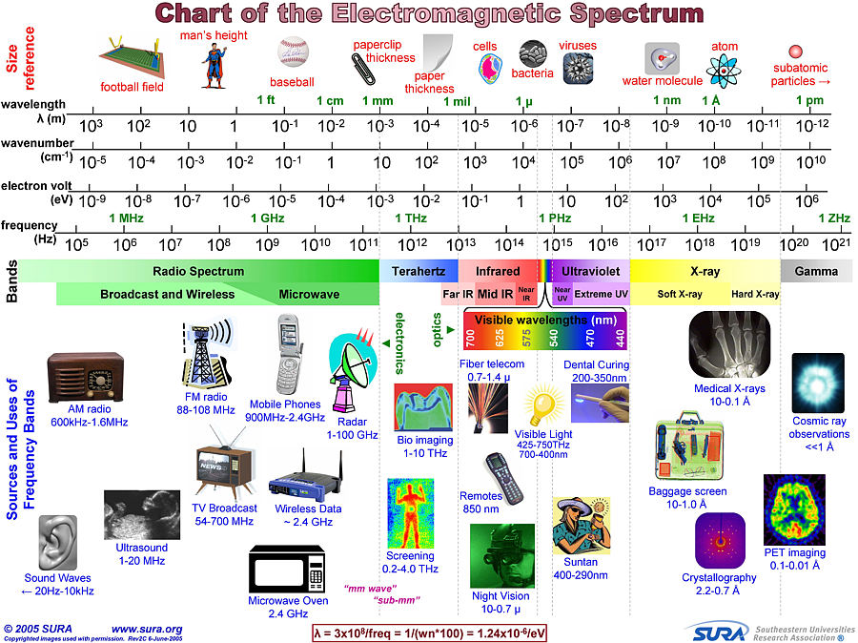

Slide 4
ANTENNA DEFINITION
There are several definitions of antenna and are as follows:
The IEEE Standard Definitions of Terms (IEEE Std 145-1983):
Antenna is a means for radiating or receiving radio waves
• An antenna is a device that converts electronic signals to electromagnetic waves (and vice versa) effectively with minimum loss of signals
• An antenna is basically a transforming device that will convert impedance of transmitter output (50/75 Ohm) into free space impedance (120pi or 377 Ohm).
• Region of transition between guided and free space propagation
• Concentrates incoming wave onto a sensor (Rx case)
• Launches waves from a guiding structure into space/air (Tx case)

Slide 5
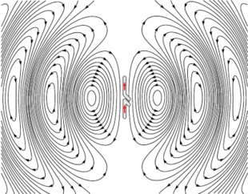
RADIATION MECHANISM
(DIPOLE ANTENNA TRANSMITTING CASE)
• The Antenna has two vertical metal rods
• An Alternating current applied at its center from a Tx
• The voltage charges the two sides of the antenna alternatively positive(+) and Negative(-)
• Loops of electric field leave the antenna and travel away at the speed of light.

Slide 6
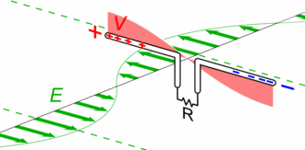
RADIATION MECHANISM
DIPOLE ANTENNA RECEIVING CASE
• The Antenna consists of two metal rods and are connected to a receiver R
• The Electric field of the incoming wave pushes the electrons in the rod back and forth, charging the ends of the rods alternatively Positive (+) and Negative (-).
The oscillating field induces standing waves of voltage (red) and currents in the rods
The oscillating current flows down the transmission line and through the receiver.

Slide 7
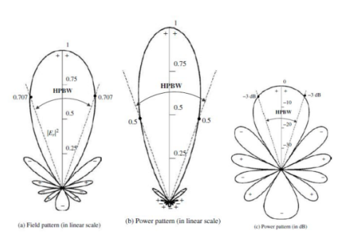
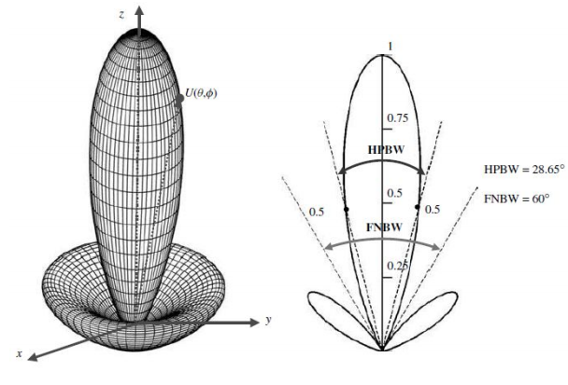
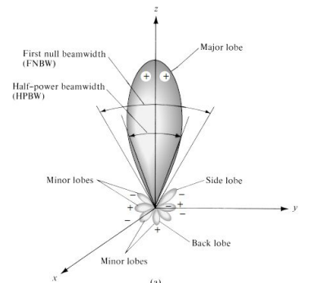
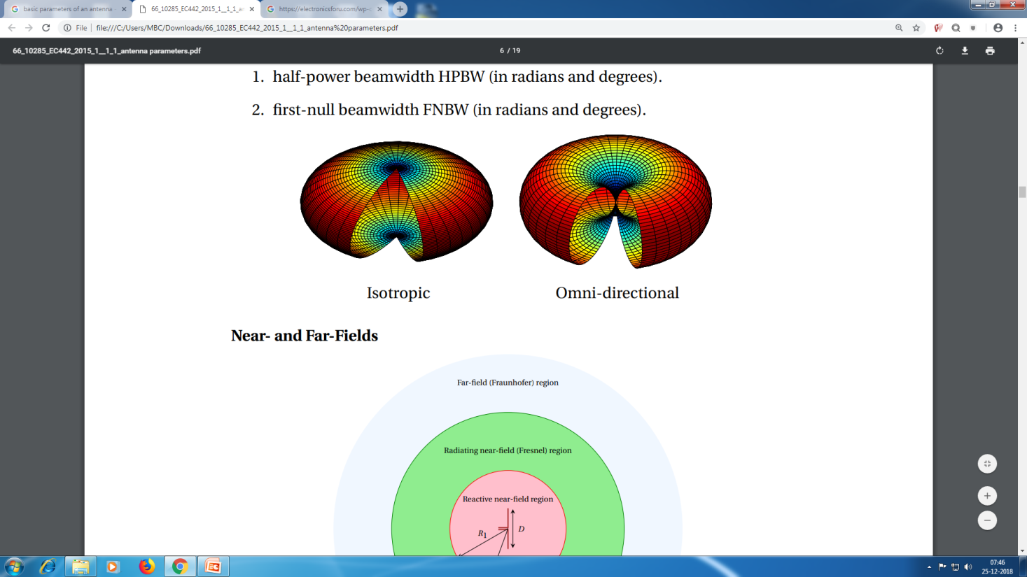
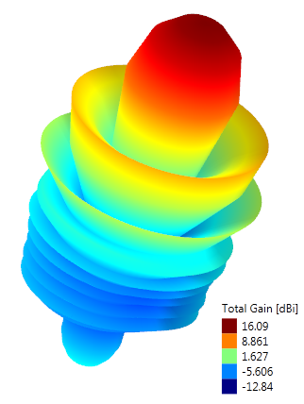
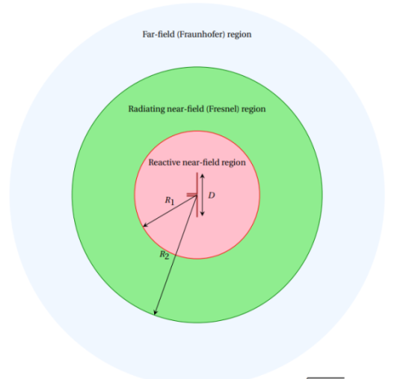
ANTENNA PARAMETERS
Frequency & Bandwidth
VSWR
Radiation pattern
Beam Width
Sidelobe level
Directivity
Gain
Polarization
Axial ratio
Efficiency
Power handling
Input/ Output Connector
Size
Weight
Environmental specifications
R1 = 0.62p D3/λ,
R2 = 2D 2 /λ

Slide 8
ANTENNA BANDWIDTH
BROADBAND AND NARROW BAND ANTENNAS
Antenna Bandwidth: The Range of frequencies, within which the antenna characteristics ( Input impedance, pattern) conform to certain specifications
Impedance or VSWR Band Width (BW)
Pattern Bandwidth
Polarization bandwidth ( Axial Ratio )
Broadband Antennas: Bandwidth expressed as ratio of upper to lower frequencies of acceptable operation eg: 10:1 BW means f_{H} is 10 times greater than f_{L.}
Narrow Band Antennas: Bandwidth expressed as percentage of frequency difference over center frequency, eg: 5% means
( f_{H}-f_{L})/f₀ is 0.05
Frequency Independent Antennas: BW is 40: 1

Slide 9
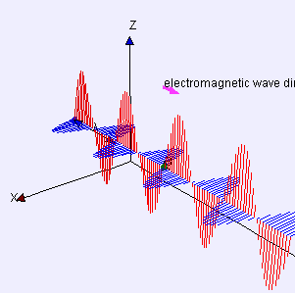
ANTENNA POLARIZATION
The electric field plane determines the polarization or orientation of the radio wave
Linear Polarization
A linear polarized antenna radiates wholly in one plane containing the direction of propagation
An antenna is said to be vertically polarized (linear) when its electric field is perpendicular to the Earth's surface

Slide 10
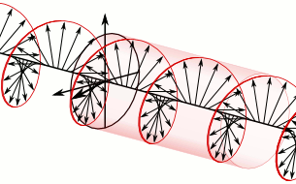
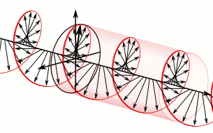
ANTENNA POLARIZATION
Circular polarization
Circular polarized wave radiates energy in both the horizontal and vertical planes and all planes in between.
The plane of polarization rotates in a circle making one complete revolution during one period of the wave.
If the rotation is clockwise looking in the direction of propagation, the sense is called right-hand-circular (RHC).
If the rotation is counter clockwise, the sense is called left-hand-circular (LHC).
Right-Hand-Circular polarization
Left-Hand-Circular polarization

Slide 11
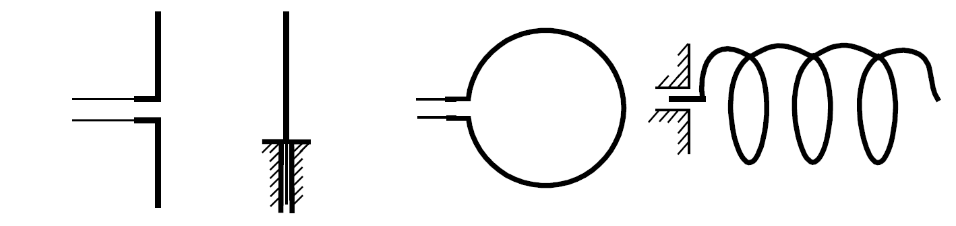
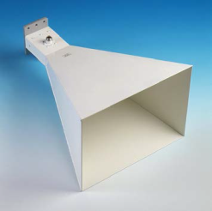
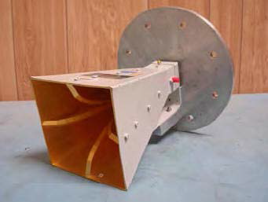
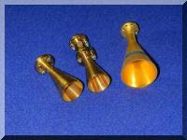
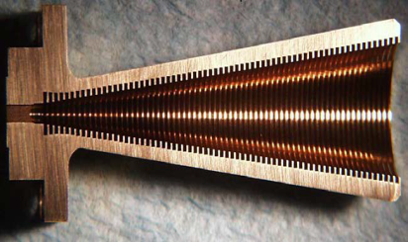
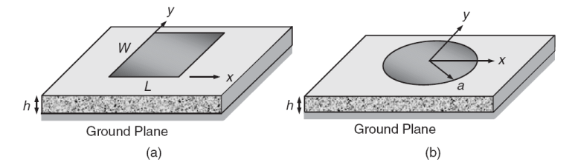
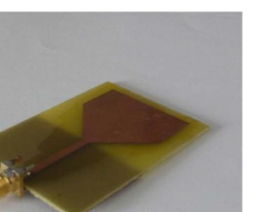
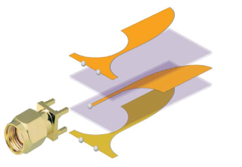
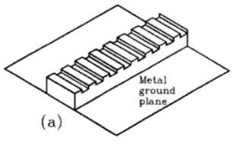
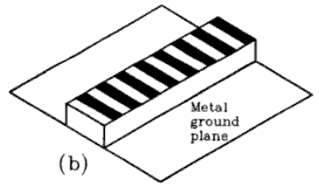
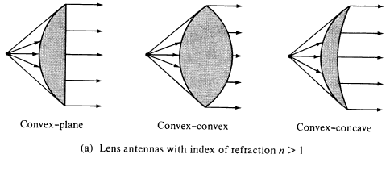
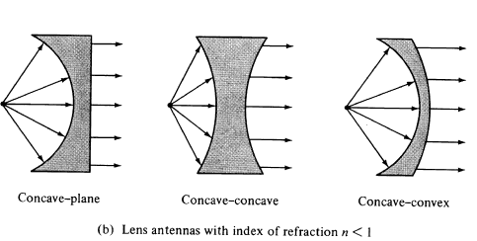
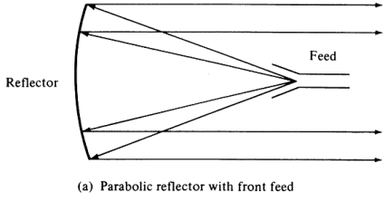
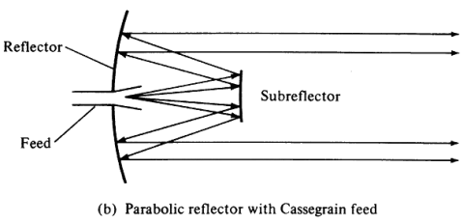
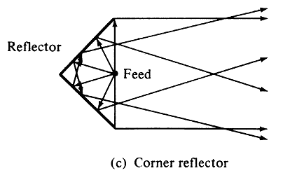
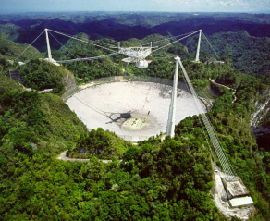
ANTENNA CLASSIFICATION/ CONFIGURATIONS
Single Element Radiators
Wire Antennas
Aperture Antennas
Printed Antennas
Leaky wave antennas
Reflector Antennas
Lens Antennas
Wire Antennas
Aperture Antennas ( Horns)
Printed Antennas
Leaky wave Antennas
Lens Antennas
Reflector Antennas

Slide 12
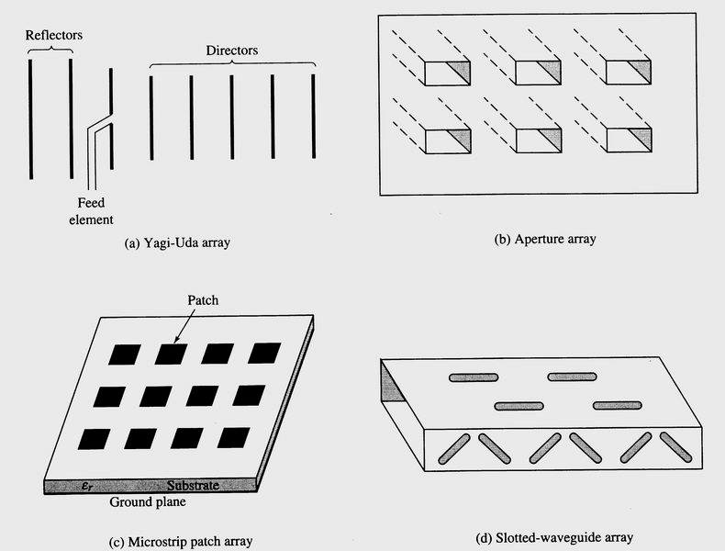
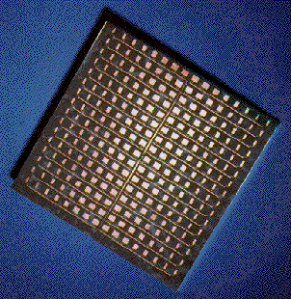
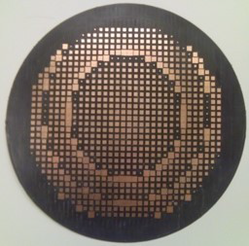
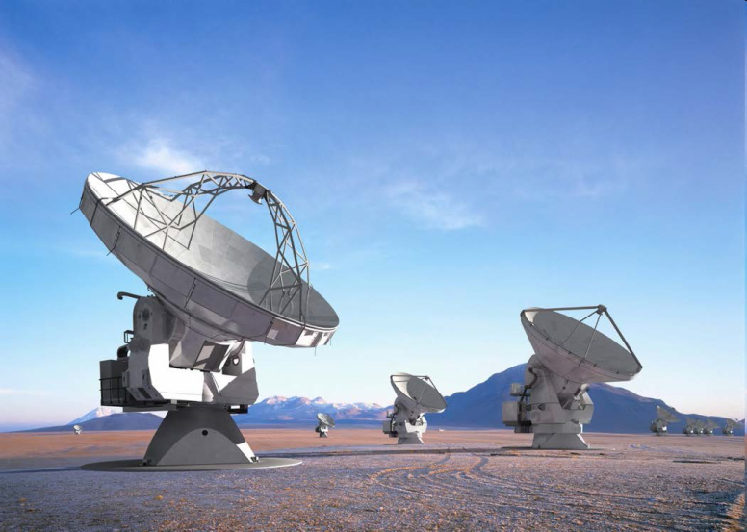
ANTENNA CLASSIFICATION/ CONFIGURATIONS
Array Antennas

Slide 13
ANTENNA APPLICATIONS
Application | Type of Antenna | Description
Radio Broadcasting | Monopole, Dipole, Ferrite rod, Whip, Microstrip | For Broadcasting Radio signals AM and FM
Television Broadcasting | Turnstile, Yagi, Reflector | For Broadcasting Radio signals AM and FM
Two way Radio communications | Monopole, Dipole, Reflectors Yagi and Log periodic, Sector Antenna | For communicating signals from Point To Point (Education, Business campuses, Theme parks & Resorts, Transportation Terminals) Point to Multi Point(Convention Centers, Hotels, Hospitals, Business centers)
Cell Phones | Monopole, Dipole, Helix, Microstrip, Smart Antennas | For AM, FM, Data, GPS Communication
Radar | Reflector Antennas, Phased arrays ( Micro- strip antennas, Vivaldi elements, Dipole, Open ended W/G, Horns, Dielectric rod etc) | Search, Tracking, Fire control, Air Traffic Control Synthetic Aperture, Weather prediction
Electronic Warfare | Monopole, Dipole, Microstrip, Horns, Spirals, Log Periodic, Reflectors, Phased Arrays | Search, Interception, Monitoring, Direction Finding, Jamming
Satellite Communications | Monopole, Dipole, Microstrip, Horns, Helix Reflectors, Phased Arrays(Vivaldi elements, Horn antennas) | For Onboard Satellite, Ground Station
Biomedical | Monopole, Dipole, Microstrip, Smart Helical antennas | Imaging, Tomography, Diathermy, hearing aids, Heart monitoring, Implant
Mobile Wireless | Omni Directional, Microstrip, Embedded PCB | Military, Mobile Field & Marine applications, Agriculture vehicles
Radio Astronomy | Reflector Antennas, Phased Arrays | For Observation of Deep space

Slide 14
Flow Chart for Antenna Design and Development
START
Check ,
Dimensions
Test & Measure for
Electrical
Spec.
Redesign
/ Improve
No
Literature Survey &
Problem Statement
Yes
No
Performance
is
ok
Design &
Simulation
If Yes ,Seal the Antenna. Carry out QT test
Performance Analysis & Characterization
Reject,
Analyze defects & Rectify or Redesign
Produce the remaining antennas . Carry out ESS tests on remaining Antenna
No
Check whether
Antenna is
passed
Yes
Satisfied
Specs / Requirement
No
Check whether
Antenna are
passed
Antenna Fabrication & Assembly
Yes
Delivery of antennas for Systems Integration

Slide 15
COMMERCIAL ELECTROMAGNETIC SIMULATORS
EM Simulator | Mesher | Algorithm | Area of Application
Empire | automatic/ adaptive or manual | FDTD | For RF and microwave antennas, components, and systems
HFSS | Automatic adaptive | FEM FDTD PO Hybrid FEBI MoM Eigen Mode Free Antenna and Waveguide Design Kit | For antenna/filter/IC packages, Radome,RFIC,LTCC,MMIC,Antenna Placement,Wave guides , EMI,FSS,Metamaterial,Composite Material ,RCS-Mono and Bi development.
CST Microwave Studio | Manual | FIT FDTD FEM TLM MoM SBR PEEC | For antenna/filter/EMI/SI /packages/ TWT/accelerators.
AWR AXIEM | adaptive | Modified MoM | Passive elements and planar antenna.
Antenna Magus | N/A | Parametric interpolation | Antenna selection from 225 templates of antenna types
FEKO Lite | adaptive | Selectable (5 solvers) | Complex geometry or large-scale, especially specific absorption of RF radiation.
NewFasant MONURBS | adaptive | MoM with Fast multipole method | Antenna design, EMC and radar cross-section

Slide 16
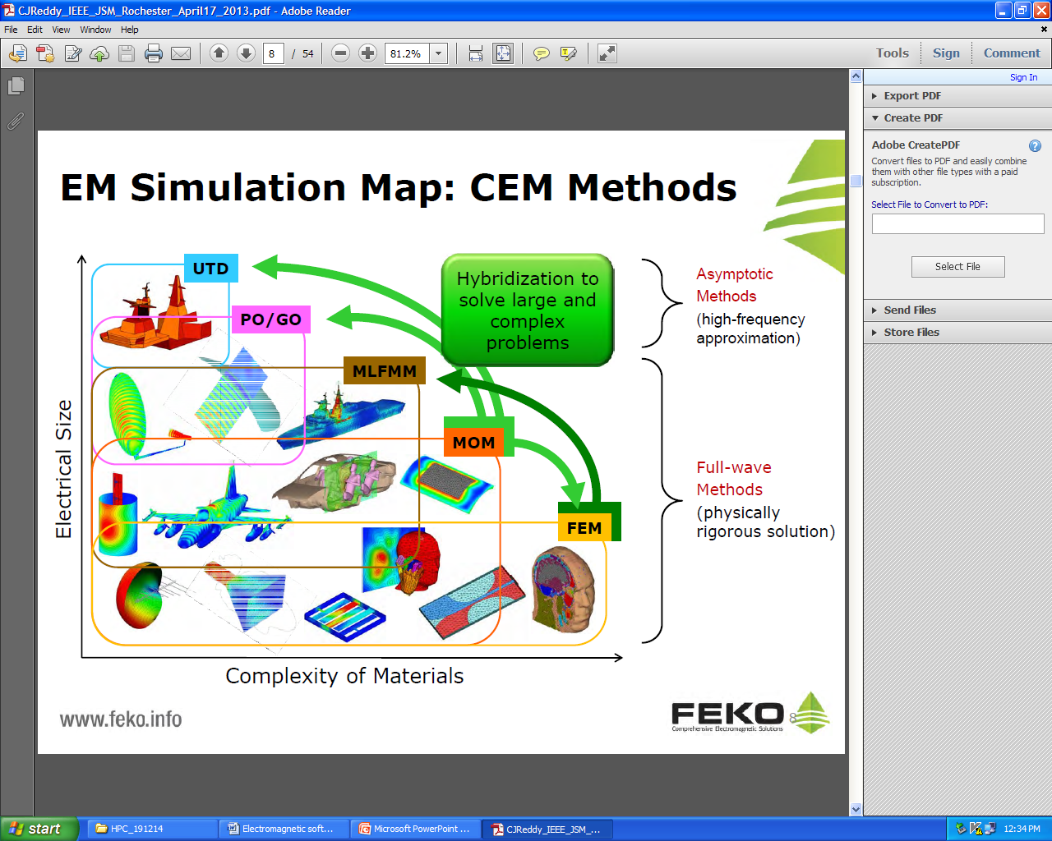
EM SIMULATIOMN : CEM METHODS

Slide 17
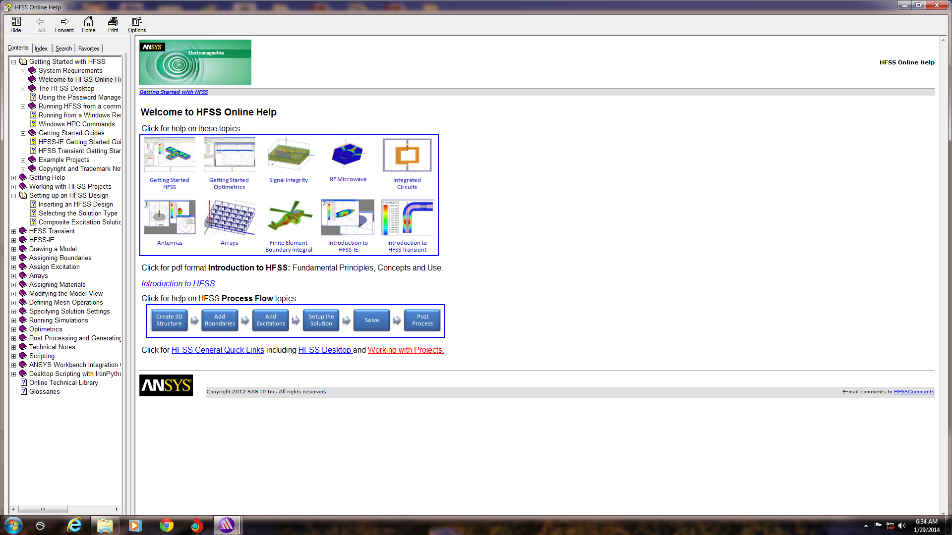
HIGH FREQUENCY STRUCTURE SIMULATOR(HFSS)
HFSS uses the finite element method (FEM) to solve for the electromagnetic fields in the solution region. It meshes over the entire solution volume and solves for the electric field throughout that volume.
The geometric model is automatically divided into a large number of tetrahedrals, where a single tetrahedron is a four-sided pyramid. This collection of tetrahedral is referred to as the finite element mesh
HFSS supports co-simulation of Electromagnetic and mechanical properties such as temperature, structural and fluid dynamic.
Co-simulation with circuit simulator ANSYS Designer
FEBI and PO are used for simulation of electrically large structure

Slide 18
HFSS Features
Computes S-Parameters and full-wave fields for arbitrarily-shaped 3D passive structures
Powerful drawing capabilities to simplify design entry
Excellent Boolean functions: Unite, Subtract, Intersect, Split, Imprint etc.
Excellent Optimetrics tool
Field solving engine with accuracy-driven adaptive solutions
Powerful post-processor for unprecedented insight into electrical performance with Advanced materials
Model Library-including spiral inductors
Calculate far-field patterns
Wideband fast frequency sweep
Create parameterized cross section models- 2D models

Slide 19
Electronic Warfare is a military action involving the use of electromagnetic energy to determine, exploit, reduce, or prevent the hostile use of electromagnetic spectrum as well as action which retains friendly use of electromagnetic spectrum.

Slide 20
CHARACTERISTICS OF EW ANTENNAS
Broad frequency bandwidth
Wide angular coverage
Omni Polarization
Varying Radiation patterns
  Omni- Directional
  Directional
  Shaped beam
Stringent Electrical and Environmental requirements
Tailor made to meet specific requirement
OBJECTIVES OF EW ANTENNAS
Signal Search, Intercept, Monitor & Identification
Direction Finding
Countermeasure action (Jamming)

Slide 21
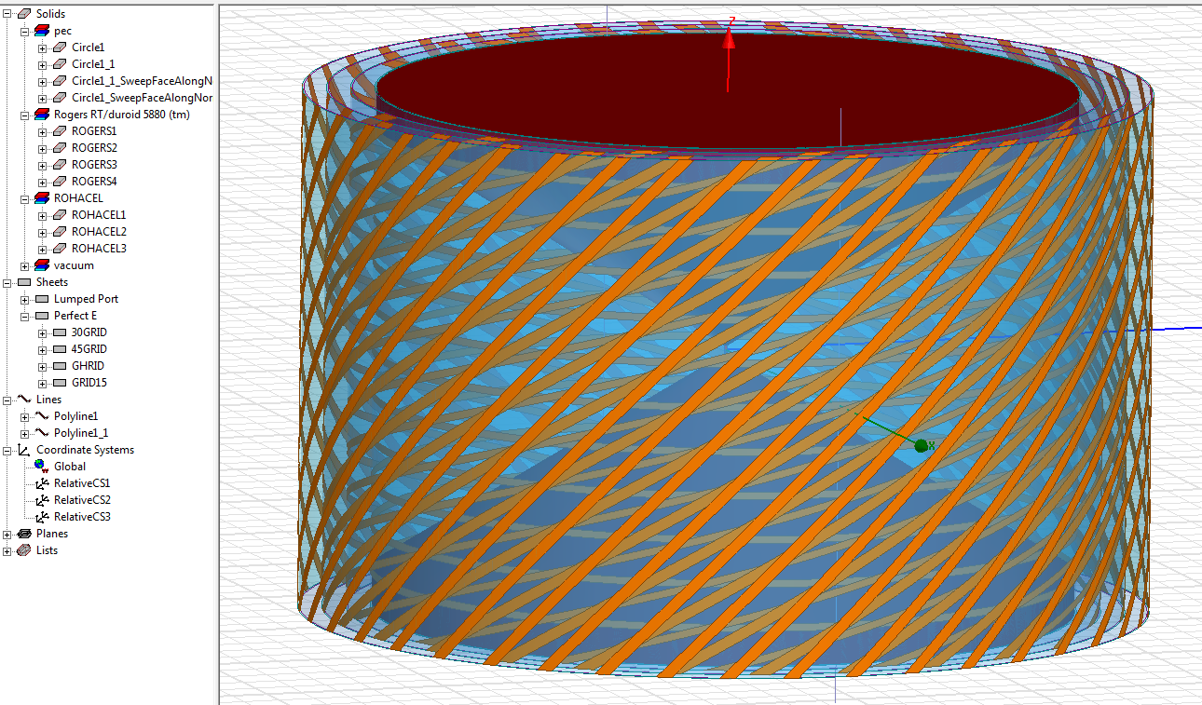
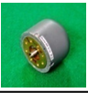
BICONICAL OMNI ANTENNA SIMULATION MODEL

Slide 22
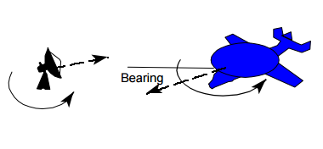
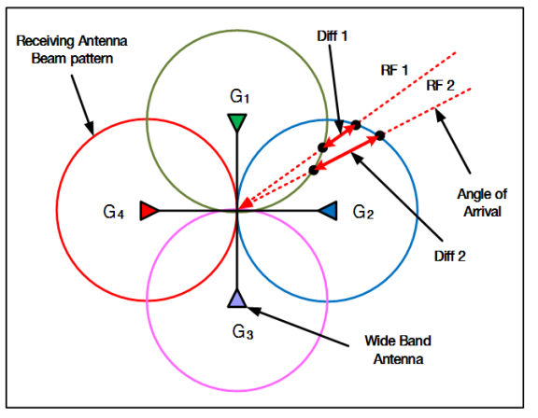
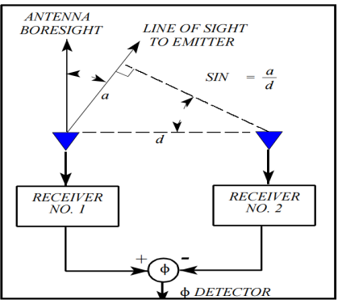
DIRECTION FINDING TECHNIQUES
1. Rotary DF Technique
Simple & Easy to implement
Higher Accuracy & Sensitivity
Slow Response
Low Probability of Intercept
2. Amplitude Comparison
DF Technique: DOA = f (G2/G1)
Wide open
Simple, Lower complexity, Low cost
Small size
Relatively less accurate, 5⁰-7⁰ RMS
3. Phase Comparison Interferometer
DF Technique: DOA = f (∆ Phase)
Wide open
High DF Accuracy, 2⁰ RMS
Higher complexity, High cost
Large size
4. Time Difference of Arrival DF Technique: DOA=f(∆ Time)
  Wide open
Very High DF accuracy – 1º RMS
Less hardware & Cost effective
Gain and phase matched front ends not required
Less susceptible for multi path effects
DoA is independent of frequency
φ = (2π d/λ) sin θ
θ
1
d mtrs
2
T = (d sin θ ) / c

Slide 23
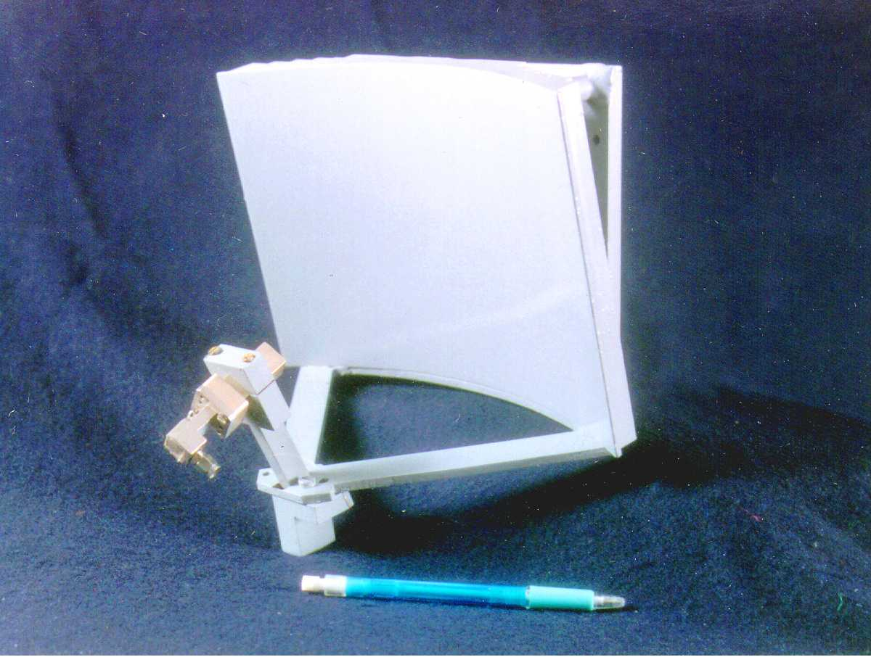
ROTARY DIRECTION FINDING ANTENNAS

Slide 24
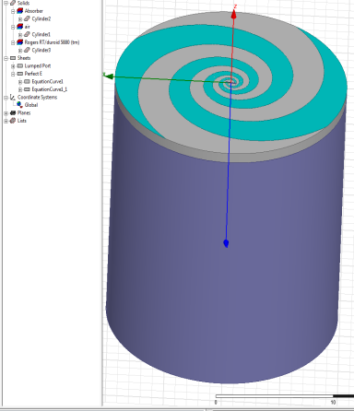
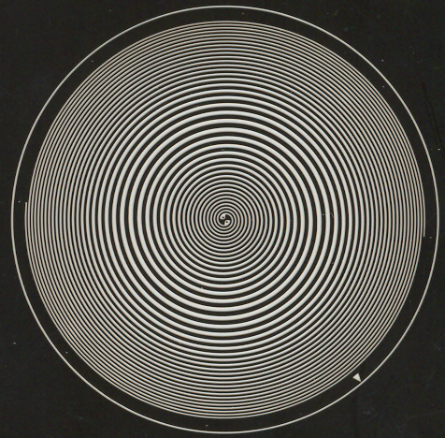
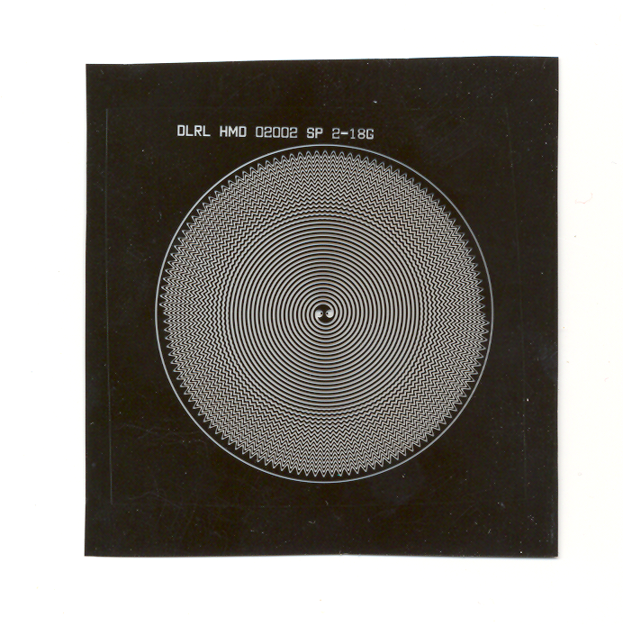
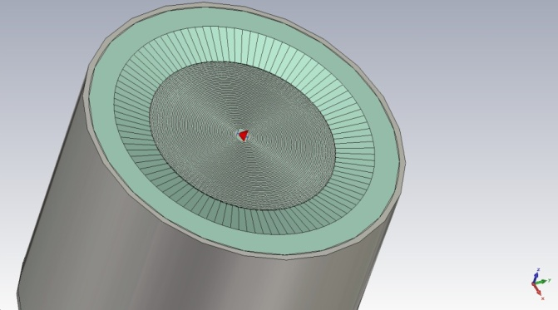
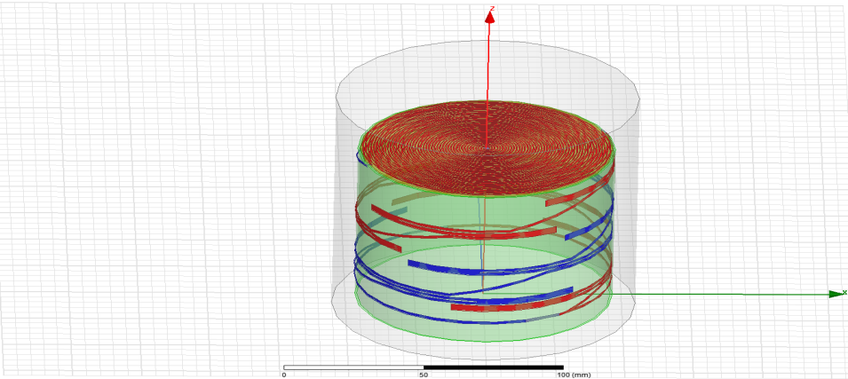
ARCHIMEDEAN SPIRAL ANTENNA
Feature:
Multi Octave Frequency Bandwidth
Circular Polarization
Compact size and weight
Innovative size reduction techniques
Inductive Loading on Expanding Spiral Arms
Dielectric Loading ( Tapered Superstrate)
Composite cavity for better Gain & Phase tracking
Equiangular Spiral Antenna
50 mm dia.
62 mm dia.
Linear Variation
sinusoidal variation
Dielectric Loading with Tapered Superstrate
Helix Spiral Antenna

Slide 25
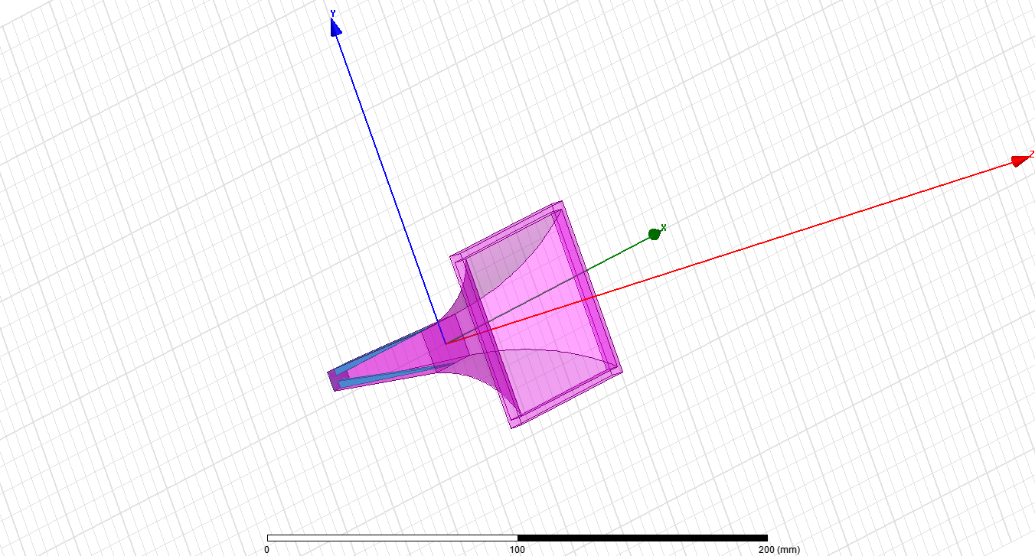
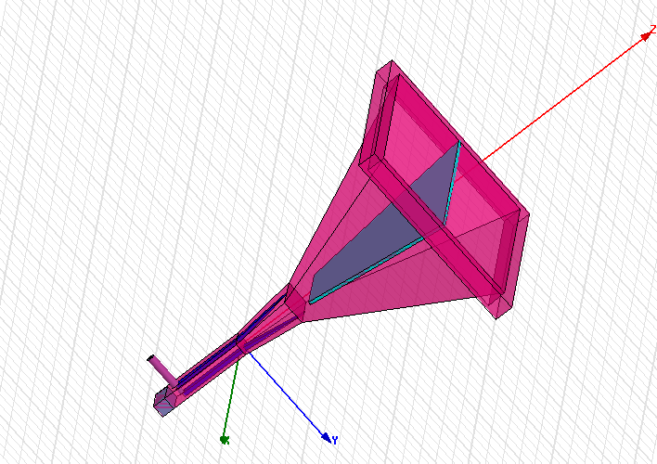
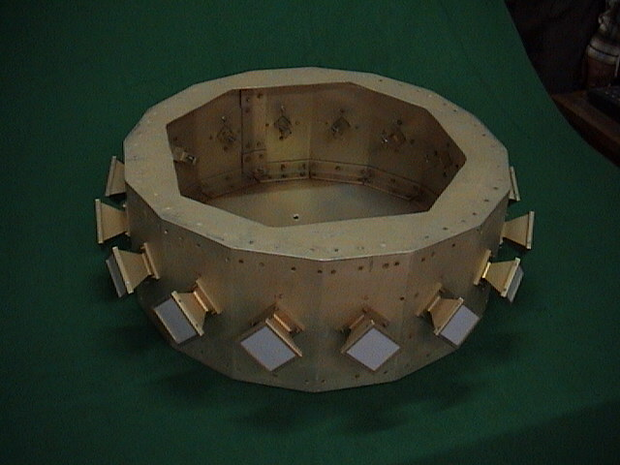
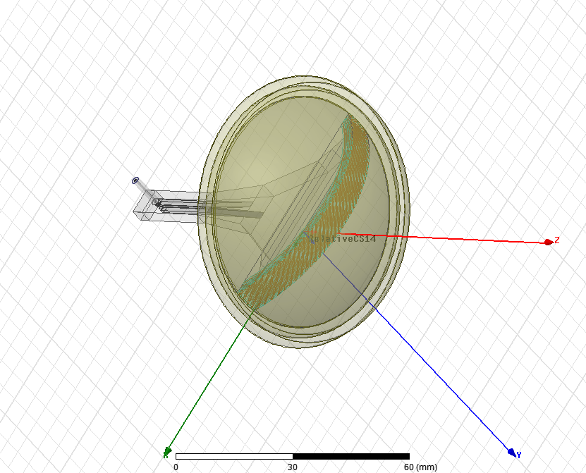





CONSTANT BEAMWIDTH HORN ANTENNA, 6-18 GHz
Simulation Model

Slide 26




FIRST GENERATION JAMMER HORN ANTENNAS
Broad beam Horn
Servo driven Horn Antenna
Fabricated Antenna model
With the flat plate reflector

Slide 27
SECOND GENERATION JAMMER ANTENNAS
Reflector with
Autotrack Horns
Reflector Beam
Autotrack Horn
Beam
Servo driven
Reflector Antenna

Slide 28







MULTI-THREAT SCENARIO
Modern EW system demands
Targeting Data
Wide spectral coverage
High ERP
High POI
Emitter Identification
Threat Warning
Multi Threat Jamming
Wide Angular coverage
Low Reaction Time
Helicopter
Hostile ship
Targeting Data
Targeting Data
Hostile ship
Target ship
Fighter
Antenna sub-system should provide
Broadband performance
High gain
Multi-polarization sensing
High Power Handling Capability

Slide 29




ROTMAN LENS FED MULTI-BEAM LINEAR ARRAY, 6-18 GHz
End-launch fed linear Array
Simulated Model of End-launch Coaxial to Waveguide transition
Simulated Return loss
Sectoral horn Array element
Sectoral horn Array with staggered feed
6 GHz
12 GHz
18 GHz
Simulated Radiation Patterns of Rotman Lens fed End-launch Coaxial to Waveguide transition 16-Element Linear array

Slide 30






ROTMAN LENS FED MULTI-BEAM LINEAR ARRAY,
6-18 GHZ
End-launch fed linear Array & Polarizer
22-Element Linear Array
Polarizer
6 GHz
12 GHz
18 GHz
Measured Radiation Patterns of Rotman Lens fed End-launch Coaxial to Waveguide transition 16-Element Linear array

Slide 31


RADOMES
Solid Wall
A- Sandwich
B- Sandwich
C- Sandwich
Multi-layer
  Radome development is based upon a multi disciplinary team of Engineers like Aeronautic, Radar / EW / Communication, Composite materials, Analysis, Mechanical, Quality

Slide 32









DIFFERENT TYPES OF RADOMES
Cylindrical Radomes
Streamlined Airborne Radomes
Radomes for Blade Antennas
POD Mounted and Airborne Radomes
Hemispherical Radomes
Hemispherical Radome
Radomes for DF Antennas
Submarine Radome

Slide 33
PHASED ARRAY ANTENNAS
“A group of radiating elements in which the relative phases of the respective signals feeding the elements are varied in such a way that the effective radiation pattern of the array is reinforced in a desired direction and suppressed in undesired directions “
NECESSITY OF PHASED ARRAY ANTENNA
Limitations of Mechanical Scanning
Positioning Antenna is relatively slow due to inertia of the antenna.
Increased reaction times.
Mechanical errors
Advantages of Electronic Scanning
Instantaneous Beam Positioning
Rapid Detection, Confirmation and Track Initiation
Rapid Reaction Time
Adaptable Data Rates
Optimum Resource Allocation
Elimination of Mechanical Errors
Multi-mode Operation; Multi-target capability

Slide 34

LINEAR PHASED ARRAY PRINCIPLE
Beam formation in space
Antenna Beam formation is the vector sum of the field contribution from complete aperture

Slide 35
CLASSIFICATION OF ARRAY ANTENNAS
  LINEAR ARRAY
  PLANAR ARRAY
  CONFORMAL ARRAY
  PASSIVE ARRAYS
  ACTIVE ARRAYS
Linear Array : Elements arranged on a Straight line in one dimension
Planar Array : Elements arranged on a Plane in two dimension
( Rectangular, Square or Circular Plane)
Conformal Array : Elements are distributed on a non Planar surface ( Spherical, Conical )
Passive Array : Single Transmitter with multiple radiating elements with Phase shifters
Active Array : Individual Transmitter & Receiver modules for each radiating elements

Slide 36

RADAR SYSTEM CONFIGURATIONS

Slide 37
WIDE BAND PHASED ARRAYS
Requirements
Advanced Features
Wide or Ultra wide bandwidth
High spatial Scan Coverage
High scanning resolution and low beam scanning time
Fine sidelobe control
Beam squint free steering
Multiple contemporaneous beams
Independent control of the different beams
Sum & Difference beam patterns
Physical and Environ mental requirements
Reduced size and Weight
Interference immunity
Antenna conformability to an assigned geometry
Wide operating temperature range
Mechanical Reliability
Other requirements
High Maintainability
High Reliability
Low system cost
Main Issues
Choice of Radiating Element
Choice of T/R Module
Grating lobes Phenomenon
Electromagnetic mutual coupling
Random and Quantization Errors

Slide 38




PHASED ARRAY ANTENNAS
Vivaldi Phased-Array Antenna for Multi-Function Radars
Slotted Waveguide Array for Weather Radar

Slide 39




PHASED ARRAY RADAR ANTENNAS
Radar for Defence System
Anti- Aircraft Defence System
Active Aperture Phased array antenna
Phased Array Radar for Missile Defence System

Slide 40
RECENT TRENDS AND ADVANCES IN ANTENNA TECHNOLOGY
Requirements
Installed Antenna performance onboard platform
Shared Aperture and Multi function
Beam Agility with desired radiation pattern
Conformal antennas
Reconfigurable antennas
Miniaturized Antennas
Body Wearable antennas
Multi frequency/ Wide frequency bandwidth
Modular approach

Slide 41

INSTALLED ANTENNA PERFORMANCE ONBOARD PLATFORM
Antenna pattern perturbations when more number of antennas mounted on Large Platforms like Aircrafts, Ships, Ground Vehicles, UAVs etc.
Antenna pattern perturbation on Antenna Head Units
Antenna placement Studies on Aircrafts and Co-site interference between various sensor antennas on board platforms
Large Antenna Arrays for Shared Aperture systems
Conformal and Load bearing antennas for stealth aircrafts
SOLUTION: USE HIGH
PERFORMANCE COMPUTING

Slide 42


HPC APPLICATIONS IN ELECTROMAGNETICS
Finite Array Antenna

Slide 43





HIGH PERFORMANCE COMPUTING (HPC) in HFSS
Multi-Processing
(MP)
Domain Decomposition
Method (DDM)
Distributed Solver
Option (DSO)
DSO distributes and simultaneously solves
design variations across networked processors

Slide 44

Finite Arrays Analysis with DDM:

Slide 45

Finite Arrays Analysis with FA-DDM:

Slide 46

Finite Arrays Analysis with FA-DDM:

Slide 47



20 x 20 BOR Planar Array Antenna (5-18 GHz)
Finite Arrays Analysis with FA-DDM
20x20 Element Planar Array (5-18 GHz)
Simulation Model
Radiation Pattern
BoR Vivaldi Element

Slide 48





Broadband Arrays for Multifunction EW System
Salient Features:
Body of Revolution (BoR) 3-D Vivaldi Antenna element Broad Frequency Bandwidth covering 5-18 GHz
Wide Angular coverage of ± 45º in Azimuth & Elevation planes
Easy to assemble, disassemble and suitable to connect to active microwave modules
Best suitable for T/R Module based Multi-function Phased Array EW system for Airborne & Shipborne Platforms
BoR Vivaldi Element
16 element BoR Vivaldi Linear Array
BoR Vivaldi Planar Array
Antenna (16 x 16)
BoR Vivaldi Planar Array
Antenna (8 x 4)
Measured Scanned Radiation patterns
of BoR Vivaldi Linear Array (16 x 1)

Slide 49



SHARED APERTURE/ MULTIFUNCTION ANTENNA TECHNOLOGY
Shared aperture antennas are a new class of phased array antennas that combine the functionality of several antennas into one single aperture using wideband multiple beam technology.
Multifunction antennas facilitate increase in number of functions, reduce platform radar signature (or RCS), enhance platform survivability, reduced cost & weight

Slide 50




INTEGRATED MAST FOR SHIPBORNE EW SYSTEMS
This mast type integrates the sensors into the structure itself
Benefits
Better operational performance
Reduced ship-building time
Reduced signature / increased arc of coverage
Reduced costs
Reduced topside weight / improved stability
Reduced EMI – RAM covered decks
Potential for quick role changes – flexibility, upgradeability

Slide 51


CONFORMAL ANTENNAS
A conformal antenna is an antenna that conforms to a prescribed shape. The shape can be some part of an airplane, high speed train, or other vehicle.
An antenna that conforms to a surface whose shape is determined by considerations other than electromagnetic, for example, aerodynamic or hydrodynamic.
Salient features
Uniquely thin, unobtrusive profile & reduced size
Improved performance
Conformal Mounting – less aerodynamic drag
Low Visual and Radar signatures (RCS)
Conformal array antenna for aircraft wing integration
Disadvantages
Complex antenna designs
Difficult to realize broadband conformal antennas
Complexity in control of antenna characteristics like Amplitude, Phase, Polarization
A conical conformal array for data communication from a satellite

Slide 52
ANTENNA MINIATURIZATION TECHNIQUES
Loading the antennas
Modification and optimization of antenna
geometry and shape
Using artificially engineered electromagnetic
materials (metamaterials)
Using formal optimization methods
(Genetic algorithms etc.)

Slide 53







MINIATURIZATION VIA SHAPING
Extensively used technique
Many shaping approaches
Bending
Folding
Meandering
helical
Spiraling
fractal folding
Slot loading
Slot Loading
RFID Meanderline
Antenna

Slide 54

FRAGMENTED APERTURE ANTENNA FOR ULTRA BROAD BAND APPLICATIONS
Features and Benefits
Ultra wideband upto 100:1 bandwidth
Computer based design
Taking advantage of the mutual coupling to achieve extremely wide bandwidth
Ease of fabrication using planar printed circuit
Light weight
Fragmented aperture antenna covering (300mhz-10ghz)

Slide 55
PIXEL ADDRESSABLE RECONFIGURABLE CONFORMAL ANTENNA

Slide 56

PIXEL ADDRESSABLE RECONFIGURABLE CONFORMAL ANTENNA

Slide 57
NANO ANTENNAS
Finding energy sources to satisfy the world’s growing demand is one of the society’s challenges for the next half century.
The world now uses energy at a rate of approximately 4.1x10²⁰ J/yr, equivalent to continuous power consumption of 13 trillion watts. The demand may reach 40 TW by end of century.
Suitable actions aimed at reducing the dependence on the fossil fuels are needed.
The search for clean and renewable alternative energy resources is one of the most urgent challenges to the sustainable development of human civilization.
Our primary source of clean and abundant energy is sun. About 120,000TW of radiations from sun reach earth’s surface far exceeding human needs
Nan antennas may prove useful for converting solar radiation to electricity

Slide 58


NANTENNA TECHNOLOGY
The current flow is toward the antenna feed point.
In a balanced antenna, the feed point is located at the point of lowest impedance The E-field is clearly concentrated at the center feed point.
This provides a convenience point to collect energy and transport it to other circuitry for conversion.
Right shape, materials and size the simulated nano antennas could harvest upto 92% of energy at infrared wavelength.

Slide 59






NANO ANTENNAS
Benefits and Applications
Addresses many limitations of PVs
Utilize untapped infrared parts of spectrum
Can be inexpensively mass produced
Many Diverse Applications:
  Nan antenna “skins”
  Can be ‘tuned’ to concurrently harvest multiple energy sources
  Economically scales to large infrastructure (homes, businesses)
Requires technology advances in THz
electronics. Projected 3-5 years R&D cycle.
Notes:
Can conform or be embedded on product surfaces

Slide 60



GRAPHENE NANO-ANTENNAS
Small size of the developed graphene-based nano-antennas and nano-transceivers allows them to be embedded into novel nano-machines.”
These can be incorporated into biological and chemical nano-sensors to ultimately create Wireless Nano Sensor Networks (WNSNs), with applications in advanced health monitoring systems
The size of the individual wireless nano sensor would allow the integration of WNSNs in virtually everything, from the fabrics of our clothing to the coating of a vehicle, or even inside the human body.”

Slide 61


BODY WEARABLE ANTENNAS
Requirements
Soldiers in the field need to communicate many different types of information like global positioning information, voice signals, video, and technical data.
Limitations of Present antennas
handheld radio antennas used by soldiers are narrowband
These traditional antennas are clumsy, and tend to snag on trees and bush.
They provide a visible identifier that can distinguish the radio operator and make them vulnerable to a sniper whose main goal is to disrupt communications and control.
Radio operators also has risk being exposed to electromagnetic fields
Features of Body Wearable Antennas
Ultra-broadband antenna integrated into a garment
Includes radiation absorber material to minimize radiation hazards to the wearer.
Does not provide a visual indicator for potential snipers.
Wearable helmet antenna.
Wearable UWB antenna

Slide 62
TRENDS IN ANTENNA MANUFACTURING

Slide 63
3D METAL PRINITNG TECHNOLGY
3D metal printing has certain advantages over injection moulding and traditional machining
It can yield more complex parts and can accommodate small quantities more cheaply and quickly than injection moulded plastics.
They also have an ultra low coefficient of thermal expansion.
Because 3D printing is an additive, rather than subtractive manufacturing process, it can reduce machining time and the resulting waste, saving resources, money, and manufacturing time.
Using 3D printing also enables to design antennas with components that are very different from those produced through traditional manufacturing technologies.
In many cases, previously complex assemblies of parts can be printed into a single integrated unit. This allows the part to be more mass efficient and optimized for its intended function.
Quality is also significantly improved due to the elimination of workmanship-dependent assembly steps, such as bonding and fastening.

Slide 64



METAL 3D PRINTING VIVALDI PLANAR ARRAY USING BOR ELEMENT

Slide 65


3D PRINTED ANTENNAS
Fractal Antennas
3D Metal Printing

Slide 66

3D PAD PRINTING
Pad printing 3D antenna manufacture technology offers versatile and cost effective interconnection platform compared to the flex-antenna or sheet metal technologies
The unique properties of the silicon pad enable it to pick the image up from a flat plane and transfer it to a variety of surface (i.e. flat, cylindrical, spherical, compound angles, textures, concave surfaces, convex surfaces).
Today, pad printing is a well established technology covering a wide spectrum of industries and applications

Slide 67

3D AEROSOL JET PRINTING
Mobile device antennas including LTE, NFC, GPS, Wifi, WLAN, and BT have been printed using the Aerosol Jet process.
Measured antenna performance is comparable to other production methods.
The Aerosol Jet printing process is scalable – antennas can be printed on up to 4 cases simultaneously on a single machine.
Machine throughput for a typical antenna pattern measuring ~300 mm2 averages 30,000 units per week.
Aerosol Jet Printing Process Highlight for Antennas
Low cost – no plating, simplified logistics
Standard plastics – no additives or coating
Digital process– flexible, no hard tooling
Environment friendly – no harsh chemicals
Health Benefits – no exposure to Nickel
Scalable – prints up to 4 cases simultaneously
High Machine output – average 30,000 units/week
Antenna performance – comparable to other methods
The Aerosol Jet printer lower manufacturing costs for antennas used in mobile devices.

Slide 68
ANTENNA MEASUREMENTS

Slide 69
ANTENNA MEASUREMENTS
_{IMPEDENCE}
_{MEASUREMENTS}
_{RADIATION PATTERN}
_{MEASUREMENTS}

Slide 70
IMPEDANCE MEASUREMENTS
_{BRIDGE MEASUREMENTS}
_{SLOT LINE}
_{MEASUREMENTS}
_{NETWORK ANALYSER HP 8722 D}
_{<30Mc}
_{>1000MC}
_{50MHz-40GHZ}
_{(SINGLE FREQUENCY)}
_{(SINGLE FREQUENCY)}
_{(SWEPT FREQUENCY)}

Slide 71
ANTENNA RANGES
An antenna range is a facility where antenna radiation characteristics are measured. An antenna range includes the following typical components:
A substantial space for hosting the test antenna and the source antenna
A source antenna
An antenna positioner
A transmitter and receiver system (e.g. a Network Analyser)

Slide 72
RADIATION PATTERN
MEASREMENTS
NEAR FIELD MEASUREMENTS
FAR FEILD
PLANAR NEAR FIELD
CYLENDRICAL NEAR FIELD
SPHERICAL NEAR FIELD
FREE SAPACE
RANGE
REFELCTION
RANGE
ELEVATED RANGE
SLANT RANGE
COMPACT RANGE
ANECHOIC CHAMBER
GROUND REFLECTION RANGE
TAC AT LOW FREQUENCY

Slide 73

ANTENNA TEST RANGES

Slide 74





COMPACT ANTENNA TEST RANGE

Slide 75
CONCLUSION
Antenna plays a very significant and decisive role in any Electronic system
Its performance influence the accuracy and effectiveness of Electronics systems
Antenna characteristics like wide frequency bandwidth, high gain, shaped radiation patterns, all polarization response and cost effectiveness are important for EW applications
Different type of antennas for the EW , Radar, Communication and trends in antenna technology for different applications is presented.
Antenna field is changing very fast and continuous research is on, around the world for more efficient, smaller size, light weight, cost effective alternatives to the existing one
So, Back in 21st Century, Life of antenna designer was relatively easy, but today challenges are tough….
… and there is lot of work still to be done with antennas

Slide 76
Thanks
for your attention

Slide 77

QUESTIONS

