Slide 1
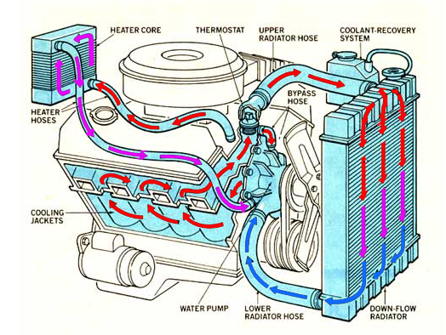
COOLING SYSTEM
The basic purpose of a cooling system is to keep the engine at an appropriate operating temperature.
In other words, the cooling system is provided to dissipate the heat developed due to engine operation and the combustion process and to cool the engine to a suitable temperature so that any of the parts of the engine is prevented from over heat.

Slide 2
Reasons for Cooling
to promote a high volumetric efficiency
to ensure proper combustion, and
to ensure mechanical operation & reliability.
Effect of Over-cooling
the thermal efficiency is decreased due to more loss of heat carried by the coolant
the vapourization of the fuel is less resulting in lower combustion efficiency
low temperature increases the viscosity of lubricant causing more loss due to friction.

Slide 3
Types of Cooling System
Air cooling (or direct cooling) system
Liquid cooling (or indirect cooling) system
Remark: engines
Aviation
engines, motor
cycle
and scooter engines are air
and
cooled; while the stationery
automobile engines are liquid cooled.

Slide 4
Air cooling system
Air cooled engines depend on airflow across their external surfaces of the engine cylinders to remove the necessary heat. The amount of heat dissipated depends upon:
the area of cooling surface in contact with the air
mass flow rate of air
temperature difference between cylinder and air and
conductivity of metal.

Slide 5
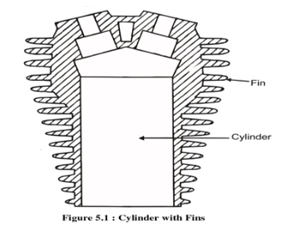
Cooling fins in air cooled system
The area of cooling surface is increased by forming thin fins, either integrally by machining them on the outer walls of the engine cylinder and cylinder head or by attaching separate fins to them.

Slide 6
Air cooling system - Advantages
The absence jackets, coolant engine lighter.
of radiator, cooling and pumps make the
The engine can be
operated in cold
climate where liquid may freeze.
In places where water
is scarce, air
cooled engine is an advantage.
Handling of liquid coolant
requires
piping and pumping auxiliaries.
Air cooled engines have no leakage or freezing problems.
coolant

Slide 7
Air cooling system - Disadvantages
Relatively large amount of power is used to drive the cooling fan.
Engines give low power output.
Cooling fins under certain conditions may vibrate and amplify the noise level.
Cooling is not uniform.
Engines are subjected to high working temperature.

Slide 8
Liquid cooling systems - Types
Thermosyphon system
Forced circulation cooling system
Evaporative cooling system

Slide 9
Thermo-syphon system
In this system, a fan
rotated by the crankshaft
Radiator
draws cold air from outside through the radiator. The radiator is connected to
Cylinder
the engine block by
means of two pipes. The
hot water passes through some thin pipes built in the
Piston
radiator, cooled. circulates
where it gets
Thus, the
fluid
through the of
system in the form
convective currents.
Schematic diagram of a thermosyphon system

Slide 10
Forced circulation cooling system
This system is used in a large number of vehicles like cars, buses, trucks and other heavy vehicles. Here, circulation of water takes place with convection currents helped by a pump.
The water or coolant is circulated through jackets around the parts of the engine to be cooled, and is kept in motion by a centrifugal pump, driven from the engine. A thermostat is
used to control the water temperature required for cooing.
Schematic diagram of a forced circulation system

Slide 11
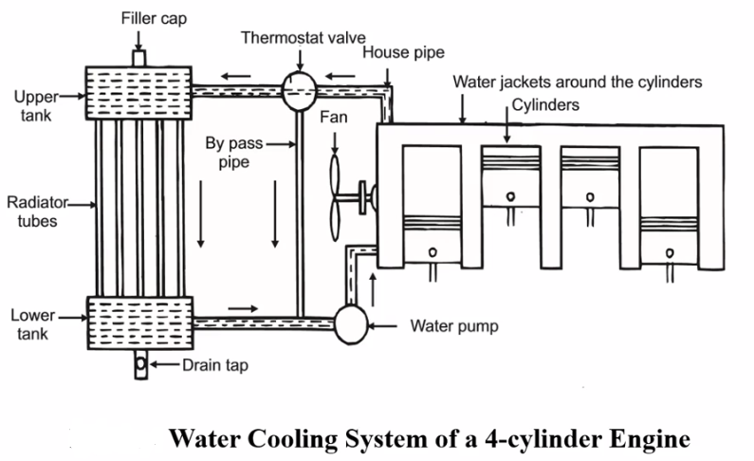
Pump-cooling or forced cooling
Pump is introduced between radiator and engine block
Rotated by crankshaft by means of a belt
Water is circulated with force => heat is removed quickly
Limitation
Cooling is independent of temp. =>Engine is overcooled (range of temp.=75-90⁰C)

Slide 12
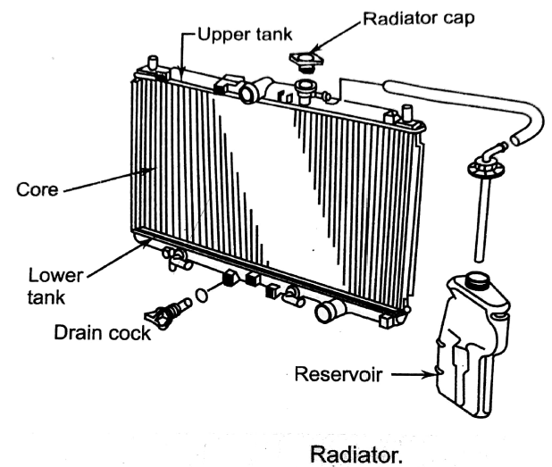
Parts of cooling systems:
Radiator:
A Radiator very efficiently lower the temperature of the coolant passing through it.
It consists of mainly three parts: 1) upper tank , 2) lower tank and 3) heat radiating core.
The upper and lower tanks are joined by the core.
The upper tank contains a neck through which coolant enters into the radiator, and over flow pipe is connected to the side.
The upper and lower tanks are usually made from plastic to make lighter.
The core is made from copper or brass.

Slide 13
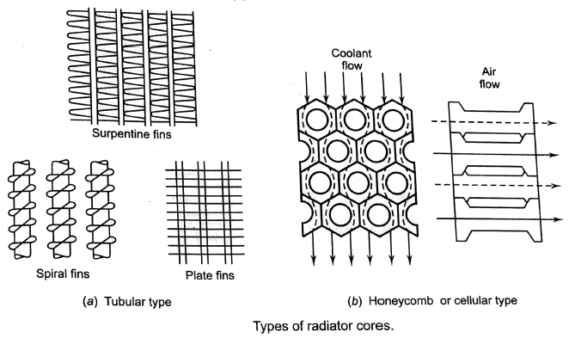
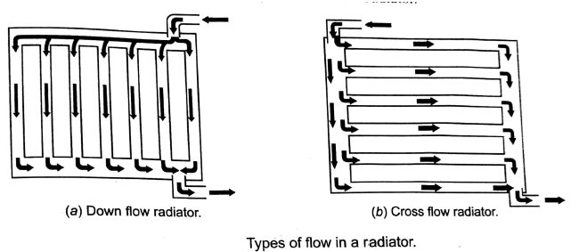
Types of Radiator:
1) According to the construction of cores: the radiators according to the construction of cores are of two types: 1) tubular type, 2)honeycomb or cellular type.
2) According to the direction of coolant flow:

Slide 14
Materials for radiator:
Good corrosion resistance
Good thermal conductivity
Must possess the required strength
Must be easily formable
Yellow brass, copper are used
Aluminium is used where weight is critical

Slide 15
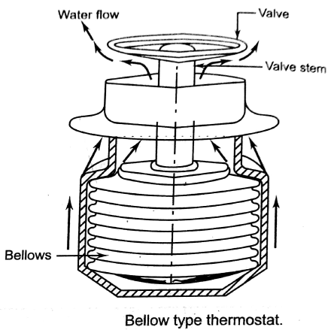
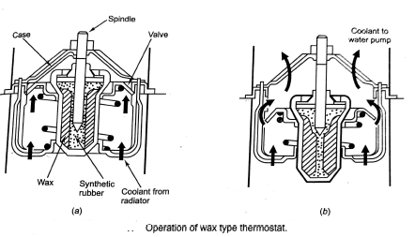
Thermostat:
1) Bellow type thermostat:
It consist of closed bellow, which is filled with a volatile liquid(like alcohol, ether or acetone).
As the bellow get hot, the liquid vaporizes and the bellow expand.
This sets in operation a linkage opening the valve.
when the bellows are cold, they contract and the close valve this stopping the circulation of the coolant through the radiator.
2) Wax type thermostat:

Slide 16
Cooling fan
Maintain an adequate air radiator matrix.
flow across the
Serves the purpose when natural draft is not sufficient to cool e.g., at low speed but heavy load, when vehicle ascends uphill etc.
Driven by a belt run by crankshaft.
Limitations
Rising level of noise.
Increasing power consumption with engine speed.
Tendency to overcool.
Cooling fan

Slide 17
Cooling fan

Slide 18
Liquid cooling system - Advantages
Because of even cooling of cylinder barrel and head (due to jacketing) makes it possible to reduce the cylinder head and valve seat temperatures.
The volumetric efficiency of water cooled engines is higher than that of air- cooled engines.
Compact design of engines with appreciably smaller frontal area is possible.
In case of water cooled engines, installation is not necessarily at the front of the mobile vehicles, aircraft etc. as the cooing system can be conveniently located.

Slide 19
Liquid cooling system - Disadvantages
The system requires more maintenance.
The engine performance becomes sensitive to climatic conditions.
The power absorbed by the pump is considerable and affects the power output of the engine.
In the event of failure of the cooling system serious damage may be caused to the engine.

Slide 20
Use of Anti-freezers
During winter or when the engine is kept out of operation in cold places, the cooling water in the cylinder jackets, radiator tanks and leading pipes will freeze, expand and lead to their fracture. To prevent damage to the engine and radiator during winter weather, suitable liquids or compound substances (known as anti-freezers) which go into solution are added to the water to lower the freezing temperature of the coolant.
Ethylene glycol is the most widely used automotive cooling-system antifreeze, although methanol, ethanol, isopropyl alcohol, and propylene glycol are also used.

Slide 21
Requirements of anti- freezers
They should thoroughly mix with water.
They should not corrode the surfa ces with which they are in conta ct.
Their boiling point should be high so that the loss due to evaporation is minimum.
They should not deposit any foreign matter in the jackets, hose, pipes or radiator.
It should be chemically stable, a good conductor of heat, and a poor conductor of electricity.

Slide 22
Conclusions
A cooling system must be provided not only to prevent damage to the vital parts of the engine (due to high temperature), but the temperature of these components must be maintained within certain limits in order to obtain maximum performance from the engine. To keep the cylinders from overheating, they are surrounded with a water jacket on liquid cooled engines, or with a finned surface in air cooled engines. Most small and medium sized engines used in two-wheelers, automobiles, aircraft are air cooled, while the stationery and some automobile engines are liquid cooled.

Slide 23
Conclusions
A typical automotive cooling system comprises:
a series of channels cast into the engine block and cylinder head, surrounding the combustion chambers with circulating water or other coolant to carry away excessive heat
a radiator consisting of many small tubes equipped with a honeycomb of fins to radiate heat rapidly, that receives and cools hot liquid from the engine
a centrifugal-type water pump to circulate coolant
a thermostat that maintains constant temperature by automatic ally varying the amount of coolant passing into the radiator, and
a fan, which draws fresh air through the radiator.

