Slide 1



Slide 2
WHAT IS A DISASTER ?
A disaster is a natural or manmade event which results in widespread human loss, loss of livelihood, property and life.
An event that has unfortunate consequences.
Natural Disaster can be classified as follows:
Atmospheric Terrestrial Aquatic Biological

Slide 3
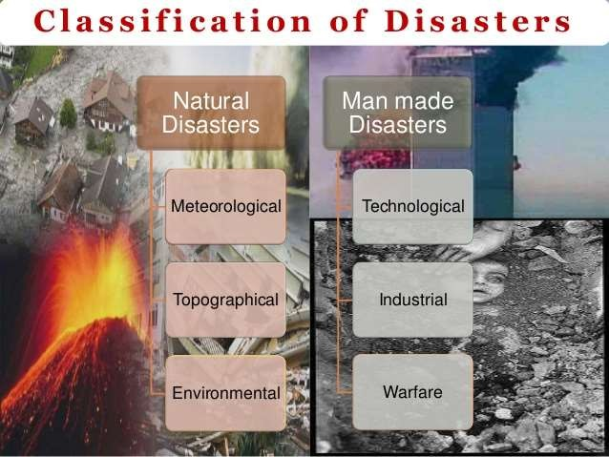

Slide 4
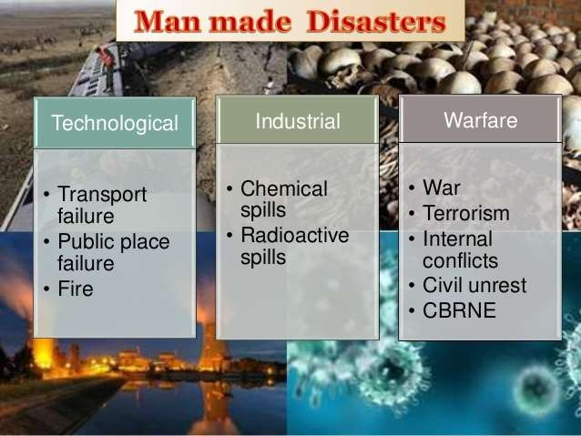

Slide 5
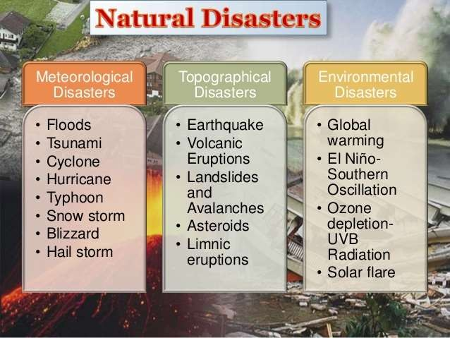

Slide 6
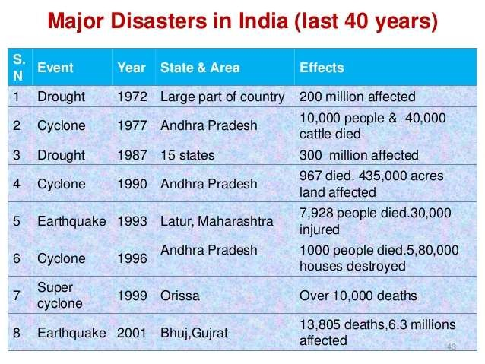

Slide 7
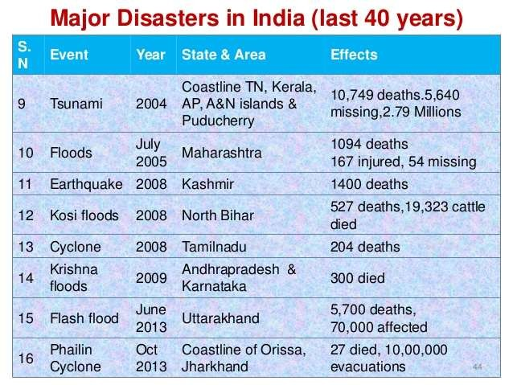

Slide 8
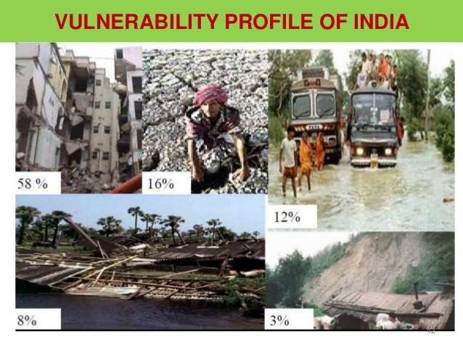

Slide 9
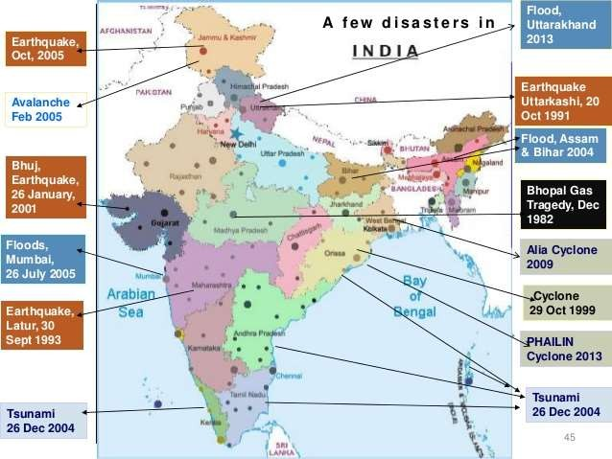

Slide 10
EARTHQUAKE
In India, more than 1200 earthquakes have occurred. Based on this, India is divided into five earthquake zones :
  Very high damage risk zone
  High damage risk zone
  Moderate damage risk zone
  Low damage risk zone
  Very low damage risk zone

Slide 11
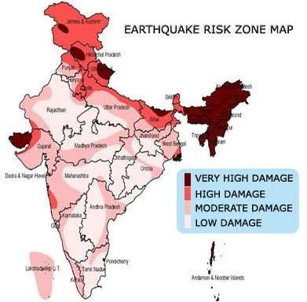
EARTH QUAKE RISK ZONE IN INDIA

Slide 12
EARTH QUAKE HAZARD MITIGATION
Establishing earthquake monitoring centres (seismological centre) for regular monitoring. Use GPS (Geographical Positioning System) for monitoring the movement of tectonic plates.
Prepare vulnerability map of country and educate the people of that area on minimizing the impact of disaster management.
Discouraging constructions of high rise building
Adopt earthquake resistant designs and use light material for construction.

Slide 13
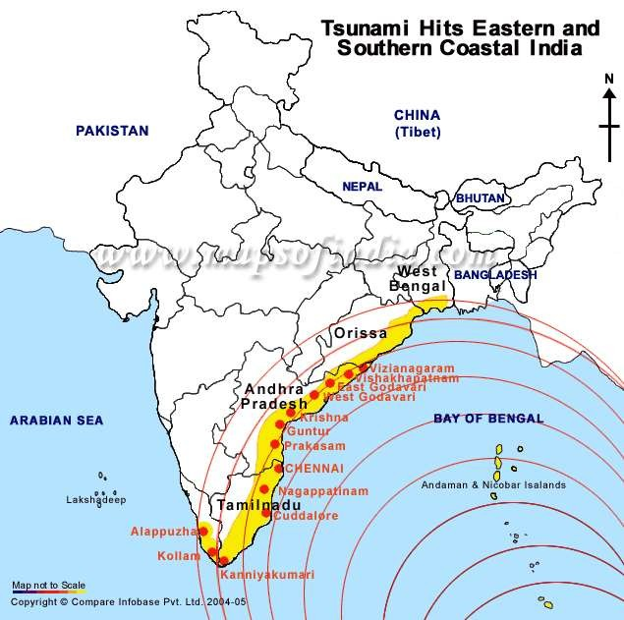

Slide 14
TSUNAMI
The biggest tsunami ever happened at lituya bay, Alaska on July 9,1958. The mega tsunami was around 150 meters tall.
The tsunami caused by 2004 Indian ocean earthquake, is the 6th deadliest natural disaster in recorded history with a death toll of 2,30,210 – 2,80,000

Slide 15
NATIONAL TSUNAMI HAZARD MITIGATION PROGRAM
(NTHMP)
The National Tsunami Hazard Mitigation Program (NTHMP) is a Federal and State program designed to protect people and reduce property losses in the event of a tsunami.
Led by the National Oceanic and Atmospheric Administration (NOAA), the NTHMP consists of other primary participants , including the Federal Emergency Management Agency (FEMA).

Slide 16
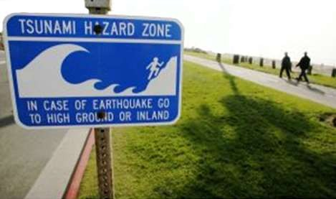
TSUNAMI MITIGATION PROGRAM
Guidance for producing consistent and accurate tsunami inundation and evacuation zones
Tsunami hazard guidance/products for maritime, land-use, and recovery planning
Annual national tsunami exercises to test and update response plans and improve the effectiveness of the warning system
National Tsunami Education and Outreach Action Plan

Slide 17
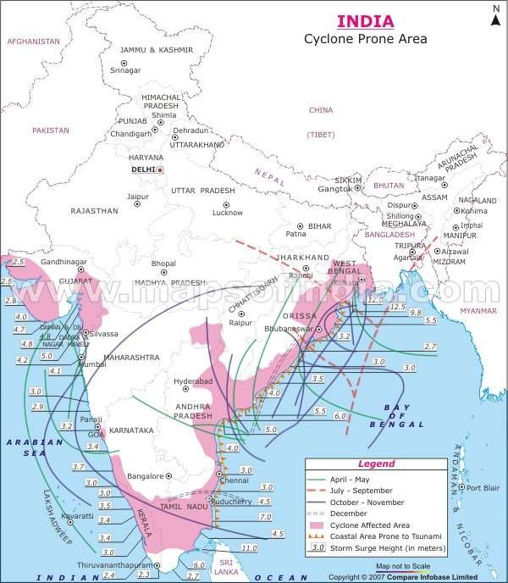

Slide 18
NATIONAL CYCLONE RISK MITIGATION PROJECT
(NCRMP)
improved early warning dissemination systems
enhanced capacity of local communities to respond to disasters
improved access to emergency shelter, evacuation, and protection against wind storms, flooding and storm surge in high areas
strengthening DRM capacity at central, state and local levels

Slide 19
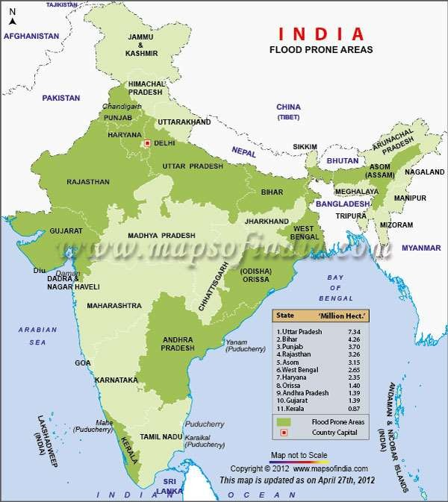

Slide 20
EXISTING FLOOD MANAGEMENT MECHANISMS IN INDIA
Central Water Commission (CWC)
Brahmaputra Board
Ganga Flood Control Commission
Farakka Barrage Project Authority
National Disaster Management Authority (NDMA)

Slide 21
GOVERNMENT’S POLICIES ON FLOODS
Policy Statement – 1954
High Level Committee On Floods – 1957 & Policy Statement of 1958
National Flood Commission (Rashtriya Barh Ayog) – 1980.
Expert Committee to Review the Implementation of the Recommendations of National Flood Commission-2003 (R Rangachari Committee)
National Water Policy ( 1987/ 2002/2012)

Slide 22
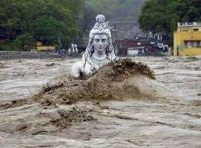
GENERAL FLOOD MANAGEMENT MEASURES PRACTICED
IN INDIA
An artificially created reservoir behind a dam across a river
Channelization of river.
Artificially raised embankments that reduce spilling
Channel and drainage improvement works, which artificially reduce the flood water level

Slide 23
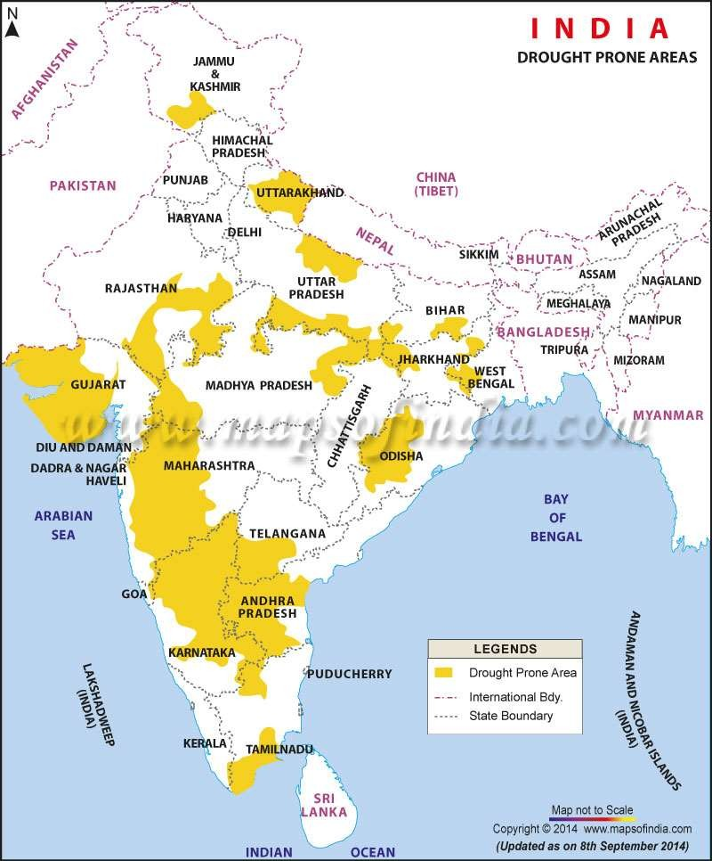

Slide 24

GUIDELINES ON MANAGEMENT OF DROUGHT
Creation of Drought Monitoring Cells (DMCs) cells at state level
Preparation of vulnerability maps for each state
Development of real-time drought related information by using information and communication technology.
The watershed development approach would be taken up
for drought management

Slide 25
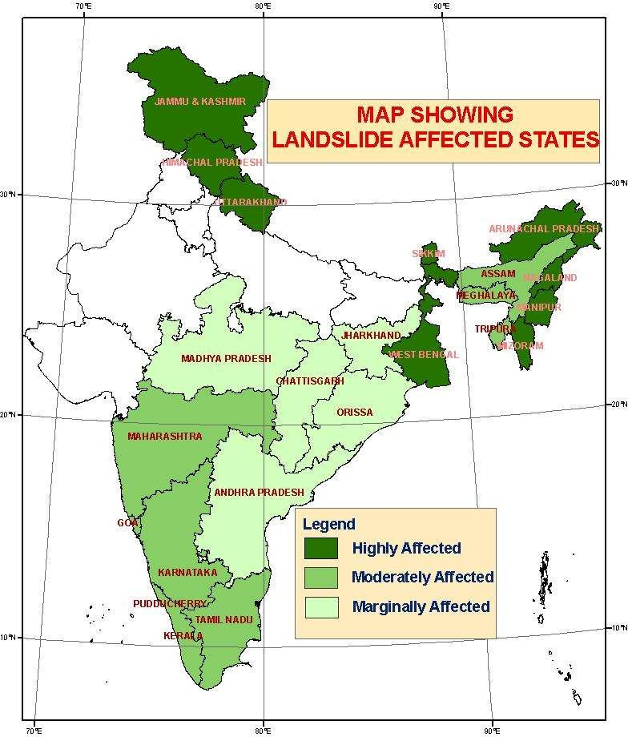

Slide 26
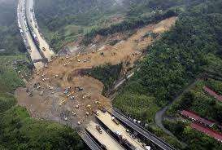
MEASURES TO PREVENT LANDSLIDE
Improving surface and subsurface drainage
Excavating the head
Buttressing the toe
Constructing piles and retaining walls

Slide 27

AVALANCHE PREVENTIVE MEASURES
Afforestation of avalanche prone area.
Trapping the avalanche by control measures.
Disposing the avalanche potential snow packs by artificial triggering
Predicting the occurrence of avalanches and issuing
warning.
Guiding the residents about the emergency evacuation shelters.

Slide 28
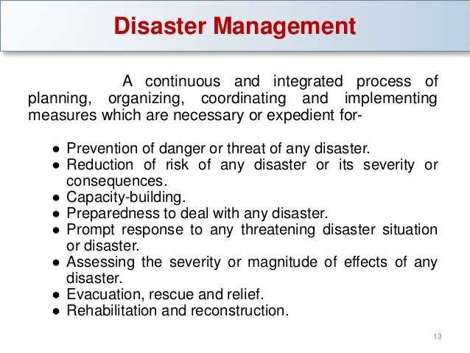
DISASTER MANAGEMENT

Slide 29
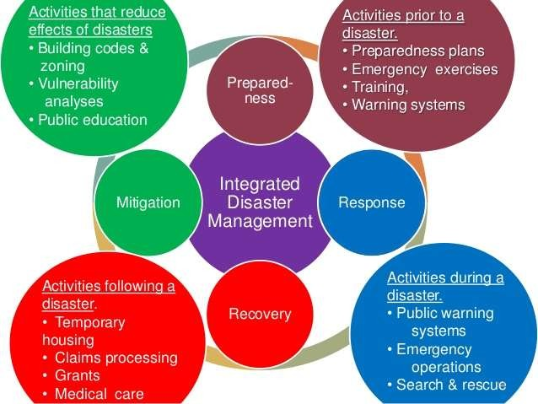

Slide 30
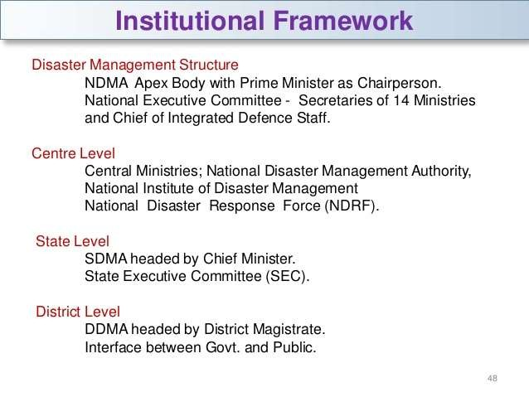

Slide 31
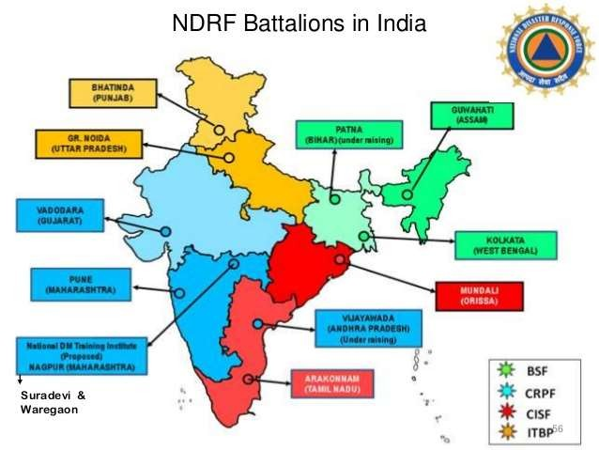

Slide 32
ROLE OF DISTRICT COLLECTOR
Collector has the responsibility for the over all
management of disaster in the district
All departments work under the leadership of the collector except metropolitan areas
He also enjoys the authority to request for assistance from the armed force.

Slide 33


