Slide 1
The back to back connection of two fully controlled converters across the load circuit is named as Dual converter.
The single phase full converters allow only two quadrant operation with inductive loads to extend the operation to four quadrant the dual converters are used.
Dual converters are suitable for high power applications but not for low power applications.

Slide 2
There are two functional modes: Non-circulating current mode and circulating mode
Non Circulating Current Mode
One converter will perform at a time. So there is no circulating current between the converters.
During the converter 1 operation, firing angle (α₁) will be 0<α₁< 90º; V_{dc} and I_{dc} are positive.
During the converter 2 operation, firing angle (α₂) will be 0<α₂< 90º; V_{dc} and I_{dc} are negative.

Slide 3
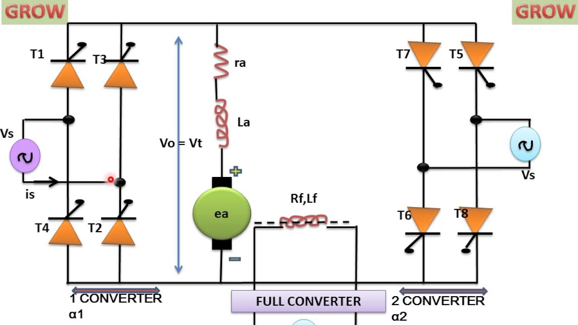

Slide 4
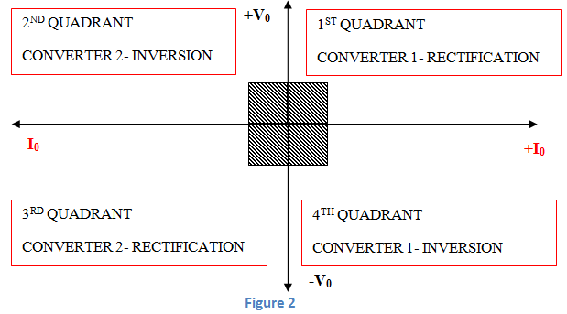

Slide 5
Circulating Current Mode:
Two converters will be in the ON condition at the same time. So circulating current is present.
The firing angles are adjusted such that firing angle of converter 1 (α₁) + firing angle of converter 2 (α₂) = 180º.
Converter 1 performs as a controlled rectifier when firing angle be 0<α₁< 90º and Converter 2 performs as an inverter when the firing angle be 90º<α₂< 180º. In this condition, V_{dc} and I_{dc} are positive.
Converter 1 performs as an inverter when firing angle be 90º<α₁< 180º and Converter 2 performs as a controlled rectifier when the firing angle be 0<α₂< 90º In this condition, V_{dc} and I_{dc} are negative.

Slide 6
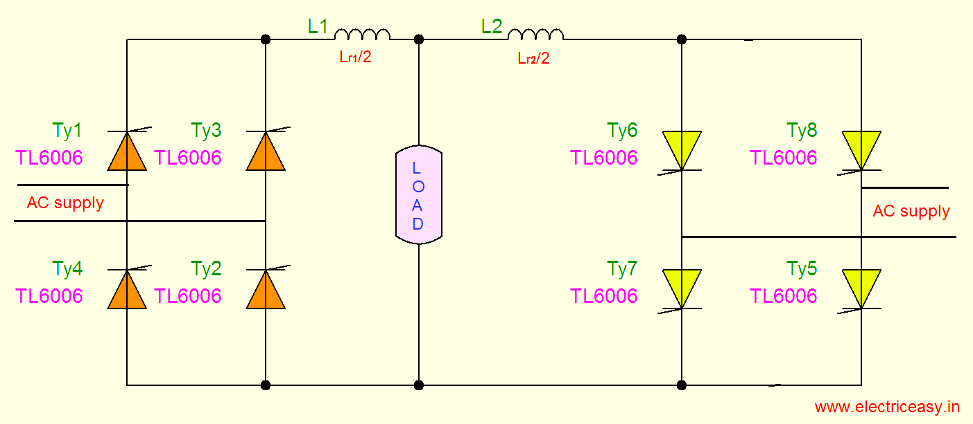

Slide 7
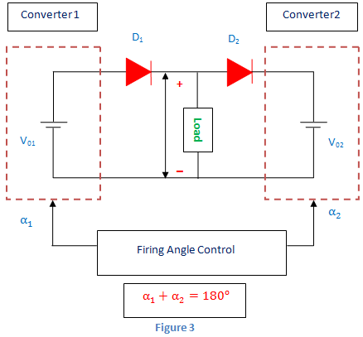

Slide 8
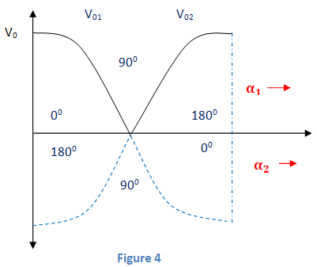

Slide 9
The dual converters consists of two full converters one with positive and another with negative output voltages.
*for highly inductive load the dual converters will operate in four quadrant with continuous current mode.
The delay angle varies from 0 to +2Vm/π, -2Vm/π

Slide 10
When the circuit is fed with the supply
the thyristor T1 and T3 conducts positive half cycle at converter 1 and T7, T8 conducts positive half cycle at converter 2
For negative half cycle the thyristors T3,T4,T5,T6 are takes the active position at converter 1 and converter 2.
For positive half cycle the current direction is given by
For converter 1: P – T1 – Lr1/2 – LOAD – T2 – N
For converter 2: N – T7 – Lr2/2 – LOAD – T8 – P
For negative half cycle the current direction is given by
Converter 1: N – T3 – Lr1/2 – LOAD – T4 – P
Converter 2: P – T5– Lr2/2 – LOAD – T6 – N

Slide 11
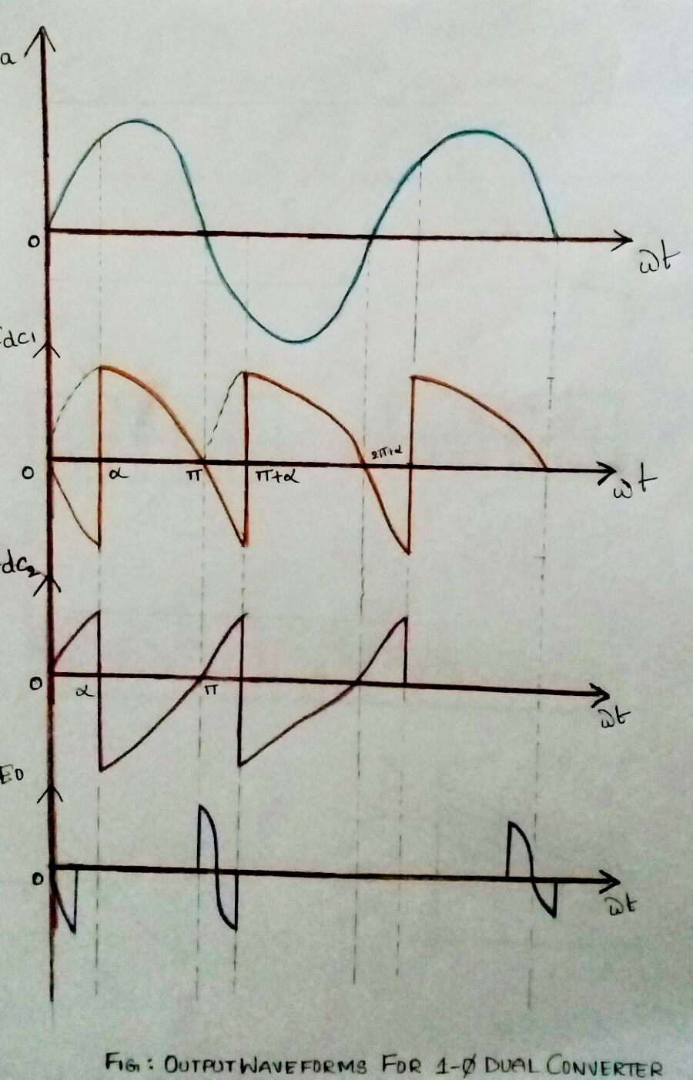

Slide 12
In circulating current mode
1. load current is continuous and it is fast process
2. Two converters are simultaneously operated
3. The circuit will protect with current limiting reactors
4. Average output load will be more than the load.

Slide 13
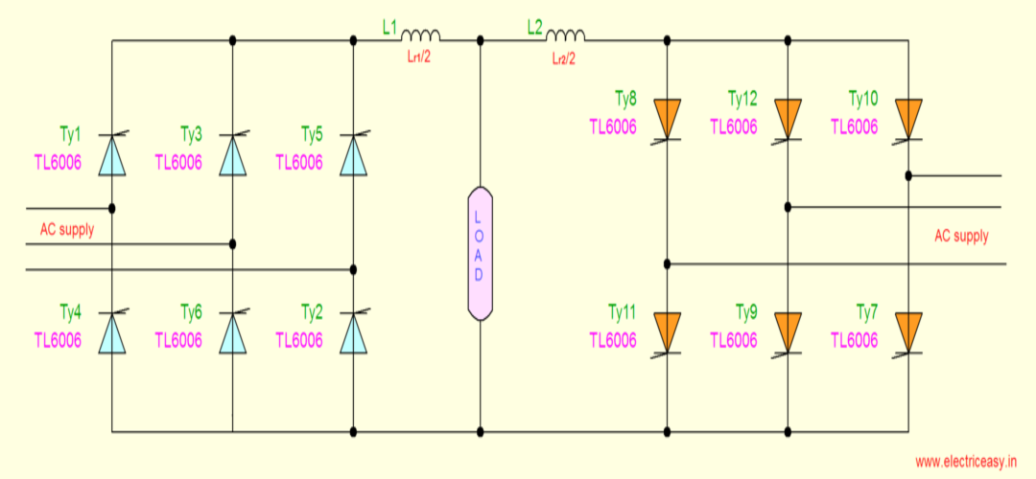

Slide 14
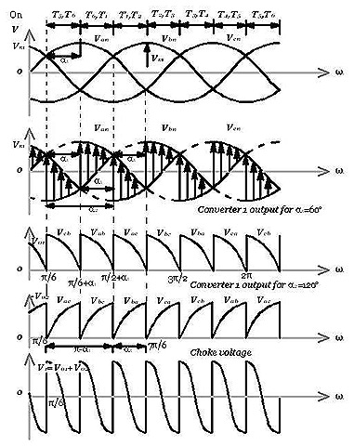

Slide 15
Closed Loop Control of Drives
In electrical drives feedback loops or closed loop control satisfy the following requirements.
1. Protection
2. Enhancement of speed of response
3. To improve steady-state accuracy
Current Limit Control
During the starting, we know if precautionary measures are not taken there is a chance of huge current flow through the motor circuit. To limit the current and sense the current fed to the motor, current limit controller is installed. The feedback loop does not effect the normal operation of the drive but if the current exceeds the predetermined safe limit, the feedback loop activates and the current is brought down below the safe limit. Once the current is brought down below the safe limit the feedback loop again deactivates and in this way the control of current takes place.

Slide 17
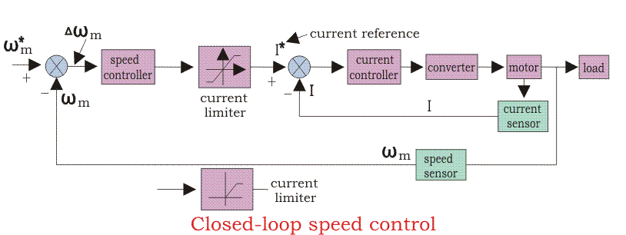
Closed Loop Speed Control
Speed control loops are perhaps the most widely used feedback loops for drives.

Slide 18
The inner current control loop limits the converter and motor current or motor torque below the safe limit.
Suppose the reference speed W_{m}* increases and there is a positive error ΔW_{m}, which indicates that the speed is needed to be increased.
Now the inner loop increases the current keeping it under maximum allowable current. And then the driver accelerates, when the speed reaches the desired speed then the motor torque is equal to the load torque and there is a decrease in the reference speed W_{m} which indicates that there is no need of any more acceleration but there must be deceleration, and braking is done by the speed controller at maximum allowable current.
So, we can say that during speed controlling the function transfers from motoring to braking and from braking to motoring continuously for the smooth operation and running of the motor.

