Slide 1
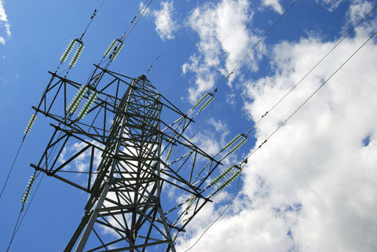
A Presentation On…..
1

Slide 2
FACTS
Flexible AC Transmission System (Facts) is a new integrated concept based on power electronic switching converters and dynamic controllers to enhance the system utilization and power transfer capacity as well as the stability, security, reliability and power quality of AC system interconnections.

Slide 3
INTRODUCTION
Flexible Alternating Current Transmission System.
FACTS as they are generally known, are new devices that improve transmission systems.
FACTS is a static equipment used for the AC transmission of electrical energy.
It is generally a power electronics based device.
Meant to enhance controllability and increase power transfer capability.
3

Slide 4
BENEFITS OF FACTS DEVICES
Regulation of power flows in prescribed transmission routes.
Reduces the need for construction of new transmission lines, capacitors and reactors.
Provides greater ability to transfer power between controlled areas.
These devices help to damp the power oscillations that could damage the equipment.

Slide 5
Improves the transient stability of the system.
Controls real and reactive power flow in the line independently.
Damping of oscillations which can threaten security or limit the usable line capacity.

Slide 6
Better utilization of existing transmission system assets
Increased transmission system reliability and availability (lower vulnerability to load changes, line faults)
Increased dynamic and transient grid
Stability and reduction of loop flows
Increased quality of supply for sensitive industries
(through mitigation of flicker, frequency variations)
Environmental benefits
UPFC CIRCUIT DIAGRAM
6

Slide 7
OVER VIEW OF FACTS
AC- NETWORK CONTROLLERS
CONVENTIONAL (Switched)
FACTS-Devices
(Fast and Static)
R,L,C, Transformer
Thyristor Valve
VSC
Hybrid
Shunt Devices
STATCOM
STATCOM + Energy Storage
Switched Shunt Compensation
SVC
Series Devices
Switched Series Compensation
TCSC
SSSC, IPFC
FCL
Shunt-Series
Phase Shifting Transformer
UPFC, DPFC
DFC
7

Slide 8
Basic Types of FACTS Controllers

Slide 9
Basic Types of FACTS Controllers
FACTS controllers are classified as
Series Controllers
Shunt Controllers
Combined Series-Series Controllers
Combined Series-Shunt Controllers

Slide 10
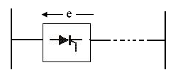
Basic Types of FACTS Controllers
Series Controllers:
It could be a variable impedance (capacitor, reactor, etc) or a power electronic based variable source of main frequency, subsynchonous and harmonic frequencies to serve the desired need.

Slide 11
Basic Types of FACTS Controllers
Series Controllers:
Inject a voltage in series with the line.
If the voltage is in phase quadrature with the current, controller supplies or consumes reactive power.
Any other phase, involves control of both active and reactive power.

Slide 12
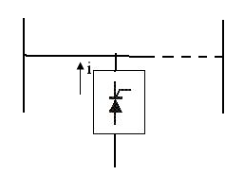
Basic Types of FACTS Controllers
Shunt Controllers:
It could be a variable impedance (capacitor, reactor, etc) or a power electronic based variable source or combination of both.

Slide 13
Basic Types of FACTS Controllers
Shunt Controllers:
Inject a current in the system.
If the current is in phase quadrature with the voltage, controller supplies or consumes reactive power.
Any other phase, involves control of both active and reactive power.

Slide 14
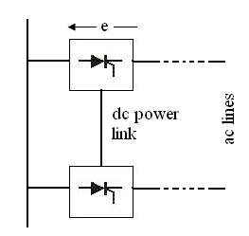
Basic Types of FACTS Controllers
Combined Series-Series Controllers:
It could be a combination of separate series controllers or unified controller.

Slide 15
Basic Types of FACTS Controllers
Combined Series-Series Controllers:
Series controllers supply reactive power for each line and real power among lines via power link.
Interline power flow controller balance real and reactive power flow in the lines.

Slide 16
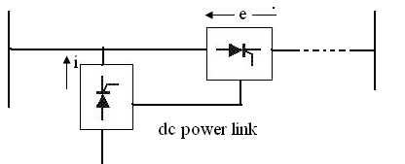
Basic Types of FACTS Controllers
Combined Series-Shunt Controllers:
It could be a combination of separate series & shunt controllers or unified power flow controller.

Slide 17
Basic Types of FACTS Controllers
Combined Series-Shunt Controllers:
Inject current into the system with the shunt controller and voltage in series with the line with series controller.
When the controllers are unified, exchange real power between series and shunt controllers via power link.

Slide 18
Basic Types of FACTS Controllers
Choice of the controller:
Series controller controls the current/power flow by controlling the driving voltage.
To control current/power flow and damp oscillations, series controller is several times more powerful than shunt controller.
Shunt controller injects current in the line
Thus it is used for more effective voltage control & damp voltage oscillations.

Slide 19
Basic Types of FACTS Controllers
Injecting the voltage in series with the line can improve the voltage profile.
But shunt controller is more effective to improve the voltage profile at substation bus.
For a given MVA, size of series controller is small compared to shunt controller.
Shunt controllers cannot control the power flow in the lines.
Series controllers should bypass short circuit currents and handle dynamic overloads.

Slide 20
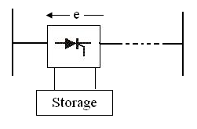
Basic Types of FACTS Controllers
Controllers with gate turn off devices are based on dc to ac converters and exchange active/reactive power with ac lines.
This requires energy storage device.

Slide 21
Basic Types of FACTS Controllers
Energy storage systems are needed when active power is involved in the power flow.
A controller with storage is more effective for controlling the system dynamics.
A converter-based controller can be designed with high pulse order or pulse width modulation to reduce the low order harmonic generation to a very low level.
A converter can be designed to generate the correct waveform in order to act as an active filter.

Slide 22
Static VAR Compensators (SVC)

Slide 23
Shunt connected static var generators and/or absorbers whose outputs are varied so as to control specific power system quantities
The term static is used to denote that there are no moving or rotating components
Basic types of SVCs:
Thyristor-controlled reactor (TCR)
Thyristor-switched capacitor (TSC)
Saturated reactor

Slide 24
A static var system (SVS) is an aggregation of SVCs and mechanically switched capacitors or reactors whose outputs are coordinated
When operating at its capacitive limit, an SVC behaves like a simple capacitor

Slide 25
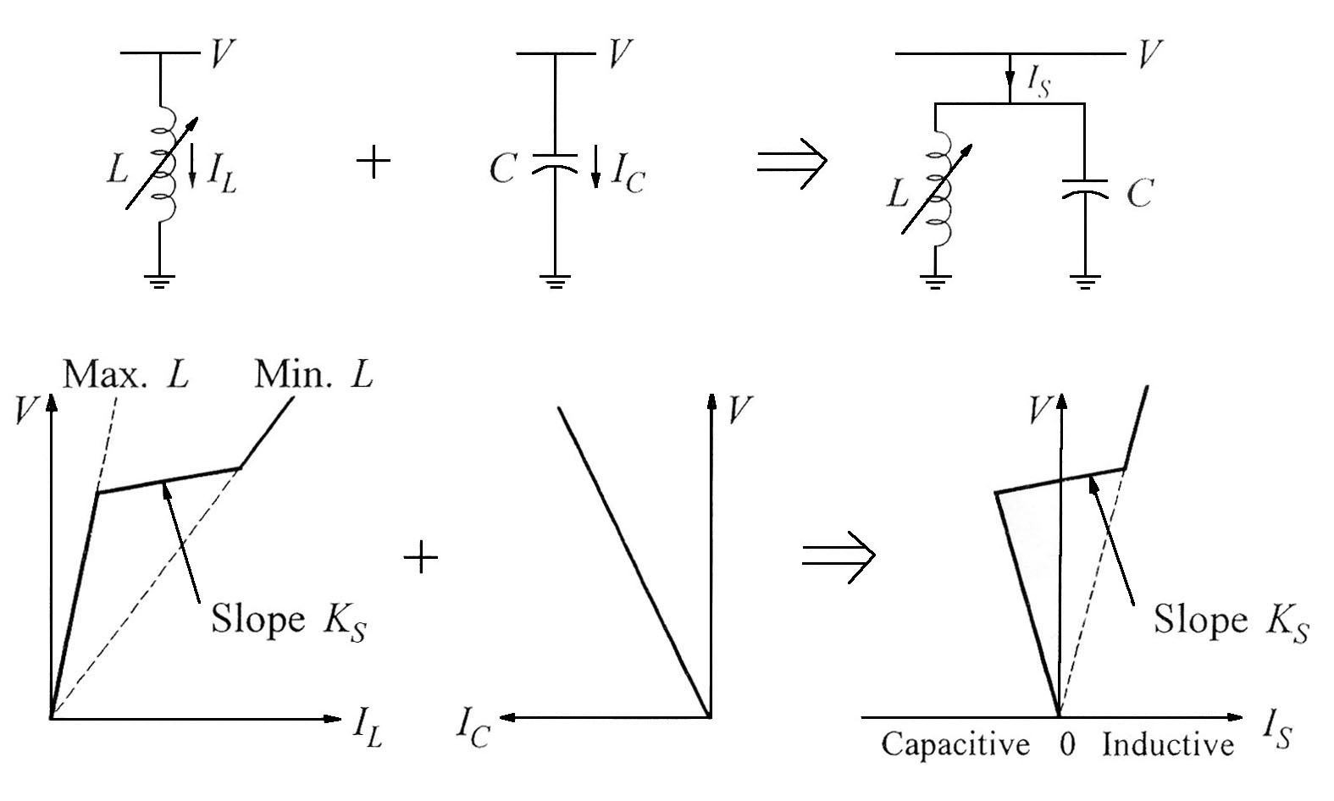
(a) Controllable reactor
(b) Fixed capacitor
(c) SVS
Composite characteristics of an SVS

Slide 26
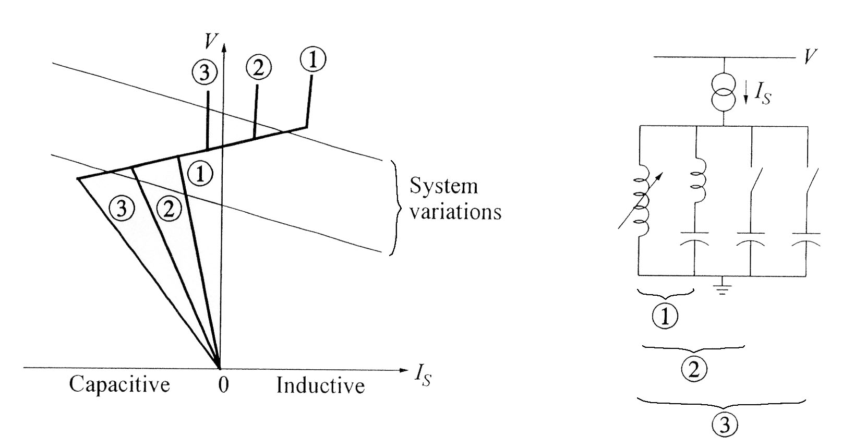
Use of switched capacitors to extend continuous control range

Slide 27
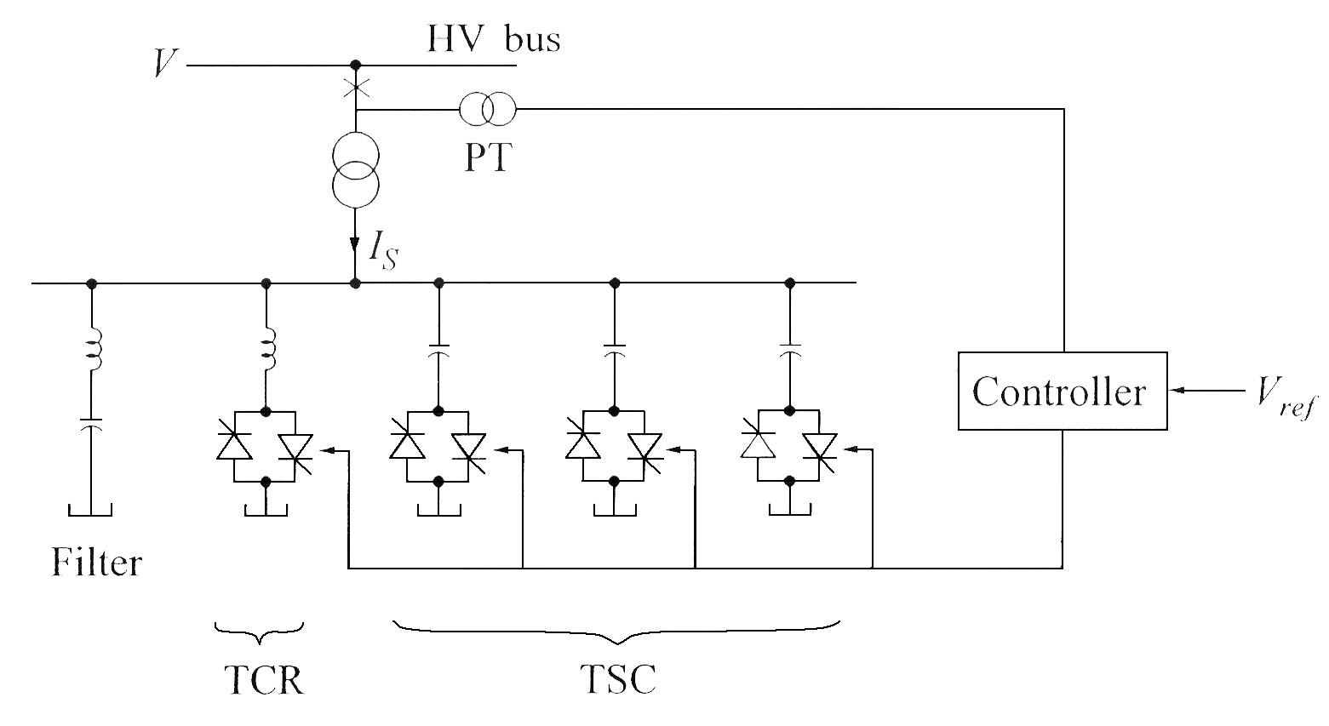
A typical static var system

Slide 28
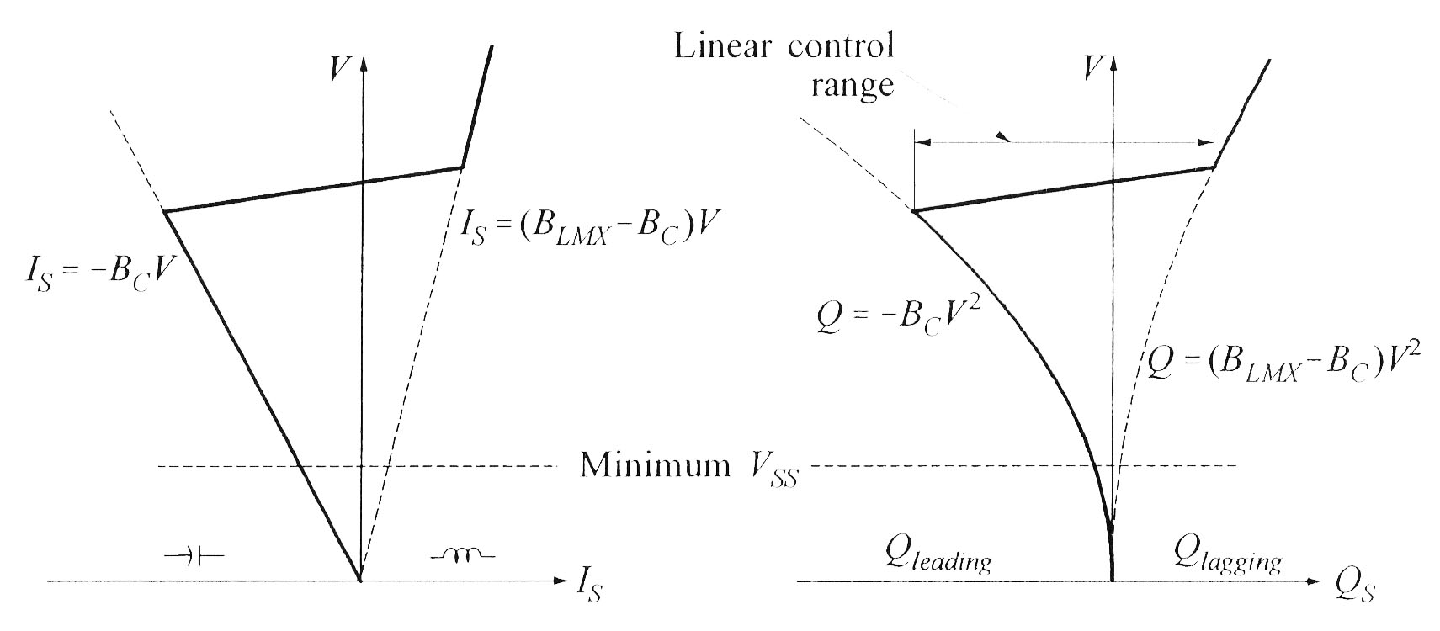
SVS steady-state characteristics
(a) Voltage-current characteristic
(b) Voltage-reactive power characteristic

Slide 29
Static Synchronous Compensator (STATCOM)

Slide 30
This shunt connected static compensator was developed as an advanced static VAR compensator where a voltage source convertor (VSC) is used in- stead of the controllable reactors and switched capacitors.
Although VSCs require self-commutated power semiconductor devices such as GTO, IGBT, IGCT, MCT, etc (with higher costs and losses) unlike in the case of variable impedance type SVC which use thyristor devices.

Slide 31
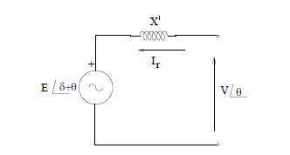
A STATCOM is comparable to a Synchronous Condenser (or Compensator) which can supply variable reactive power and regulate the voltage of the bus where it is connected. The equivalent circuit of a Synchronous Condenser (SC) is shown in Fig.1.
Fig.1. Synchronous condenser
A STATCOM (previously called as static condenser (STATCON) has a similar equivalent circuit as that of a SC. The AC voltage is directly proportional to the DC voltage (Vdc) across the capacitor (see Fig.2. which shows the circuit for a single phase STATCOM)

Slide 32
There are many technical advantages of a STATCOM over a SVC. These are primarily:
(a) Faster response
(b) Requires less space as bulky passive components (such as reactors) are eliminated
(c) Inherently modular and relocatable
(d) It can be interfaced with real power sources such as battery, fuel cell or SMES (superconducting magnetic energy storage)
(e) A STATCOM has superior performance during low voltage condition as the reactive current can be maintained constant (In a SVC, the capacitive reactive current drops linearly with the voltage at the limit (of capacitive susceptance). It is even possible to increase the reactive current in a STATCOM under transient conditions if the devices are rated for the transient overload. In a SVC, the maximum reactive current is determined by the rating of the passive components – reactors and capacitors.

Slide 33
STATCOM is a regulating(poor power factor and poor voltage) device.
Based on a power electronics voltage-source converter and can act as either a source or sink of reactive AC power.
If connected to a source of power it can also provide active AC power.
STATCOM provides better damping characteristics than the SVC as it is able to transiently exchange active power with the system

Slide 34
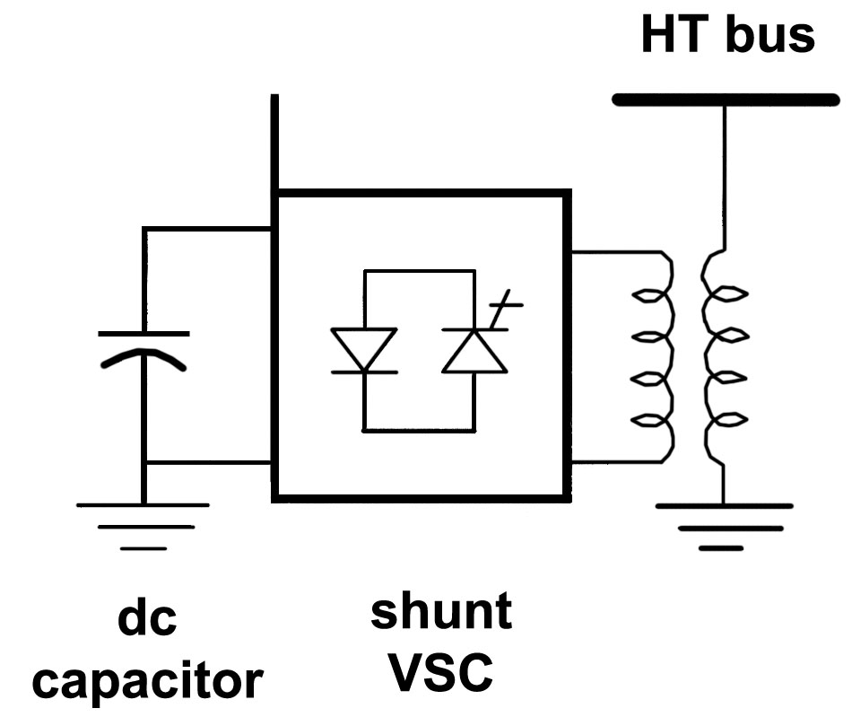
Can be based on a voltage-sourced or current-sourced converter
Figure below shows one with voltage-sourced converter
driven by a dc voltage source: capacitor
Effectively an alternating voltage source behind a coupling reactance
controllable in magnitude
Can be operated over its full output current range even at very low (typically 0.2 pu) system voltage levels
Requires fewer harmonic filters and capacitors than an SVC, and no reactors
significantly more compact

Slide 35
Structure of STATCOM
Basically, the STATCOM system is comprised of Power converters, Set of coupling reactors or a step up transformer, Controller

Slide 36
Advantages of STATCOM
The reactive components used in the STATCOM are much smaller than those in the SVC.
The characteristics of STATCOM are superior.
The output current of STATCOM can be controlled up to the rated maximum capacitive or inductive range.
Reduction of the capacity of semiconductor power converter and capacitor bank to one half of those for the conventional SVC.
Better transient response of the order of quarter cycle.
Reduction of harmonic filter capacity.
Reduction of size of high value air-cored reactor.
Reduction of equipment volume and foot-print.

Slide 37
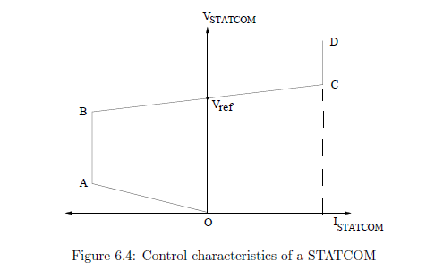

Slide 38
COMPARISON
OF STATCOM AND SVC CHARACTERISTICS

Slide 39
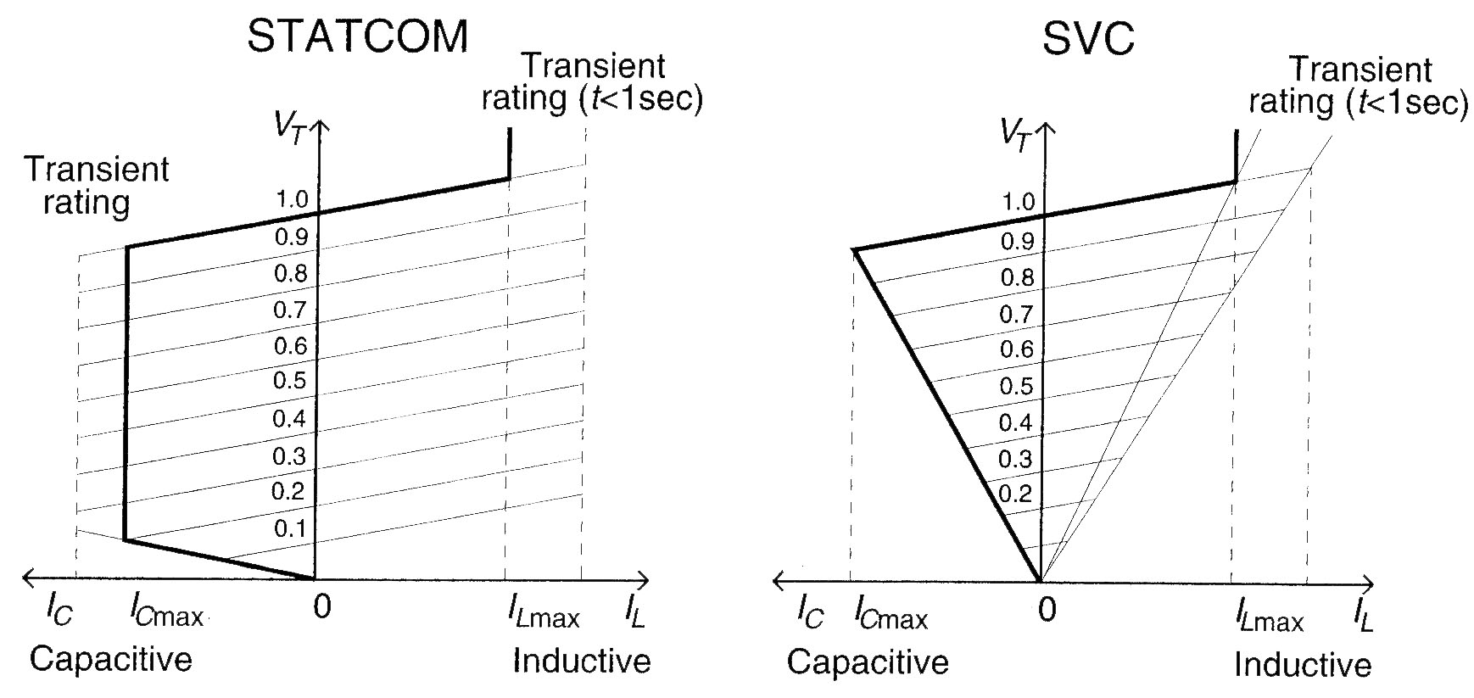
(i) V-I characteristics

Slide 40
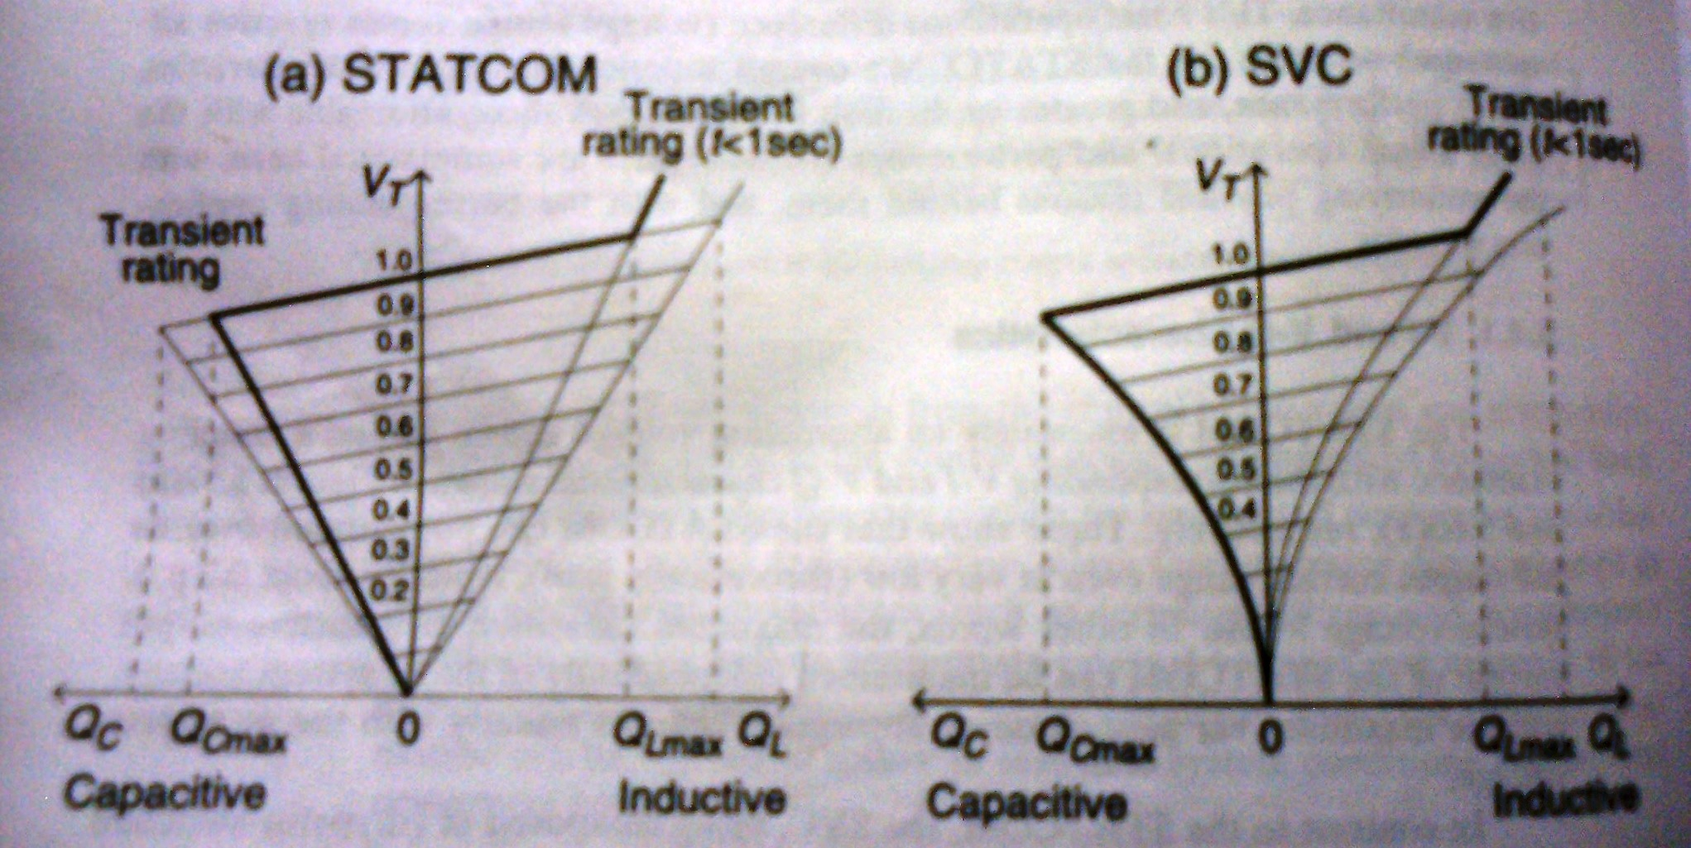
(ii) V-Q Characteristics

Slide 41
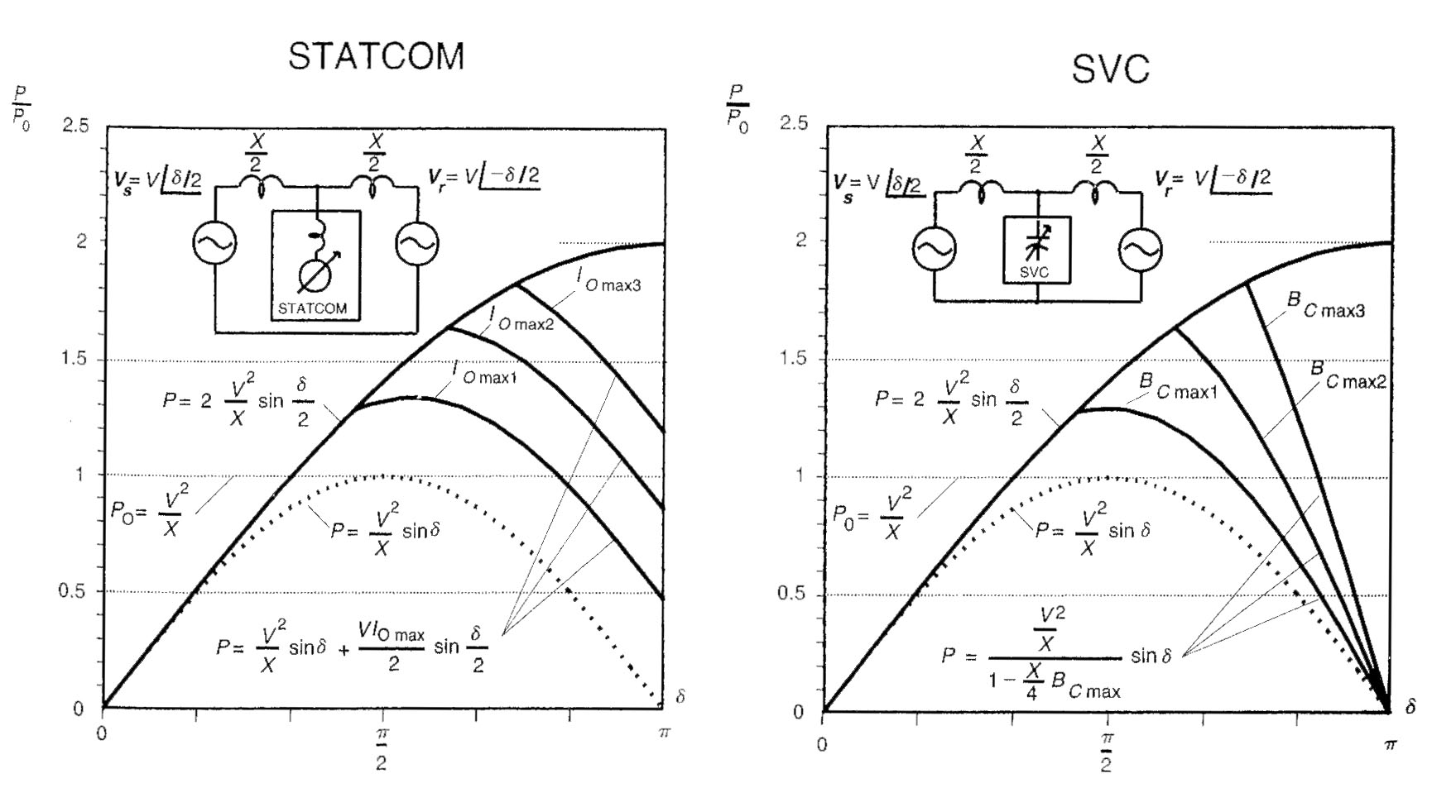
(iii) Transient stability
P- δ characteristics with mid-point compensation

Slide 42
(iv) Response Time
Transport lag
SVC- Between 2.5 ms to 5.0 ms
STATCOM- Between 200 µs to 300 µs

Slide 43
(v) Capability to exchange real power
For applications requiring active (real) power compensation it is clear that the STATCOM, in contrast to the SVC, can interface a suitable energy storage with the AC system for real power exchange.

Slide 44
(vi) Operation with unbalanced AC System
SVC controls establishes three identical shunt admittances, one for each phase. Consequently, with unbalanced system voltages the compensating currents in each phase would become different . It is possible to control the three compensating admittances individually by adjusting delay angle of the TCRs so as to make the three compensating currents identical.
However in this case triple-n harmonic content would be different in each phase and their normal cancellation through delta connection would not place. This operation mode thus would generally require the installation of the usually unneeded third harmonic filters.

Slide 45
The operation of the STATCOM under unbalanced system conditions is different from that of the SVC, but the consequences of the such operation are similar.
The STATCOM operation is governed by fundamental physical law requiring that the net instantaneous power at the ac and dc terminals of the voltage-sourced converters employed must be always be equal. This is because the converter has no internal energy storage and thus energy transfer through it is absolutely direct, and consequently the net instantaneous power at the ac and dc terminals must be equal.

Slide 46
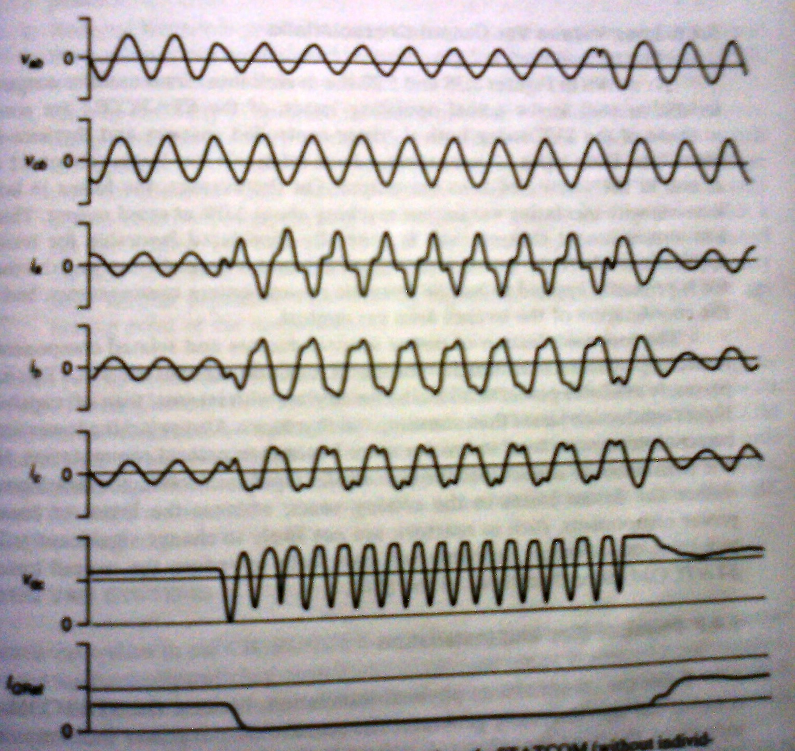
Wave forms illustrating the operation of a STATCOM during LG Fault at the regulated bus

Slide 47
(vii) Loss Versus Var output characteristics
The loss contribution of power semiconductors and related components to the total compensator losses is higher for the STATCOM than for the SVC. This is because presently available power semiconductor devices with internal turn-off capability have higher conduction losses than conventional thyristors.
Thus the technological advances probably will have help to reduce the overall losses of the STATCOM more than those of the SVC.

Slide 48
(viii) Physical size and installation
From the stand point of physical installation, because the STATCOM not only controls but also internally generates the reactive output power, the large capacitor and reactor banks with their associated switchgear and protection, used in conventional thyristors controlled SVCs, are not needed.
This results in a significant reduction in overall size (about 30 to 40 %) , as well as installation labor and cost.

