Slide 1
Field Effect Transistor(FET)
By
k. Sreevidya
Asst .professor
Dept of ECE

Slide 2
Difference between BJT & FET
BJT
FET
Three terminal semiconductor device.
Emitter, base, collector
Current controlled device
Bipolar device
Two types- npn & pnp
Three terminal semiconductor device
Source, gate,drain
Voltage controlled device
Unipolar device
Two types – JFET & MOS FET

Slide 3
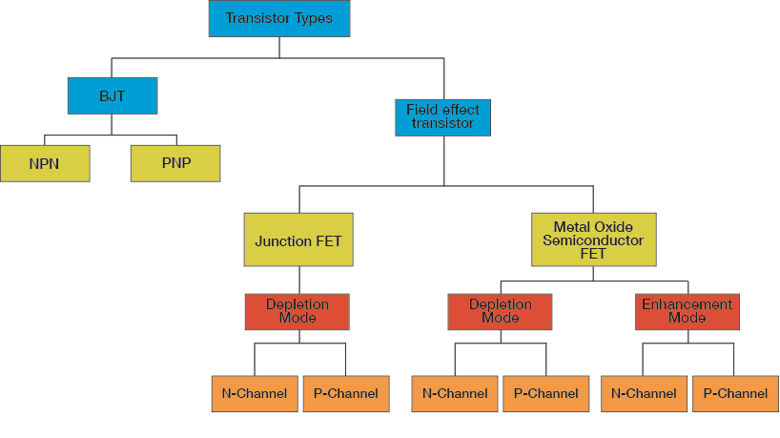
Classification of FET

Slide 4
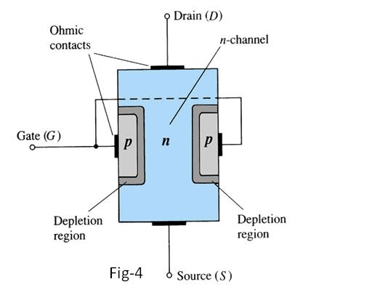
Construction of N-channel JFET
Major part of the structure is n- type meterial.
Top of the n-type channel Is connected through an ohmic contact to a terminal Reffered to as drain(D).
As lower end Connected through an ohmic contact to a terminal Reffered as source (S).
P-type meterials connected to gether and taken as terminal gate(G).
JFET has two pn junctions under no bias condition.

Slide 5
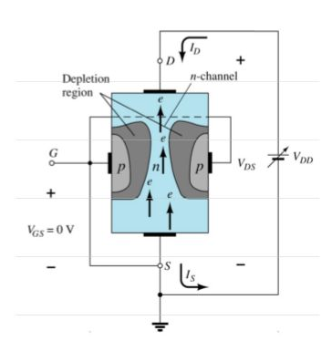
JFET operating characteristics:VGS=0V
Three things happen when Vgs=0v and Vds Is increased from 0v to more positive Voltage
A depletion region between p-gate and N-channel increases as electrons from N-channel Combine with holes From p-gate.
Increasing the depletion region decreasing the size of N-channel Which increases the resistance of the N-channel.
Even through the N-channel resistance increasing the current (ID) from source to drain through the N-channel is increasing.This is because Vds is increasing.

Slide 6
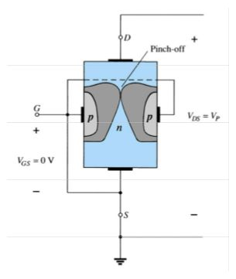
JFET operating characteristics: pinch off
If Vgs =0v and Vds is further increased to a more positive Voltage , that the depletion region gets increases and pinchoff the N-channel.
This suggests that the current in N-channel (ID) would be dropped to SaturatIon.

Slide 7
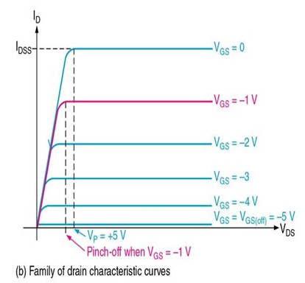
JFET drain characteristics
Plot between Vds Vs Id for different values of vgs.
When Vgs=0v & Vds is positive ,Id increases linearly.
When Vds is more positive Voltage id gets saturated as Idss.
When Vgs=-ve ,& Vds positive Voltage Id current reduces from the previous value of Id.

Slide 8
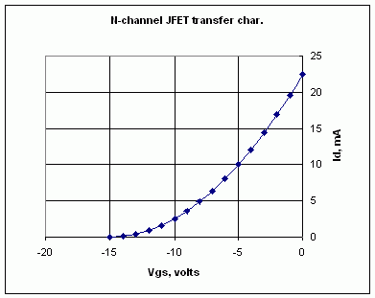
JFET TRANSFER CHARACTERISTICS
Plot between vgs and id for fixed value of vds
When vgs = 0v id is idss and as vgs more negative ,the drain current Id reduces.

Slide 9
THANK YOU

