Slide 1
GREEN CHEMISTRY
Introduction – Green Chemistry
Principles of Green Chemistry
Pollution
Composite materials

Slide 2
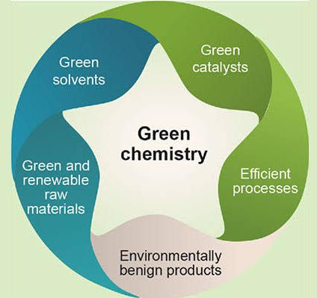
Green Chemistry
Green chemistry, also called sustainable chemistry, is an area of chemistry and chemical engineering focused on the designing of products and processes that minimize the use and generation of hazardous substances.
The overarching goals of green chemistry—namely, more resource-efficient and inherently safer design of molecules, materials, products, and processes—can be pursued in a wide range of contexts.

Slide 3
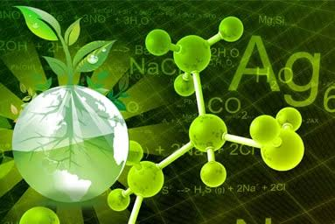
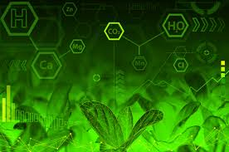
Green chemistry emerged from a variety of existing ideas and research efforts (such as atom economy and catalysis) in the period leading up to the 1990s, in the context of increasing attention to problems of chemical pollution and resource depletion.

Slide 4
Principles of Green Chemistry
In 1998, Paul Anastas (who then directed the Green Chemistry Program at the US EPA) and John C. Warner (then of Polaroid Corporation) published a set of principles to guide the practice of green chemistry. The twelve principles address a range of ways to reduce the environmental and health impacts of chemical production, and also indicate research priorities for the development of green chemistry technologies.

Slide 5
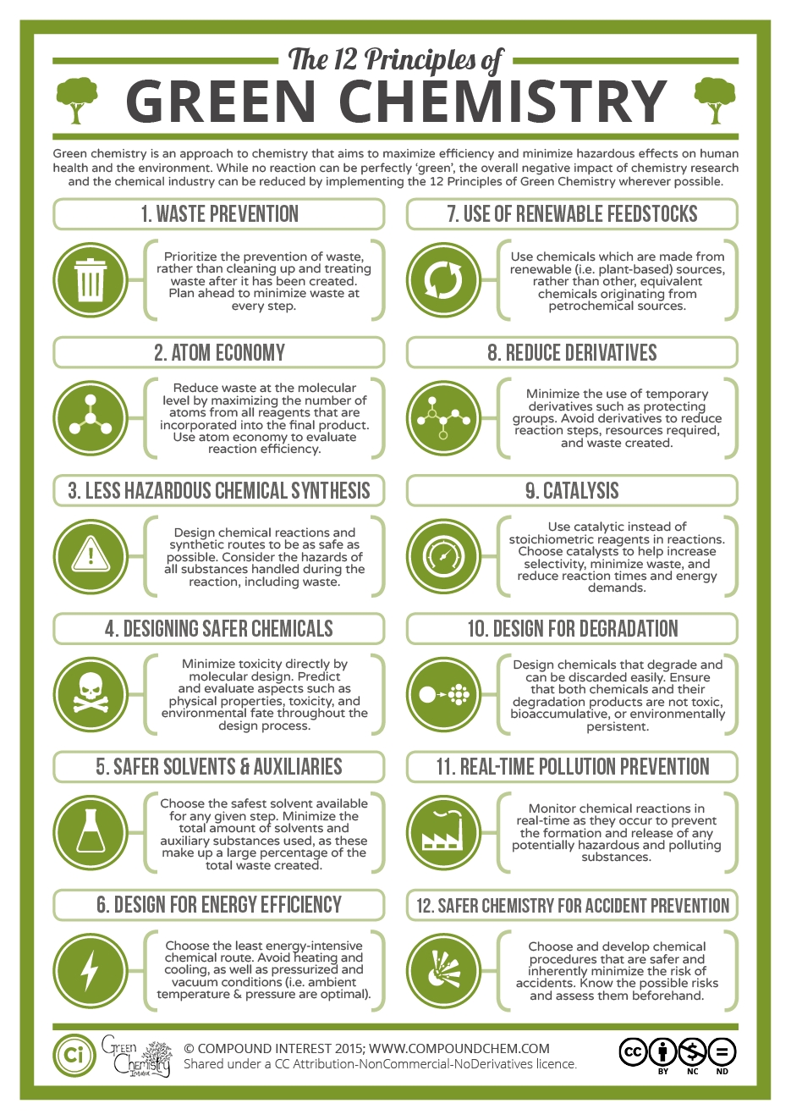
The twelve principles of green chemistry are:

Slide 6
1.Prevention
Preventing waste is better than treating or cleaning up waste after it is created.

Slide 7
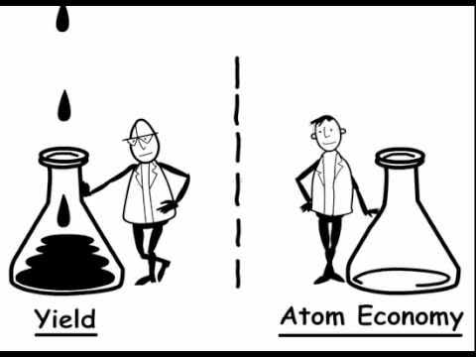
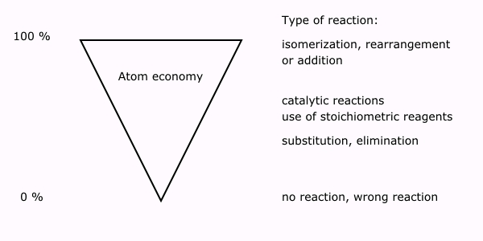
2.Atom Economy
Synthetic methods should try to maximize the incorporation of all materials used in the process into the final product.

Slide 8
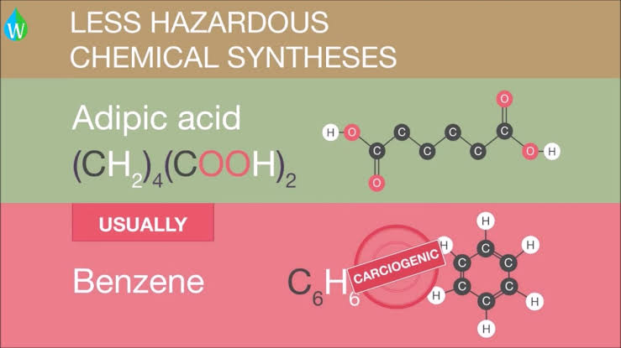
3.Less hazardous chemical syntheses
Synthetic methods should avoid using or generating substances toxic to humans and/or the environment.

Slide 9
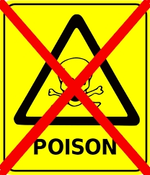
4.Designing safer chemicals
Chemical products should be designed to achieve their desired function while being as non-toxic as possible.

Slide 10
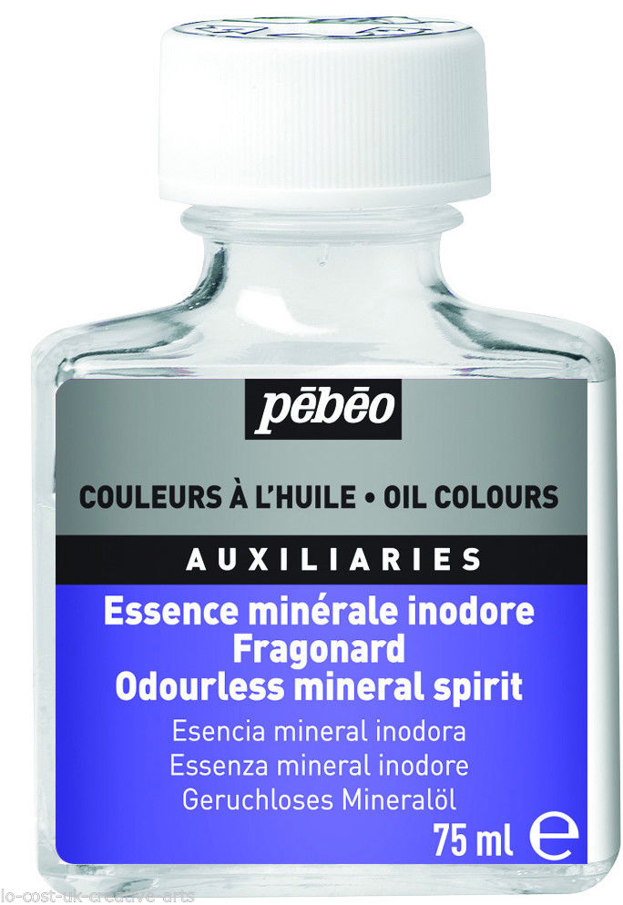
5.Safer solvents and auxiliaries
Auxiliary substances should be avoided wherever possible, and as non-hazardous as possible when they must be used.

Slide 11
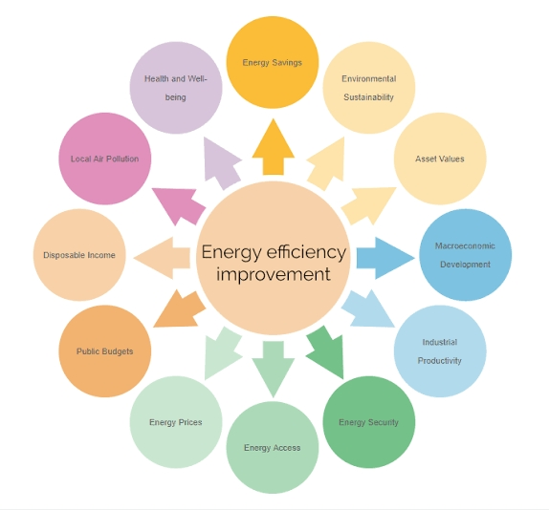
6.Design for energy efficiency
Energy requirements should be minimized, and processes should be conducted at ambient temperature and pressure whenever possible

Slide 12
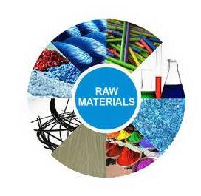
7. Use of renewable feedstocks
Whenever it is practical to do so, renewable feedstocks or raw materials are preferable to non-renewable ones.

Slide 13
8. Reduce derivatives
Unnecessary generation of derivatives—such as the use of protecting groups—should be minimized or avoided if possible; such steps require additional reagents and may generate additional waste.
9. Catalysis
Catalytic reagents that can be used in small quantities to repeat a reaction are superior to stoichiometric reagents (ones that are consumed in a reaction).

Slide 14
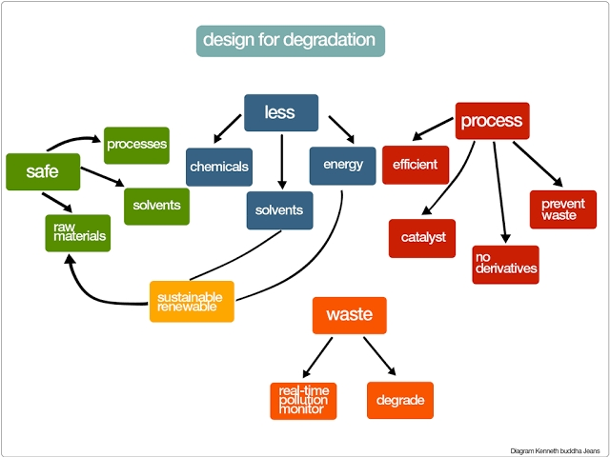
10. Design for degradation
Chemical products should be designed so that they do not pollute the environment; when their function is complete, they should break down into non-harmful products.

Slide 15
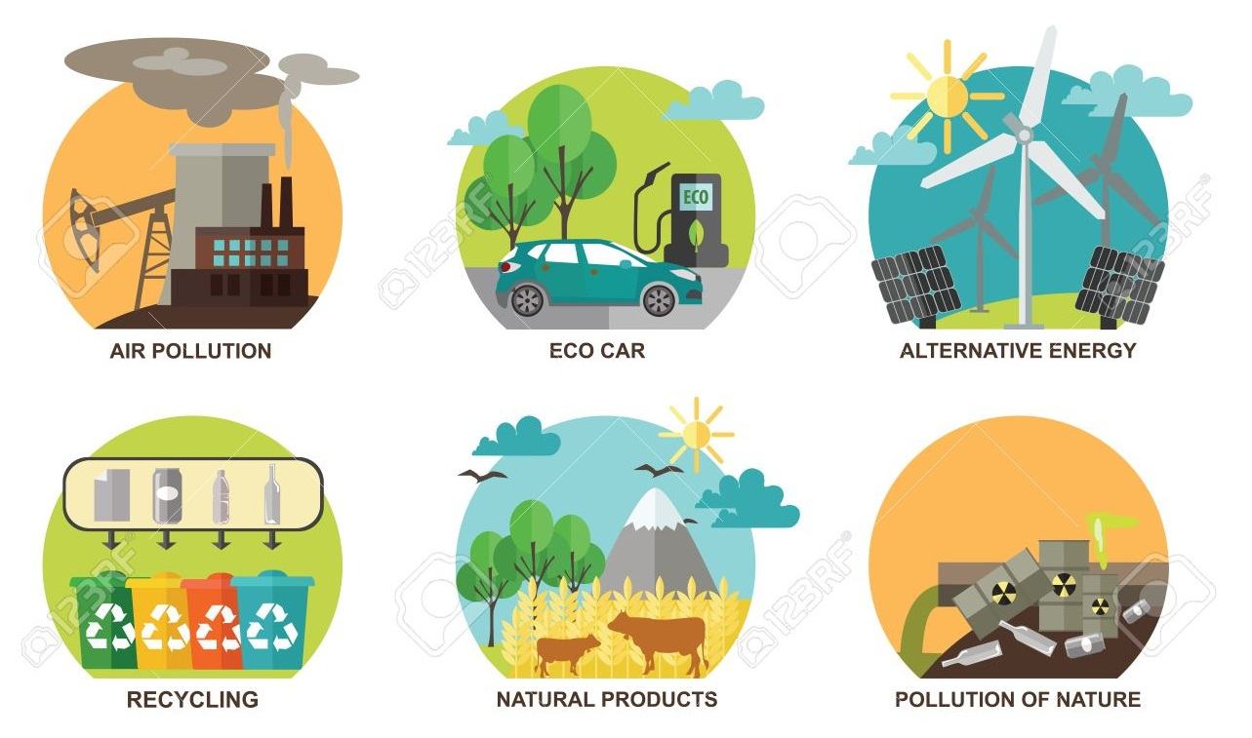
11. Real-time analysis for pollution prevention.
Analytical methodologies need to be further developed to permit real-time, in-process monitoring and control beforehazardous substances form.

Slide 16
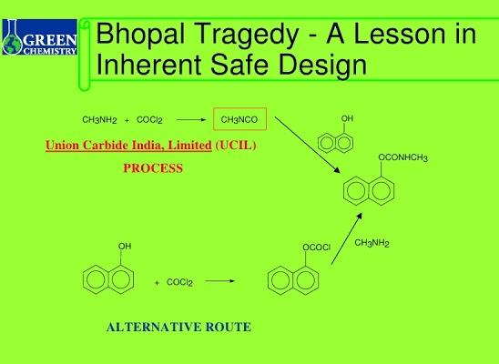
12. Inherently safer chemistry for accident prevention
Whenever possible, the substances in a process, and the forms of those substances, should be chosen to minimize risks such as explosions, fires, and accidental releases.

Slide 17
Pollution
Pollution is the introduction of contaminantsinto the natural environment that cause adverse change.
Pollution can take the form of chemical substances or energy, such as noise, heat or light.
Pollutants, the components of pollution, can be either foreign substances/energies or naturally occurring contaminants.

Slide 18
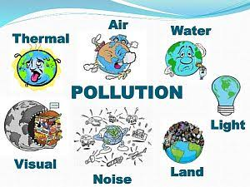
Types of Pollution
Few common forms of pollution are:
Air Pollution
2. Water Pollution
3. Noise Pollution
4. Soil Contamination
5.Radioactive Pollution
6. Light Pollution
7.Thermal Pollution

Slide 19
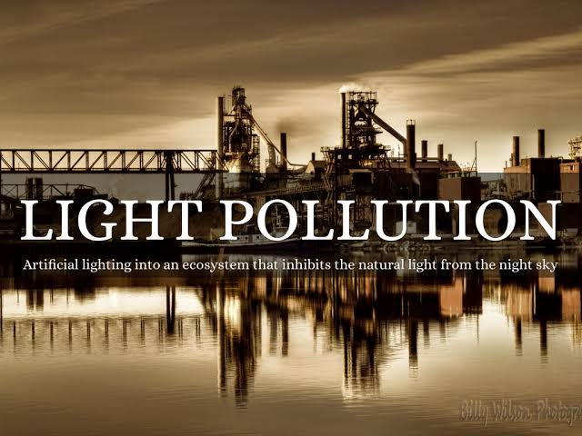
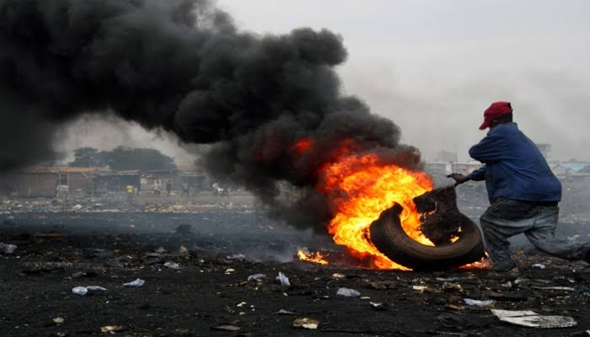
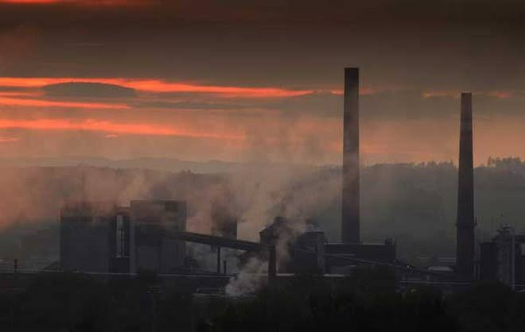
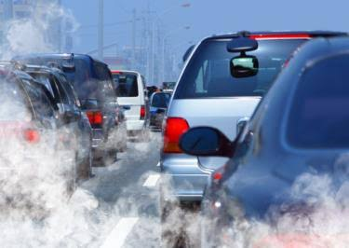

Slide 20
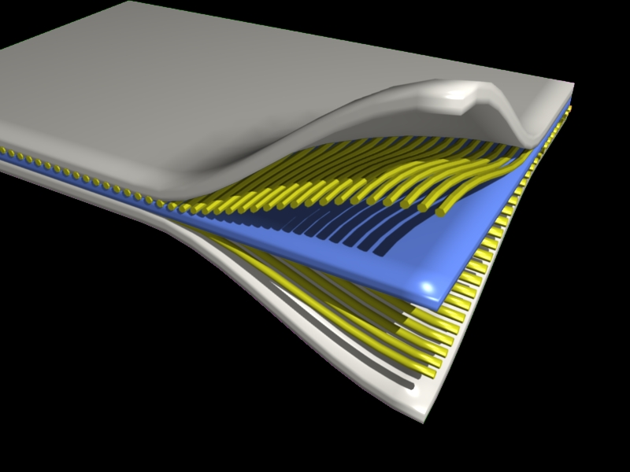
Composite Materials
A composite material (also called a composition material or shortened to composite, which is the common name) is a material made from two or more constituent materials with significantly different physicalor chemical properties that, when combined, produce a material with characteristics different from the individual components. The individual components remain separate and distinct within the finished structure, differentiating composites from mixtures and solid solutions.

Slide 21
Composite materials are generally used for buildings, bridges, and structures such as boat hulls, swimming pool panels, racing carbodies, shower stalls, bathtubs, storage tanks, imitation granite and cultured marble sinksand countertops.

Slide 22
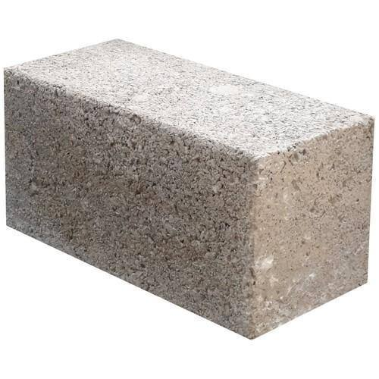
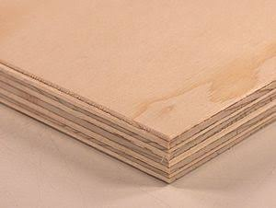
Examples of composites
Concrete is a mixture of cement and aggregate, giving a robust, strong material that is very widely used
Plywood is used widely in construction

Slide 23
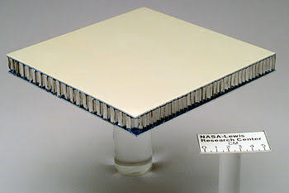
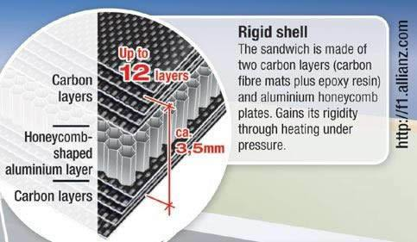
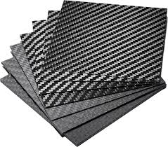
Composite sandwich structure panel used for testing at NASA
Carbon fibre composite part

