Slide 1
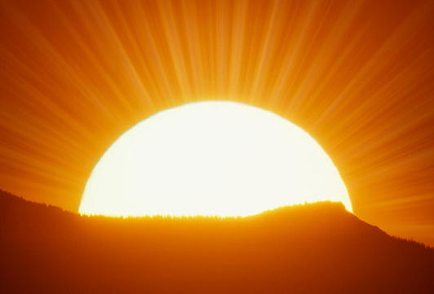
Unit-2 solar energy

Slide 2
Solar constsant
Dia of sun=1.39x10⁶ km , dia of earth=1.27x10⁴ km.
Mean dist between them is 1.50x10⁸ km.
Solar constant: It is the rate at which solar energy arrives at the top of atmosphere.
It is the amount of energy received per unit area perpendicular to suns direction at the mean distance of the earth from the sun.
NASA standard value for solar constant is 1.353kw/m²
We are more interested in energy available at the surface of the earth than in atmosphere.

Slide 3
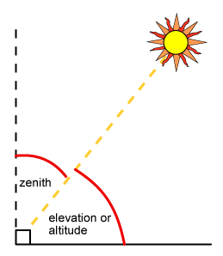
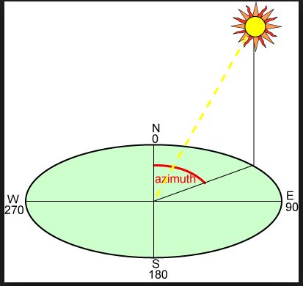
Zenith angle:
The zenith angle is the angle between the sun and the vertical. The zenith angle is similar to the elevation angle but it is measured from the vertical rather than from the horizontal, thus making the zenith angle = 90° - elevation.
Azimuth angle:
It is the solar angle in degrees along the
Horizon east or west of north.

Slide 4
Solar radiation is absorbed in different stages
Solar radiation that finally reaches the earth is
Called direct radiation or beam radiation.
Molecules in air
ozone
Water vapor,CO2,dust
Diffuse radiation is that solar radiation received
from the sun after its direction is changed by
Reflection and scattering by the atmosphere.
Total solar radiation=direct radiation+diffuse radiation

Slide 5
Solar radiation data
Solar radiation data include the following information:
Whether they are instantaneous measurement or values integrated over some period of time.
The time or time period of measurement.
Whether the measurements are of beam,diffuse or total radiation, and the instrument used.
Receiving surface orientation.
The period over which they are averaged.
Solar radiation is measured by
Pyrheliometer
pyranometer

Slide 6
Solarimeter is the device to measure the solar radiation received by the earth which gives reading for instantaneous measurements.
1 Langley=1cal/cm² per hr or per day .
Total daily solar radiation received in Kolkata on the basis of yearly avg is 680 Langley.
Average solar radiation are also available from maps.
Charts are also available.
India lies between 7deg and 37deg N and receives annual avg intensity of solar radiation 400-700cal/cm^{2/} /day.
The annual daily diffuse radiation by india is 7300Kj/m2/day

Slide 7
Solar collectors
Solar collectors are device to collect solar radiations and pass the energy to fluid in contact with it.they are of two types:
Non concentrating or flat type
Concentrating type
The fundamental principle of conversion of radiation to heat is GREEN HOUSE EFFECT.
The energy we receive from the sun comes in the form of light, a short wave radiation, not all of which is visible to human eye, when the radiation strikes a solid or liquid, it is absorbed and transformed to heat energy. The material becomes warm and stores the heat, conducts to surrounding materials

Slide 8
Flat plate collectors
Simple to construct
Below 90deg tempr
Can collect both direct and diffuse radiation.
They are classified as
Liquid heating collectors-for water heating,non freezing aqueous soln
Air or gas heating collectors-for solar air heaters.

Slide 9
Flat plate collectors
A solar flat plate collector typically consists of a large heat absorbing plate, usually a large sheet of copper or aluminium as they are both good conductors of heat, which is painted or chemically etched black to absorb as much solar radiation as possible for maximum efficiency.

Slide 10
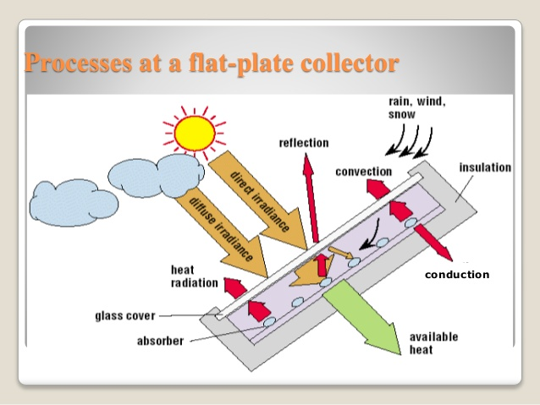
This blackened heat absorbing surface has several parallel copper pipes or tubes called risers, running length ways across the plate which contain the heat transfer fluid, typically water.
These copper pipes are bonded, soldered or brazed directly to the absorber plate to ensure maximum surface contact and heat transfer. Sunlight heats the absorbing surface which increases in temperature.
As the plate gets hotter this heat is conducted through the risers and absorbed by the fluid flowing inside the copper pipes which is then used by the household.

Slide 11
Air heat collectors or solar air heaters
Air is heated by the back side of collector plate.fins attached to the plate increases the contact surface.the back side of the collector is heavily insulated with mineral wool.
Applications:
Drying and curing agricultural products,space heating for comforts,seasoning of timber etc.
Heating green houses.
For heat engines working on brayton cycle.

Slide 12
Advantages:
They use both beam and diffuse radiations.
They don’t require orientation towards sun.
They require little maintenance
Simple in construction

Slide 13
Collector efficiency
The performance of solar collector is given by energy balance that indicates the distribution incident solar radiation into useful energy gain and various losses.
The useful energy delivered by collector is
Qu=Ac[HR(τ.α ) –U_{L}(tp-ta)]
Ac-collector area,HR-useful heat gain by absorber

Slide 14
A diagrammatic representation of heat loss is shown in the fig above.
To get high performance in solar collector there should be increase in
HR(τ.α ) and decrease in U_{L}(tp-ta).

Slide 15
The greater the energy absorbtion in the metal surface and lower the heat loss from the surface the higher is the useful recovery.
To reduce the rate of radiation and convection loss one or more transparent surface like glass is placed above the absorber surface.
One layer of glass can transmit as much as 92% of solar radiation striking it,and reduces heat loss coeff U_{L.}
The heat loss can further be reduced by using one more layer of transparent cover with an air space between the two surfaces.

Slide 16
The collector is more efficient at lower plate temperature.
The plate tempr again depends upon the fluid flowing inside it, the rate of flow and type of fluid.
Collector efficiency also depends on collector design,operating conditions,solar energy input,atm tempr.
Collector eff is defined as useful gain over any time period to the incident solar energy over same time period.
η c=ʃQudT
ʃHRdT

Slide 17
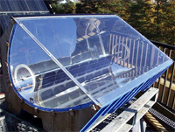
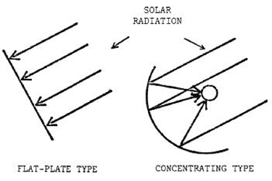
Concentrating type collector
They are also called focusing collectors.
It collects solar energy with high intensity.
It uses optical systems as reflectors or refractors.
Radiation falling on a large area is focused on to a receiver of small area.

Slide 18
Concentrating, or focusing, collectors intercept direct radiation over a large area and focus it onto a small absorber area.
These collectors can provide high temperatures more efficiently than flat-plate collectors, since the absorption surface area is much smaller. However, diffused sky radiation cannot be focused onto the absorber.
Most concentrating collectors require mechanical equipment that constantly orients the collectors toward the sun and keeps the absorber at the point of focus. Therefore; there are many types of concentrating collectors.

Slide 19
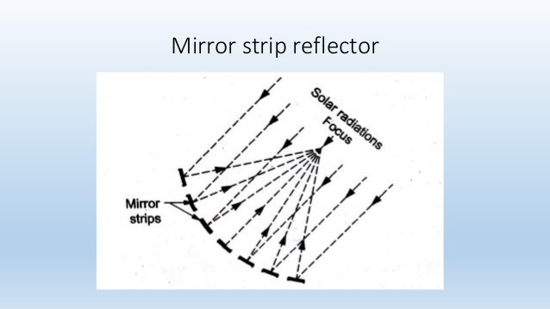
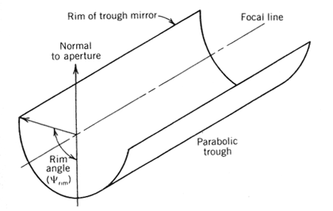
Types of Concentrating type collector
Parabolic trough collector
Mirror strip reflector
Fresnel lens collector
Flat plate collector with adjustable mirrors
Compound parabolic concentrator
(a)
(b)

Slide 20
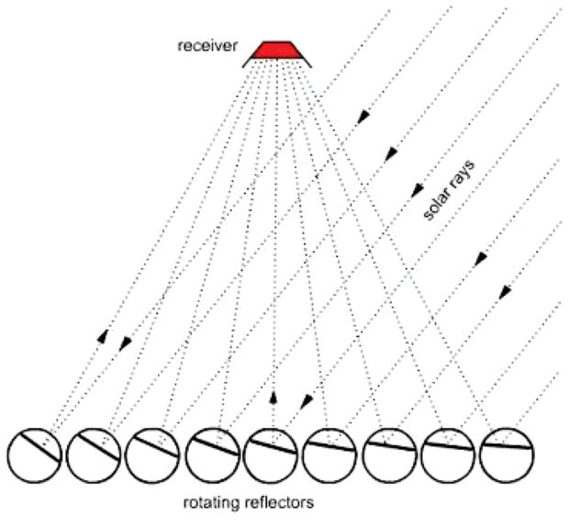
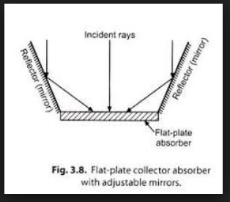
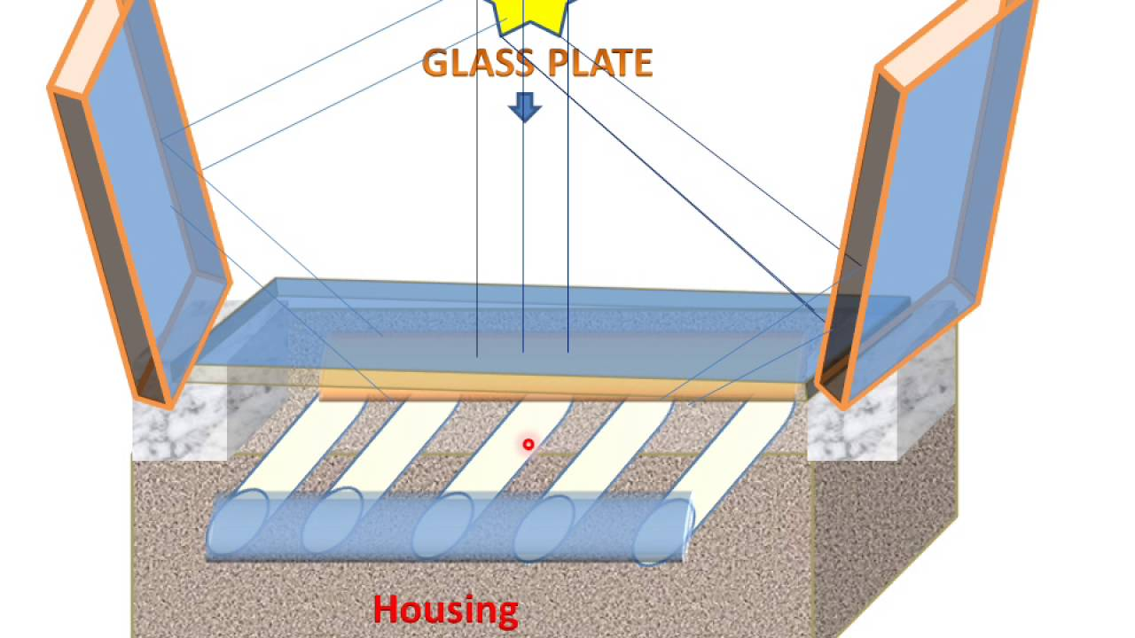
Fresnel lens collector
Flat plate collector with adjustable mirrors

Slide 21
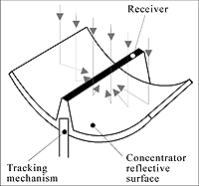
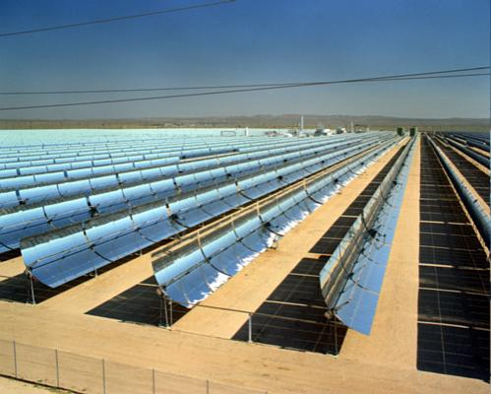
1. Parabolic trough system
Parabolic troughs are devices that are shaped like the letter “u”. The troughs concentrate sunlight onto a receiver tube that is positioned along the focal line of the trough. Sometimes a transparent glass tube envelops the receiver tube to reduce heat loss.
Their shapes are like letter “u” as shown figure 3.1.1 below.
The parabolic trough sytem is shown in the figure 3.1.2 below.
Figure 3.1.1 Crossection of parabolic trough [4].
Figure 3.1.2 Parabolic trough system [3].

Slide 22
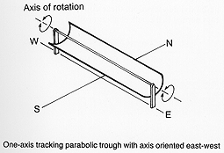
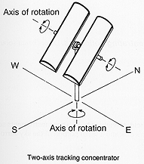
Parabolic troughs often use single-axis or dual-axis tracking.
The below figure 3.1.3 shows one axis tracking parabolic trough with axis oriented E-W.
The below figure 3.1.4 shows two axis tracking concentrator.
Figure 3.1.3 One Axis Tracking Parabolic Trough with Axis Oriented E-W [8].
Figure 3.1.4 Two Axis Tracking Concentrator [8].

Slide 23
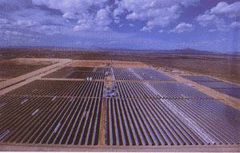
Temperatures at the receiver can reach 400 °C and produce steam for generating electricity. In California, multi-megawatt power plants were built using parabolic troughs combined with gas turbines .
Parabolic trough combined with gas turbines is shown figure below.
Figure 3.1.5 Parabolic trough combined with gas turbines [4].

Slide 24
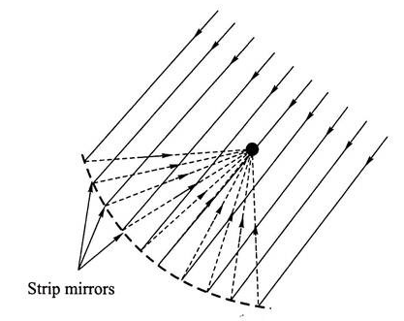
2) Mirror strip reflector:
A number of plane or slightly curved mirror strips are mounted on a flat base.The angles of these strips are such that they reflect solar radiation from a specific direction on to the same focal line.
The angle of mirror must be adjusted to allow for changes in the suns elevation,while the focal line remains at same position.

Slide 25
3) Fresnel lens collector
It has a trough shape collector,lens and receiver pipe..
The fresnel lens must be continously be aligned with the sun in two directions namely both along and perpendicular to its length.this is achieved by orienting the trough in both north –south directions.
It has solar radiation absorber with central steel pipe.a hollow steel plug within the absorber restricts the flow of heat transfer to annular region.
The solar radiation is focussed into the absorber from the top,rather than from the bottom as in parabolic type.

Slide 26
4) Flat plate collector with adjustable mirrors
It is the simplest type of concentrating collector .
It consist of flat plate facing south with mirrors attached to its south and north edges.
If the mirrors are set at proper angles,they reflect solar radiation onto the absorber plate.therefore absorber receives radiation in addition to that which is falling on it.

Slide 27
5.Compound parabolic concentrator
It consist of two parabolic mirrors.
Solar radiation from many directions is reflected towards bottom of the trough.
It provides good concentration of both diffuse and direct radiations without adjustments of sun tracking.
It can be designed for any absorber shapes.
They are suitable for temperature range of 100-150⁰C

Slide 28
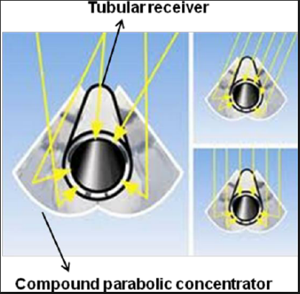
Compound parabolic concentrator

Slide 29
Advantages of conc collector
Reflecting surfaces require less material and are simple in construction.
Absorber area is small compared to flat plate collector for same energy collection.
Working fluid can attain higher temperature than flat plate system.
Economically feasible system
Disadvantages:
Only beam component is collected.
Expensive tracking systems
Maintenance wrt dirt,weather,oxidation required.
Non uniform flux in absorber.
High initial cost

Slide 30
Solar engines
Solar energy has several features that can be used as an engine for irrigation
The basic system has the following components:
a) solar collector
b) heat transport system
c) boiler
d) heat engine
e) condenser
f) pump

Slide 31
Solar heat engines
Rankine engine
Stirling engine
Brayton cycle engine
Rotary piston engine

Slide 32
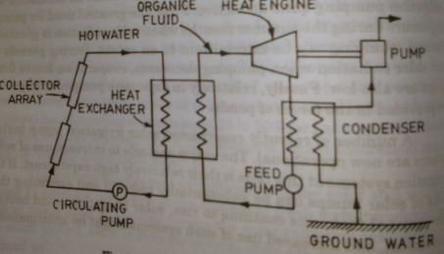
Solar pump for water pumping using flat plate collector and rankine engine.

Slide 33
Photo voltaics system-PV system
It is defined as generation of electromotive force as a result of absorbtion of ionizing radiation.
The device –solar cell
Combination of solar cell-module or array
Semiconductors
As photons are received free electrical charges are generated.
They can operate at lower temperatures.
Efficiency-25%.
Eff decreases with tempr
Silicon is used in solar cell

Slide 34
PV system consist of
Solar cell array
Load leveler
Storage system
Tracking system
PV system can be used for power plants.
One square metre of fixed array facing south yield 0.5kwh of energy

Slide 35
A semiconductor with one side p type and other side n type is called p-n junction.
When photons are absorbed free electrons of n-side move to p side, and
Holes of p side move to n side to compensate for their deficiencies.
This diffusion create electric field

Slide 36
Stand alone solar systems
A free standing or Stand Alone PV System is made up of a number of individual photovoltaic modules (or panels) usually of 12 volts with power outputs of between 50 and 100+ watts each.
These PV modules are then combined into a single array to give the desired power output.
A simple stand alone PV system is an automatic solar system that produces electrical power to charge banks of batteries during the day for use at night when the suns energy is unavailable.
A stand alone small scale PV system employs rechargeable batteries to store the electrical energy supplied by a PV panels or array.

Slide 37
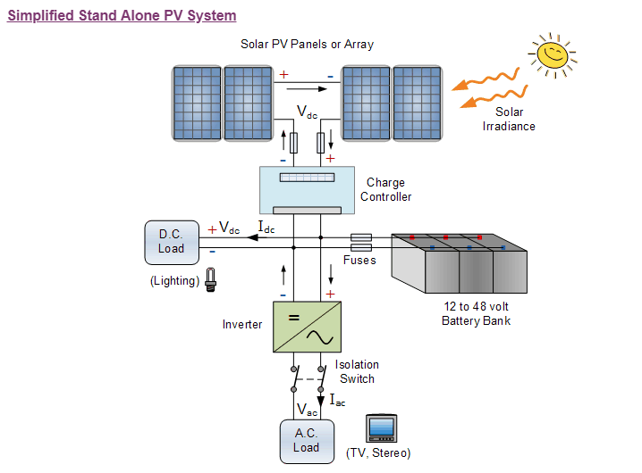

Slide 38
Stand alone PV systems are ideal for remote rural areas and applications where other power sources are either impractical or are unavailable to provide power for lighting, appliances and other uses.
In these cases, it is more cost effective to install a single stand alone PV system than pay the costs of having the local electricity company extend their power lines and cables directly to the home.

Slide 39
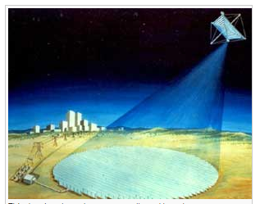
Grid connected solar power satellite.
A satellite with solar panels to convert light energy into electricity can be put into orbit. Indeed, most satellites in orbit today are powered by solar panels.
But how can we get the energy from the satellite back to earth?
Clearly it would be impossible to use the electric lines we use for long-distance power transmission on earth. This is where microwaves come in.

Slide 40
The idea is that a satellite be equipped with a microwave generator, so that the electrical energy from the solar panels can be converted into a microwave beam.
Then the microwave beam can be directed to antennas on the surface of the earth, which would convert the microwaves back to electrical energy.
The energy could then either be used at the site of the antenna or injected into the electric-power network.

Slide 41
Solar energy storage systems
1.Thermal storage
a) sensible heat storage
B) latent heat storage
Sensible heat is storage of heat by increase in temperature of a material.
Storage by phase change is called latent heat.
Thermal storage is essential for water heating and space heating.
Water and rock are typical examples for sensible heat storage.
Glauber salt is used as latent heat storage system.

Slide 42
2)electrical storage
Capacitors can store large amount of energy for long period of time.
3) Chemical storage-methane

