Slide 1
UNIT-3
WIND ENERGY

Slide 2
Contents
Wind energy conversion
General formula-lift and drag-Basis of wind energy conversion-
Effect of density-Frequency variances
Angle of attack and wind speed.
Windmill rotors-Horizontal and vertical axis rotors.
Determination of torque coefficient
Induction type generators-working principle

Slide 3
Wind results from air in motion.
Solar radiation heats the air near equator,and this low density air is buoyed up. Thus wind is caused by solar energy irradiating the earth.
It has been estimated that 2% of all solar radiation falling on the surface of earth.
The power obtained by wind mill is depended on:
1)wind speed
2)cross section of wind swept by rotor
3) overall conversion efficiency of rotor

Slide 4
Parts of wind turbine

Slide 6
Well designed blades will typically extract 70% of theoretical maximum,but losses during transmission in different parts bring down its efficiency to 35%.
Wind mill works on the principle in which kinetic energy is converted into mechanical energy.
Kinetic energy=$\frac{1}{2}$mV²
m=ρAV
K.E=$\frac{1}{2}$ρAV .V²
Power=$\frac{1}{2}$ρAV³ watt
Max power obtained in horizontal axis wind turbine=$\frac{8}{27}$ ρAV³
Power/area is called power density w/m²

Slide 7
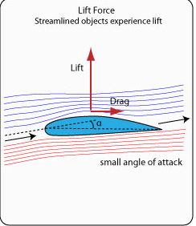
Power is proportional to cube of velocity.
Double of velocity increases 8 times the power.
Lift and drag
Lift and drag are two primary mechanisms
for producing forces from the Wind.

Slide 8
The Lift Force is perpendicular to the wind direction.
It is caused by a pressure difference between the air on either side of the blade.
The Drag Force is in the same direction as the wind.
The ratio between lift and drag largely depends on the shape of the blade and the angle of the main line of the blade (chord line) and the main wind direction - the angle of attack. The lift force is largest for streamlined
Depending on the design of the turbine, either drag or lift moves the blades.
Most wind turbines today use the prinicple of lift rather than drag.
For efficient operation a wind turbine blade needs to function with as much lift and minimum drag as possible.

Slide 9
However, we need to remember that the efficiency of the turbine is a function of wind speed.
It varies with wind speed.
Now, let us try to calculate the wind speed required to generate power equivalent to 1 square meter PV panel with 12% efficiency.
We know that solar insolation available at the PV panel is 1000 watts/m 2 at standard condition.
Hence the output of the PV panel with 12% efficiency would be 120 watts.

Slide 10
Now the speed required to generate this power by the turbine with 30% efficiency can be calculated as follows:
Turbine output required = 120 Watts/m 2
Power Density at the blades = 120/ (0.3) = 400 watts/m 2
Therefore, the wind speed required to generate equivalent power
will be=( $\frac{400}{0.6} )$^{1/3} =8.735m/s

Slide 11
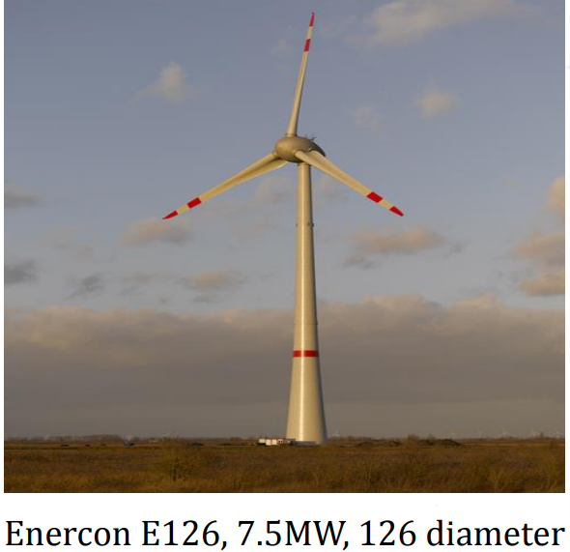
Horizontal axis,vertical axis wind turbines.

Slide 12
Horizontal axis wind turbine

Slide 14
Vertical axis wind turbine

Slide 15
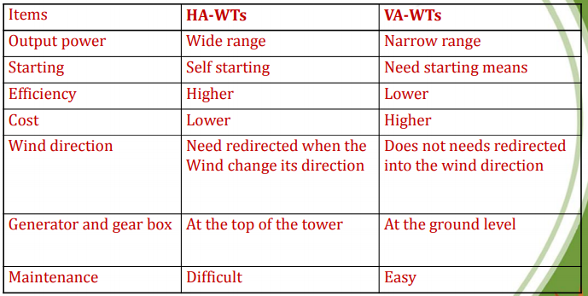
Comparison of HORIZONTAL,VERTICAL AXIS WIND TURBINES

Slide 16
UPWIND,DOWNWIND TURBINES

Slide 26
Induction generators
An induction generator or asynchronous generator is a type of alternating current (AC) electrical generator that uses the principles of induction motors to produce power. Induction generators operate by mechanically turning their rotors faster than synchronous speed. A regular AC induction motor usually can be used as a generator, without any internal modifications.

Slide 27
Applications:
Induction generators are useful in applications such as mini hydro power plants, wind turbines, or in reducing high-pressure gas streams to lower pressure, because they can recover energy with relatively simple controls.
Principle of operation:
An induction generator produces electrical power when its rotor is turned faster than the synchronous speed. For a typical four-pole motor (two pairs of poles on stator) operating on a 60 Hz electrical grid, the synchronous speed is 1800 rotations per minute (rpm).
The same four-pole motor operating on a 50 Hz grid will have a synchronous speed of 1500 RPM. The motor normally turns slightly slower than the synchronous speed;
The difference between synchronous and operating speed is called "slip" and is usually expressed as per cent of the synchronous speed. For example, a motor operating at 1450 RPM that has a synchronous speed of 1500 RPM is running at a slip of +3.3%.

Slide 28
In normal motor operation, the stator flux rotation is faster than the rotor rotation. This causes the stator flux to induce rotor currents, which create a rotor flux with magnetic polarity opposite to stator. In this way, the rotor is dragged along behind stator flux, with the currents in the rotor induced at the slip frequency.
In generator operation, a prime mover (turbine or engine) drives the rotor above the synchronous speed (negative slip). The stator flux still induces currents in the rotor, but since the opposing rotor flux is now cutting the stator coils, an active current is produced in stator coils and the motor now operates as a generator, sending power back to the electrical grid.

