Slide 1
SOFTWARES USED IN ESTIMATION COSTING

Slide 2
STACK Takeoff & Estimating:
STACK Estimating is a cloud-based on-screen takeoff and estimating tool for professional contractors of all business sizes and all trades. STACK users can quickly and easily upload digital plans and complete takeoffs using the software. Then users can create detailed estimates and submit accurate bids.

Slide 3
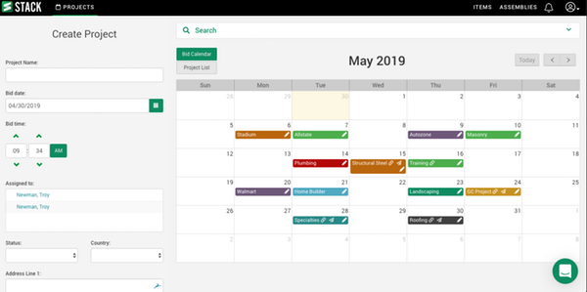

Slide 4
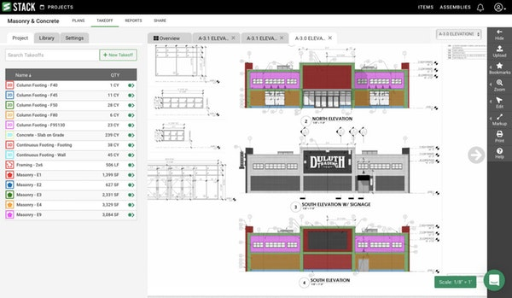

Slide 5
ESTICOM
Esticom is a cloud-based construction takeoff and estimating platform that helps contractors manage construction projects with real-time access to labor, pricing, plans and material database. Primarily catering to trades such as electrical, plumbing, structured cabling, fire safety, security and HVAC, Esticom provides tools to handle operations, purpose-built estimates and projects.

Slide 6
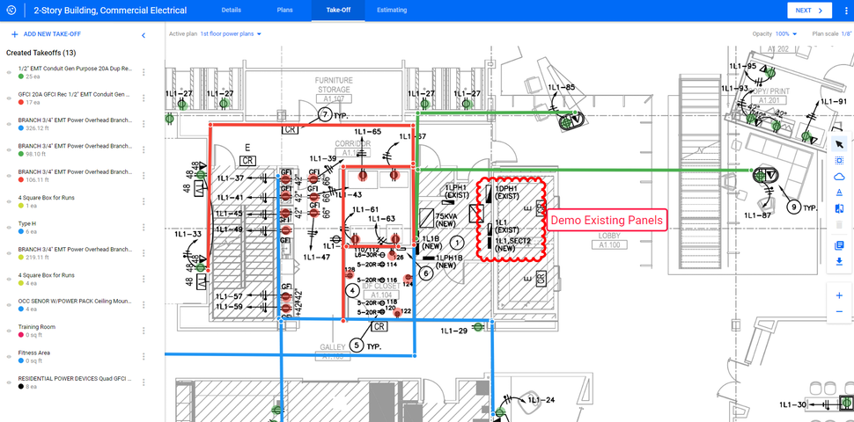

Slide 7
TurboBid Estimating:
TurboBid is an on-premise estimating software solution for small and midsize contractors designed to help them complete project estimations, regardless of the type of work, whether it's new residential, light commercial, remodeling, service work or flat rate pricing.

Slide 8
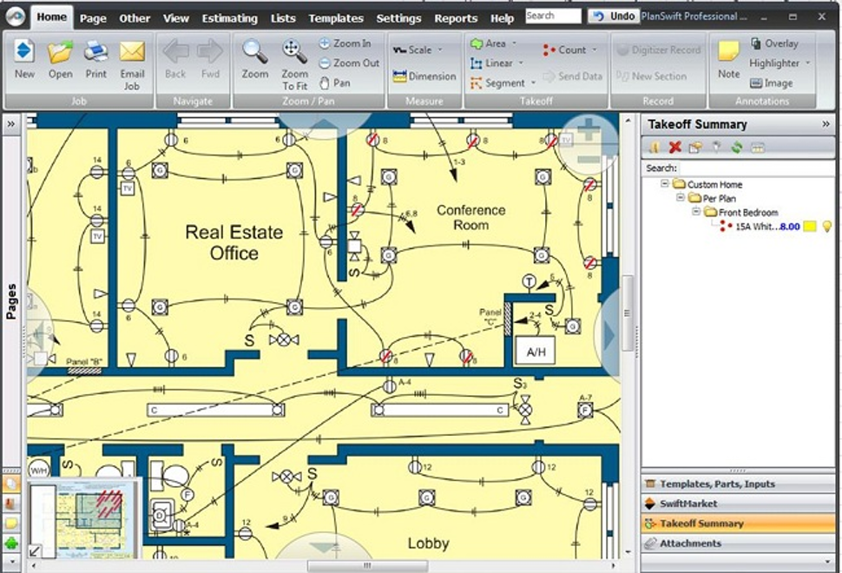

Slide 9
MS PROJECT
Microsoft Project is the world's most popular project management software developed and sold by Microsoft.
The application is designed to assist project managers in developing plans, assigning resources to tasks, tracking progress, managing budgets and analysing workloads.

Slide 10
MS PROJECT
Microsoft Project creates budgets based on assignment work and resource rates. As resources are assigned to tasks and assignment work estimated, Microsoft Project calculates the cost equals the work times the rate. This rolls up to the task level, then to any summary tasks and finally to the project level.

Slide 11
MS PROJECT – KEY ELEMENTS
RESOURCES
ALLOCATION
SCHEDULING
PREDECESSOR & SUCESSOR
GANT CHART
CRITICAL PATH

Slide 12
MS PROJECT – KEY ELEMENTS
RESOURCES: Resources are referred to as profile which is needed to perform a particular task.
ALLOCATION: Defining the resources to a particular task is called allocation.
SCHEDULING: It is one of the important task in Microsoft project. Scheduling is done in two ways
Manual scheduling
Automatic scheduling
PREDECESSOR & SUCESSOR: Predecessor is the task preceding a particular task and Sucessor is the task performed after the particular task.

Slide 13
MS PROJECT – KEY ELEMENTS
GANT CHART: It shows the overall duration of project in the defined constraints.
CRITICAL PATH: Longest duration in the network analysis diagram.

Slide 14
TYPES OF PREDECESSORS
FINISH TO START (FS)
START TO START (SS)
START TO FINISH (SF)
FINISH TO FINISH (FF)

Slide 15
THANK YOU

