Slide 1
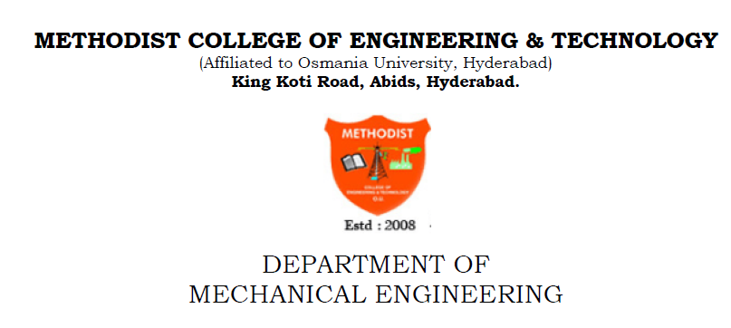
Steering system
- Dr. P. Ravichander

Slide 2
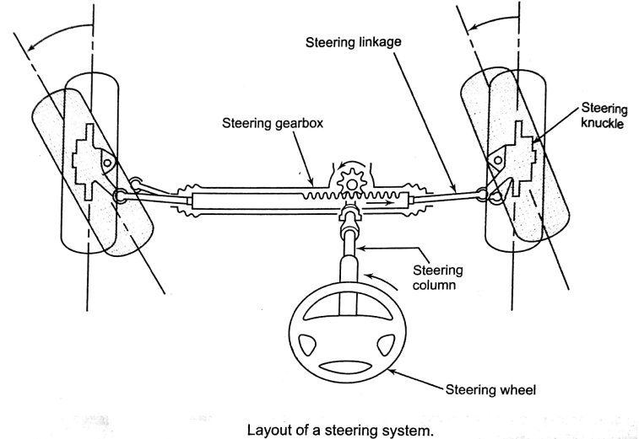
STEERING SYSTEM:
The steering system provides the change in the direction of motion of a vehicle.
This is achieves by converting the rotary motion imparted to the steering wheel by the driver into the angular turns of the front wheels.
The steering system consists of following major components as shown in figure.
1)Steering wheel, 2)steering column and shaft, 3)steering gear box, 4)steering linkages(steering arm, drag link or tie rod) and 5) steering knuckle(or stub axle).

Slide 3
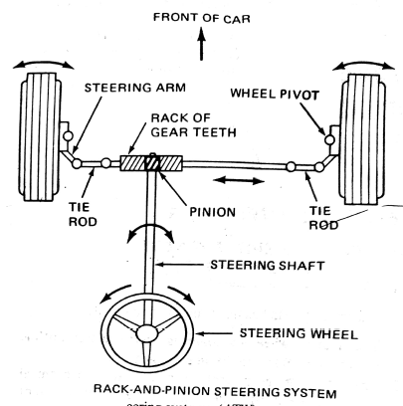
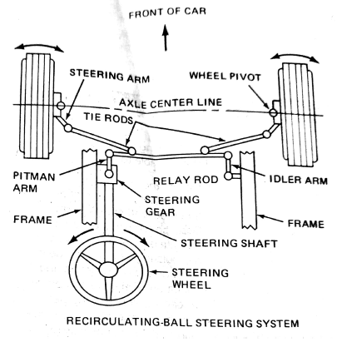

Slide 4
The steering system should posses the following qualities:
It must be capable of keeping the wheels in true rolling motion at all times without rubbing or scuffing of tyres on roads.
It should have a certain degree of self centering action to keep the vehicle on straight path.
It must be easy to operate.
It should be light i.e it should not require excessive effort to turn the steering.
Principle of correct steering:
The steering gear mechanism is used for changing the direction of two or more wheel axles with reference to the chassis.
So as to move the vehicle, usually, the two back wheels have a common axis, which is fixed in direction with reference to the chassis and steering is done by means of the front wheels.
In automobiles, the front wheels are placed over the front axles, which are pivoted at the points A and B as shown in figure and these points are fixed to the chassis. the rear wheel are placed over the back axle.
When the vehicle takes turn, the front wheels along with respective axles turn about the respected pivot points. The rear wheels remain straight and do not turn. Therefore, steering is done by means of front wheels only.

Slide 5
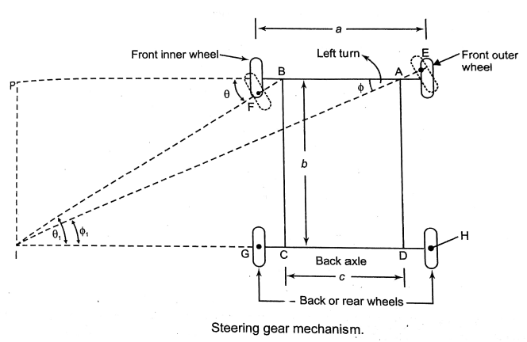

Slide 6
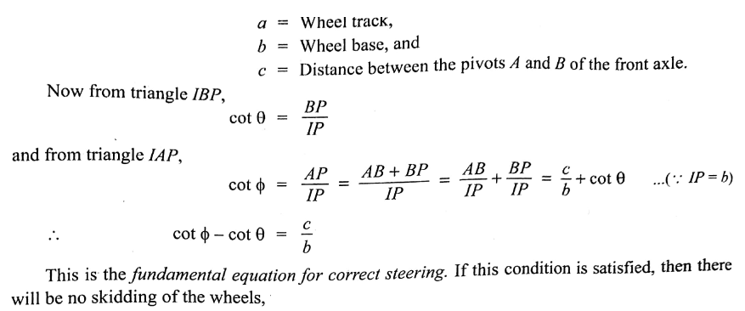
In order to avoid skidding, the two front wheels must turn about the same instantaneous centre I, which lies on the axis of the back wheels.
If the instantaneous centre of the two front wheels do not coincide with instantaneous centre of the rear wheels, the skidding on front or rear wheels will definitely take place, which will cause more wear and tear of the tyres.
Thus, the condition of correct steering is that the four wheels must turn about the instantaneous centre.
The axis of the inner wheel makes a larger turning angle θ then the angle φ subtended by the axis of outer wheels.

Slide 7
Steering Mechanisms:
There are two type of steering mechanisms:
1)Davis steering mechanism.
2) Ackermann steering mechanism.
the main difference the two steering gear mechanisms is that the Davis steering gear has sliding pair, whereas the Ackermann steering gear has only turning pairs.
Ackermann steering mechanism:
The Ackermann steering mechanism consists of four link mechanism ABCD as shown fig.
The shorter links BC and AD are equal length and are connected with stub axles BF and AE respectively.
The length of the link CD is shorter than that of the link AB.
When the vehicle is moving ahead in straight position, the links BC and AD are parallel and subtend equal angles (θ=φ) with the centerline of the vehicle.
Then the vehicle is turned to the left, the stub axle AE and BF turn through different angles, in respect to their previous positions.
The stub axle BF will turn through a greater angle θ, then the stub axle AE, which will turn through an angle φ.
In this position, the lines from the front wheels axle intersect on the rear wheels axles at the instantaneous centre I, this arrangement known as Ackermann steering mechanism.

Slide 8
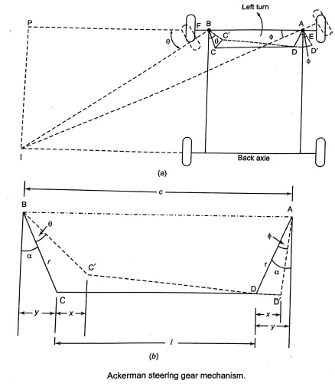

Slide 9
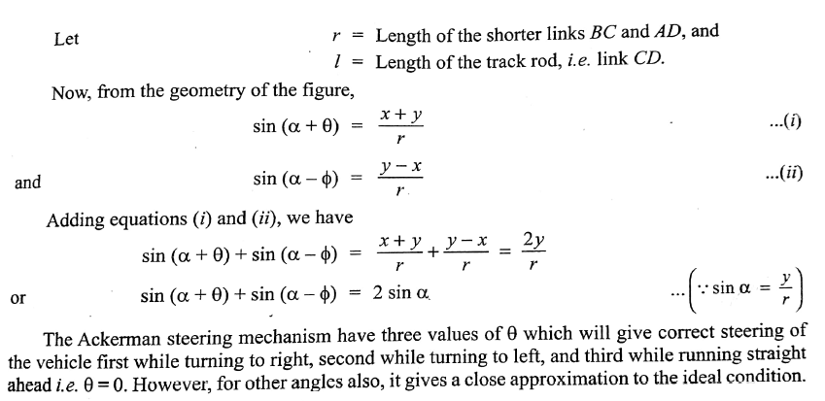

Slide 10
Steering Gearbox:
The steering gearbox mainly consists of two gears enclosed in a housing. One of them is attached to the steering shaft and the other is attached to the steering linkages which are further attached to the front wheels.
The Primary function of a steering gearbox:
It converts the rotary motion of the steering wheel into straight line motion, which will move the steering linkages.
It provide mechanical advantages(i.e. gear reduction it may be 12:1 to 35:1) which enables the driver to steer the vehicle easily.
Types of steering boxes:
Worm and sector steering gear box:
In this type of steering gear, a worm is placed at the end of the steering shaft and it is in constant mesh with a sector gear mounted on a sector shaft which is attached to the pitman arm ( Drop arm).
The worm shaft is supported in the housing with the help of two bearings, one at the top and the other at the bottom, so that it can rotate easily.
The sector shaft is also held in the housing with bronze bushes on either side.
This type of steering gear is commonly used in tractors.

Slide 11
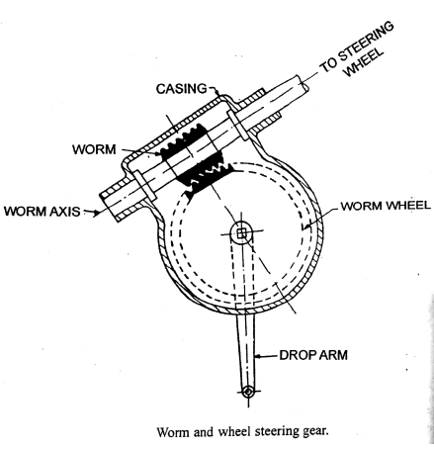
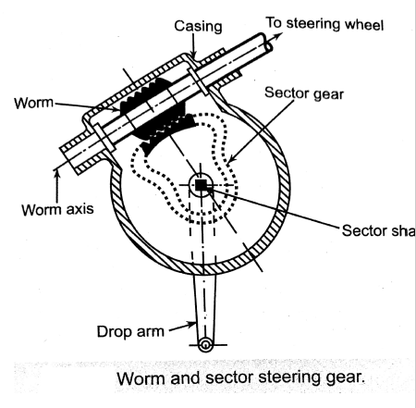
2) Worm and roller steering gear:
This type of steering gear is similar to worm and sector type.
The difference is that in this case, a complete gear is fixed on the sector shaft whereas in sector type, only a sector of the gear is used.

Slide 12
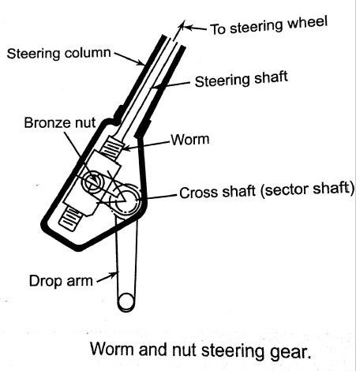
3) Worm and nut steering gear:
In this type of steering gear, worm and steering shaft are made out of a single piece.
At the end of the shaft, square screw threads are made, therefore, when the steering column is rotated the worm also rotates.
A bonze nut is fixed on the worm, this nut attached to the cross(sector) shaft.
In its operation, this steering gear acts like a bolt and nut.
The turning of a steering wheel moves the nut along the steering shaft screw thread up and down, moving the cross(sector) shaft.

Slide 13
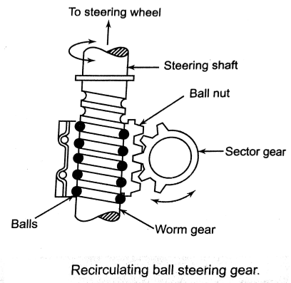
4) Worm and nut with re-circulating ball steering drop arm gear:
This type of steering gear is an improved type of worm and nut steering gear.
In this type of steering gear, a ball nut is mounted on the worm.
The steel balls are provided between the worm groves and ball nut. These steel balls ensure a smooth and frictionless drive.
The teeth on the ball nut meshes with the teeth of the sector gear mounted on the shaft.
This type of steering gear produces a light steering feel but has a complex construction.

Slide 14
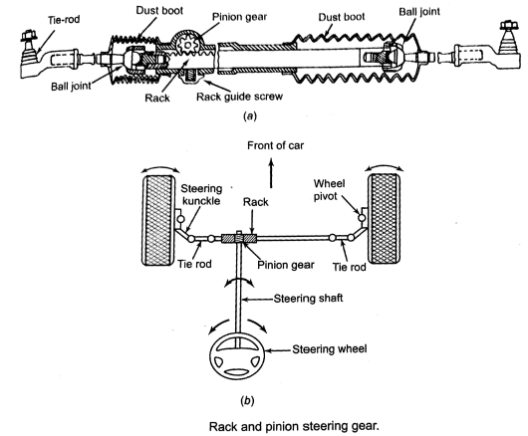
5) Rack and pinion type steering gear:
In this type of steering gear, the steering shaft is connected to a small pinion gear.
This gear is in mesh with the teeth on top of the long bar, called a rack.
Both end of the a rack are joined to tie rods with the help of ball joints.
The other end of tie rods are fixed with steering knuckle arms at right and left.
When the steering wheel is turned, the pinion shaft rotates and revolving.
The rack and pinion type of steering gear is most commonly used at present in smaller vehicles, due to its simple in construction and excellent steering sensitivity.

Slide 15
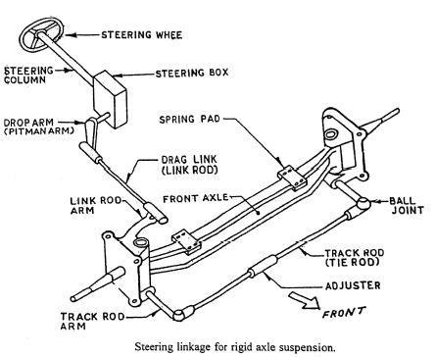
Steering linkages:
The steering linkages is a connection of various links between the steering box and the from wheels.
The steering linkages transfers the side to side or front to rear movements of the pitman arm in the left to right movement of the wheels.
Following are the different types of steering linkages:
Conventional steering linkage:

Slide 16
2) Independent front suspension steering linkages:
Parallelogram steering linkage:
the parallelogram steering linkage is found on larger cars, pick-ups and larger SUV’s.
The drop arm connects the linkage of the steering column through steering gear located at the base of the column.
These parallelogram linkages is of different forms:
Centre link arrangement: in centre link arrangement, a centre link is supported at one end by drop arm and the other end by the idler arm. These two arms are parallel to each other. It is further attached to the vehicle frame.
The outer ends of the centre link are further connected through the tie rods.
The tie rods actually make the final connections between the steering linkage and steering knuckles.
The tie rods have adjustable sleeves or bolts to adjust correct toe settings.
The centre link and tie rods are nearly parallel when viewed at the top.
Centre link arrangement

Slide 17
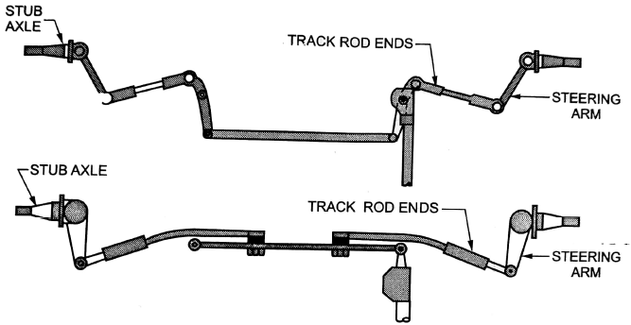
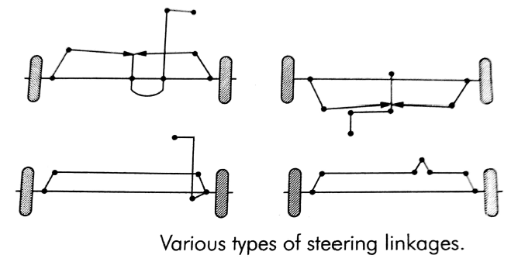
Relay linkage type: the relay rod connects the drop arm and an idler arm placed parallel to it, on the other side of frame.
The relay rod is further connected through the tie rods placed parallel to relay rod
Relay linkage type
b) Rack and pinion steering linkage:

Slide 18
POWER STEERING:
The power steering system is the system employed in automobile to reduce the effort required to operate the steering wheel.
This features adds to the comfort while driving, less effort is required to turn the steering by the driver.
Advantages:
The power steering system reduces the number of turns of steering wheel required to move it from lock to lock.
Easy steering while parking, at low speeds or tight turns.
Types of power sheerings:
Hydraulic power steering system
Electronic power steering system

Slide 19
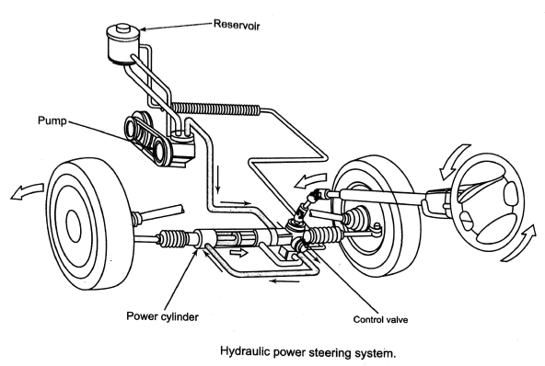
HYDRAULIC POWER STEERING SYSTEM:

Slide 20
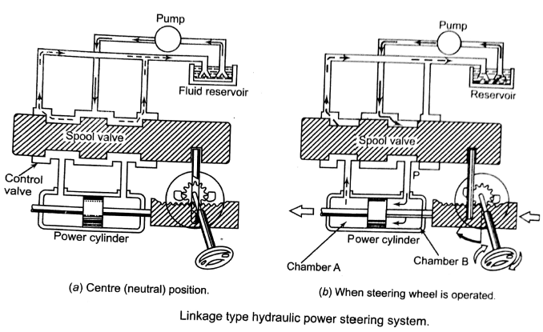
Types of Hydraulic power steering systems are generally of the following two types:
a) Linkage type, b) integral type.
Linkage type Hydraulic power steering system:
In this type steering system uses a separate hydraulic power cylinder controlled by a valve assembly attached to the drop arm to assist in steering.
This type steering system contains fluid reservoir and pump, control valve (which is a spool valve type control valve). Power cylinder. Connecting fluid lines and necessary steering linkages.

Slide 21
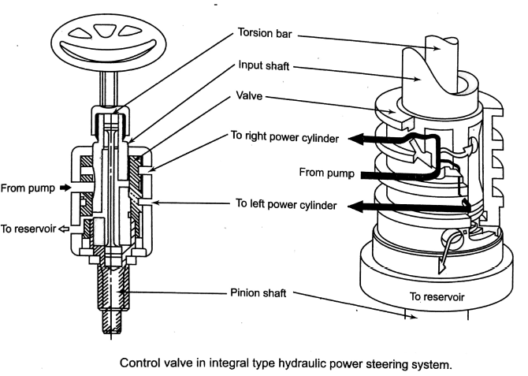
b) Integral type Hydraulic power steering system:
The pump is connected by flexible hydraulic lines to a power cylinder that along with a control valve is an integral part of the steering gear.
The control valve in this system is a rotary type and is located in the upper section of the gear housing.
This rotary valve type power steering system are relatively simple in construction and of compact size.
It consist of input shaft, a torsion bar and a valve, all of these are mounted in a coaxial manner.

Slide 22
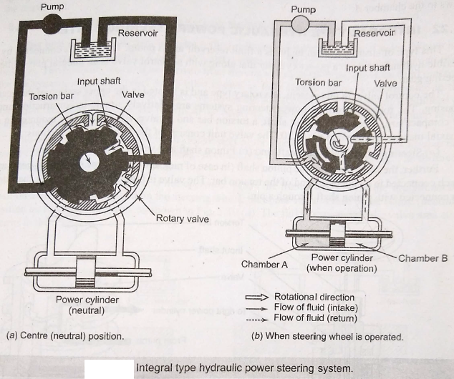

Slide 23
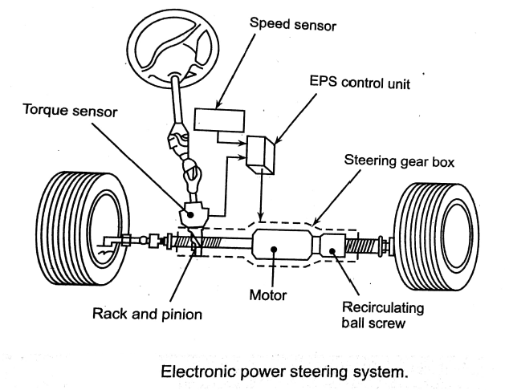
2)ELECTRONIC POWER STEERING:

Slide 24
The basic operating principle of electronic power steering is same as hydraulic power steering except the following component changes:
The torque sensor is used in place of valve body unit.
The electronic motor is used in place of hydraulic power cylinder.
The EPS control unit is added.
In this system consist of a rack and pinion steering gear with an electric motor( DC motor) installed around the rack, which supplies the power.
The rack shaft passes through the motors armature and is held by recalculating ball screw.
The motor transmits its power to push the rack right or left.
A steering sensor is installed on the input shaft(pinion shaft) which is actually made up of two sensors that is torque sensor and rotation sensor.
The torque sensor converts steering torque input and its direction into voltage signals and a rotating sensor converts the rotation speed and direction into voltage signals.
Following are the advantages of using EPS:
It is compact, light and quiet in operation.
It also provides precise control at different speeds.
It requires less maintenance as there are no hydraulic lines.

Slide 25
WHEEL ALIGNMENT:
The wheel alignment refers to the relative positioning of the wheels for obtaining a true and free rolling movement over road.
If the wheels where all mounted directly onto a vehicle at right angles, then that vehicle would actually be very difficult to handle.
It would steer poorly and would be particularly dangerous at high speeds and moreover.
For that reasons several wheel alignment factors require consideration for the simple steering, reliable handling, smooth control and favorable tyre wear characteristics may be obtained.
The important wheel alignment factors are:
camber, b) Toe-in and Toe-out, c)steering axis inclination(i.e. king pin angle),
d) Caster.
Depending upon the design of suspension system, it is possible to adjust some of these factors .
Also, some of the factors are changed with the operation of suspension.

Slide 26
a)CAMBER:
The camber is an inward or outward tilting of the wheels at the top from the vertical axis.
when the wheels tilt outward at the top, the camber is positive and when the tilt is inward, the camber is negative.
When viewing a vehicle with positive chamber from the front, the top of the wheel is father apart than the bottom.
The camber is measured in degrees and can be adjustable.
The zero camber gives maximum tyre life, since the tyre tread contacts the road surface equally on both sides of the tyre.
The positive camber also places the centerline of the wheel closer to the steering axis.
The distance between the wheel centerline and steering axis centerline at the point where they intersect at the road surface is called a camber offset(scrub radius).
The smaller the offset, the lower is the effort required to steer the vehicle.
The old vehicle often have a large camber angle to reduce this offset, but excessive camber will , however, cause uneven tyre wear and loss of traction.
In modern vehicles use wider tyres and power steering, therefore most vehicles have only small degree of camber angle(usually it varies between 1⁰ to 3⁰)

Slide 27
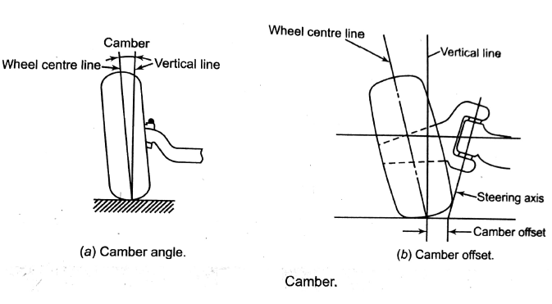
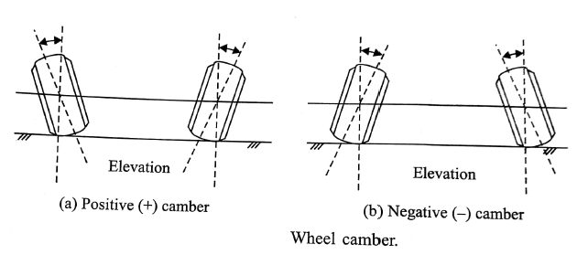

Slide 28
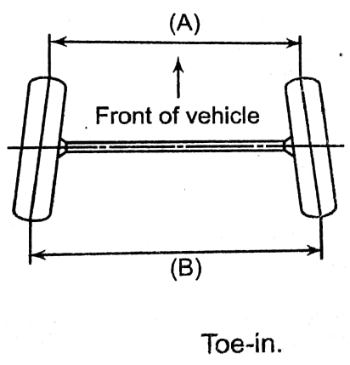
b)Toe-in and toe-out:
Toe in:
The toe-in is pointing of the wheels inward at the front.
In the vehicle with toe-in, the distance between the front wheels at the front(A) is less than at the rear(B) as shown in fig.
The toe-in is indicated by this difference( B-A), and measured in millimeters.
The purpose of toe-in is to ensure parallel rolling of wheels, steering stability, and to prevent both side slipping and excessive wear of tyres.
It also serves to offset the small deflections in the wheel- support system which comes out when the car is moving forward.

Slide 29
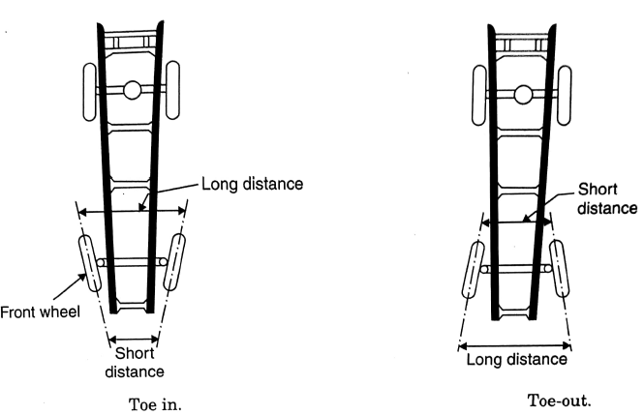
Toe-out:
Toe-out is the difference in angles between the two front wheels and the car frame during turns.
The steering system is designed to turn the inside wheel through a larger angle then the outside wheel when making a turn.
This condition causes the wheels to toe-out on turns, due to the difference in their turning angle.
When the car is taking a turn, the outer wheels rolls on a large radius then the inner wheel and the circle on which the two front wheels must roll are concentric.
As shown fig. when the front wheels are steered to make a turn, the inner wheel turns to an angle of 23⁰ with the car frme, while the outer wheel turns only 20⁰ with car frame.
The toe-out is secured by providing the proper relationship between the steering knuckle arms, tie rods and pitman arm.

Slide 30
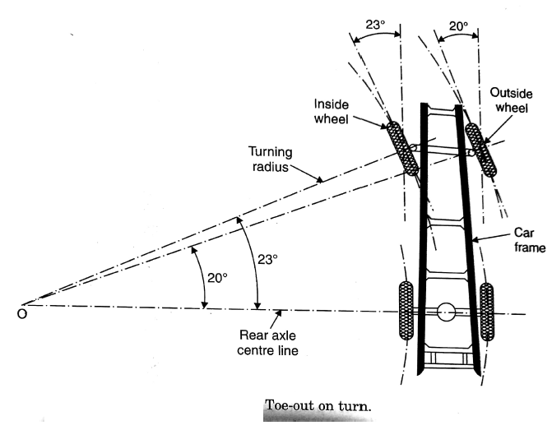

Slide 31
c)steering axis inclination(i.e. king pin angle):
The steering axis inclination is the angle(when viewed from the front of the car) between the steering axis(i.e. the line drawn through the axis of ball joints) and the vertical axis. As shown in fig.
This inward tilt or inclination tends to keep the wheels straight ahead.
It also helps the return of wheels to the straight ahead position after the turn has been made.
The steering axis inclination is also called king pin inclination, because the older vehicles were fitted with a component called kingpins which acted as the steering axis.
The kingpins are still available on large sized trucks.
The kingpin inclination, in combination with caster, is used to provide directional stability in modern cars, by tending to return the wheels to the straight-ahead position after turn.
It reduces the steering effort particularly when the vehicle is stationary and reduce tyre wear also.
The steering pin inclination in modern vehicles ranges from 4 to 8⁰ and it must be equal on both the sides.
If it is greater on one side then other, the vehicle will tend to pull to the side having the greater angle.

Slide 32
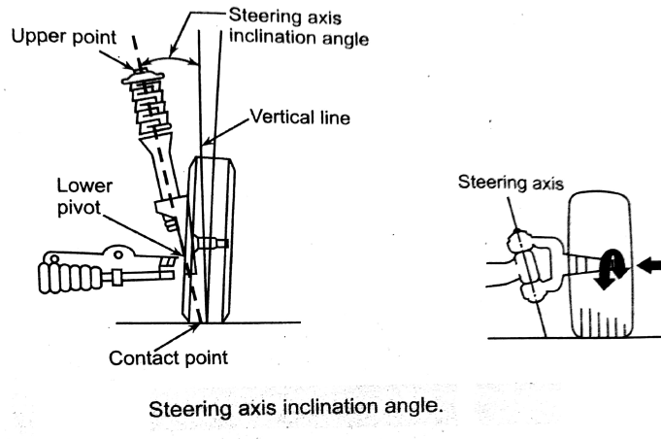
Included Angel:
The combined chamber and kingpin inclination is called the included angle.
This angle is important because it determines the point of intersection of the wheel and kingpin centre lines.
If the point of intersection is above the ground, the wheel tends to toe-in.
If it is below the ground , the wheel tends to toe-out.
If it is at the ground, the wheel keeps its straight position without any tendency to toe-in or toe-out.
In this position the steering is called centre point steering.

Slide 33
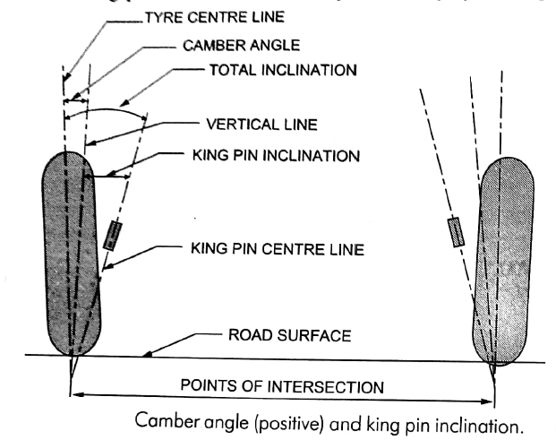
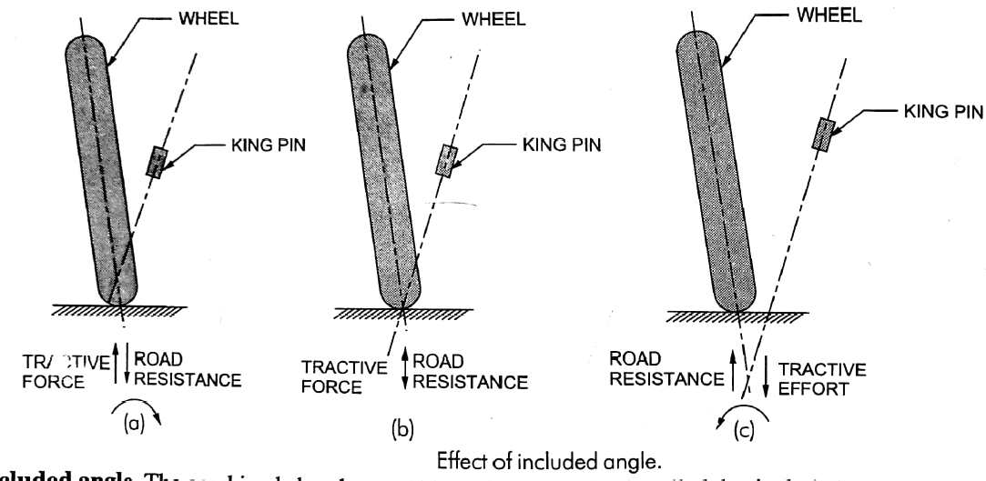

Slide 34
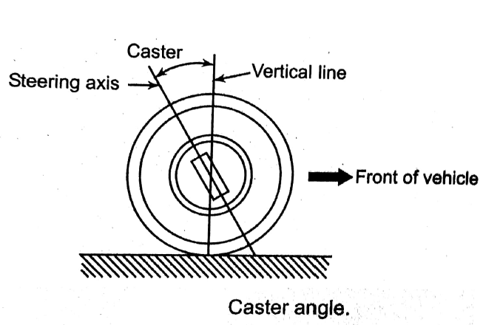
d) caster:
In addition to being tilted inward or toward the centre of the vehicle, the kingpin axis may also be tilted forward or backward from the vertical line.
This tilt is known as the caster, thus the angle between the vertical line and the kingpin centre line in the plane of the wheel( when viewed from the side) is called the caster angle.
When the top of the kingpin is backward, the caster angle is positive, and when it is forward the caster angle is negative.
The caster angle in modern vehicles ranges from 2 to 8⁰ .

Slide 35
Effect of in correct alignment:
S.no | PROBLEM | EFFECT ON VEHICLE
1 | Incorrect camber setting | i)Uneven tyre wear ii)vehicle pulls to the side of the most positive or least-negative camber
2 | Incorrect toe-in | i) Excessive tire wear. ii) unstable steering
3 | Uneven toe-in | Vehicle tends to pull to one side
4 | Incorrect steering axis inclination | i)instability of vehicle ii)poor steering recovery iii)vehicle pull to side of lesser inclination iv)hard steering
5 | Too much caster | i)Hard steering ii)Excessive road shock iii)wheel shimmy
6 | Insufficient caster | Instability at high speeds
7 | Unequal caster | Vehicle pulls to the side of the most caster

