Slide 1
Stretch forming is a metal forming process in which the sheet metal is placed under a tensile load over a forming block and stretching it to the plastic range, thus cause permanent deformation to take place.
This process is useful in making prototype models of aircraft and automotive parts.
It is performed on a stretch press, in which a piece of sheet metal is securely gripped along its edges by gripping jaws.

Slide 2
Stretch Forming.
The gripping jaws are each attached to a carriage that is pulled by pneumatic or hydraulic force to stretch the sheet.
The tooling used in this process is a stretch form block, called a form die, against which the sheet metal will be pressed.

Slide 11
Another advantage is that the residual stresses are less in this process.
The reduction of residual stresses leads to lower spring back.

Slide 13
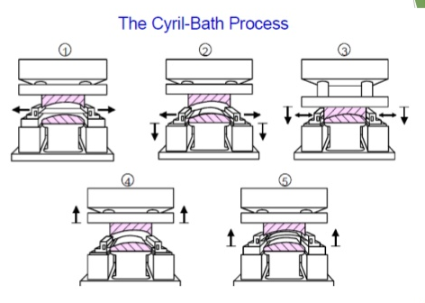
In this process the work piece is stretched between the mating dies.
The work piece is held in tension by grippers and as the grippers move, they pre-form the work piece in a lower die.
The upper die is then descends on to the work piece and forming it into the shape between the dies.

Slide 16
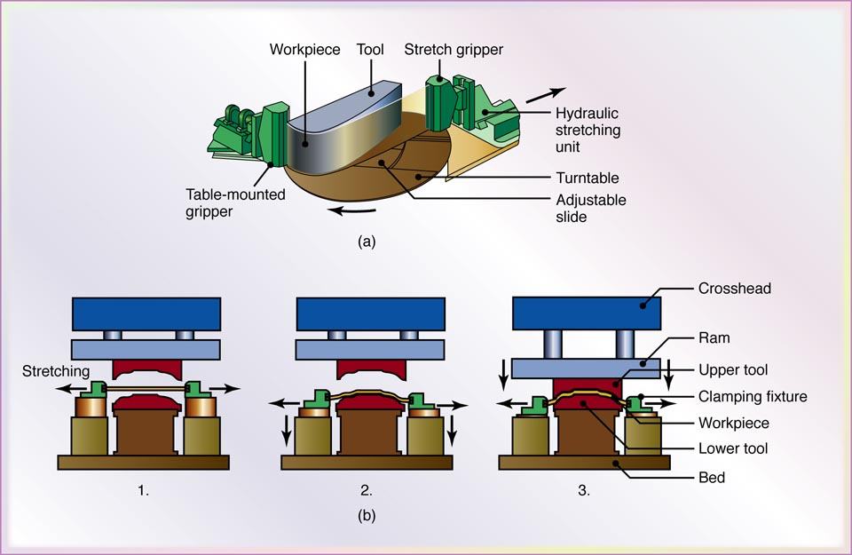
Stretch-Forming Process
Figure 16.30 Schematic illustration of a stretch-forming process. Aluminum skins for aircraft can be made by this method. Source: Courtesy of Cyril Bath Co.

Slide 21
Radial Draw Forming
It is a method of forming various shapes of rolled or extruded sections.
Similar to Stretch Draw forming.
In this case, the metal blank is first stressed by pulling it to its yield point.
In this semi plastic state, the part is easily made to conform to the shaped forming dies.

Slide 22
Radial Draw Forming

Slide 23
Applications
Industrial Conveyor track
Monorail guide beams
Structural members for truck, bus and aircraft applications.
Materials that can be formed by Radial draw forming:
Steel Nickel
Aluminium Titanium alloys

