Slide 1
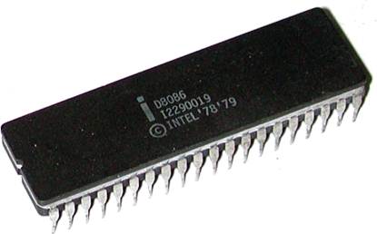
Input/output – I/O Interface to 8086
Unit - 3
Presented By
M. Mahesh Babu

Slide 2
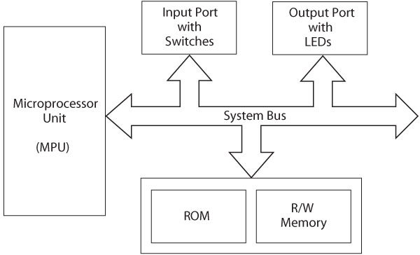
Microprocessor-Based Systems

Slide 3
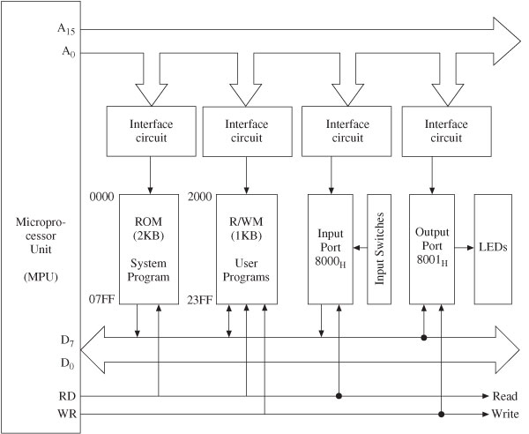
Microprocessor-Based Systems

Slide 4
Microprocessor Architecture
MPU communicates with Memory and I/O using the System Bus
Address bus
Unidirectional
Memory and I/O Addresses
Data bus
Bidirectional
Transfers Binary Data and Instructions
Control lines
Read and Write timing signals

Slide 5
Primary function of MPU
Read Instruction from memory
Execute instruction
Read/Write data to memory
Some time send result to output device
LEDs, Monitor, Printer
Interfacing a peripheral
Why: To enable MPU to communicate with I/O
Designing logic circuit H/W for a I/O
Writing instruction (S/W)

Slide 6
The 8086 microcomputers can employ two types of input/output (I/O):
Isolated I/O.
Memory-mapped I/O.
These I/O methods differ in how I/O ports are mapped into the 8086's address spaces. We will only consider isolated I/O.

Slide 7
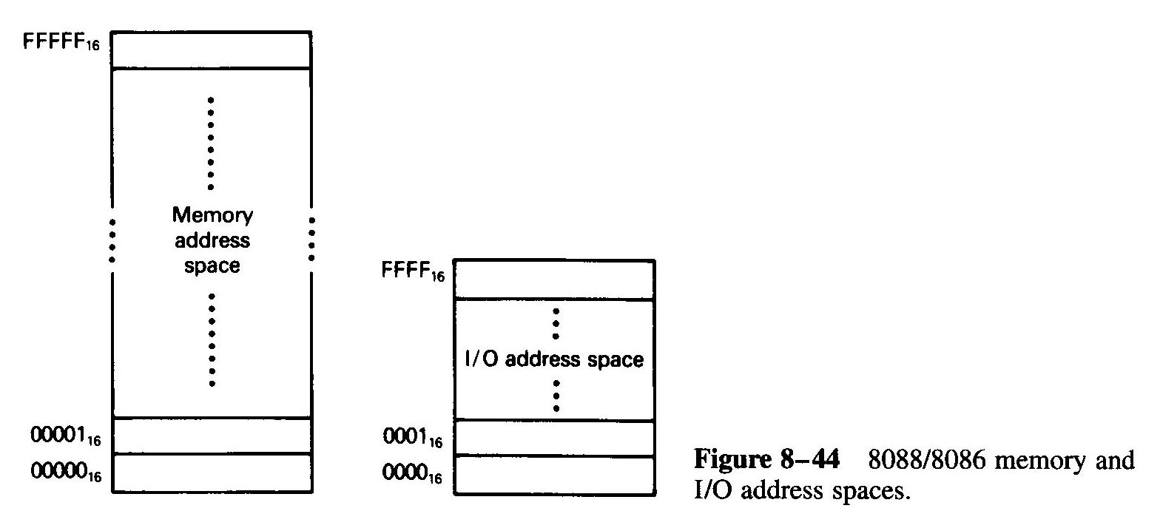

Slide 8
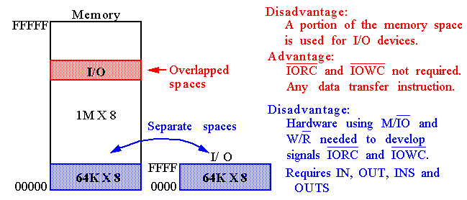
Memory mapped I/O

Slide 9
Isolated Input/Output:
In this scheme, the I/O devices are treated separate from memory. I/O ports are organized as bytes of data;
the memory address space contains 1M consecutive byte addresses in the range 00000H, through FFFFFH; and the I/O address space contains 64K consecutive byte addresses in the range 0000H through FFFFH.

Slide 10
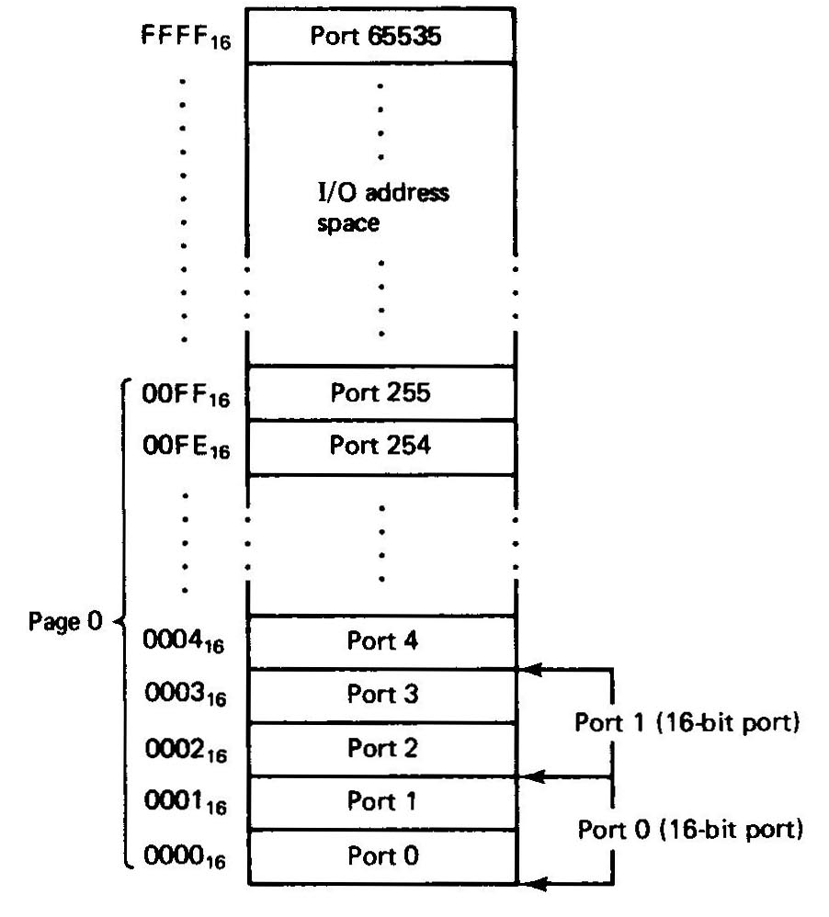
Fig. shows that bytes of data in two consecutive I/O addresses could be accessed as word-wide data. For instance, I/O addresses 0000H, 0001H, 0002H, and 0003H can be treated as independent byte-wide I/O ports: ports 0, 1, 2 and 3, or as word-wide ports 0 and 1.

Slide 11
Memory-Mapped Input/Output
I/O devices can be placed in the memory address space of the microcomputer.
In this case, the MPU looks at the I/O port as though it is a storage location in memory.

Slide 12
Memory-Mapped I/O
I/O Devices and memory share the same address space.
Each I/O Device is assigned a unique set of addresses.
When the processor places a particular address on the address lines, the device recognizing this address responds to the commands on the control lines.
The processor requests either a read or a write operation, and the requested data is transferred over the data lines.
Any machine instruction that can access memory can be used to transfer data to/from I/O devices.
Mov datain, R0

Slide 13
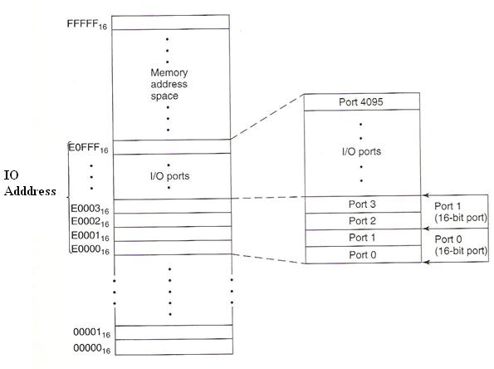

Slide 14
Difference between isolated I/O and memory-mapped I/O.
isolated I/O
memory-mapped I/O
The I/O locations are isolated from memory system in a separated I/O address space.
Memory can be expanded to its full size without using any of memory space for I/O devices.
Data transfer between microprocessor and I/O requires IN, INS, OUT and OUTS instructions.
Faster because I/O instructions is specifically designed to run faster than memory instructions.
Separate control signals that indicate IORC or IOWC operations.
The memory address space is not affected.
I/O locations are mapped within the memory.
Full memory can’t be expanded since a portion is used as I/O map.
No such instruction is required for transferring data. All memory instructions and addressing modes are available to perform I/O operation.
Slower because memory instructions execute slower than the special I/O instructions.
IORC and IOWC have no function and may reduce the amount of circuitry.
Part of the memory address space is lost.

Slide 15
Parallel I/O
I/O devices connect to processor through PORTS
Ports are:
registers (part of the I/O interface)
8, 16, or 32 bits wide
Addressed in the range 0000-FFFFh
Accessed with 2 instructions – IN, OUT

Slide 16
Modes of I/O Instructions
Direct I/O – the port address is one of the operands.
Address must be 00-FFh.
IN AL, 27h
Data flows through the accumulator
MOV AX, BX
OUT 26h, AX ; move 16-bit data from AX to port ; 26h (AL to 26h and AH to 27h)
Indirect I/O – the port address is preloaded into DX
Address can be 0000-FFFFh
String I/O – allows data to pass directly through the accumulator (from I/O device to memory)

Slide 17
80x86 I/O Instructions

Slide 18
Ways to Drive Hardware Devices using Parallel Buses
There are three ways of transferring data between the microprocessor and a physical I/O device.
Programmed I/O
Interrupt driven I/O
Direct Memory Access (DMA)

Slide 19
The microprocessor executes a program to communicate with an external device via a register called I/O port for programmed I/O.
An external device requests microprocessor to transfer data by activating a signal on the microprocessor’s interrupt line during interrupt I/O. In response, the microprocessor executes a program called the interrupt-service routine to carry out the function desired by the external device.
Data transfer between microcomputer’s memory and an external device occurs without microprocessors involvement in Direct Memory Access.

Slide 20
I/O Device Speeds
Processors can operate at speeds that are vastly different than I/O speeds.
When a human is entering characters on a keyboard, the processor can execute millions of instructions between successive character entries.
So, how does the processor handle I/O inputs…

Slide 21
Three types of I/O Strategies
Polled I/O
Interrupt Driven I/O
DMA I/O

Slide 22
Polled IO versus Interrupt Driven I/O
Polled IO – processor continually checks IO device to see if it is ready for data transfer
Inefficient, processor wastes time checking for ready condition
Interrupt Driven IO – IO device interrupts processor when it is ready for data transfer
Processor can be doing other tasks while waiting for last data transfer to complete – very efficient.

Slide 23
Rate of Transmission
For parallel transmission, all of the bits are sent at once.
For serial transmission, the bits are sent one at a time. Therefore, there needs to be agreement on how “long” each bit stays on the line.
The rate of transmission is usually measured in bits/second or baud.

Slide 24
Given a certain baud rate, how long should each bit last?
Baud = bits / second.
Seconds / bits = 1 /baud.
At 1200 baud, a bit lasts 1/1200 = 0.83 m Sec.

Slide 25
Comparison of transfer rates
Polled waiting loops provide data rates that are a bit slower, but still quite reasonable.
Interrupt-driven I/O requires overhead of saving and restoring the machine state (significantly degrades data rates unless more than one byte can be transferred per interrupt.
DMA has fastest transfer rates (additional hardware complexity needed.

Slide 26
disadvantage of programmed I/O
The microcomputer needs to check the status bit (BUSY signal for the A/D converter) by waiting in a loop.
This type of I/O transfer is dependent on the speed of the external device.
For a slow device, this waiting may slow down the capability of the microprocessor to process other data.

Slide 27
Interrupt Driver I/O
Interrupt I/O is a device-initiated I/O transfer. The external device is connected to a pin called the interrupt (INT) pin on the processor chip.
When the device needs an I/O transfer with the microcomputer, it activates the interrupt pin of the processor chip.
The microcomputer usually completes the current instruction and saves at least the contents of the current program counter on the stack.

Slide 28
The microcomputer then automatically loads an address into the program counter to branch to a subroutine like program called the interrupt service routine.
This program is written by the user. The external device wants the microcomputer to execute this program to transfer data.
The last instruction of the service routine is a RETURN, which is typically the same instruction used at the end of a subroutine.
This instruction normally loads the address (saved in the stack before going to the service routine) in the program counter. Then, the microcomputer continues executing the main program.

Slide 29
Direct Memory Access (DMA)
DMA is a technique that transfers data between a microcomputer’s memory and I/O device without involving the microprocessor.
DMA is widely used in transferring large blocks of data between a peripheral device and the microcomputer’s memory.
The DMA technique uses a DMA controller chip for the data transfer operation.

Slide 30
The main functions of a typical DMA controller are summarized as follows:
The I/O devices request DMA operation via the DMA request line of the controller chip.
The controller chip activates the microprocessor HOLD pin, requesting the CPU to release the bus.
The processor sends HLDA (hold acknowledge) back to the DMA controller, indicating that the bus is disabled. The DMA controller places the current value of its internal registers, such as the address register and counter, on the system bus and sends a DMA acknowledge to the peripheral device. The DMA controller completes the DMA transfer.

Slide 31
There are three basic types of DMA
block transfer,
cycle stealing, and
interleaved DMA.

Slide 32
block transfer DMA
For block transfer DMA, the DMA controller chip takes the bus from the microcomputer to transfer data between the memory and I/O device.
The microprocessor has no access to the bus until the transfer is completed. During this time, the microprocessor can perform internal operations that do not need the bus.
This method is popular with microprocessors. Using this technique, blocks of data can be transferred.

Slide 33
cycle stealing DMA
Data transfer between the microcomputer memory and an I/O device occurs on a word by- word basis with cycle stealing. Typically, the microprocessor clock is enabled by ANDing an INHIBIT signal with the system clock.
The system clock has the same frequency as the microprocessor clock. The DMA controller controls the INHIBIT line. During normal operation, the INHIBIT line is HIGH, providing the microprocessor clock.
When DMA operation is desired, the controller makes the INHIBIT line LOW for one clock cycle. The microprocessor is then stopped completely for the cycle. Data transfer between the memory and I/O takes place during this cycle. This method is called cycle stealing because the DMA controller takes away or steals a cycle without microprocessor recognition. Data transfer takes place over a period of time.

Slide 34
interleaved DMA
With interleaved DMA, the DMA controller chip takes over the system bus when the microprocessor is not using it. For example, the microprocessor does not use the bus while incrementing the program counter or performing an ALU operation.
The DMA controller chip identifies these cycles and allows transfer of data between the memory and I/O device. Data transfer takes place over a period for time for this method.

Slide 35
Peripheral Controllers
Intel has developed several peripheral controller chips designed to support its processors.
The goal is to give a complete I/O interface in one chip.
Examples:
8255 is Programmable Peripheral Interface (PPI).
8259 is Programmable Interrupt Controller (PIC)
8253/8254 is Programmable Interval Timer (PIT)
82378257 is Programmable DMA controller.
8251 is Universal Synchronous, Asynchronous Receiver and Transmitter.
In PC/XT computers these chips are built into the system board and can be seen by inspection.
In modern Computers the functionality of these chips has been built into the system board chipset.

Slide 36
8255A
Is one of the peripheral controller chips designed to support its processors.
8255 is Programmable Peripheral Interface (PPI).
It is a general purpose parallel I/O Interfacing device.

Slide 37
8255 PPI
The parallel input-output port chip 8255 is also called as programmable peripheral input-output port.
The Intel’s 8255 is designed for use with Intel’s 8-bit, 16-bit and higher capability microprocessors.
The 8255A is LSI peripheral designed to permit easy implementation of parallel I/0 in the 8086 micro-computer systems.
It provides a flexible parallel interface, which includes features such as single-bit, 4-bit, and byte-wide input and output ports.

Slide 38
Features of 8255 PPI
It is a general purpose programmable I/O device which is compatible with all INTEL processors and also most other processors.
It provides 24 I/O pins which may be individually programmed in two groups.
This chip is completely TTL compatible.
It is available in 40 pin DIP and plastic leaded chip carrier (PLCC) packages.
It has three 8 bit ports. Port A, Port B and Port C. Port C is treated as two 4 bit ports also.
This 8255 is mainly programmed in two modes (a) the I/O mode and (b) The bit set/reset mode (BSR) mode. The I/O mode is further divided into three modes: Mode 0, Mode 1, and Mode 2.
An 8 bit control word resister is used to configure the modes of 8255.

Slide 39
8255 PPI
It has 24 input/output lines which may be individually programmed in two groups of twelve lines each, or three groups of eight lines.
The two groups of I/O pins are named as Group A and Group B.
Each of these two groups contains a subgroup of eight I/O lines called as 8-bit port and another subgroup of four lines or a 4-bit port.
Thus Group A contains an 8-bit port A along with a 4-bit port C upper. The port A lines are identified by symbols PA0-PA7 while the port C lines are identified as PC4-PC7.

Slide 40
8255 PPI
Similarly, Group B contains an 8-bit port B, containing lines PB0-PB7 and a 4-bit port C with lower bits PC0- PC3.
The port C upper and port C lower can be used in combination as an 8-bit port C.
Both the port C are assigned the same address. Thus one may have either three 8-bit I/O ports or two 8-bit and two 4-bit ports from 8255.
All of these ports can function independently either as input or as output ports.
This can be achieved by programming the bits of an internal register of 8255 called as control word register (CWR).

Slide 41
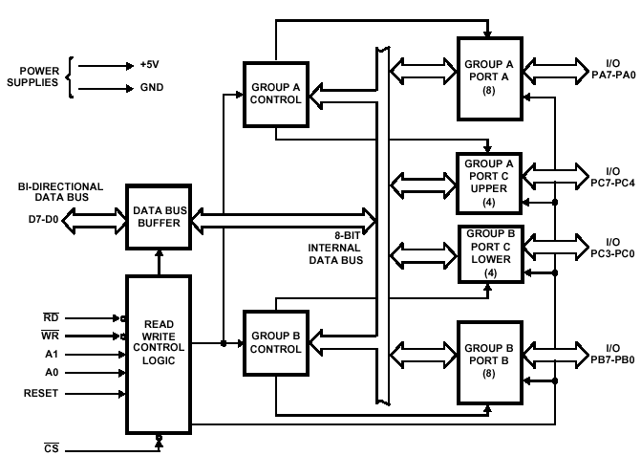
Block Diagram of 8255

Slide 42
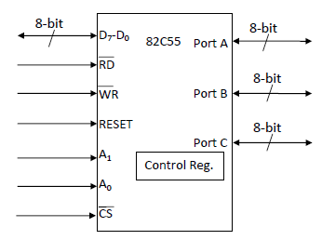

Slide 43
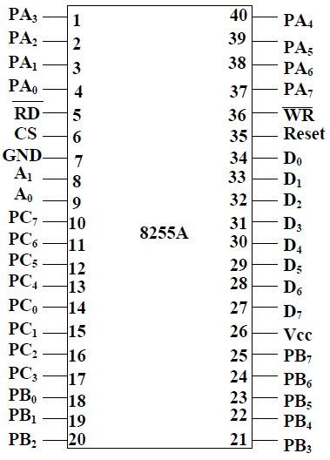
Pin Configuration of 8255
D0
D1
D2
D3
D4
D5
D6
D7
PA0
PA1
PA2
PA3
PA4
PA5
PA6
PA7
PORT A
PB0
PB1
PB2
PB3
PB4
PB5
PB6
PB7
8255
Mode 2 Control Signals
PORT B
RD
WR
A0
A1
RESET
CS
PC0
PC1
PC2
PC3
PC4
PC5
PC6
PC7
PORT C

Slide 44
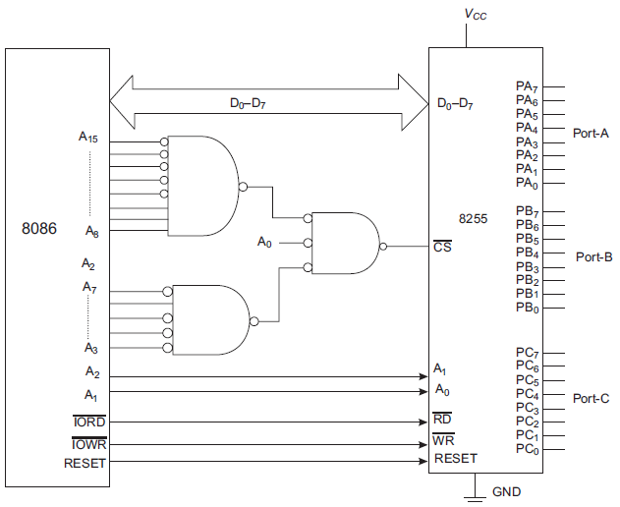
Interfacing 8255 to 8086

Slide 45
8255 PPI
Control Logic of 8255:
D0-D7: These are the data bus lines those carry data or control word to/from the microprocessor.
RESET: A logic high on this line clears the control word register of 8255. All ports are set as input ports by default after reset.
PA7-PA0: These are eight port A lines that acts as either latched output or buffered input lines depending upon the control word loaded into the control word register.
PC7-PC4: Upper nibble of port C lines. They may act as either output latches or input buffers lines. This port also can be used for generation of handshake lines in mode 1 or mode 2.
PC3-PC0: These are the lower port C lines, other details are the same as PC7-PC4 lines.
PB0-PB7: These are the eight port B lines which are used as latched output lines or buffered input lines in the same way as port A.

Slide 46
8255 PPI
Control Logic of 8255:
RD : This is the input line driven by the microprocessor and should be low to indicate read operation to 8255.
WR : This is an input line driven by the microprocessor. A low on this line indicates write operation.
CS : This is a chip select line. If this line goes low, it enables the 8255 to respond to RD and WR signals, otherwise RD and WR signal are neglected.
A1-A0 : These are the address input lines and are driven by the microprocessor. These lines A1-A0 with RD, WR and CS from the following operations for 8255. These address lines are used for addressing any one of the four registers, i.e. three ports and a control word register as given in table below.
In case of 8086 systems, if the 8255 is to be interfaced with lower order data bus, the A0 and A1 pins of 8255 are connected with A1 and A2 respectively.

Slide 47
8255 PPI
Control Logic.
CS signal is a Master Chip Select, whereas A₀ and A₁ determine the input/output ports or control registers as tabulated in Table 1.
Table 1: The function of CS, A₀ and A₁
CS | A₁ | A₀ | Selection
0 | 0 | 0 | port A
0 | 0 | 1 | port B
0 | 1 | 0 | port C
0 | 1 | 1 | Control Register
1 | X | X | 8255 is disabled

Slide 48
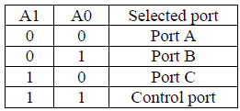
8255 PPI
There are 3 ports in 8255 from user’s point of view - Port A, Port B and Port C.
Port C is composed of two independent 4-bit ports : PC7-4 (PC Upper) and PC3-0 (PC Lower)
Selection of Ports:

Slide 49
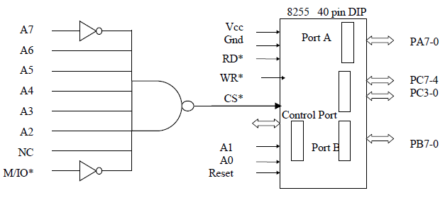
Intel 8255 PPI
Chip Select Circuit
A7=0, A6=1, A5=1, A4=1, A3=1, A2=1, & M/IO*= 0

Slide 50
Intel 8255 PPI
There is also a Control port from the Processor point of view. Its contents decides the working of 8255.
When CS (Chip select) is 0, 8255 is selected for communication by the processor. The chip select circuit connected to the CS pin assigns addresses to the ports of 8255.
For the chip select circuit shown, the chip is selected when A7=0, A6=1, A5=1, A4=1, A3=1, A2=1, and M/IO*= 0.
Port A, Port B, Port C and Control port will have the addresses as 7CH, 7DH, 7EH, and 7FH respectively.

Slide 51
8255 PPI
Three main steps in 8255:
Determine the port address of A, B and C using CS, A₁ and A₀.
Write control word in control register.
Write I/O instructions to communicate with ports.

Slide 52
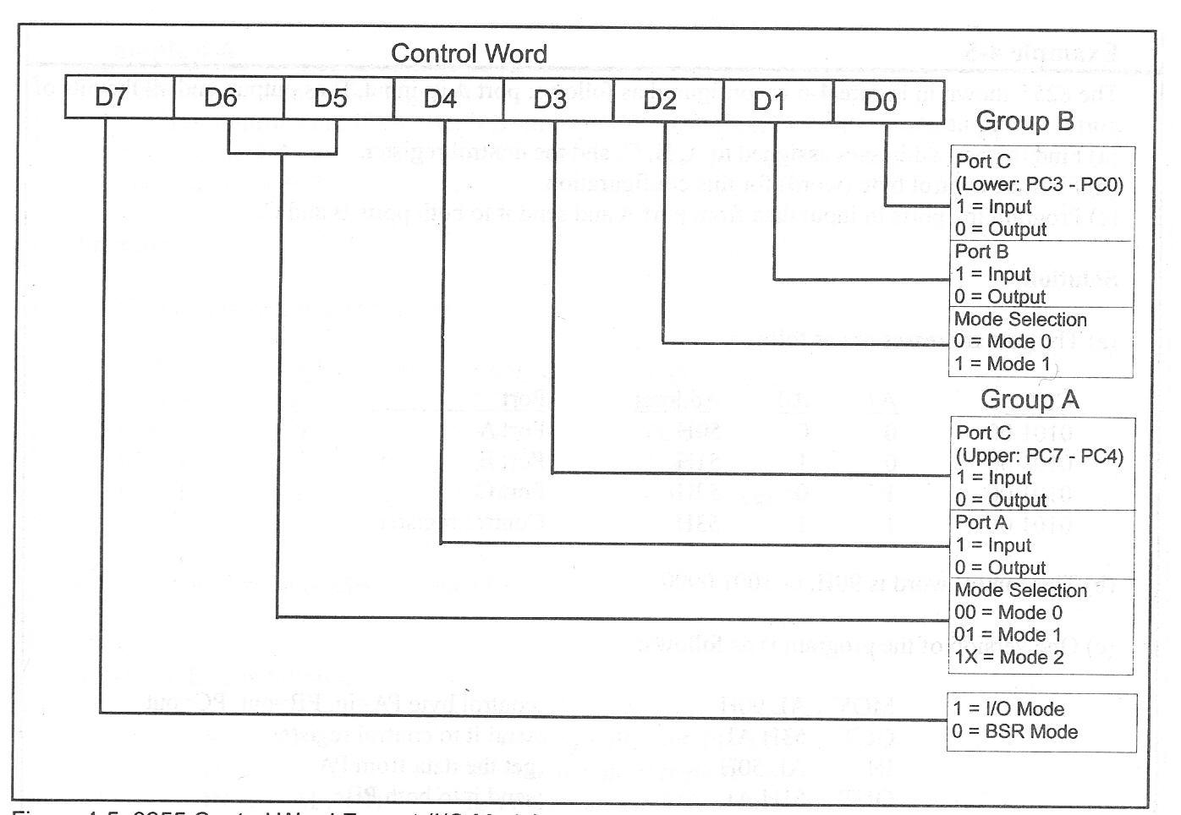
8255 Control Word

Slide 53
8255 PPI-Operation modes
Figure shows the function of 8255, categorized in two mode:
Set/Reset Bit (BSR) mode
I/O mode.
The BSR mode is used to set or reset bit at port C by sending OUT instruction to the CONTROL registers.
Whereas the I/O is divided into 3 groups:
Mode 0, Mode 1 and Mode 2.
Mode 0, all ports function as input or output (I/O function).
Mode 1, is handshake mode, where port A and/or port B used port C as handshake bit.
Mode 2, port A can be used as bi-directional data transfer port with port C as handshake port and port B will be in mode 1 or mode 2.

Slide 54
8255 PPI-Operation modes
Bit Set/Reset (BSR) mode:
The BSR mode is used to set or reset bit at port C by sending OUT instruction to the CONTROL registers.
In this mode any of the 8-bits of port C can be set or reset depending on D0 of the control word. The bit to be set or reset is selected by bit select flags D3, D2 and D1 of the CWR.
BSR command word is used for enabling / disabling interrupts from Ports A and B when they are configured in mode 1 or mode 2.

Slide 55
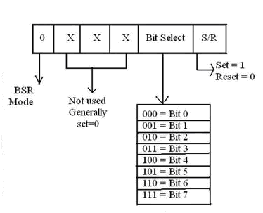

Slide 56
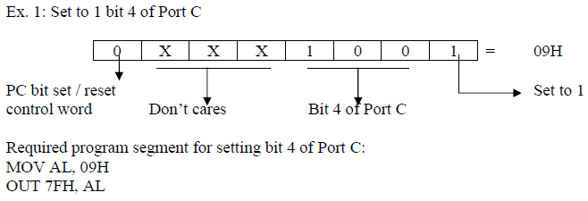
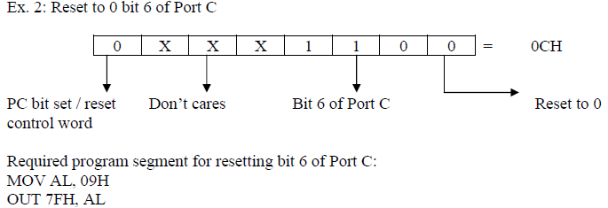

Slide 57
8255 PPI-Operation modes
I/O mode:
The I/O mode is further divided into 3 modes: mode 0, mode 1 and mode 2.
In mode 0, all ports function as simple I/O ports.
Mode 1 is a handshake mode whereby Port A and/or Port B use bits from Port C as handshake signals. In the handshake mode, two types of I/O data transfer can be implemented: status check and interrupt.
In mode 2, Port A can be set up for bidirectional data transfer using handshake signals from Port C, and Port B can be set up either in mode 0 or mode 1.

Slide 58
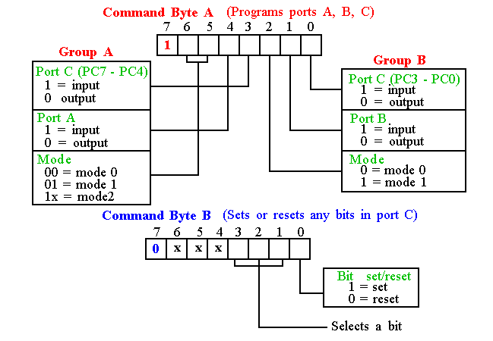
Programming 8255
8255 has three operation modes: mode 0, mode 1, and mode 2

Slide 59
Basic Mode Definitions and Bus Int
Mode 0
Basic I/O
Mode 1
Strobe I/O
Mode 2
Bi-Dir Bus

Slide 60
8255 PPI Mode selection:
There are 3 basic modes of operation that can be selected by the system software for the 8255:
Mode 0 - Basic Input/Output mode
Mode 1 – Input/output with Handshake (Strobed I/O) mode
Mode 2 - Bidirectional Data Transfer mode

Slide 61
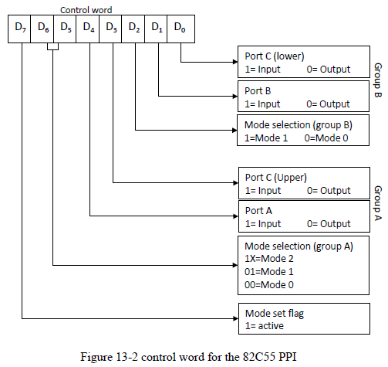
8255 PPI - Mode Definition Format

Slide 62
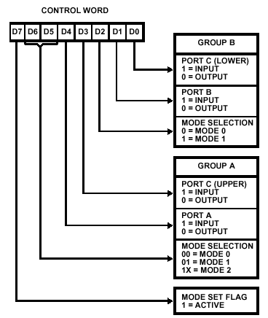
8255 PPI

Slide 63
8255 PPI - Bit Set/Reset mode

Slide 64
8255 PPI - Mode 0
Mode 0 (Basic Input/Output):
This functional configuration provides simple input and output operations for each of the three ports. No ``handshaking‘’ is required, data is simply written to or read from a specified port.
It is used for interfacing an i/p device or an o/p device.
In this mode, Port A and Port B are used as two simple 8-bit I/O ports and Port C as two 4-bit I/O ports can be combinedly used as a third 8-bit port. Each port (or half-port, in case of Port C) can be programmed to function as simply an input port or an output port.
Output ports are latched. Input ports are not latched.
All these modes can be selected by programming a register internal to 8255 known as CWR.
Ports do not have handshake or interrupt capability.
16 different Input/Output configurations are possible in this Mode.

Slide 65
8255 PPI
MODE 1 (Strobed Input/Output):
This functional configuration provides a means for transferring I/O data to or from a specified port in conjunction with strobes or ``handshaking'' signals. In mode 1, Port A and Port B use the lines on Port C to generate or accept these ``handshaking'' signals.
Two groups –
Group A
This group including port A and PC3-PC5. Thus port C is utilized for generating handshake signals.
Group B
This group which includes port B and PC0-PC2. Port C provides strobe or handshake lines for port B.
The 8-bit data port can be either used as input and output port. The inputs and outputs both are latched and Interrupt logic is supported.

Slide 66
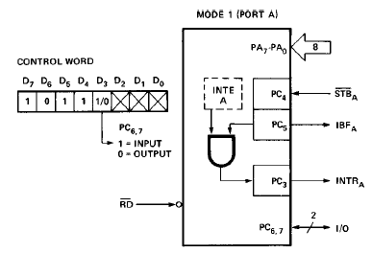
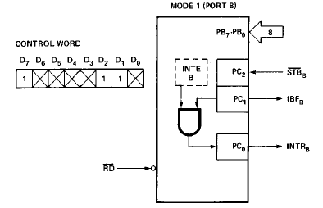
Mode 1 - Input

Slide 67
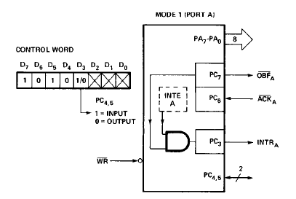
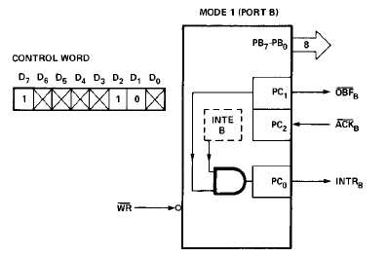
Mode 1 Output

Slide 68
Mode 1 -Input Control Signal Definition
STB (Strobe Input): A ``low'' on this input loads data into the input latch.
IBF (Input Buffer Full F/F):
A ``high'' on this output indicates that the data has been loaded into the input latch; in essence, an acknowledgement. IBF is set by STB input being low and is reset by the rising edge of the RD input.
INTR (Interrupt Request):
A ``high'' on this output can be used to interrupt the CPU when an input device is requesting service. INTR is set by the STB is a ``one'', IBF is a ``one‘’ and INTE is a ``one''. It is reset by the falling edge of RD. This procedure allows an input device to request service from the CPU by simply strobing its data into the port.
INTE A
Controlled by bit set/reset of PC4.
INTE B
Controlled by bit set/reset of PC2.

Slide 69
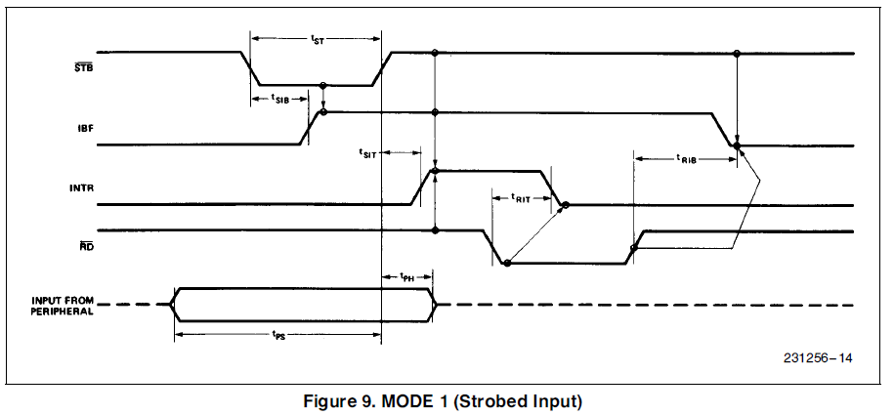
8255 PPI

Slide 70
8255 PPI Output Control Signal Definition
OBF (Output Buffer Full F/F).
The OBF output will go ``low'' to indicate that the CPU has written data out to the specified port. The OBF F/F will be set by the rising edge of the WR input and reset by ACK Input being low.
ACK (Acknowledge Input).
A ``low'' on this input informs the 82C55A that the data from Port A or Port B has been accepted. In essence, a response from the peripheral device indicating that it has received the data output by the CPU.
INTR (Interrupt Request).
A ``high'' on this output can be used to interrupt the CPU when an output device has accepted data transmitted by the CPU. INTR is set when ACK is a ``one'', OBF is a ``one‘’ and INTE is a ``one''. It is reset by the falling edge of WR.
INTE A
Controlled by bit set/reset of PC6.
INTE B
Controlled by bit set/reset of PC2.

Slide 71
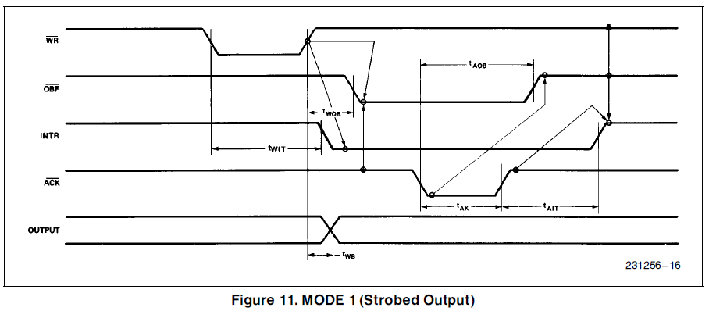

Slide 72
MODE 2 (Strobed Bidirectional Bus I/O):
This functional configuration provides a means for communicating with a peripheral device or structure on a single 8-bit bus for both transmitting and receiving data (bidirectional bus I/O). ``Handshaking'' signals are provided to maintain proper bus flow discipline in a similar manner to MODE 1. Interrupt generation and enable/disable functions are also available.
The single 8-bit port in group A is available.
The 8-bit port is bidirectional and additionally a 5-bit control port is available.
Three I/O lines are available at port C.(PC2 – PC0)
Inputs and outputs are both latched.
The 5-bit control port C (PC3-PC7) is used for generating / accepting handshake signals for the 8-bit data transfer on port A.

Slide 73
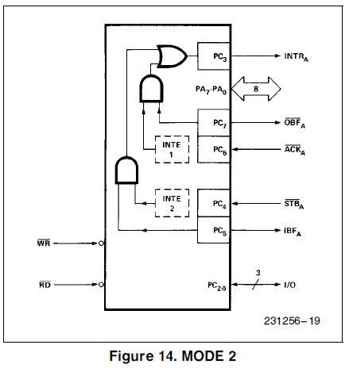

Slide 74
Mode 2 - Input Operations
STB (Strobe Input). A ``low'' on this input loads data into the input latch.
IBF (Input Buffer Full F/F). A ``high'' on this output indicates that data has been loaded into the input latch.
INTE 2 (The INTE Flip-Flop Associated with IBF). Controlled by bit set/reset of PC4.

Slide 75
Mode 2 - Output Operations
OBF (Output Buffer Full). The OBF output will go ``low'' to indicate that the CPU has written data out to port A.
ACK (Acknowledge). A ``low'' on this input enables the tri-state output buffer of Port A to send out the data. Otherwise, the output buffer will be in the high impedance state.
INTE 1 (The INTE Flip-Flop Associated with OBF). Controlled by bit set/reset of PC6.

Slide 76
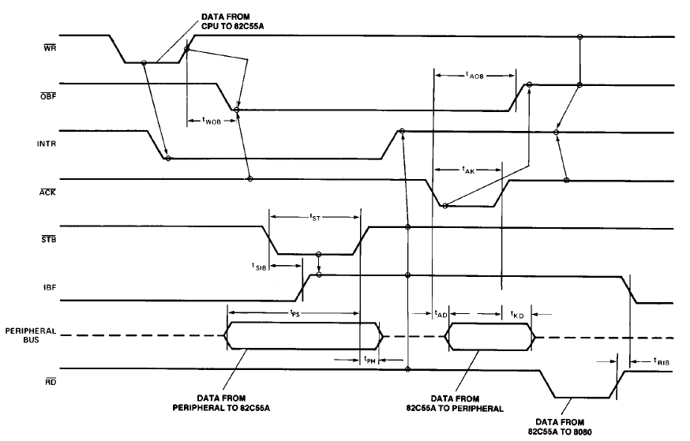

Slide 77
8255 PPI Mode 0 interface to 8086
Example: In 8086's 8-bit isolated I/O system, an 82C55 PPI is connected so that the address of A, B, C ports, and Control register are 4D0816, 4D0916,4D0A16 and 4D0B16
a) Draw the circuit diagram. respectively.
b) Write program to set Register A, B as input and Register C as output (all in mode 0). Then continuously receive two unsigned number from Registers A and B, compare them and output the larger to Register C.

Slide 78
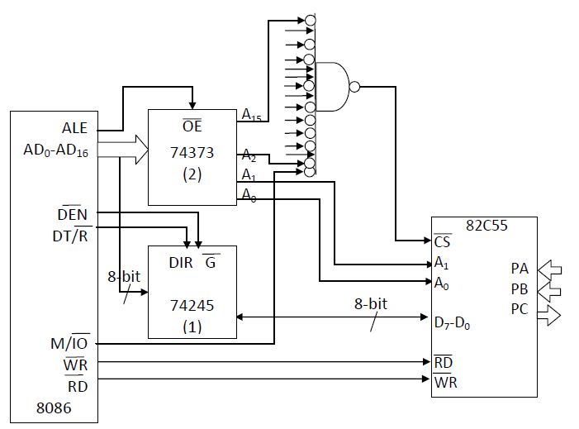
Solution to Example:

Slide 79
MOV AL, 92H
MOV DX, 4D0BH
OUT DX, AL
again: MOV DL, 08H (because DH is the same)
IN AL,DX
MOV BL, AL
INC DL
IN AL, DX
CMP AL, BL
JNC no_exchange
MOV AL, BL
no_exchange: INC DL
OUT DX, AL
MOV CX, FFFFH
delayloop: DEC CX
JNZ delayloop
JMP again

Slide 80
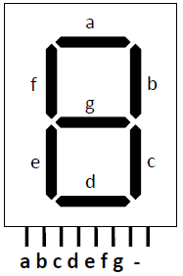
Seven-segment display Interface
Seven-segment display used to display number (and letters). Seven segment display labeling is shown in figure

Slide 81
7-Segement Display
Segment
Driver
Common

Slide 82
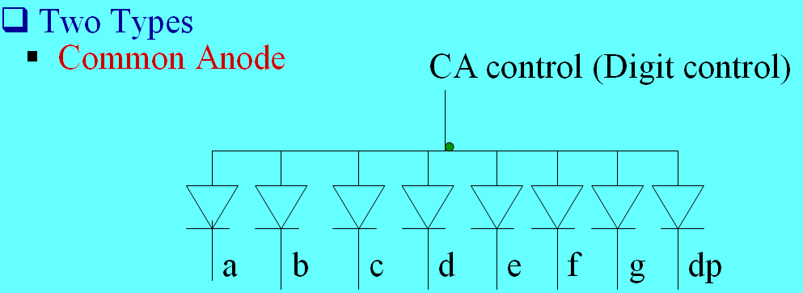
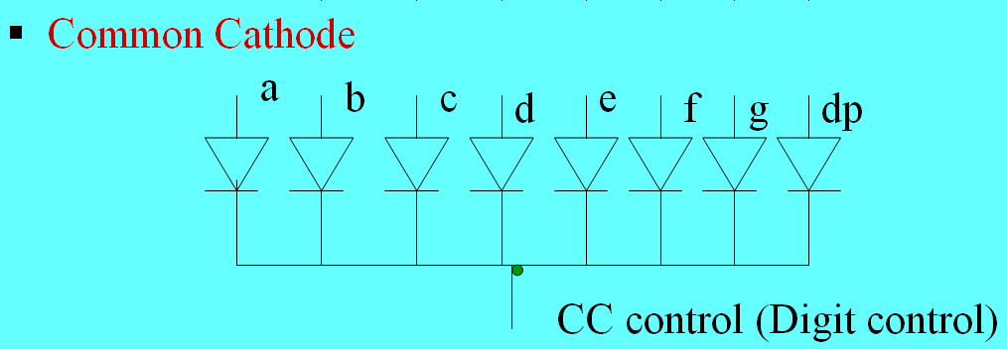
7-Segement Display
CA
→ Vcc
Anode
Cathode
Select Segments: Switched Resistors to GND
CC
Select Segments: Switched Resistors to Vcc
→ GND

Slide 83
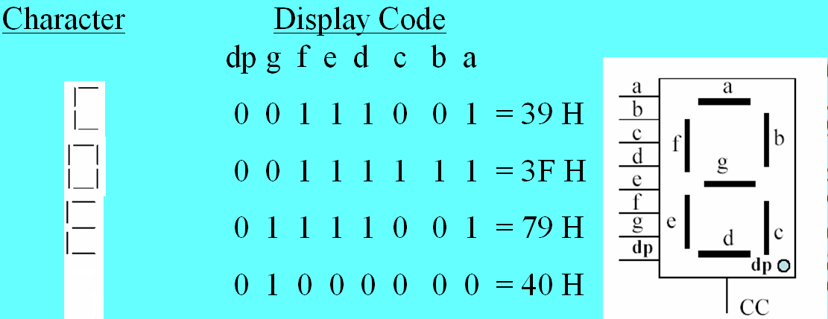
7-Segement Display
Anode
Cathode
Segment Data (1 byte)
for each character

Slide 84
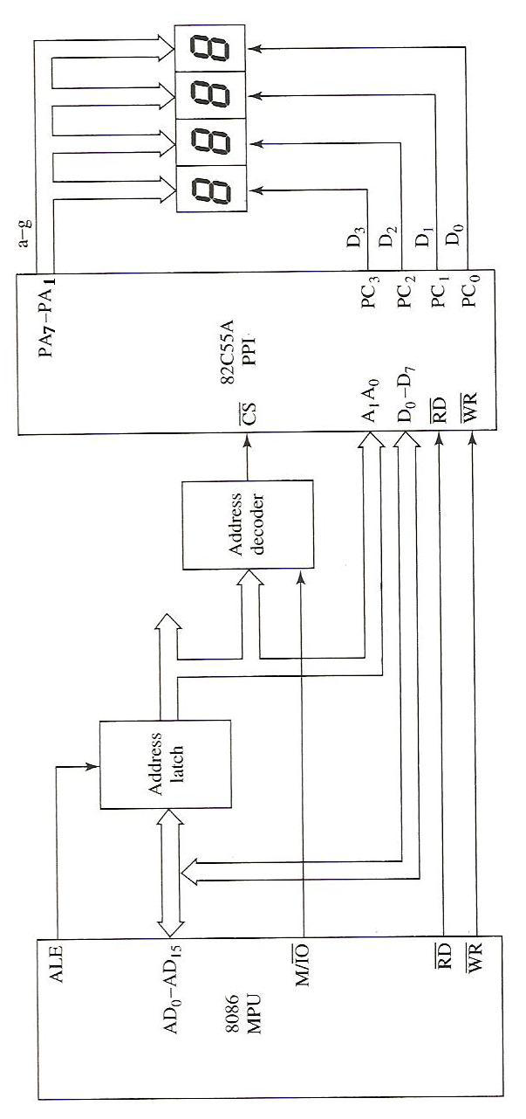
Four-digit Seven-segment display interface to 8086 using 82C55 PPI

Slide 85
Example :
Above figure shows an interface of four-digit seven-segment numeric display. The circuit use Port A to output value to the display, and Port C lower to select which digit is active.
a) Draw the detail of the address decode circuit that make the address of port A is 005416, address of port C is 005616 and address of control register is 005716
b) Write program to display the word PASS. Note that the program must continuously set each one of the four digits because they are multiplexed.

Slide 86
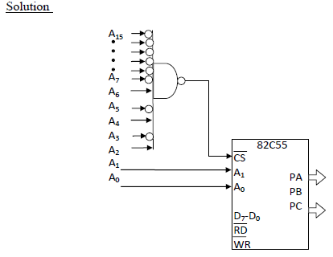
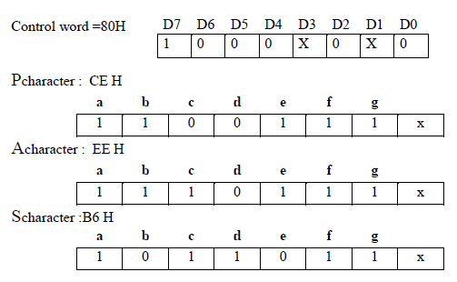
Seven-segment display Interface

Slide 87
Program:
MOV AL, 80H
OUT 57H, AL (set the control register)
again: MOV AL, 08H
OUT 56H, AL (enable fourth digit)
MOV AL, CEH
OUT 54H, AL (display character P)
MOV AL, 04H
OUT 56H, AL (enable third digit)
MOV AL, EEH
OUT 54H, AL (display character A)
MOV AL, 02H
OUT 56H, AL (enable second digit)
MOV AL, B6H
OUT 54H, AL (display character S)
MOV AL, 01H
OUT 56H, AL (enable first digit)
MOV AL, B6H
OUT 54H, AL (display character S)
JMP again

Slide 88
Interfacing analog to digital(ADC) data converters
In most of the cases, the PIO 8255 is used for interfacing the analog to digital converters with microprocessor.
We have already studied 8255 interfacing with 8086 as an I/O port, in previous section. This section we will only emphasize the interfacing techniques of analog to digital converters with 8255.
The analog to digital converters is treated as an input device by the microprocessor, that sends an initializing signal to the ADC to start the analogy to digital data conversation process. The start of conversation signal is a pulse of a specific duration.
The process of analog to digital conversion is a slow process, and the microprocessor has to wait for the digital data till the conversion is over. After the conversion is over, the ADC sends end of conversion EOC signal to inform the microprocessor that the conversion is over and the result is ready at the output buffer of the ADC. These tasks of issuing an SOC pulse to ADC, reading EOC signal from the ADC and reading the digital output of the ADC are carried out by the CPU using 8255 I/O ports.

Slide 89
Interfacing analog to digital(ADC) data converters
The time taken by the ADC from the active edge of SOC pulse till the active edge of EOC signal is called as the conversion delay of the ADC.
It may range any where from a few microseconds in case of fast ADC to even a few hundred milliseconds in case of slow ADCs.
The available ADC in the market use different conversion techniques for conversion of analog signal to digitals. Successive approximation techniques and dual slope integration techniques are the most popular techniques used in the integrated ADC chip.
The selection of ADC for a particular application is done, keeping in mind the required speed, resolution and the cost factor.

Slide 90
General algorithm for ADC interfacing contains the following steps:
Ensure the stability of analog input, applied to the ADC.
Issue start of conversion(SOC) pulse to ADC
Read end of conversion(EOC) signal to mark the end of conversion processes.
Read digital data output of the ADC as equivalent digital output.
It may be noted that Analog input voltage must be constant at the input of the ADC right from the start of conversion till the end of the conversion to get correct results. This may be ensured by a sample and hold circuit which samples the analog signal and holds it constant for a specific time duration. The microprocessor may issue a hold signal to the sample and hold circuit.
If the applied input changes before the complete conversion process is over, the digital equivalent of the analog input calculated by the ADC may not be correct.

Slide 91
ADC 0808/0809
The analog to digital converter chips 0808 and 0809 are 8-bit CMOS, successive approximation converters. This technique is one of the fast techniques for analog to digital conversion. The conversion delay is 100μs at a clock frequency of 640 KHz, which is quite low as compared to other converters. These converters do not need any external zero or full scale adjustments as they are already taken care of by internal circuits.
These converters internally have a 3:8 analog multiplexer so that at a time eight different analog conversion by using address lines - ADD A, ADD B, ADD C. Using these address inputs, multichannel data acquisition system can be designed using a single ADC.
The CPU may drive these lines using output port lines in case of multichannel applications. In case of single input applications, these may be hardwired to select the proper input.
There are unipolar analog to digital converters, i.e. they are able to convert only positive analog input voltage to their digital equivalent. These chips do no contain any internal sample and hold circuit

Slide 92
Block Diagram of ADC 0808/0809:
This converter internally has a 3:8 analog multiplexer, so that at a time 8 different analog inputs can be connected to the chips.
Out of these 8 inputs only one can be selected for conversion by using 3 address lines A, B, C.
The CPU may drive these lines using output port lines in case of multichannel applications.
In case of single input applications these may be hardwired to select the proper input.

Slide 93
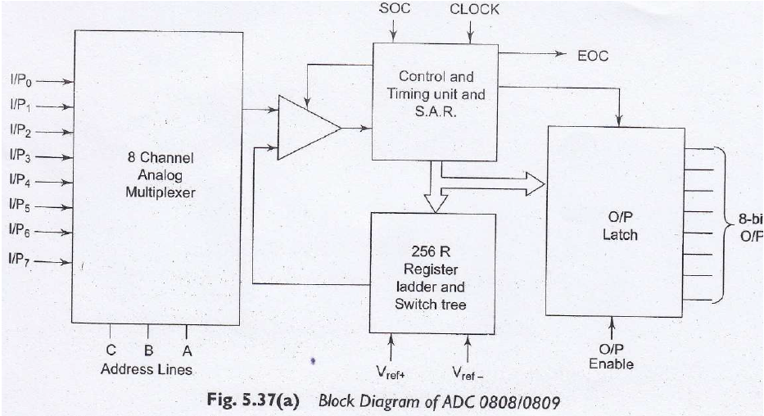
Block Diagram of ADC 0808/0809:

Slide 94
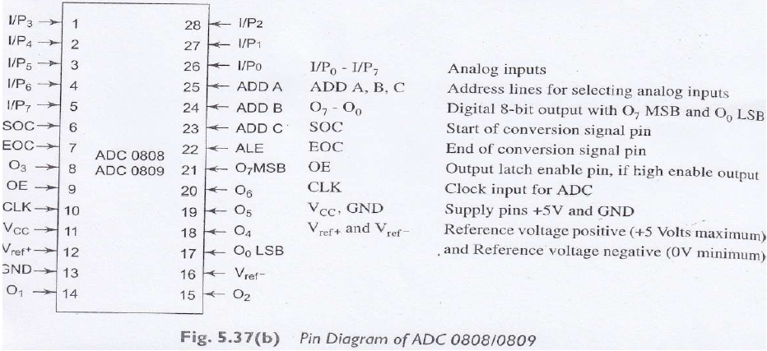
Pin Diagram of ADC 0808/0809:

Slide 95
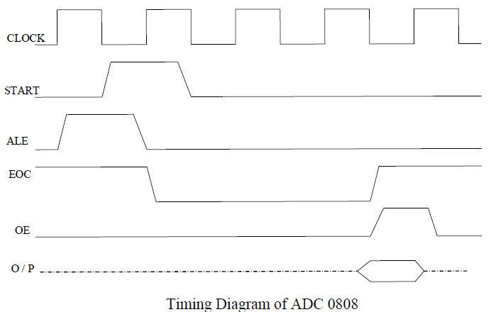

Slide 96
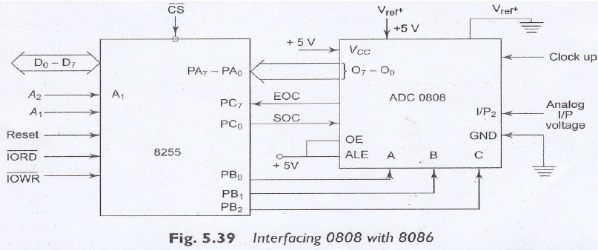
Interfacing b/w ADC to Microprocessor

Slide 97
Interfacing b/w ADC to Microprocessor
Example:
Interface ADC 0808 with 8086 using 8255 ports. Use Port A of 8255 for transferring digital data output of ADC to the CPU & Port C for control signals. Assume that an analog input is present at I/P2 of the ADC and a clock input of suitable frequency is available for ADC. Draw the schematic & timing diagram of different signals of ADC0808.
Solution:-
The analog input I/P2 is used & therefore address pins A,B,C should be 0,1,0 respectively to select I/P2.
The OE (Output latch Enable) & ALE pins are already kept at +5v to select the ADC and enable the outputs.
Port C upper acts as the input port to receive the EOC signal while Port C lower acts as the output port to send SOC to ADC.
Port A acts as a 8-bit input data port to receive the digital data output from the ADC.
The 8255 control word is written as follows:
D7 D6 D5 D4 D3 D2 D1 D0 Control word
1 0 0 1 1 0 0 0 = 98H

Slide 98
Interfacing b/w ADC to Microprocessor
The required ALP is as follows:
MOV AL, 98 H ; Initialization of 8255
OUT CWR, AL ; .
MOV AL, 02 H ; Select I/P 2 as analog
OUT Port B, AL ; input.
MOV AL,00H ; Give start of conversion
OUT Port C,AL ; pulse to the ADC
MOV AL,01H
OUT Port C,AL
Wait: IN AL, PortC ; Check for EOC by
RCR ; reading port C upper and rotate through carry
JNC Wait
IN AL, PortA ; If EOC, read digital equivalent in AL
HLT ; Stop

Slide 99
Interfacing Digital To Analog Converters (DAC):
The digital to analog converters convert binary numbers into their analog equivalent voltages or currents. Several techniques are employed for digital to analog conversion.
Weighted resistor network
R-2R ladder network

Slide 100
Interfacing Digital To Analog Converter(DAC):
The DAC find applications in areas like:
Digitally controlled gains,
Motor speed control,
Programmable gain amplifiers,
Digital voltmeters,
Panel meters, etc.
D/A converter have many applications besides those where they are used with a microcomputer.
In a compact disk audio player for example a 14-or16-bit D/A converter is used to convert the binary data read off the disk by a laser to an analog audio signal.
Most speech synthesizer integrated circuits contain a D/A converter to convert stored binary data words into analog audio signals.

Slide 101
DAC 0800 8-bit DAC
Features:
DAC0800 is a monolithic 8-bit DAC manufactured by National semiconductor.
It has settling time around 100ms
It can operate on a range of power supply voltage i.e. from 4.5V to +18V. Usually the supply V+ is 5V or +12V. The V- pin can be kept at a minimum of -12V.
Resolution of the DAC is 39.06mV

Slide 102
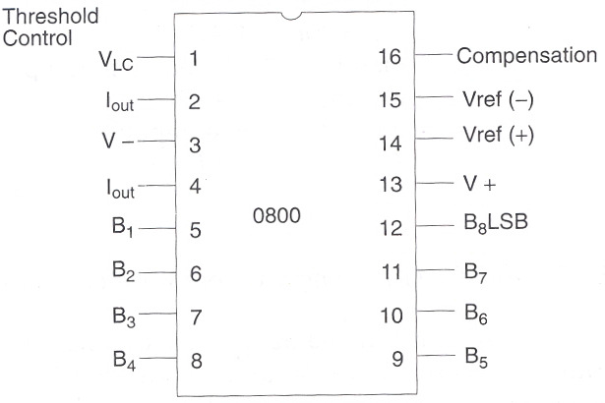
Pin Diagram of DAC 0800:

Slide 103
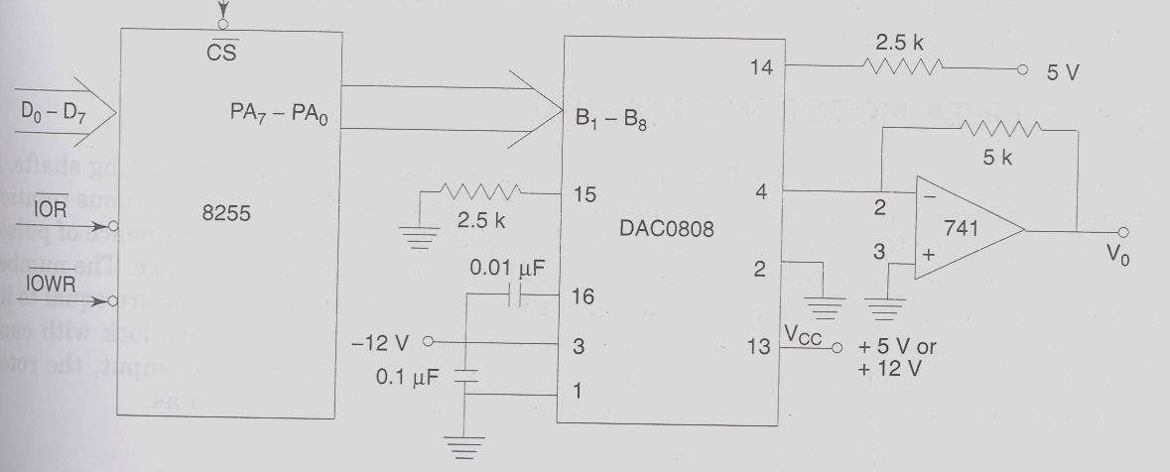
Interfacing of DAC0800 with 8086:

Slide 104
Interfacing Digital To Analog Converter(DAC):
AD 7523 8-bit Multiplying DAC :
Intersil AD 7523 is a 16 pin DIP, multiplying digital to analog converter, containing R-2R ladder (R=10K) for digital to analog conversion along with NMOS switches to connect the digital I/Ps to the ladder.

Slide 105
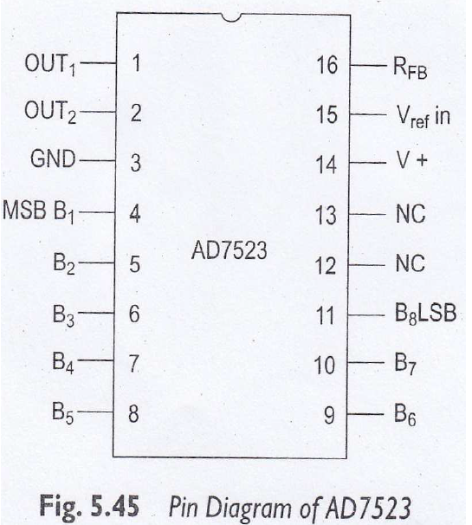
Interfacing Digital To Analog Converter(DAC):
Pin diagram of AD 7523:

Slide 106
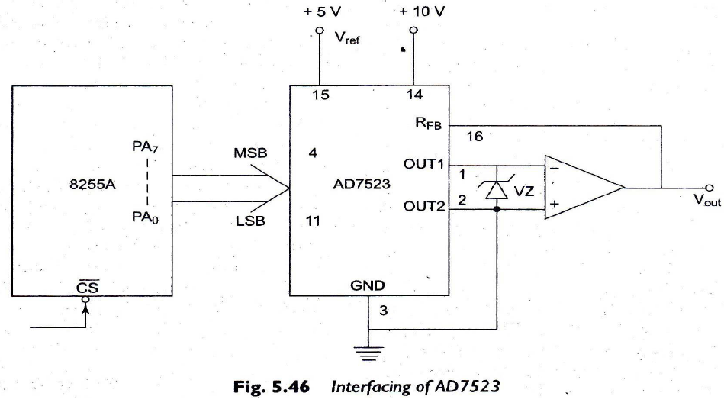
Interfacing Digital To Analog Converter(DAC):
Interfacing of AD 7523 to 8086 using 8255:

Slide 107
Interfacing of AD 7523 with 8086
Problem: Interface DAC AD7523 with the 8086 running at 8MHz & write ALP to generate a sawtooth waveform of period 1ms with Vmax 5v.
Solution:
Assume cs: code
Code segment
Start: MOV AL, 80H
OUT CWR, AL
AGAIN: MOV AL, 00H
BACK: OUT Port A, AL
INC AL
CMP AL, 0F2H
JB BACK
JMP AGAIN
Code ends
End Start

Slide 108
In the above program, port A is initialized as the output port for sending the digital data as input to DAC. The ramp starts from the 0V (analog), hence AL starts with 00H. To increment the ramp, the content of AL is increased during each execution of loop till it reaches F2H.
After that the saw tooth wave again starts from 00H, i.e. 0V(analog) and the procedure is repeated. The ramp period given by this program is precisely 1.000625 ms. Here the count F2H has been calculated by dividing the required delay of 1ms by the time required for the execution of the loop once. The ramp slope can be controlled by calling a controllable delay after the OUT instruction.

Slide 109
Operation of a Stepper Motor
A stepper motor is a digital motor as it moves in discrete steps.
Figure(a) shows that the rotor is repelled by the same pole and moves a step to 45 degrees. Then it is attracted by the different pole and moves another step to 135 degrees. Thus it also moves Upto 225 degrees and 315 degrees.

Slide 110
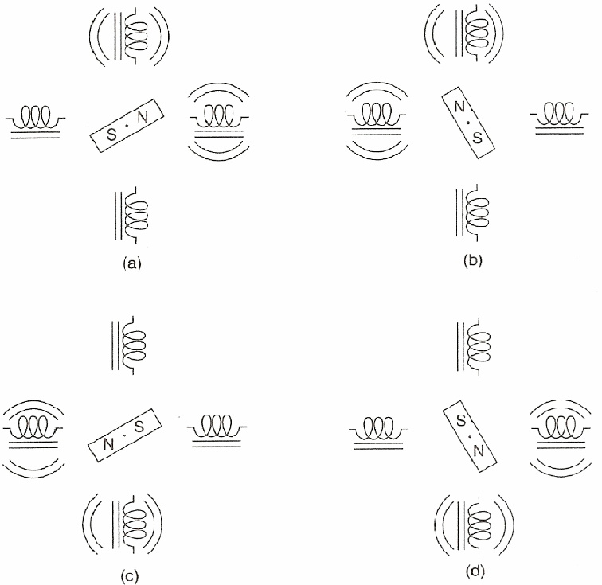
The stepper motor showing full-step operation: (a) 45° (b) 135° (c) 225° (d) 315°.
2 coils
driven at a time
45°
135°
Anti-clockwise Rotation
N Pole lies between the two energized coils
Rotation Direction: Anti-clock wise
Step angle: 90°
225°
315°

Slide 111
Operation of a Stepper Motor
Stepper motor is a device used to obtain an accurate position control of rotating shafts. A stepper motor employs rotation of its shaft in terms of steps, rather than continuous rotation as in case of AC or DC motor.
To rotate the shaft of the stepper motor, a sequence of pulses is needed to be applied to the windings of the stepper motor, in proper sequence. The numbers of pulses required for complete rotation of the shaft of the stepper motor are equal to the number of internal teeth on its rotor.
The stator teeth and the rotor teeth lock with each other to fix a position of the shaft.

Slide 112
With a pulse applied to the winding input, the rotor rotates by one teeth position or an angle x. the angle x may be calculated as.
x = 3600 / no. of rotor teeth
After the rotation of the shaft through angle x, the rotor locks it self with the next tooth in the sequence on the internal surface of the stator.
The stepper motors have been designed to work with digital circuits.

Slide 113
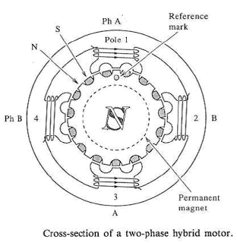
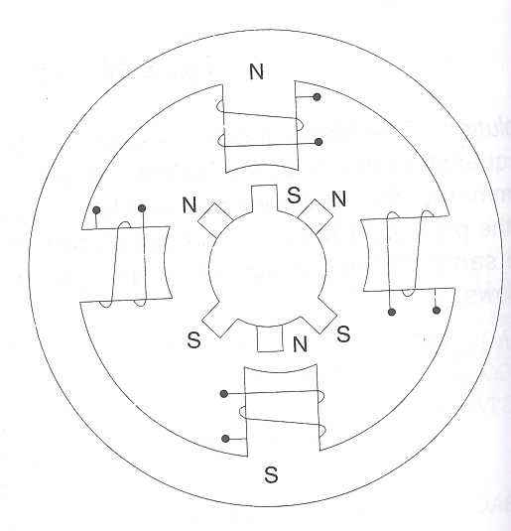
Internal Schematic of a Four Winding Stepper Motor
The typical schematic of a typical stepper motor with four windings is as shown below.

Slide 114
Stepper Motor Interface
Stepper motor is digital in nature
It rotates in a sequence of discrete steps controlled by sequentially energizing a set of coils (windings)
Step angles vary from 1° to 15 ° depending on precision required (and cost)
2 coils
driven at a time
45°
135°
Anti-clockwise Rotation
N Pole lies between the two energized coils
Rotation Direction: Anti-clock wise
Step angle: 90°
ROL: Motor rotates anticlockwise
225°
315°
0
0
1
1
ROR reverses the direction of
Motor rotation

Slide 115
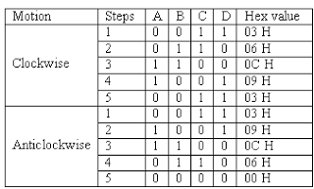
Binary level pulses of 0-5V are required at its winding inputs to obtain the rotation of the shafts. The sequence of the pulses can be decided, depending upon the required motion of the shaft.
By suitable sequence of the pulses the motor can be used in three modes of operation.
One phase ON (medium torque)
Two phase ON (high torque)
Half stepping (low torque)

Slide 116
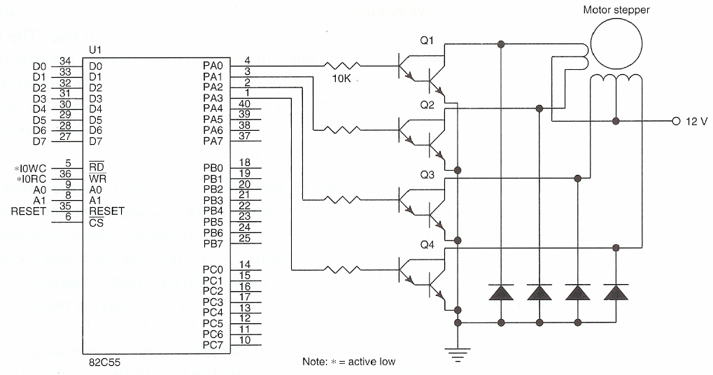
1 activates coil
Darlington pairs
for driving
high load currents
Anti-surge diodes
ROL
Rotate instruction operates on whole byte
We want to rotate half the byte→ duplicate pattern!
33H = 00110011
66H = 01100110
CCH = 11001100
99H = 10011001
ROL
ROR
POS
Current angular
Position stored at location
POS (in memory)
Clockwise
33H or 66H or CCH or 99H
Anti-Clockwise

Slide 117
Assembly language program for stepper motor to rotate anticlockwise direction
MOV AL,80
MOV DX,0FFC6
OUT DX
A0:MOV BX,02
A1:MOV CX,00FF
A2:MOV AL,77
MOV DX,0FFC4
OUT DX CALL DELAY
MOV AL,0BB
MOV DX,0FFC4
OUT DX CALL DELAY
MOV AL,0DD
MOV DX,0FFC4
OUT DX
CALL DELAY
MOV AL,0EE
MOV DX, 0FFC4
OUT DX
CALL DELAY
LOOP A1
DEC BX
JNZ A2

Slide 118
Assembly language program for stepper motor to rotate anticlockwise direction
MOV AL,80 MOV DX,OFFC6 OUT DX MOV BX,0002
MOV CX,00FF MOV AL,0EE MOV DX,0FFC4 OUT DX CALL DELAY MOV AL,0DD
MOV DX,0FFC4 OUT DX CALL DELAY MOV AL,0BB
MOV DX,0FFC4 OUT DX CALL DELAY MOV AL,077
MOV DX,0FFC4 OUT DX CALL DELAY LOOP A1 DEC BX JNZ A2

Slide 119
Interfacing a MP To Keyboard
When you press a key on your computer, you are activating a switch. There are many different ways of making these switches.
the most common types.
Mechanical key switches:
Membrane key switches:
Capacitive key switches:
Hall effect key switches:

Slide 120
Interfacing a Microprocessor To Keyboard
Mechanical key switches:
In mechanical-switch keys, two pieces of metal are pushed together when you press the key. The actual switch elements are often made of a phosphor-bronze alloy with gold platting on the contact areas. The key switch usually contains a spring to return the key to the non-pressed position and perhaps a small piece of foam to help damp out bouncing.
Membrane key switches:
These switches are really a special type of mechanical switches. They consist of a three-layer plastic or rubber sandwich.
The top layer has a conductive line of silver ink running under each key position. The bottom layer has a conductive line of silver ink running under each column of keys.

Slide 121
Interfacing a Microprocessor To Keyboard
Capacitive key switches:
A capacitive key switch has two small metal plates on the printed circuit board and another metal plate on the bottom of a piece of foam.
When u press the key, the movable plate is pushed closer to fixed plate. This changes the capacitance between the fixed plates. Sense amplifier circuitry detects this change in capacitance and produce a logic level signal that indicates a key has been pressed.
Hall effect key switches:
This is another type of switch which has no mechanical contact. It takes advantage of the deflection of a moving charge by a magnetic field.

Slide 122
Keyboard Circuit Connections and Interfacing
In most keyboards, the key switches are connecting in a matrix of rows and columns, as shown in fig.
We will use simple mechanical switches for our examples, but the principle is same for other type of switches.
Getting meaningful data from a keyboard, it requires the following three major tasks:
Detect a key press.
Debounce the key press.
Encode the key press
Three tasks can be done with hardware, software, or a combination of two, depending on the application.

