Slide 1
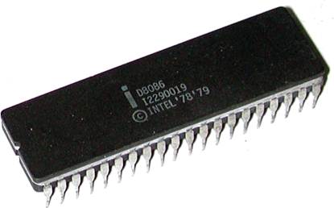
Input/output – I/O Interface to 8086
Unit - 3
Presented By
M. Mahesh Babu

Slide 2
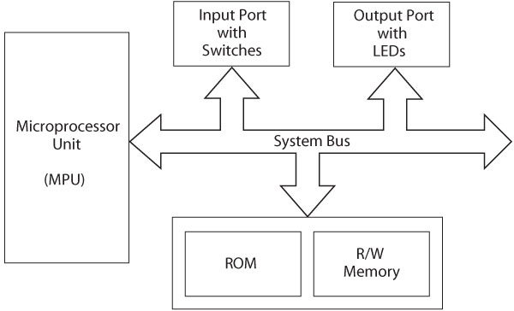
Microprocessor-Based Systems

Slide 3
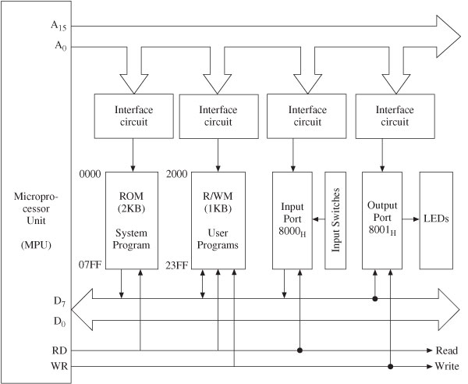
Assembly Language

Slide 4
Microprocessor Architecture
MPU communicates with Memory and I/O using the System Bus
Address bus
Unidirectional
Memory and I/O Addresses
Data bus
Bidirectional
Transfers Binary Data and Instructions
Control lines
Read and Write timing signals

Slide 5
Primary function of MPU
Read Instruction from memory
Execute instruction
Read/Write data to memory
Some time send result to output device
LEDs, Monitor, Printer
Interfacing a peripheral
Why: To enable MPU to communicate with I/O
Designing logic circuit H/W for a I/O
Writing instruction (S/W)

Slide 6
Assembly Language Programming
The 8086 microcomputers can employ two types of input/output (I/O):
1. Isolated I/O.
2. Memory-mapped I/O.
These I/O methods differ in how I/O ports are mapped into the 8086's address spaces. We will only consider isolated I/O.

Slide 7
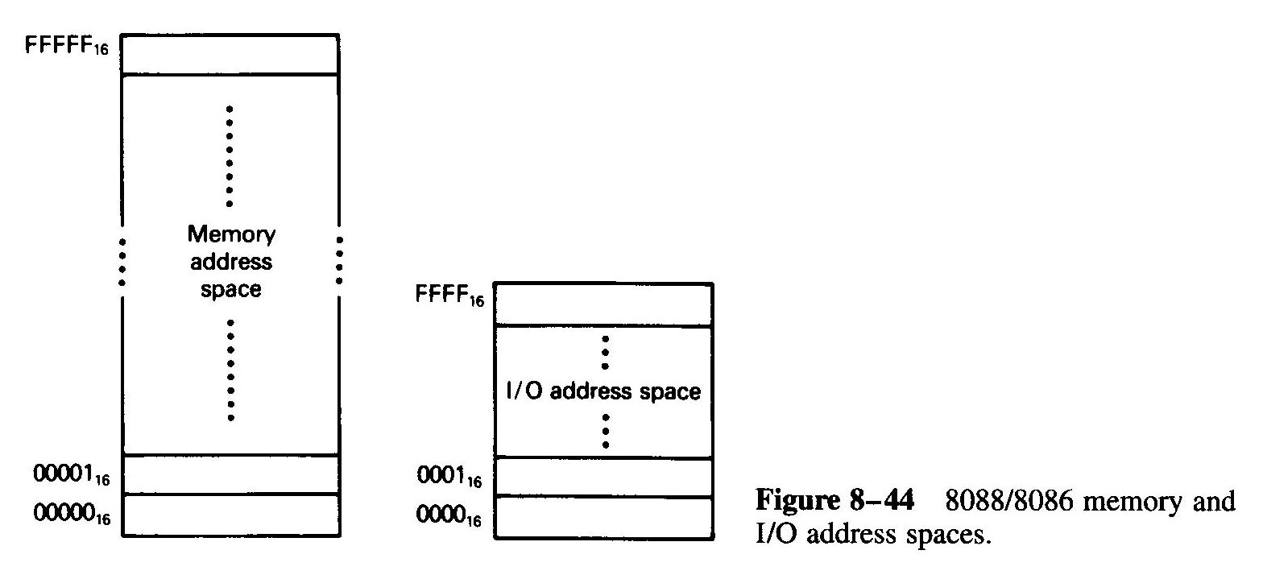

Slide 8
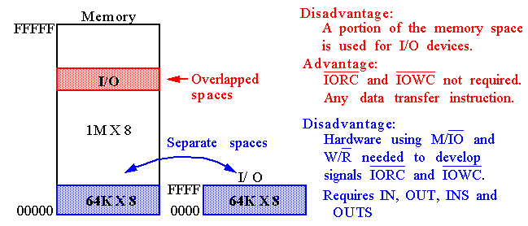
Memory mapped I/O

Slide 9
Isolated Input/Output:
In this scheme, the I/O devices are treated separate from memory (see Fig. 8-44). I/O ports are organized as bytes of data;
the memory address space contains 1M consecutive byte addresses in the range 00000H, through FFFFFH; and the I/O address space contains 64K consecutive byte addresses in the range 0000H through FFFFH.

Slide 10
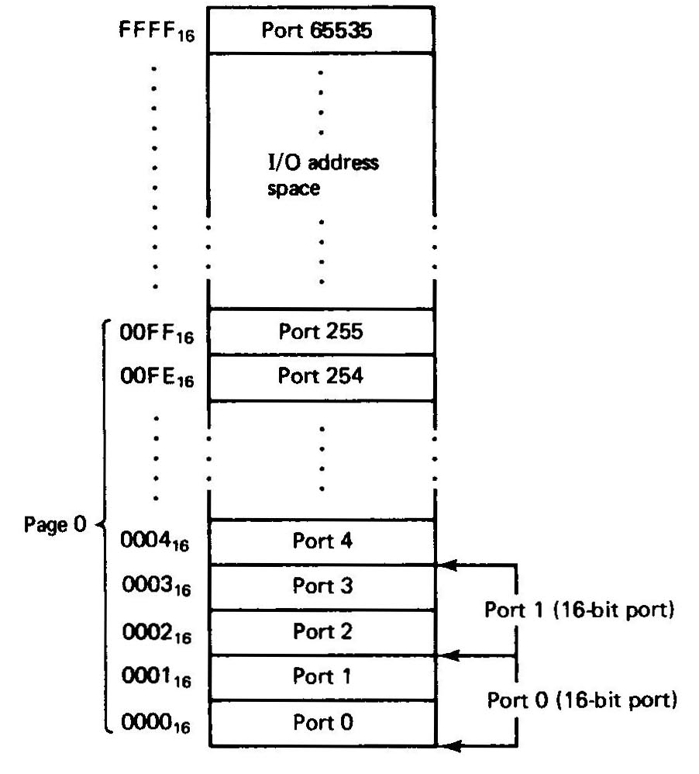
Fig. 8-45 shows that bytes of data in two consecutive I/O addresses could be accessed as word-wide data. For instance, I/O addresses 0000H, 0001H, 0002H, and 0003H can be treated as independent byte-wide I/O ports: ports 0, 1, 2 and 3, or as word-wide ports 0 and 1.

Slide 11
Memory-Mapped Input/Output
I/O devices can be placed in the memory address space of the microcomputer.
In this case, the MPU looks at the I/O port as though it is a storage location in memory.

Slide 12
Memory-Mapped I/O
I/O Devices and memory share the same address space.
Each I/O Device is assigned a unique set of addresses.
When the processor places a particular address on the address lines, the device recognizing this address responds to the commands on the control lines.
The processor requests either a read or a write operation, and the requested data is transferred over the data lines.
Any machine instruction that can access memory can be used to transfer data to/from I/O devices.
Mov datain, R0

Slide 13
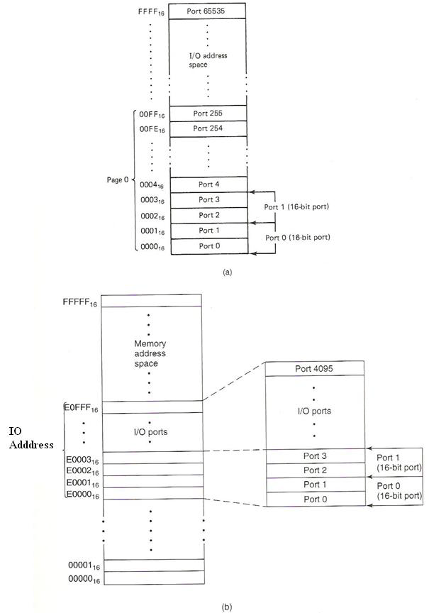

Slide 14
Compare between isolated I/O and memory-mapped I/O.
isolated I/O
memory-mapped I/O
Use only the special input/output instructions. (IN and OUT)
Faster because I/O instructions is specifically designed to run faster than memory instructions.
The memory address space is not affected.
All memory instructions and addressing modes are available to perform I/O operation. (MOV, AND XCHG, SUB …….)
Slower because memory instructions execute slower than the special I/O instructions.
Part of the memory address space is lost.

Slide 15
Parallel I/O
I/O devices connect to processor through PORTS
Ports are:
registers (part of the I/O interface)
8, 16, or 32 bits wide
Addressed in the range 0000-FFFFh
Accessed with 2 instructions – IN, OUT

Slide 16
Modes of I/O Instructions
Direct I/O – the port address is one of the operands.
Address must be 00-FFh.
IN AL, 27h
Data flows through the accumulator
MOV AX, BX
OUT 26h, AX ; move 16-bit data from AX to port ; 26h (AL to 26h and AH to 27h)
Indirect I/O – the port address is preloaded into DX
Address can be 0000-FFFFh
String I/O – allows data to pass directly through the accumulator (from I/O device to memory)

Slide 17
80x86 I/O Instructions

Slide 18
Ways to Drive Hardware Devices using Parallel Buses
There are three ways of transferring data between the microprocessor and a physical I/O device.
Programmed I/O
Interrupt driven I/O
Direct Memory Access (DMA)

Slide 19
The microprocessor executes a program to communicate with an external device via a register called I/O port for programmed I/O.
• An external device requests microprocessor to transfer data by activating a signal on the microprocessor’s interrupt line during interrupt I/O. In response, the microprocessor executes a program called the interrupt-service routine to carry out the function desired by the external device.
• Data transfer between microcomputer’s memory and an external device occurs without microprocessors involvement in Direct Memory Access.

Slide 20
I/O Device Speeds
Processors can operate at speeds that are vastly different than I/O speeds.
When a human is entering characters on a keyboard, the processor can execute millions of instructions between successive character entries.
So, how does the processor handle I/O inputs…..

Slide 21
Three types of I/O Strategies
Polled I/O
Interrupt Driven I/O
DMA I/O

Slide 22
Polled IO versus Interrupt Driven I/O
Polled IO – processor continually checks IO device to see if it is ready for data transfer
Inefficient, processor wastes time checking for ready condition
Interrupt Driven IO – IO device interrupts processor when it is ready for data transfer
Processor can be doing other tasks while waiting for last data transfer to complete – very efficient.

Slide 23
Rate of Transmission
For parallel transmission, all of the bits are sent at once.
For serial transmission, the bits are sent one at a time. Therefore, there needs to be agreement on how “long” each bit stays on the line.
The rate of transmission is usually measured in bits/second or baud.

Slide 24
Given a certain baud rate, how long should each bit last?
Baud = bits / second.
Seconds / bits = 1 /baud.
At 1200 baud, a bit lasts 1/1200 = 0.83 m Sec.

Slide 25
Comparison of transfer rates
Polled waiting loops provide data rates that are a bit slower, but still quite reasonable.
Interrupt-driven I/O requires overhead of saving and restoring the machine state (significantly degrades data rates unless more than one byte can be transferred per interrupt.
DMA has fastest transfer rates (additional hardware complexity needed.

Slide 26
disadvantage of programmed I/O
The microcomputer needs to check the status bit (BUSY signal for the A/D converter) by waiting in a loop.
This type of I/O transfer is dependent on the speed of the external device.
For a slow device, this waiting may slow down the capability of the microprocessor to process other data.

Slide 27
Interrupt Driver I/O
Interrupt I/O is a device-initiated I/O transfer. The external device is connected to a pin called the interrupt (INT) pin on the processor chip.
When the device needs an I/O transfer with the microcomputer, it activates the interrupt pin of the processor chip.
The microcomputer usually completes the current instruction and saves at least the contents of the current program counter on the stack.

Slide 28
The microcomputer then automatically loads an address into the program counter to branch to a subroutine like program called the interrupt service routine.
This program is written by the user. The external device wants the microcomputer to execute this program to transfer data.
The last instruction of the service routine is a RETURN, which is typically the same instruction used at the end of a subroutine.
This instruction normally loads the address (saved in the stack before going to the service routine) in the program counter. Then, the microcomputer continues executing the main program.

Slide 29
Direct Memory Access (DMA)
DMA is a technique that transfers data between a microcomputer’s memory and I/O device without involving the microprocessor.
DMA is widely used in transferring large blocks of data between a peripheral device and the microcomputer’s memory.
The DMA technique uses a DMA controller chip for the data transfer operation.

Slide 30
The main functions of a typical DMA controller are summarized as follows:
The I/O devices request DMA operation via the DMA request line of the controller chip.
The controller chip activates the microprocessor HOLD pin, requesting the CPU to release the bus.
The processor sends HLDA (hold acknowledge) back to the DMA controller, indicating that the bus is disabled. The DMA controller places the current value of its internal registers, such as the address register and counter, on the system bus and sends a DMA acknowledge to the peripheral device. The DMA controller completes the DMA transfer.

Slide 31
There are three basic types of DMA:
block transfer,
cycle stealing, and
interleaved DMA.

Slide 32
block transfer DMA
For block transfer DMA, the DMA controller chip takes the bus from the microcomputer to transfer data between the memory and I/O device. The microprocessor has no access to the bus until the transfer is completed. During this time, the microprocessor can perform internal operations that do not need the bus. This method is popular with microprocessors. Using this technique, blocks of data can be transferred.

Slide 33
cycle stealing DMA
Data transfer between the microcomputer memory and an I/O device occurs on a wordby- word basis with cycle stealing. Typically, the microprocessor clock is enabled by ANDing an INHIBIT signal with the system clock. The system clock has the same frequency as the microprocessor clock. The DMA controller controls the INHIBIT line. During normal operation, the INHIBIT line is HIGH, providing the microprocessor clock.
When DMA operation is desired, the controller makes the INHIBIT line LOW for one clock cycle. The microprocessor is then stopped completely for the cycle. Data transfer between the memory and I/O takes place during this cycle. This method is called cycle stealing because the DMA controller takes away or steals a cycle without microprocessor recognition. Data transfer takes place over a period of time.

Slide 34
interleaved DMA
With interleaved DMA, the DMA controller chip takes over the system bus when the microprocessor is not using it. For example, the microprocessor does not use the bus while incrementing the program counter or performing an ALU operation. The DMA controller chip identifies these cycles and allows transfer of data between the memory and I/O device. Data transfer takes place over a period for time for this method.

Slide 35
Peripheral Controllers
Intel has developed several peripheral controller chips designed to support its processors.
The goal is to give a complete I/O interface in one chip.
Examples:
8255 is Programmable Peripheral Interface (PPI).
8259 is Programmable Interrupt Controller (PIC)
8253/8254 is Programmable Interval Timer (PIT)
8237 is Programmable DMA controller.
In PC/XT computers these chips are built into the system board and can be seen by inspection.
In modern Computers the functionality of these chips has been built into the system board chipset.

Slide 36
8255A
Is one of the peripheral controller chips designed to support its processors.
8255 is Programmable Peripheral Interface (PPI).
It is a general purpose parallel I/O Interfacing device.

Slide 37
8255 PPI
The parallel input-output port chip 8255 is also called as programmable peripheral input-output port.
The Intel’s 8255 is designed for use with Intel’s 8-bit, 16-bit and higher capability microprocessors.
The 8255A is LSI peripheral designed to permit easy implementation of parallel I/0 in the 8086 micro-computer systems.
It provides a flexible parallel interface, which includes features such as single-bit, 4-bit, and byte-wide input and output ports.

Slide 38
8255 PPI
It has 24 input/output lines which may be individually programmed in two groups of twelve lines each, or three groups of eight lines.
The two groups of I/O pins are named as Group A and Group B. Each of these two groups contains a subgroup of eight I/O lines called as 8-bit port and another subgroup of four lines or a 4-bit port.
Thus Group A contains an 8-bit port A along with a 4-bit port C upper. The port A lines are identified by symbols PA0-PA7 while the port C lines are identified as PC4-PC7.

Slide 39
8255 PPI
Similarly, Group B contains an 8-bit port B, containing lines PB0-PB7 and a 4-bit port C with lower bits PC0- PC3.
The port C upper and port C lower can be used in combination as an 8-bit port C.
Both the port C are assigned the same address. Thus one may have either three 8-bit I/O ports or two 8-bit and two 4-bit ports from 8255.
All of these ports can function independently either as input or as output ports.
This can be achieved by programming the bits of an internal register of 8255 called as control word register (CWR).

Slide 40
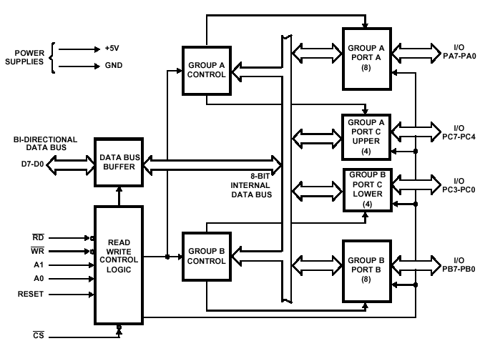
Block Diagram of 8255

Slide 41
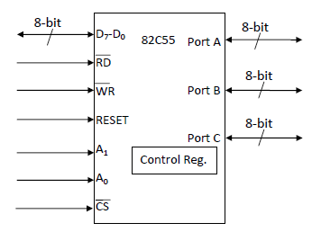

Slide 42
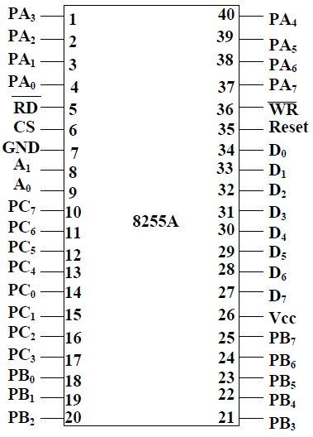
Pin Configuration of 8255
D0
D1
D2
D3
D4
D5
D6
D7
PA0
PA1
PA2
PA3
PA4
PA5
PA6
PA7
PORT A
PB0
PB1
PB2
PB3
PB4
PB5
PB6
PB7
8255
Mode 2 Control Signals
PORT B
RD
WR
A0
A1
RESET
CS
PC0
PC1
PC2
PC3
PC4
PC5
PC6
PC7
PORT C

Slide 43
8255 PPI
Control Logic of 8255:
D0-D7 : These are the data bus lines those carry data or control word to/from the microprocessor.
RESET : A logic high on this line clears the control word register of 8255. All ports are set as input ports by default after reset.
PA7-PA0: These are eight port A lines that acts as either latched output or buffered input lines depending upon the control word loaded into the control word register.
PC7-PC4 : Upper nibble of port C lines. They may act as either output latches or input buffers lines. This port also can be used for generation of handshake lines in mode 1 or mode 2.
PC3-PC0 : These are the lower port C lines, other details are the same as PC7-PC4 lines.
PB0-PB7 : These are the eight port B lines which are used as latched output lines or buffered input lines in the same way as port A.

Slide 44
8255 PPI
Control Logic of 8255:
RD : This is the input line driven by the microprocessor and should be low to indicate read operation to 8255.
WR : This is an input line driven by the microprocessor. A low on this line indicates write operation.
CS : This is a chip select line. If this line goes low, it enables the 8255 to respond to RD and WR signals, otherwise RD and WR signal are neglected.
A1-A0 : These are the address input lines and are driven by the microprocessor. These lines A1-A0 with RD, WR and CS from the following operations for 8255. These address lines are used for addressing any one of the four registers, i.e. three ports and a control word register as given in table below.
In case of 8086 systems, if the 8255 is to be interfaced with lower order data bus, the A0 and A1 pins of 8255 are connected with A1 and A2 respectively.

Slide 45
8255 PPI
Control Logic.
CS signal is a Master Chip Select, whereas A₀ and A₁ determine the input/output ports or control registers as tabulated in Table 1.
Table 1: The function of CS, A₀ and A₁
CS | A₁ | A₀ | Selection
0 | 0 | 0 | port A
0 | 0 | 1 | port B
0 | 1 | 0 | port C
0 | 1 | 1 | Control Register
1 | X | X | 8255 is disabled

Slide 46
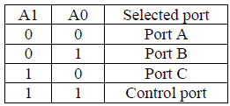
8255 PPI
There are 3 ports in 8255 from user’s point of view - Port A, Port B and Port C.
Port C is composed of two independent 4-bit ports : PC7-4 (PC Upper) and PC3-0 (PC Lower)
Selection of Ports:

Slide 47
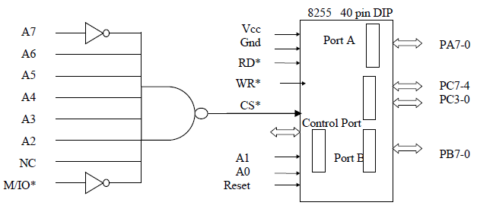
Intel 8255 PPI
Chip Select Circuit
A7=0, A6=1, A5=1, A4=1, A3=1, A2=1, & M/IO*= 0

Slide 48
Intel 8255 PPI
There is also a Control port from the Processor point of view. Its contents decides the working of 8255.
When CS (Chip select) is 0, 8255 is selected for communication by the processor. The chip select circuit connected to the CS pin assigns addresses to the ports of 8255.
For the chip select circuit shown, the chip is selected when A7=0, A6=1, A5=1, A4=1, A3=1, A2=1, and M/IO*= 0.
Port A, Port B, Port C and Control port will have the addresses as 7CH, 7DH, 7EH, and 7FH respectively.

Slide 49
8255 PPI

Slide 50
8255 PPI
Three main concept is communicate to 8255:
Determine the port address of A, B and C using CS, A₁ and A₀.
Write control word in control register.
Write I/O instructions to communicate with ports.

Slide 51
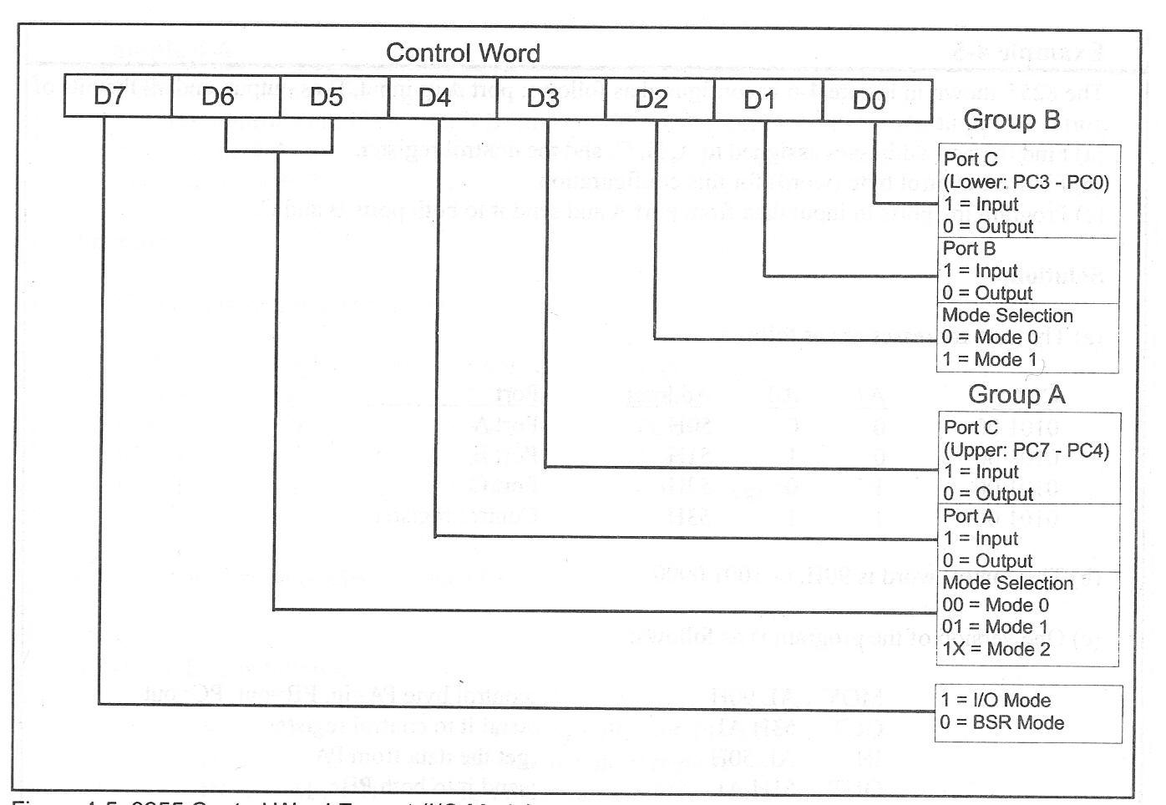
8255 Control Word

Slide 52
8255 PPI-Operation modes
Figure shows the function of 8255, categorized in two mode:
Set/Reset Bit (BSR) mode
I/O mode.
The BSR mode is used to set or reset bit at port C by sending OUT instruction to the CONTROL registers.
Whereas the I/O is divided into 3 groups:
Mode 0, Mode 1 and Mode 2.
Mode 0, all ports function as input or output (I/O function).
Mode 1, is handshake mode, where port A and/or port B used port C as handshake bit.
Mode 2, port A can be used as bi-directional data transfer port with port C as handshake port and port B will be in mode 1 or mode 2.

Slide 53
8255 PPI-Operation modes
Bit Set/Reset (BSR) mode:
The BSR mode is used to set or reset bit at port C by sending OUT instruction to the CONTROL registers.
In this mode any of the 8-bits of port C can be set or reset depending on D0 of the control word. The bit to be set or reset is selected by bit select flags D3, D2 and D1 of the CWR.
BSR command word is used for enabling / disabling interrupts from Ports A and B when they are configured in mode 1 or mode 2.

Slide 54
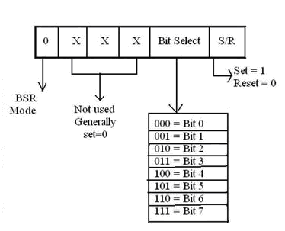

Slide 55
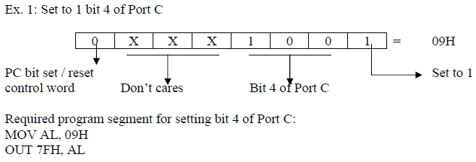
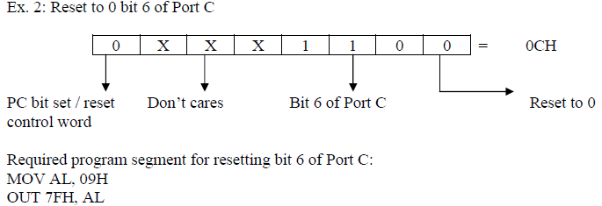

Slide 56
8255 PPI-Operation modes
I/O mode:
The I/O mode is further divided into 3 modes: mode 0, mode 1 and mode 2.
In mode 0, all ports function as simple I/O ports.
Mode 1 is a handshake mode whereby Port A and/or Port B use bits from Port C as handshake signals. In the handshake mode, two types of I/O data transfer can be implemented: status check and interrupt.
In mode 2, Port A can be set up for bidirectional data transfer using handshake signals from Port C, and Port B can be set up either in mode 0 or mode 1.

Slide 57
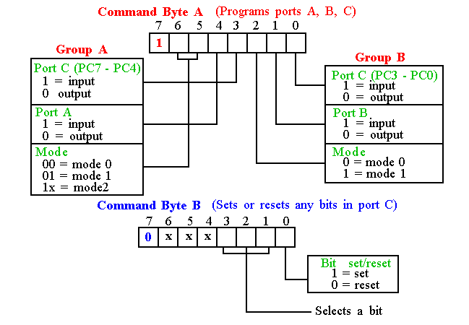
Programming 8255
8255 has three operation modes: mode 0, mode 1, and mode 2

Slide 58
Basic Mode Definitions and Bus Int
Mode 0
Basic I/O
Mode 1
Strobe I/O
Mode 2
Bi-Dir Bus

Slide 59
8255 PPI Mode selection:
There are 3 basic modes of operation that can be selected by the system software for the 8255:
Mode 0 - Basic Input/Output
Mode 1 – Input/output with Handshake (Strobed I/O)
Mode 2 - Bidirectional Data Transfer

Slide 60
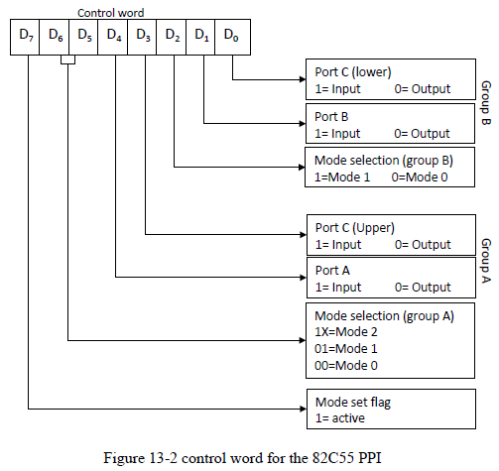
8255 PPI - Mode Definition Format

Slide 61
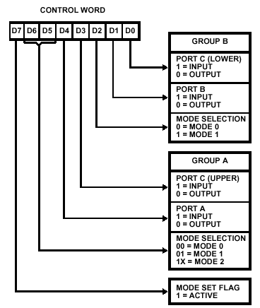
8255 PPI

Slide 62
8255 PPI - Bit Set/Reset Format

Slide 63
8255 PPI - Mode 0
Mode 0 (Basic Input/Output):
This functional configuration provides simple input and output operations for each of the three ports. No ``handshaking‘’ is required, data is simply written to or read from a specified port.
It is used for interfacing an i/p device or an o/p device.
In this mode, Port A and Port B are used as two simple 8-bit I/O ports and Port C as two 4-bit I/O ports can be combinedly used as a third 8-bit port. Each port (or half-port, in case of Port C) can be programmed to function as simply an input port or an output port.
Output ports are latched. Input ports are not latched.
All these modes can be selected by programming a register internal to 8255 known as CWR.
Ports do not have handshake or interrupt capability.
16 different Input/Output configurations are possible in this Mode.

Slide 64
8255 PPI

Slide 65
8255 PPI
MODE 1 (Strobed Input/Output):
This functional configuration provides a means for transferring I/O data to or from a specified port in conjunction with strobes or ``handshaking'' signals. In mode 1, Port A and Port B use the lines on Port C to generate or accept these ``handshaking'' signals.
Two groups –
Group A
This group including port A and PC3-PC5. Thus port C is utilized for generating handshake signals.
Group B
This group which includes port B and PC0-PC2. Port C provides strobe or handshake lines for port B.
The 8-bit data port can be either used as input and output port. The inputs and outputs both are latched and Interrupt logic is supported.

Slide 66
Mode 1 -Input Control Signal Definition
STB (Strobe Input): A ``low'' on this input loads data into the input latch.
IBF (Input Buffer Full F/F):
A ``high'' on this output indicates that the data has been loaded into the input latch; in essence, an acknowledgement. IBF is set by STB input being low and is reset by the rising edge of the RD input.
INTR (Interrupt Request):
A ``high'' on this output can be used to interrupt the CPU when an input device is requesting service. INTR is set by the STB is a ``one'', IBF is a ``one‘’ and INTE is a ``one''. It is reset by the falling edge of RD. This procedure allows an input device to request service from the CPU by simply strobing its data into the port.
INTE A
Controlled by bit set/reset of PC4.
INTE B
Controlled by bit set/reset of PC2.

Slide 67
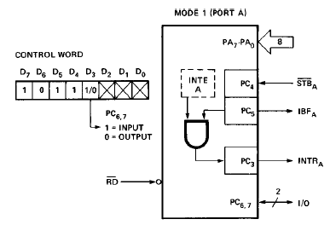
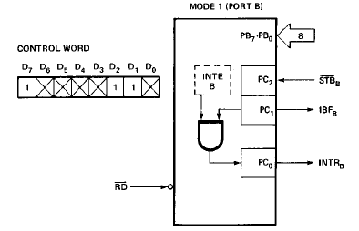
Mode 1 - Input

Slide 68
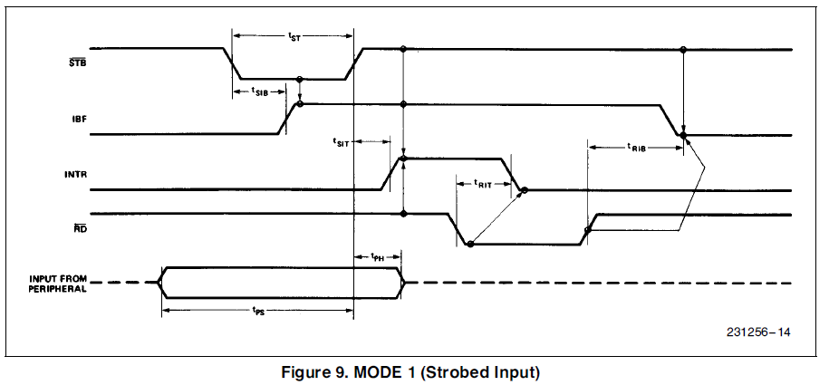
8255 PPI

Slide 69
8255 PPI Output Control Signal Definition
OBF (Output Buffer Full F/F).
The OBF output will go ``low'' to indicate that the CPU has written data out to the specified port. The OBF F/F will be set by the rising edge of the WR input and reset by ACK Input being low.
ACK (Acknowledge Input).
A ``low'' on this input informs the 82C55A that the data from Port A or Port B has been accepted. In essence, a response from the peripheral device indicating that it has received the data output by the CPU.
INTR (Interrupt Request).
A ``high'' on this output can be used to interrupt the CPU when an output device has accepted data transmitted by the CPU. INTR is set when ACK is a ``one'', OBF is a ``one‘’ and INTE is a ``one''. It is reset by the falling edge of WR.
INTE A
Controlled by bit set/reset of PC6.
INTE B
Controlled by bit set/reset of PC2.

Slide 70
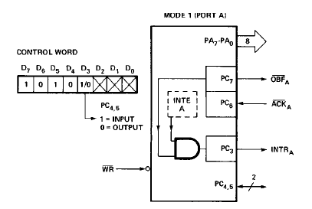
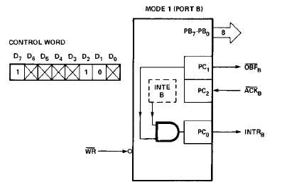
Mode 1 Output

Slide 71
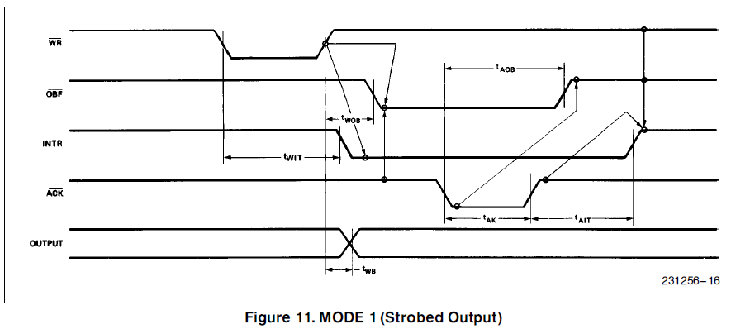
8255 PPI

Slide 72
MODE 2 (Strobed Bidirectional Bus I/O):
This functional configuration provides a means for communicating with a peripheral device or structure on a single 8-bit bus for both transmitting and receiving data (bidirectional bus I/O). ``Handshaking'' signals are provided to maintain proper bus flow discipline in a similar manner to MODE 1. Interrupt generation and enable/disable functions are also available.
The single 8-bit port in group A is available.
The 8-bit port is bidirectional and additionally a 5-bit control port is available.
Three I/O lines are available at port C.(PC2 – PC0)
Inputs and outputs are both latched.
The 5-bit control port C (PC3-PC7) is used for generating / accepting handshake signals for the 8-bit data transfer on port A.

Slide 73
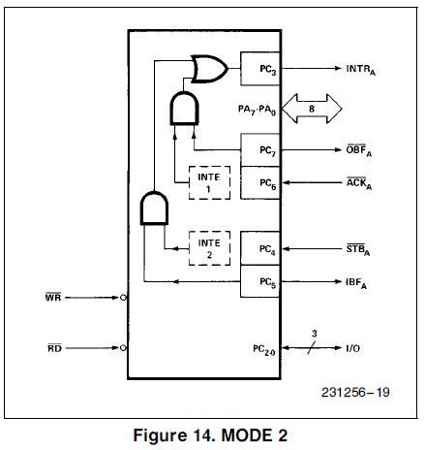
8255 PPI

Slide 74
Mode 2 - Input Operations
STB (Strobe Input). A ``low'' on this input loads data into the input latch.
IBF (Input Buffer Full F/F). A ``high'' on this output indicates that data has been loaded into the input latch.
INTE 2 (The INTE Flip-Flop Associated with IBF). Controlled by bit set/reset of PC4.

Slide 75
Mode 2 - Output Operations
OBF (Output Buffer Full). The OBF output will go ``low'' to indicate that the CPU has written data out to port A.
ACK (Acknowledge). A ``low'' on this input enables the tri-state output buffer of Port A to send out the data. Otherwise, the output buffer will be in the high impedance state.
INTE 1 (The INTE Flip-Flop Associated with OBF). Controlled by bit set/reset of PC6.

Slide 76
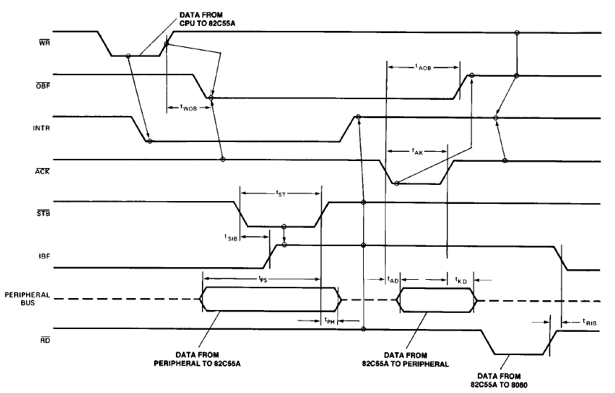
8255 PPI

Slide 77
8255 PPI

Slide 78
8255 PPI

Slide 79
8255 PPI

Slide 80
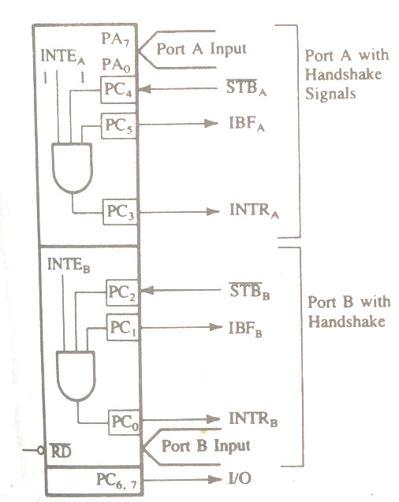
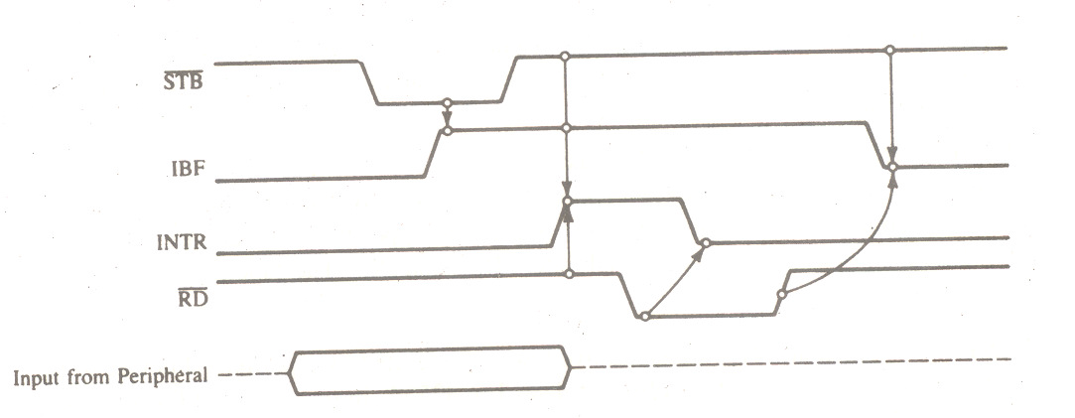
8255 PPI mode 1-input control

Slide 81
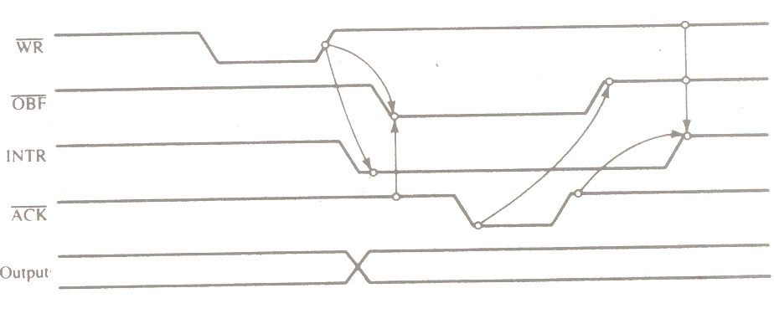
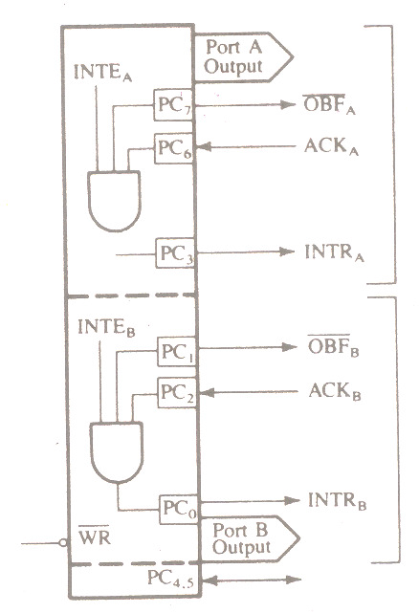
8255 PPI mode 1-out control

Slide 82
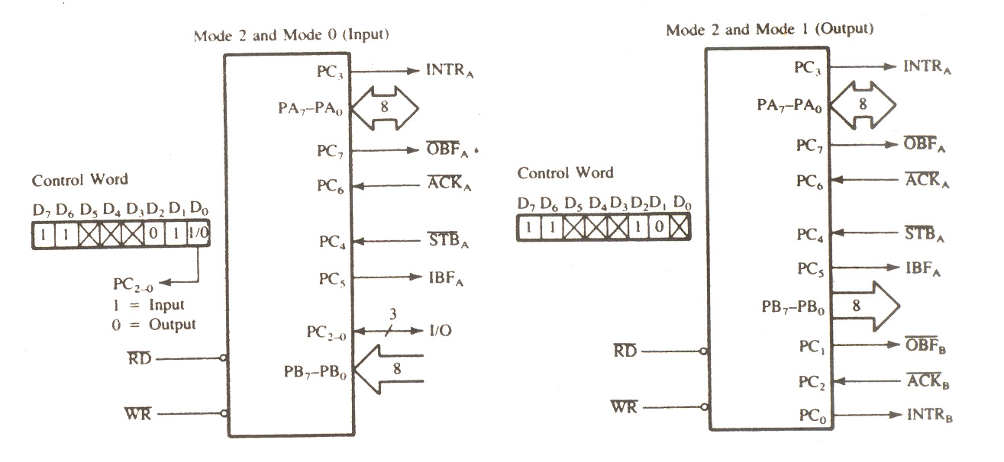
8255 PPI- Mode 2 Control Signals

Slide 83
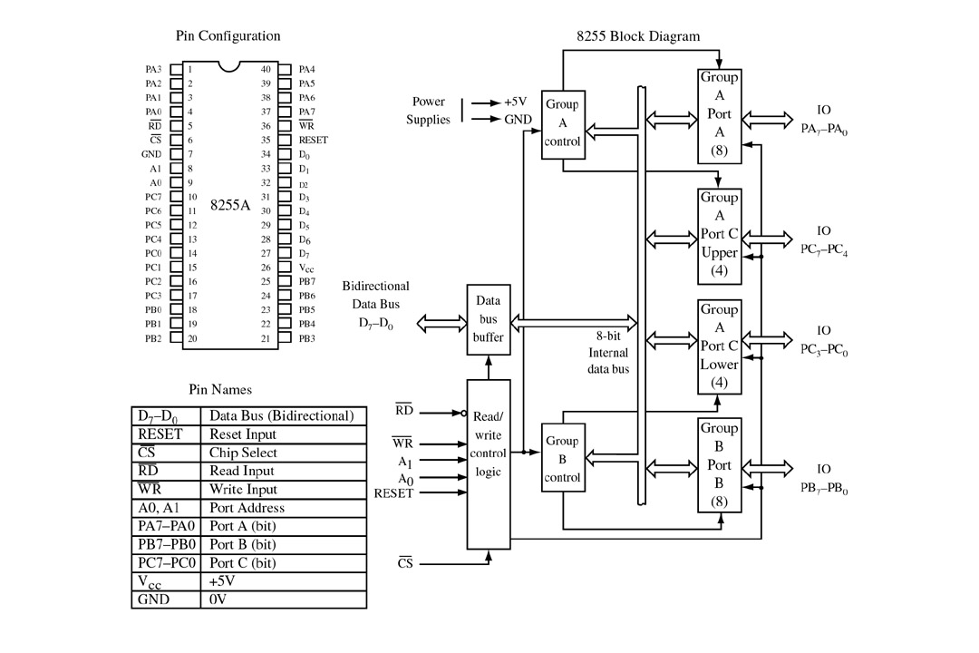
FIGURE 8-11 8255 programmable peripheral interface (PPI). Twenty-four I/O pins are provided grouped as three 8-bit I/O ports. There is one 8-bit control port. (Courtesy of Intel Corporation.)

Slide 84
Programming modes
Mode 0: the 8255A is programmed to look like three simple I/O ports.
Mode 1: the 8255A is programmed to have two handshaking I/O ports.
Mode 1: the 8255A is programmed to have one bidirectional port with five handshaking signals.
The modes can be intermixed, for example, port A is programmed to operate in mode 2, while port B operates in mode 0.
bit set/reset mode allows individual bits of port C to be set or reset for control purposes.

Slide 85
Continued ...

Slide 86
Continued ...

Slide 87
The 8255 is a widely used, programmable parallel I/O device. It can be programmed to transfer data under data under various conditions, from simple I/O to interrupt I/O.
It is flexible, versatile and economical (when multiple I/O ports are required). It is an important general purpose I/O device that can be used with almost any microprocessor.
The 8255 has 24 I/O pins that can be grouped primarily into two 8 bit parallel ports: A and B, with the remaining 8 bits as Port C.
The 8 bits of port C can be used as individual bits or be grouped into two 4 bit ports : CUpper (CU) and CLower (CL). The functions of these ports are defined by writing a control word in the control register.

Slide 88
8255 PPI

